Slide 1
Health Reform 2.0
PNHP National Meeting
May 22, 2010
29 East Madison, Suite 602
Chicago, Il 60602
312-782-6006
www.pnhp.org

Slide 2
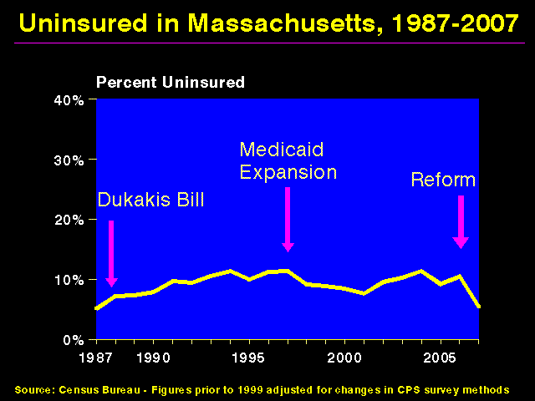
Uninsured in Massachusetts
20%
15%
10%
5%
0%
Dukakis Bill
Medicaid Expansion
Reform
Percent uninsured
1987
1990 | 1995 | 2000 | 2005
Source: Census Bureau. Figures prior to 1999 adjusted for changes in CPS survey methods

Slide 3
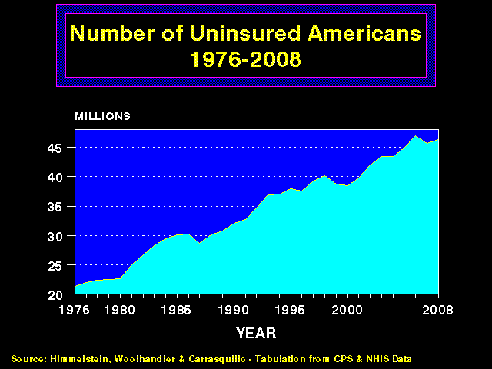
47 Million Americans
Without Insurance Today
45
40
35
30
25
20
Millions of Uninsured Americans
1976
1980 | 1985 | 1990 | 1995 | 2000
2008
Source: Himmelstein, Woolhandler, Carrasquilo – Tabulation from CPS and NHIS data

Slide 4
Uninsured Children Have
Higher Inpatient Mortality
Adjusted* mortality rate (%)
*Adjusted for gender, race, age, location, hospital type, and admission source
Source: Jnl of Public Health, October 29, 2009

Slide 5
Impact of Health Reform
On the Uninsured
46 million today; ~23 million in 2019
Less funding for safety net hospitals
Community health center funding enhanced
Less uninsured Americans
Medicare funding cut by $36 billion through 2019
Increased by $1 billion annually

Slide 6
Uninsured and Underinsured
Delay Care for Heart Attacks
Odds ratio for delayed care*
*Adjusted for age, sex, race, clinical, health status, social/psych factors, urban/rural
** Under-insured = had coverage but patient concerned about cost
Source: JAMA April 15, 2010:303:1392

Slide 7
Increasing Medicare HMO Copayments Drives People Into the Hospital
Less outpatient visits
198 less visits per 1,000 enrollees
More admissions to the hospital
22 more admissions per 1,000 enrollees
More days in the hospital
134 more days per 1,000 enrollees
Differences between plans that did and did not raise copayments
Source: NEJM 2010 362:320

Slide 8
Expenses Are Rising for the Privately Insured
Full-year, privately-insured households
with out-of-pocket expenses >$5,000 (2006 dollars)
Source: Bernstein D. Office of Economic Policy, US Treasury

Slide 9
Impact of Health Reform
On the Underinsured
If you like your current coverage, you can keep it
If you don’t like your current job-based coverage, you have to keep it
Policies will be required to cover
at least 60% of expected health costs
e.g. $2,000 deductible + 20% co-insurance for next $15,000 of care

Slide 10

Is This Affordable Care?
Massachusetts policies available through the exchange to a 56 year-old with income > $32,000
$5,000 annual premium
$2,000 deductible
20% coinsurance for the next $15,000

Slide 11
Crimes and Punishments
In Massachusetts
The Crime | The Fine
Violation of Child Labor Laws | $50
Employers Failing to Partially Subsidize a Poor Health Plan for Workers | $295
Illegal Sale of Firearms, First Offense | $500 max.
Driving Under the Influence, First Offense | $500 min.
Domestic Assault | $1000 max.
Cruelty to or Malicious Killing of Animals | $1000 max.
Communication of a Terrorist Threat | $1000 min.
Being Uninsured In Massachusetts | ~ $1000

Slide 12
Most of the Medically Bankrupt
Had Insurance Coverage
Insurance at onset of illness
Source: Himmelstein et al. Am J Med, Aug. 2009

Slide 13
Health Reform Will Have
Little Impact on Medical Bankruptcy
Subgroup of Medical Bankruptcy Filers | Proportion In Subgroup | Impact On Bankruptcy Rates
Insured | 75% | No change
Medically bankrupt who were uninsured in 2007 but will gain coverage under reform. | 25% | Up to a 50% drop
Maximum impact on medical bankruptcy rates |  | 12.5% reduction

Slide 14
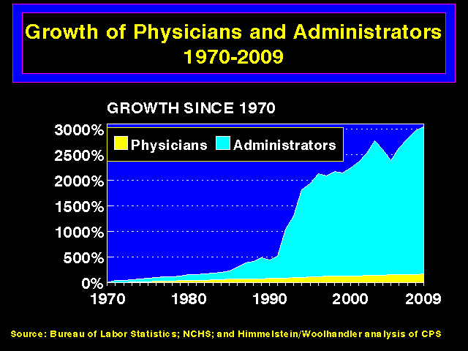
Administrators Are Growing
Faster Than Physicians
3,000%
2,000%
1,000%
0
Administrators
Physicians
1970
1980
1990
2000
2009
Source: Bureau of Labor Statistics; NCHS; Himmelstein/Woolhandler analysis of CPS

Slide 15
HMO Overhead, 2009
Source: SEC filings to shareholders.
Calculated as (100 – Medical Loss Ratio)

Slide 16
HMO CEO’s Pay, 2009
Executive | Firm | Pay
Steve Hemsley | United | $102.0 Million*
Ronald Williams | Aetna | $24.3 Million
Edward Hanaway** | Cigna | $18.8 Million
Angela Braly | WellPoint | $9.8 Million
Michael McCallister | Humana | $6.5 Million
Dale Wolf | Coventry | $9.0 Million
Source: AFL/CIO CEO Pay Database & StarTribune 4/15/2010
* Includes exercised stock options
** Retired with $73 million bonus

Slide 17
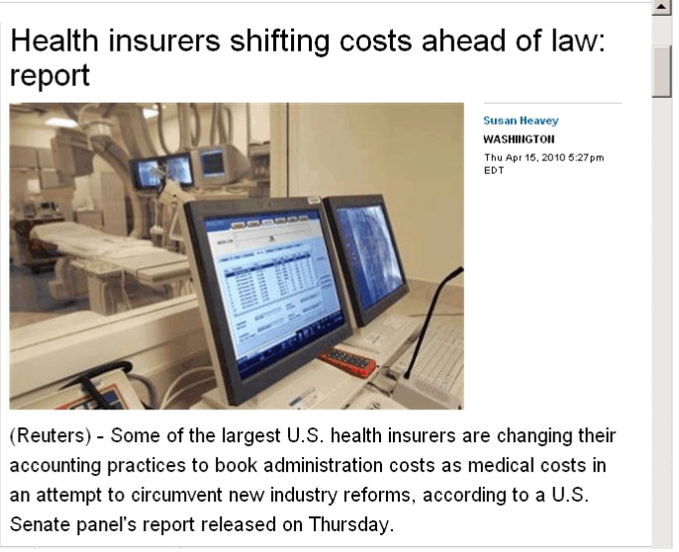
Report: Health Insurers
Shifting Costs Ahead of Law
“Some of the largest US health insurers are changing their accounting practices to book administration costs as medical costs in an attempt to circumvent new industry reforms, according to a US Senate panel’s report.”
Source: Susan Heavey, Washington (Reuters) April 15, 2010 5:27 PM EDT

Slide 18
Private Medicare Advantage
Plans’ High Overhead
Overhead per enrollee, 2008
Source: US House Committee on Energy and Commerce, December 2009

Slide 19
Medicare HMOs:
High Overhead and Profits
Traditional Medicare
Medicare Advantage Plans
Sources: GAO 6/24/2008 and
National Health Account Data for 2005

Slide 20

Despite high overhead,
HMOs prosper by cherry-picking
Especially in Medicare, where cherry-picking is already illegal

Slide 21
A Few Sick People Drive Most Costs
Percentage of total health spending in 2001
Decile of privately insured
Source: MEPS data, from Thorpe and Reinhart

Slide 22
A Few Sick People Drive Most Costs
Percentage of total health spending in 2001
Top two deciles account for 78.3% of spending
Decile of privately insured
Source: MEPS data, from Thorpe and Reinhart

Slide 23
Medicare HMOs:
The Healthy Go In, The Sick Go Out
Inpatient costs relative to FFS Medicare
Source: NEJM 1997; 337:169

Slide 24
Impact of Health Reform
On Administrative Costs
IRS cost to enforce mandate: $5 – 10 billion
Running insurance exchanges: ~4% of premiums (based on MA plan)
Insurance overhead: ~13% of new premium revenues = $42 billion
Cap on insurance overhead: ????
Standardized claim forms: ????

Slide 25
US Public Spending Is More Than the Total Spending in Other Nations
Note: “US Public” includes benefit costs for government employees and tax subsidies for private insurance
Sources: OECD 2008; Health Affairs 2002;21(4)88 – Data are for 2006

Slide 26

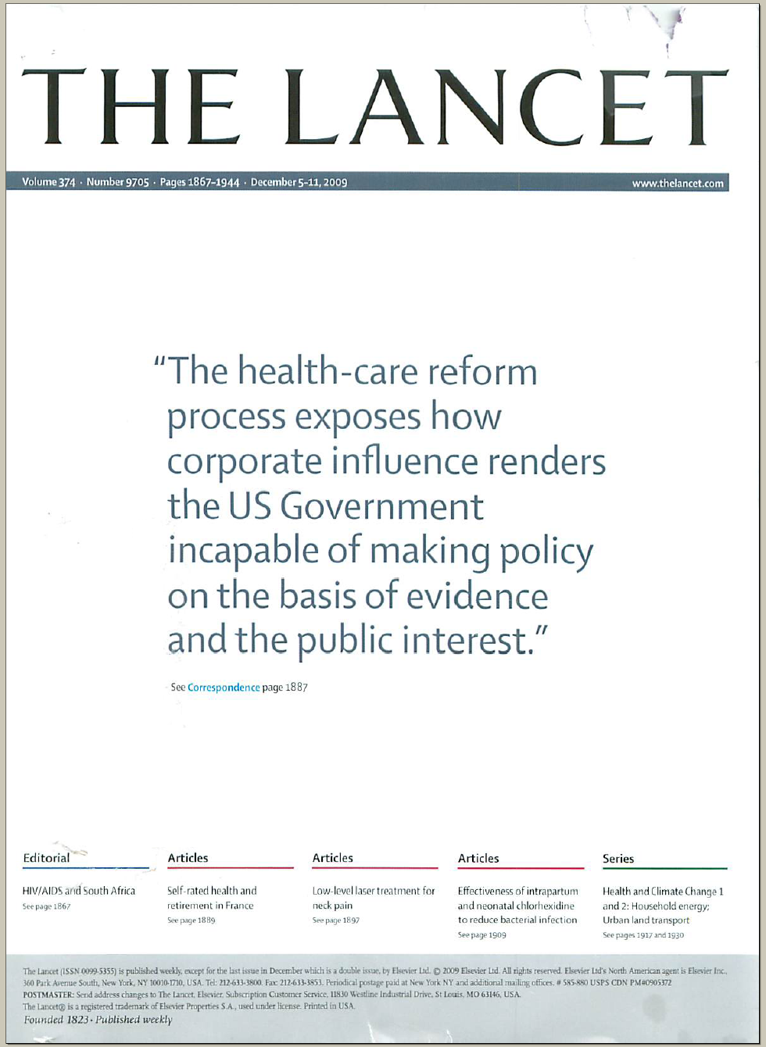
The Lancet Cover: Dec. 5, 2009
“The health-care reform process exposes how corporate influence renders the US Government
incapable of making policy
on the basis of evidence
and the public interest.”

Slide 27
Role Played by Health Industry
In Health Reform
Insurance donations to both Democrats & Republicans
Insurance company ads both favoring and opposing reform
Pharma spent over $100 million on ads supporting reform
Senate framework written by Liz Fowler, former VP of Public Policy for WellPoint/Anthem

Slide 28
Cost of Health Reform
Expansions in Coverage
Expanded
Medicaid
$434 billion
Subsidies for
private coverage
$358 billion
Small employer
tax credits
$37 billion
Temporary high risk pools, subsidy for retirees <65, etc
~$10 billion
All figures reflect spending through 2019

Slide 29
Sources of Health Reform Savings
Decreased Medicare Advantage/HMO overpayment:
$136 billion
Decreased Medicare (DSH) payment to safety net hospitals:
$36 billion
Decreased Medicare fee-for-service payments to doctors and hospitals:
$196 billion
Other Medicare and
Medicaid cuts:
$87 billion
All figures reflect spending through 2019

Slide 30
Impact of Health Reform
On Cost Control Provisions
Insurance Changes
Insurance Exchanges
Fraud and Abuse prosecution/recovery
Medicare Advisory Board
Benefit Changes
Tax on “Cadillac” coverage
Coverage of preventive services
System Changes
Health Information Technology
Comparative Effectiveness Research
Experiments in Change
Alternatives to Fee for Service
Malpractice reform

Slide 31

Healthcare Reform’s
Proven Cost Control Provisions
Nothing
Proven
Nothing
Proven
Nothing
Proven
Nothing
Proven

Slide 32
Robust Data About Hospital Computing and the Cost and Quality of Care
Data available for ~4,000 U.S. hospitals
Computerization
HIMSS surveys
2003–2007
Quality
Medicare / Dartmouth Atlas
Costs
Medicare cost reports
Data sources

Slide 33
Computer Myths and Evidence
Lower cost of care
Lower administrative costs
Slightly better quality scores
Real improvement or just more documentation?
No association with computerization
No association with computerization

Slide 34
Texas’ 2003 Tort Reform
Failed to Curb Medical Costs
Medicare reimbursement per enrollee, adjusted for medical service inflation
$10,000
$5,000
0
Tort reform implemented
Texas
Note: Total malpractice payments decreased 67% between 2003 and 2008
US
1992 | 1997 | 2002 | 2007
Source: Public Citizen, December 2009

