Slide 1
Occupy Healthcare
Changing the American Agenda for the 99%
Part 1. It’s the Economics Stupid
Part 2. Healthcare & Single Payer
Steve Auerbach, MD, MPH, FAAP
Physicians for a National Health Program
http://www.pnhp.org/facts/single-payer-resources
http://www.healthcareforallnc.org/

Slide 2
What’s It All About?
It is really bad
It has gotten much worse
It did not used to be this way
It does not have to be this way
(it=income and wealth inequality, wage stagnation, hollowing out of middle class, shift of tax burden to the middle class, deregulation & lack of oversight or accountability, tax cuts for rich and corporate, corporate control of politics…. Etc.. Etc… you name it)
Compiled by Dr. Steve Auerbach, PNHP, December 2011

Slide 3
Caveat
We must acknowledge how civil rights for racial and ethnic minorities, women, gay and lesbian, etc have improved.
In the slides to come, comparisons of the relative economic equity from 1945 to mid-1970s, compared to accelerating inequity and inequality from mid-1970s to present do not take this into account.
However, it is also true that African-Americans have been hurt even more in the recent meltdown then whites.

Slide 4
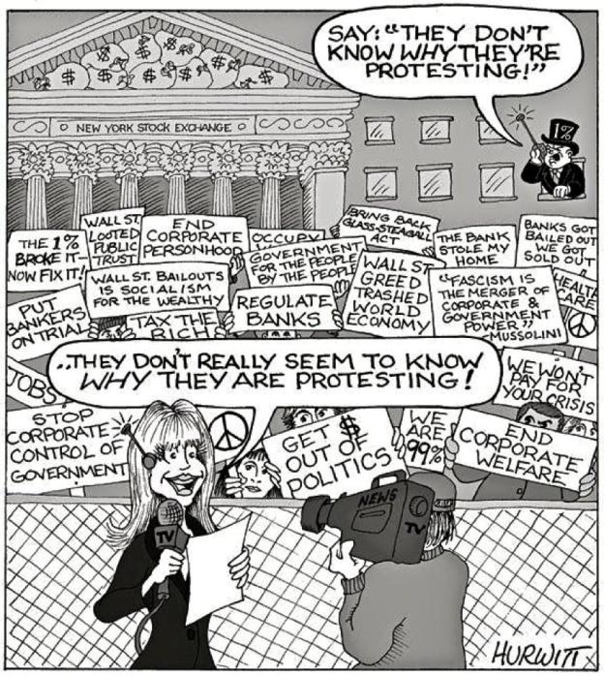
Part 1:
It’s the Economics
Stupid

Slide 5
America Went Wrong in Political Economy ~1971
Powell Memo: useful start point for when right wing businessmen re-organized to reverse New Deal
http://itsoureconomy.us/2011/08/how-did-corporate-power-get-a-stranglehold/
http://www.thenation.com/article/164349/how-wall-street-occupied-america?page=full
Winner-Take-All Politics: How Washington Made the Rich Richer & Turned Its Back on the Middle Class, Hacker & Pierson.
Invisible Hands: The Making of the Conservative Movement from New Deal to Reagan , Phillips-Fein
Chamber of Commerce 2x members & 3x budget; Business Roundtable, American Legislative Exchange Council (ALEC), Heritage Foundation, Cato Institute, Manhattan Institute, Citizens for a Sound Economy, Americans for Prosperity, American Crossroads, Fox, modern Talk Radio
Firms w/registered lobbyists: 1971=175→1982=2,500; Corporate PACs: 1976 <300→1980s> 1,200
Cutting effective tax for wealth, including income tax, capital gains, corporate, loopholes
Increase in effective tax rates on middle class, earned income, payroll deduction, state & local
Deregulation and lack of oversight
Government as the problem
Greed is good, Randian sociopathic selfishness as freedom
Kill unionization
Privatization of public functions, Kleptocratic transfer of taxes to corporate profits
Minimum=poverty; non-enforcement; exceptions

Slide 6
Carter & Reagan… Bush, Clinton, Bush, Obama
Deregulation and Tax Cuts started with Carter:
1978: Slashing the top rate of the capital gains tax from 48% to 28%
Same year, last effort to make it easier to unionize dies in Senate despite 61-vote Democratic supermajority.
Likewise, proposed Office of Consumer Representation, advocacy agency that was to work on behalf of average Americans, was defeated by an increasingly powerful business lobby.
Ronald Reagan: 1981 Economic Recovery and Tax Act (ERTA) bundled a medley of goodies any oligarch would love, including tax cuts for corporations, more in the capital gains and estate taxes,
Shift equal taxation whether income or alleged capital gains; stock options valued at zero when issued ; shift from progressive income tax and corporate tax to regressive payroll deduction (and similarly at state and local level)
1999: President Clinton signs Gramm-Leach-Bliley Act, ends Glass-Steagall and other deregulation.
2000: Commodity Futures Modernization Act by Senator Gramm blocks regulators like the Securities and Exchange Commission (SEC) from cracking down on the shadowy "over-the-counter derivatives" market, home to billions of dollars of opaque financial instruments that would, years later, nearly demolish the American economy.
Between 1929, the year the Great Depression began, and 1988, Wall Street's profits averaged 1.2% of the nation's gross domestic product; in 2005, that figure peaked at 3.3% as industry bonuses soared ever-higher.
In 2009, bad times for most Americans, bonuses hit $20 billion.
HAMP, no cramdown, phony mortgage default

Slide 7
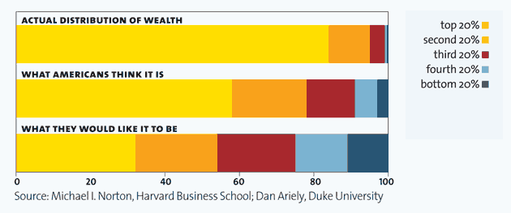
Americans Perception
What It Really Is versus
What they think wealth distribution is
&
What they would like it to be

Slide 8
60% to 80% of Americans Support… http://october2011.org/blogs/kevin-zeese/standwiththemajority
80% Reverse Supreme Court corporate $ for political campaigns ruling
Including 76% republicans, 81% of Indies, 85% of Dems
62% favor public financing system (50% pro to 40 against among Repub)
61% increasing taxes on wealthy should be first step to balancing budget
Higher and more progressive taxes to reduce deficit, support social programs and reduce income inequality
88% Bonuses at banks should be banned or taxed at high rate
77-87% No cuts to social security (raise the income cap 60% pro)
77-80% % No cuts to Medicare or Medicaid
53%-60% Jobs and economy are most important; 7% say the deficit
80% Climate change is real
77% say EPA should be allowed to its job and to do more not less
55% to 81% support variations of universal health care, national health insurance, Medicare for all, single payer; and consistent 64% support doing so “even if it means raising taxes)
74% eliminate tax credits for oil & gas companies
75% raise the minimum wage
60% oppose taking away collective bargaining right for government workers

Slide 9
Income

Slide 10
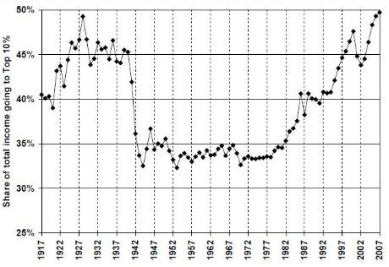
The Top 10% Family Income Share, 1917-2007
(Piketty & Saez; top 10% in 2007=$109,630)

Slide 11
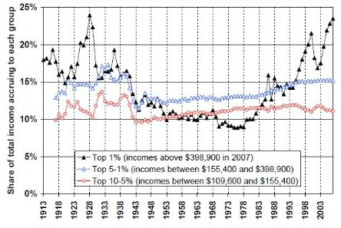
Decomposing the Top 10% Family Income Share, 1913-2007
It is mostly the top 1%

Slide 12
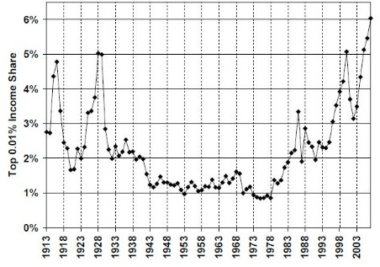
The Top 0.01% Family Income Share, 1913-2007
(Piketty & Saez; in 2007 top 0.01% 14,588 families with annual income > $11,477,000)

Slide 13
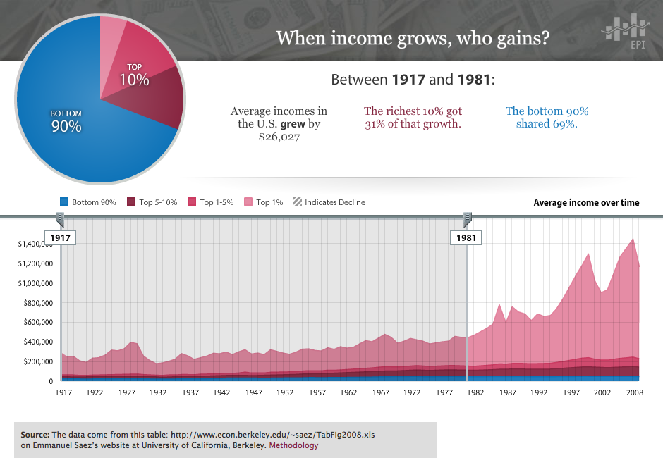

Slide 14
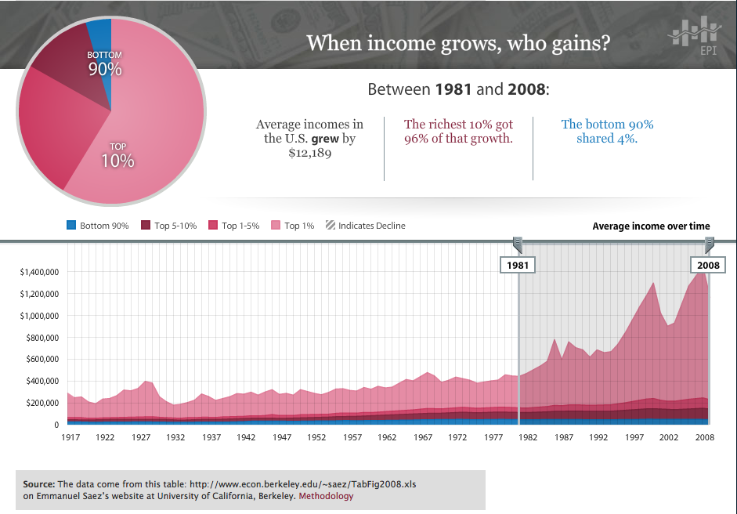

Slide 15
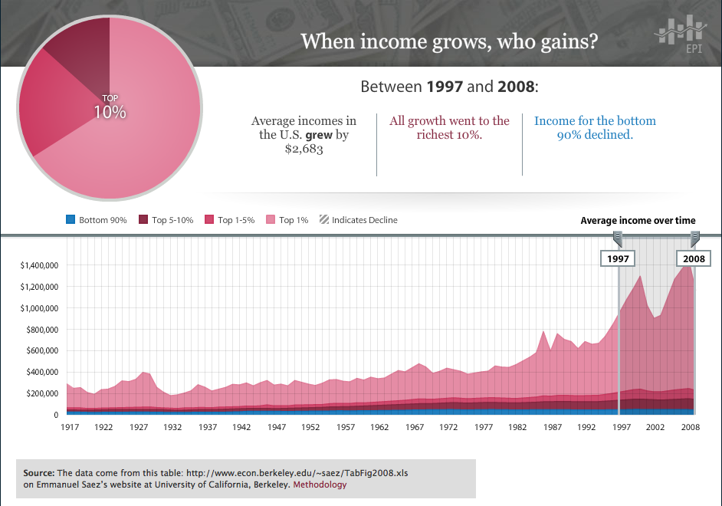

Slide 16
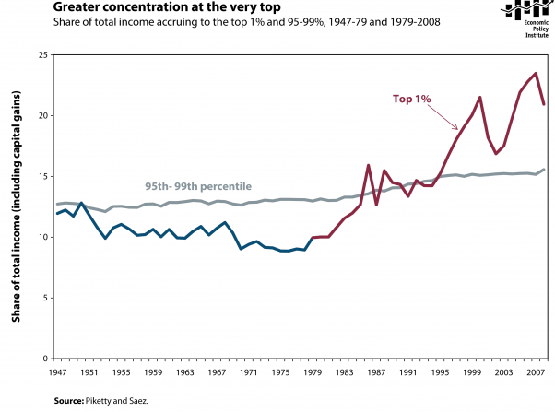

Slide 17
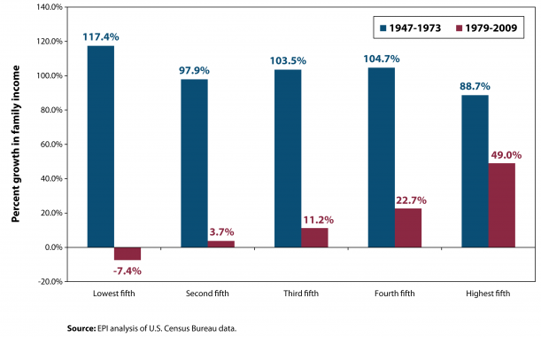
Fast-and-Fair vs. Slow-and-Skewed
Real Family Income Growth by Quintile, 1947-1973 vs. 1979-2009

Slide 18
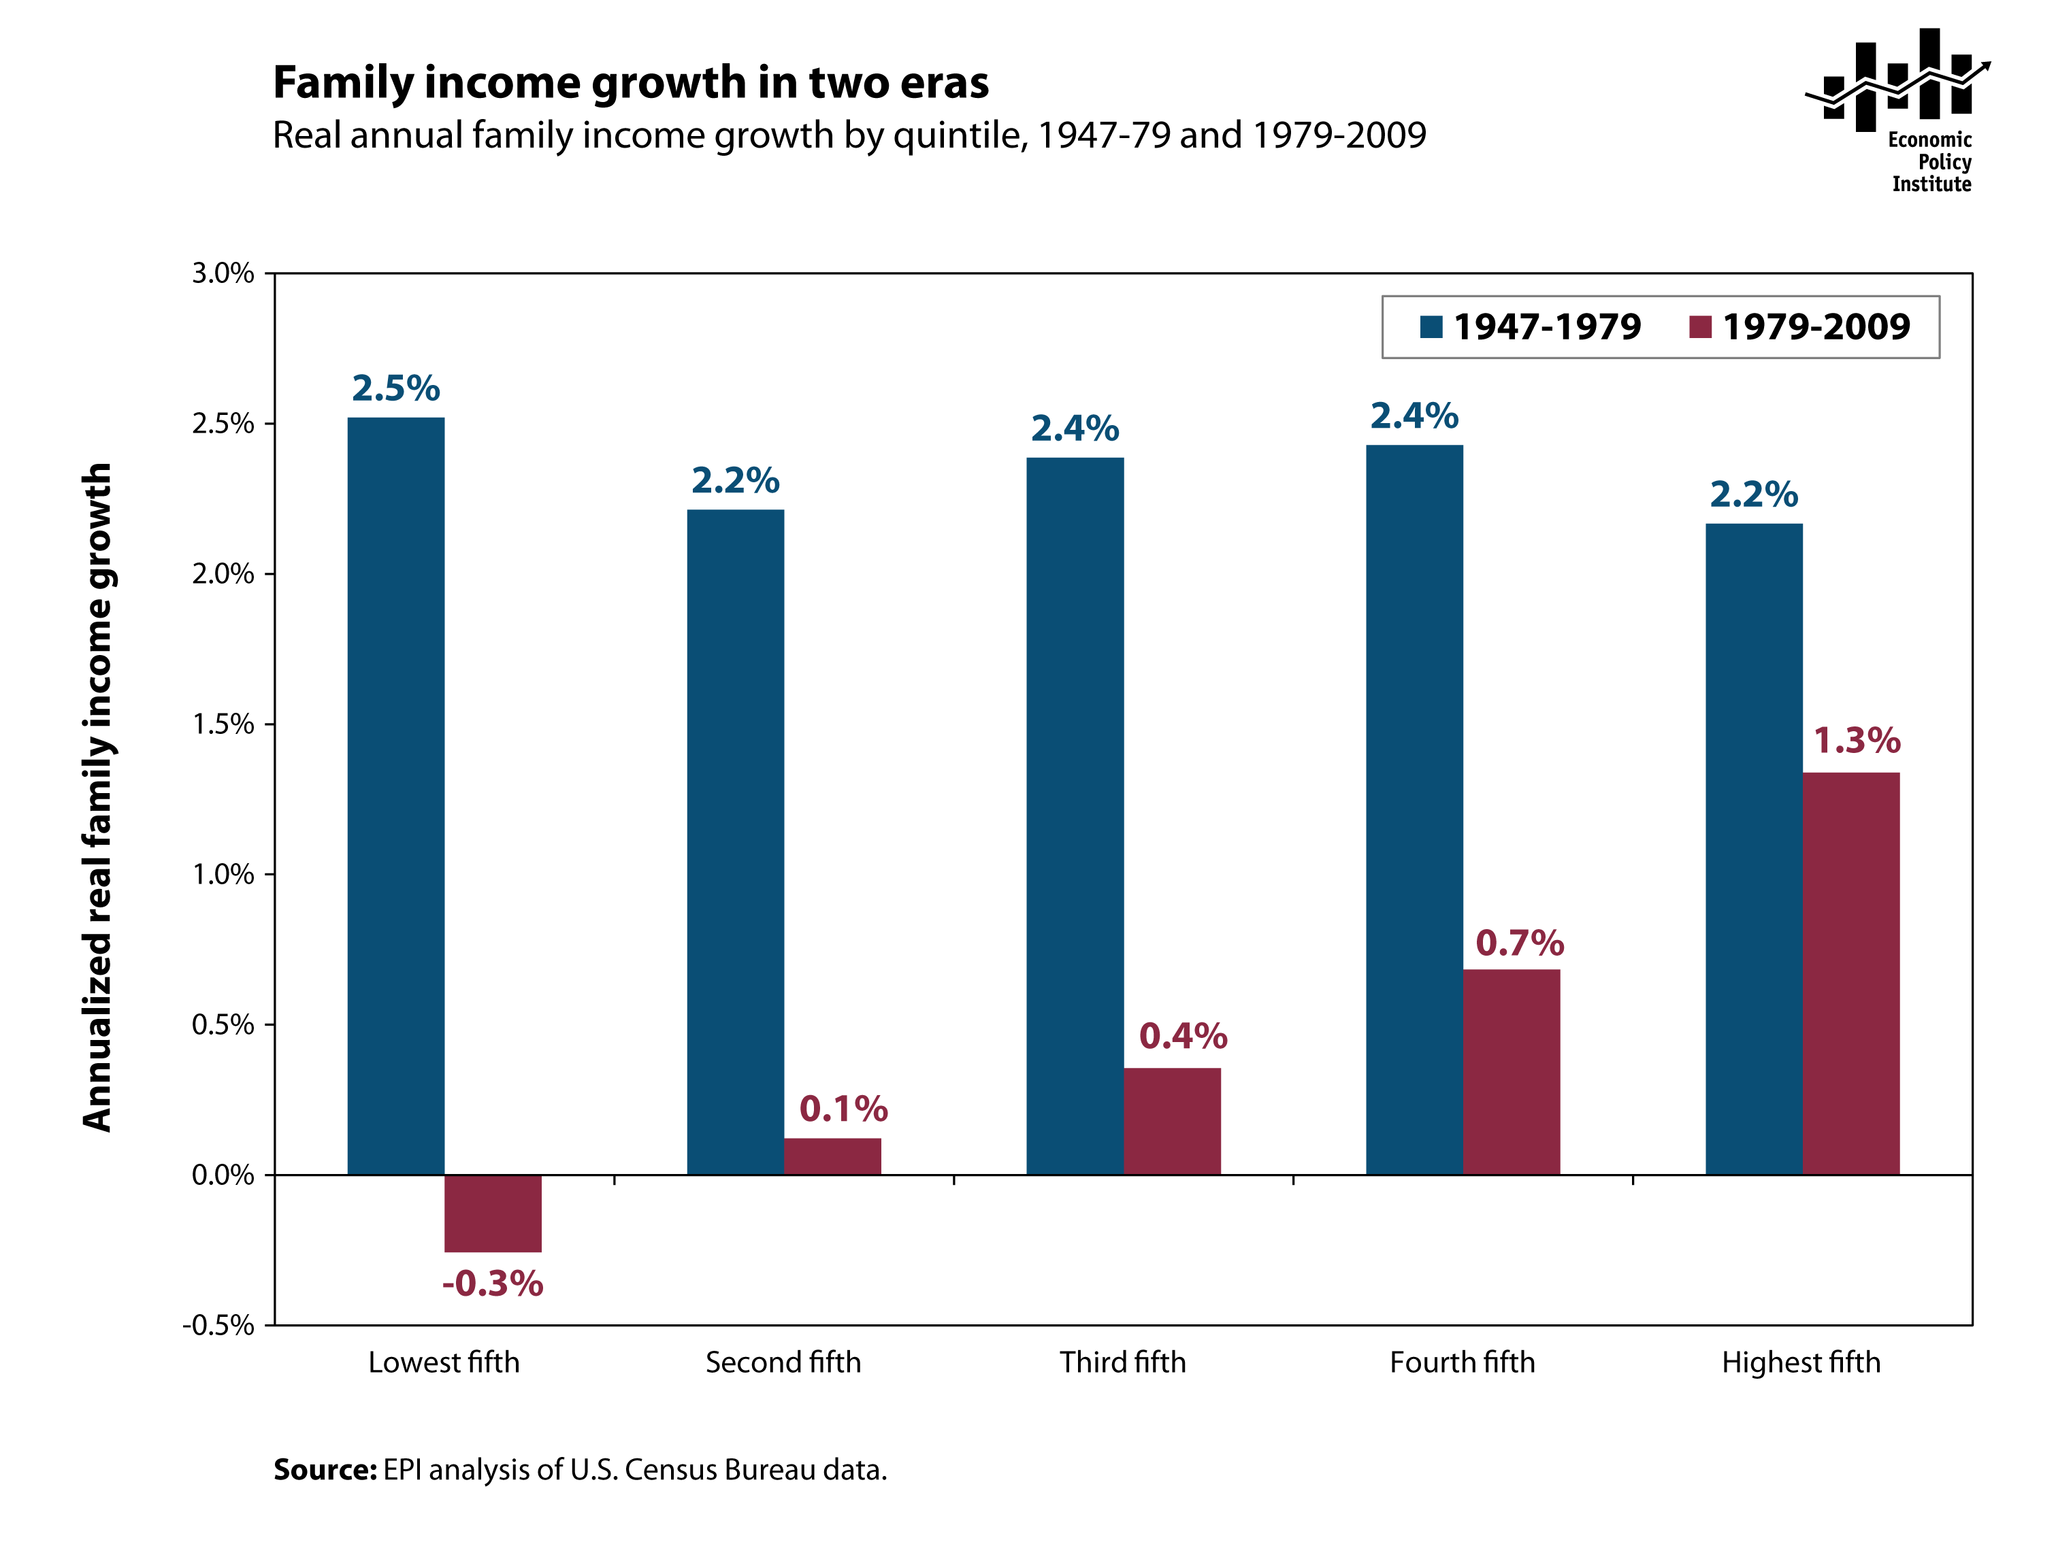

Slide 19
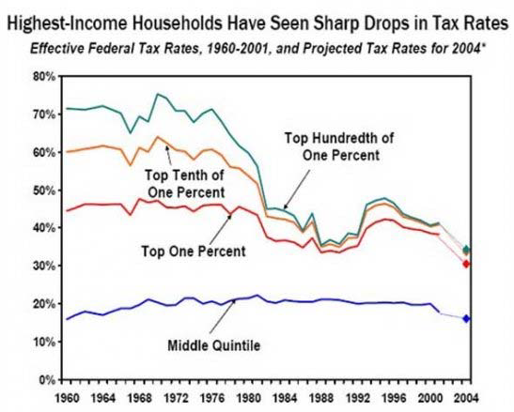

Slide 20
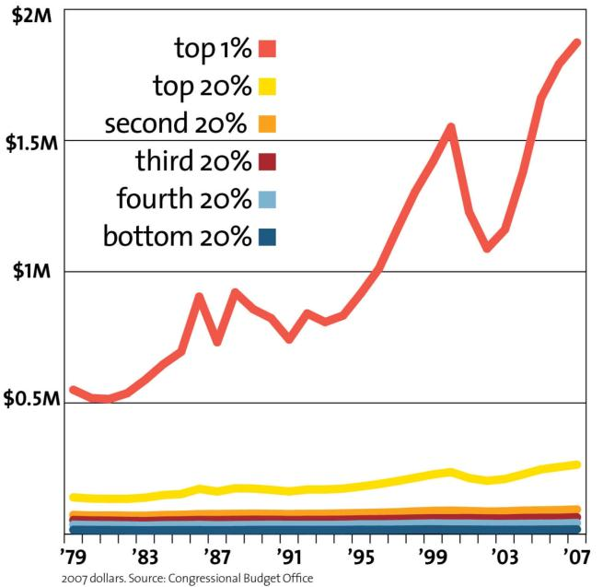
Average Household Income (before taxes)

Slide 21
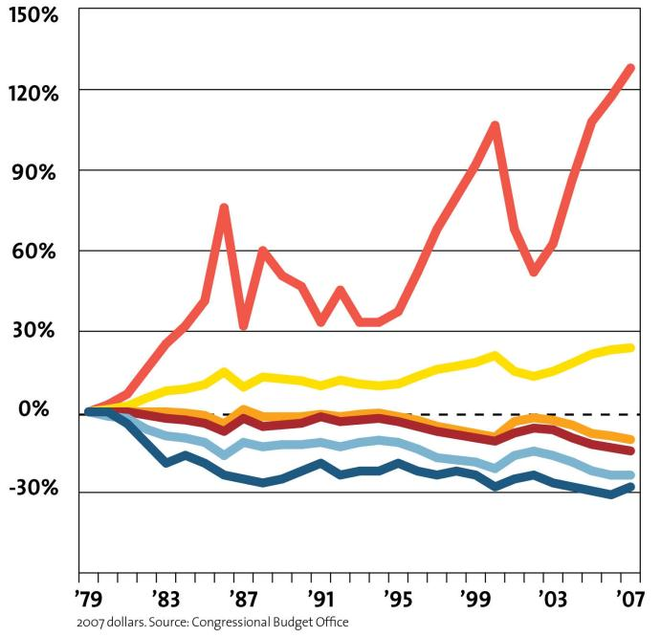
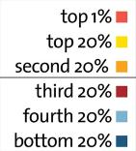
Change in Share of Income (after taxes)

Slide 22
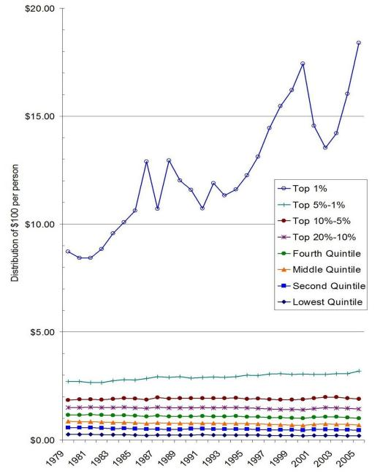
Change in Distribution of $100 per Person

Slide 23
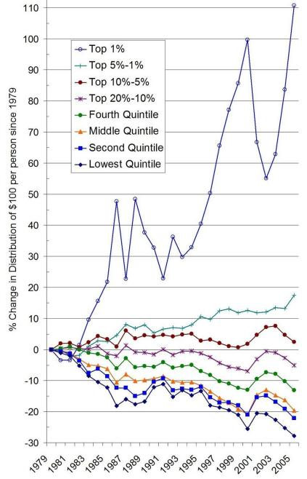
% Change in Distribution of $100 per Person

Slide 26
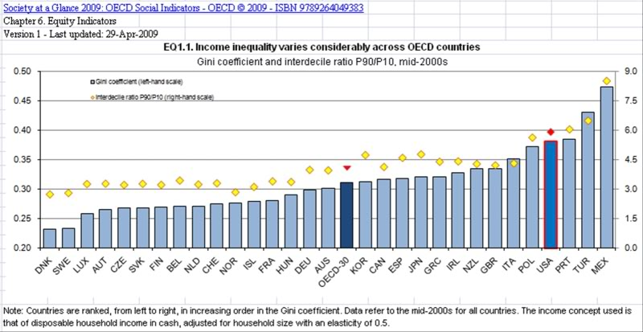
U.S. Has Worst Inequality
Among Wealthy Developed Capitalist Democracies

Slide 27
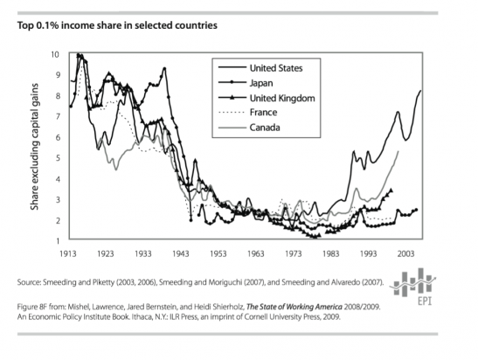

Slide 28
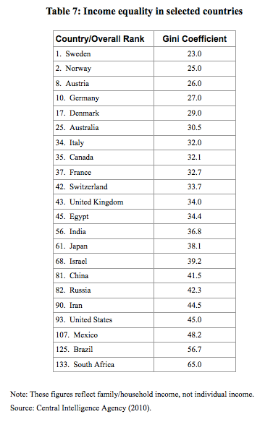

Slide 29
Wealth

Slide 30
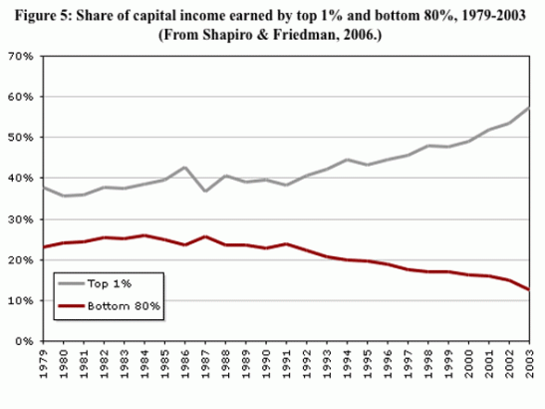
Not Just Income, Also Wealth Gap Increasing

Slide 31
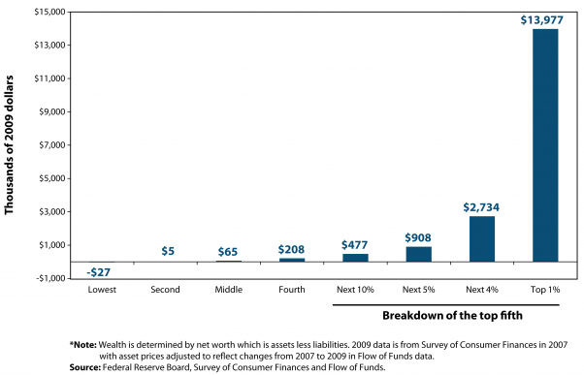
Wealth (net worth=assets-liabilities)

Slide 32
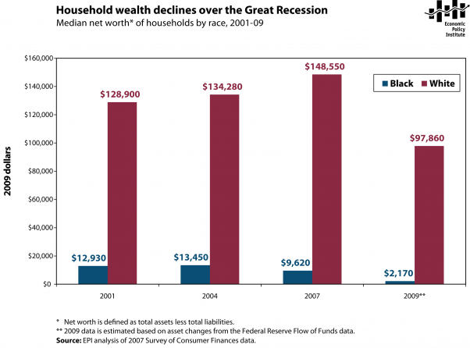
Wealth Decline by Race during Great Recession
Black much lower than White, and Worse Hit
(African Americans started from much lower baseline, total wealth less diversified, much more tied to single home, and most targeted by predatory lenders)

Slide 33
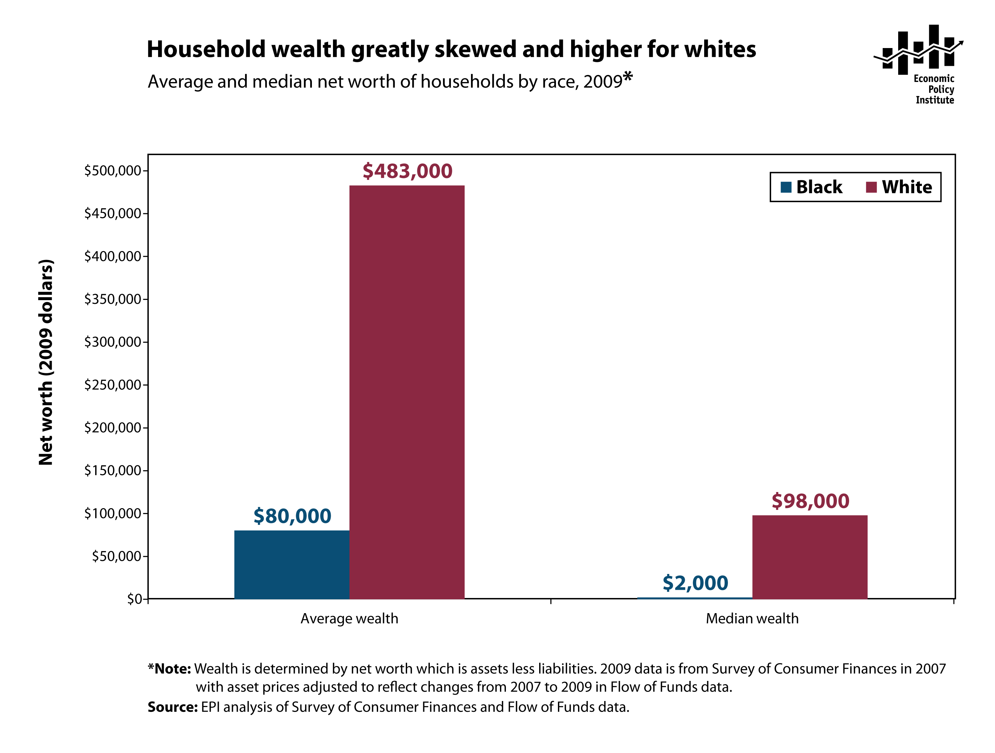

Slide 34
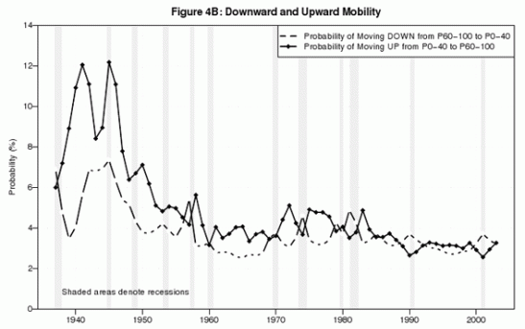
Economic Mobility Has Decreased Too

Slide 35
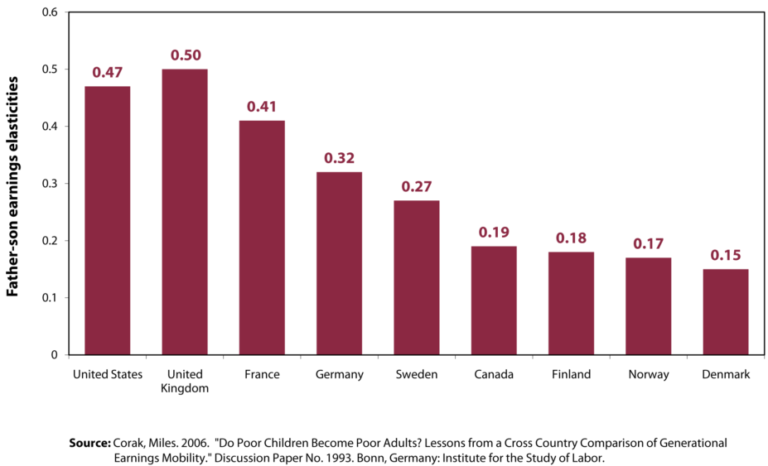
U.S. has less intergenerational Economic Mobility than other Western Capitalist Democracies

Slide 36
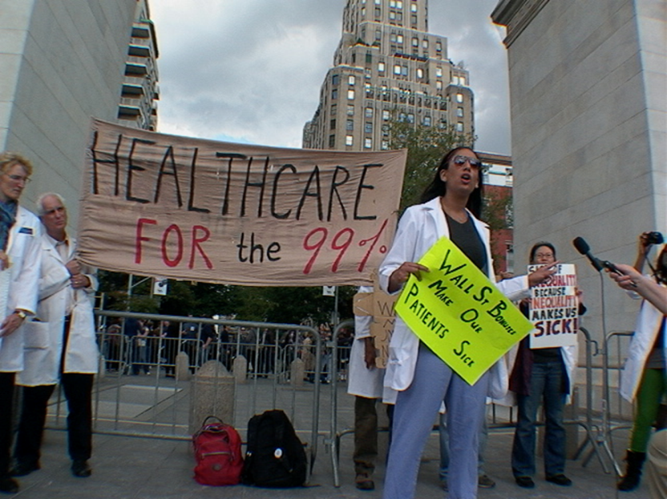
Speak-Out / Teach-in

Slide 37
Wages

Slide 38
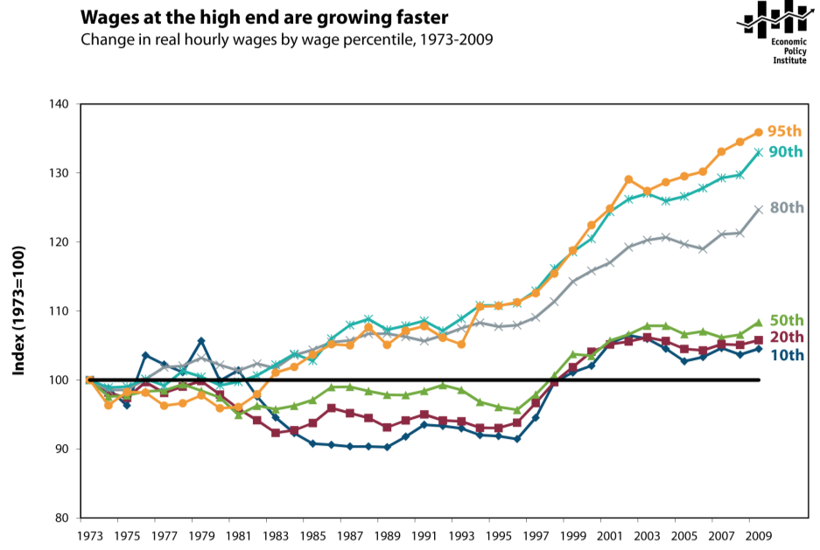

Slide 39
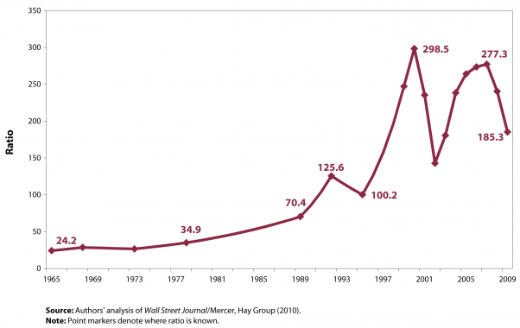
What is it about: Inequality & Pay
Ratio of CEO total direct compensation to average production worker compensation

Slide 40
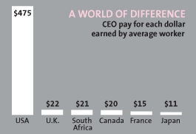
In Rest of Developed World CEO Ratio is Not nearly so high
(data from OECD study; not same as prior slide)

Slide 41
Jobs

Slide 42
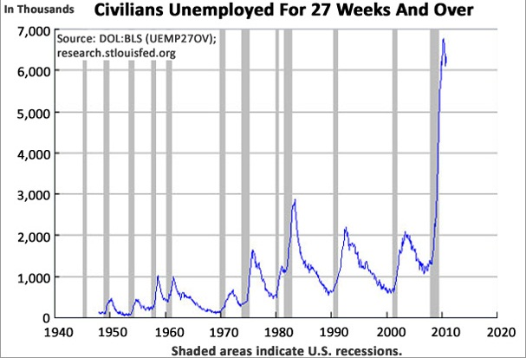
Worst Long-Term Unemployment Ever

Slide 43
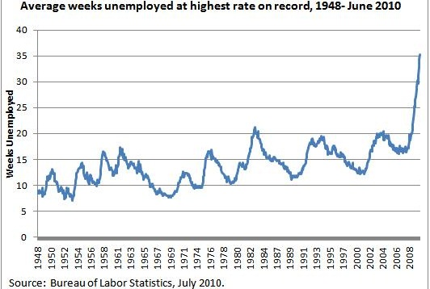
Worst Long-Term Unemployment Ever

Slide 44
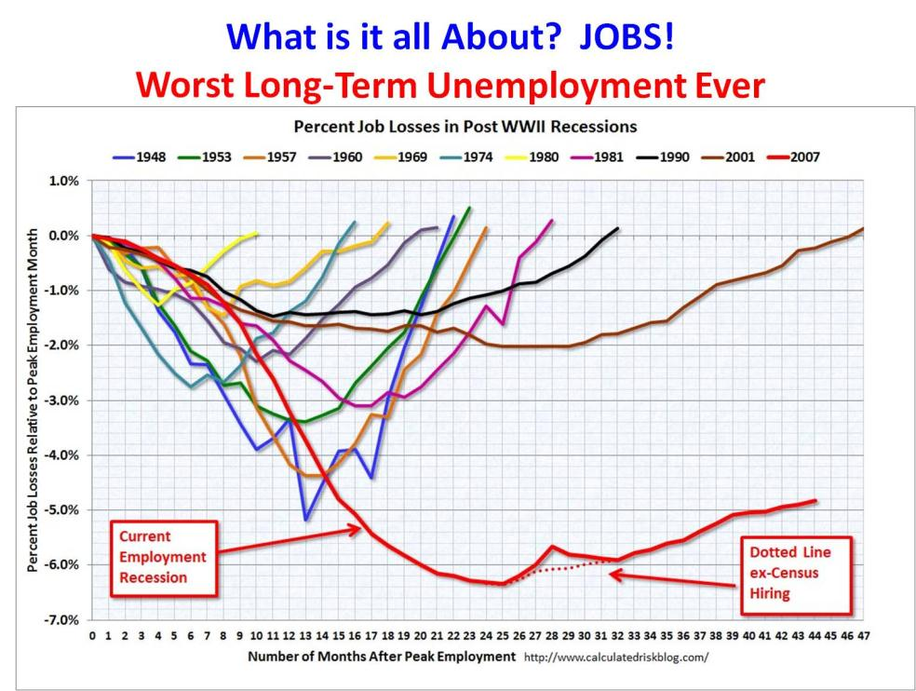

Slide 45
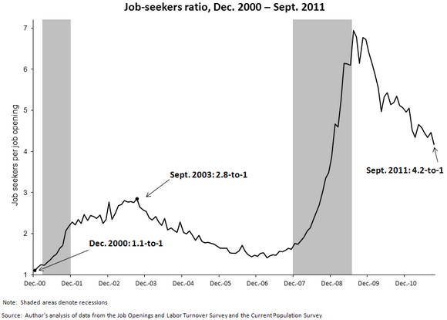
What it is About: Jobs
Folk Aren’t Suddenly Lazy… there are NO Jobs

Slide 46
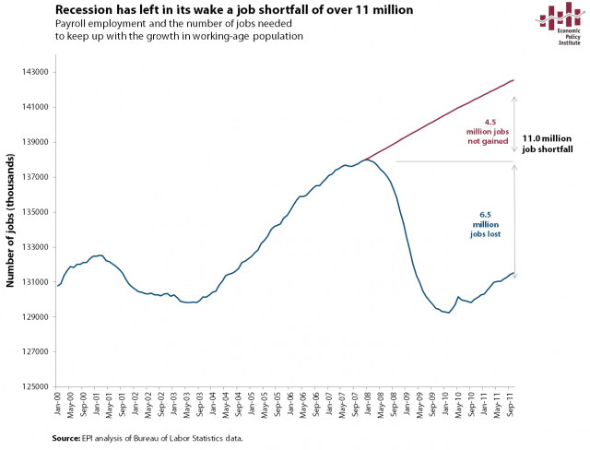

Slide 47
TAXES

Slide 48
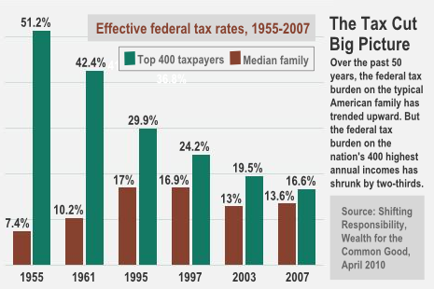

Slide 49
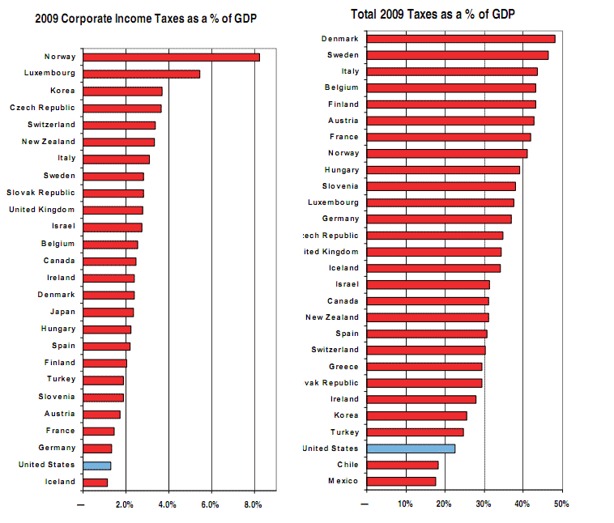

Slide 50
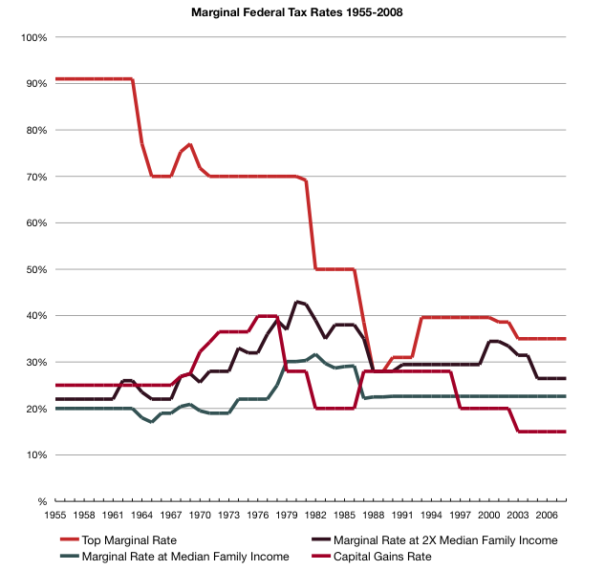

Slide 51
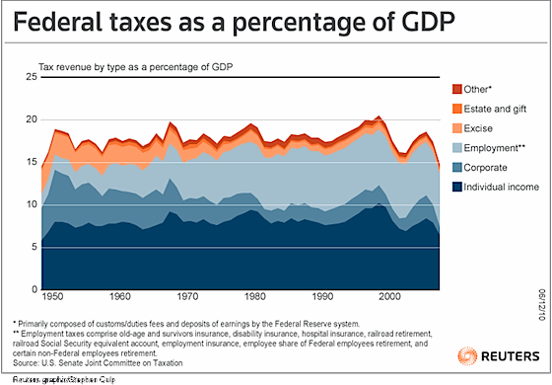

Slide 52
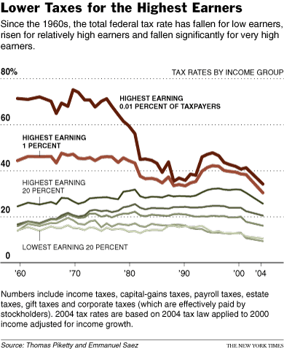

Slide 53
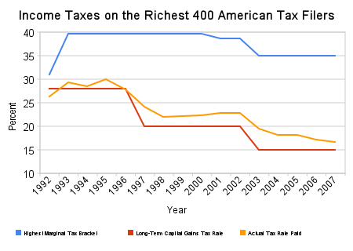

Slide 54
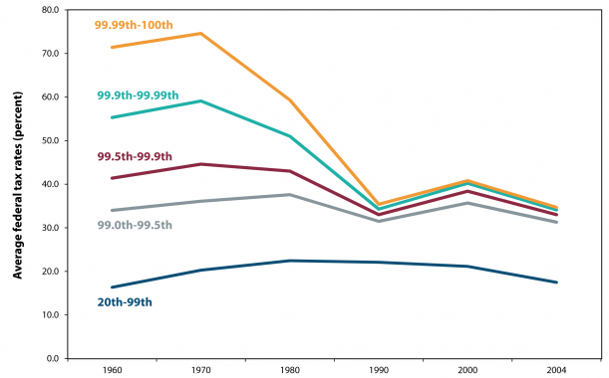
Federal Tax Rates Converge; much less Progressive
Decrease in higher marginal earned income tax rate
Decrease in Capital Gains tax rate (starts with Carter)

Slide 55
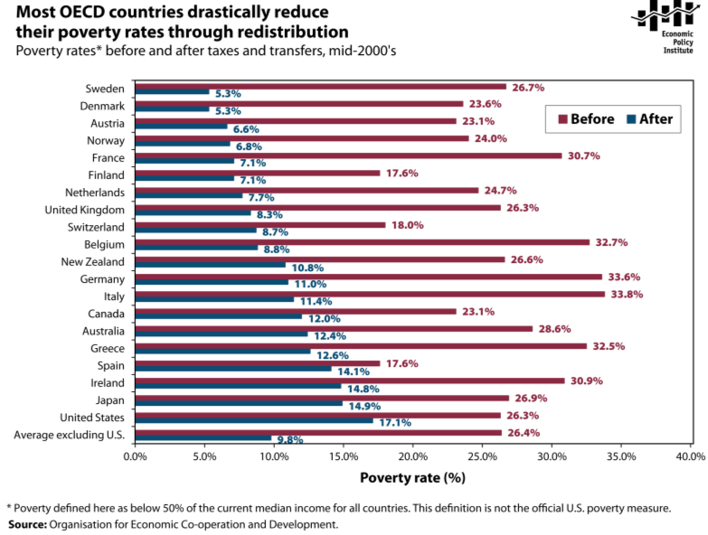
Other Capitalist Democracies have better safety-net
Reduce poverty by policy choice: taxes and transfers

Slide 56
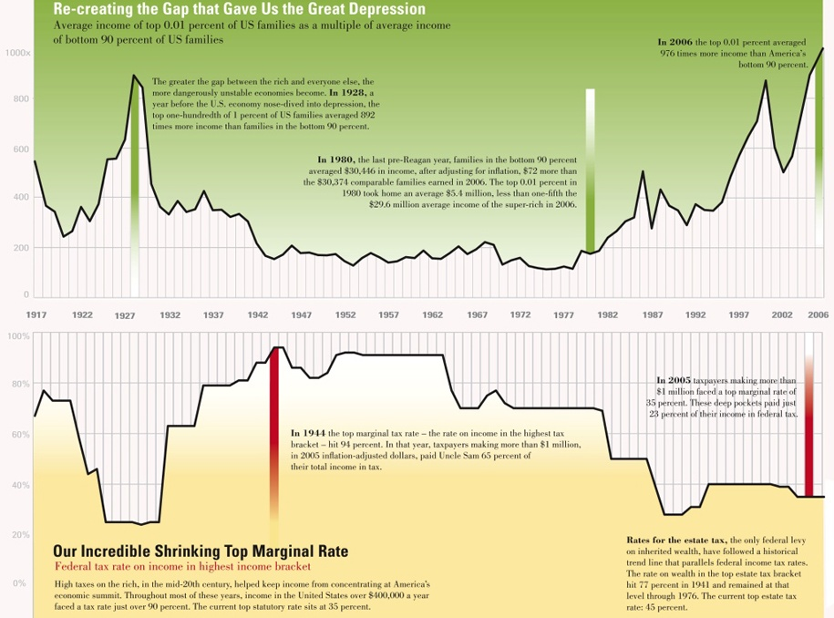

Slide 57
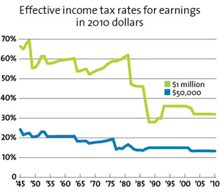
Decline in effective tax rates
Much greater for high earners (understates since this only shows income, not capital gains)
Most of what small decline there is for average income predates Reagan

Slide 58
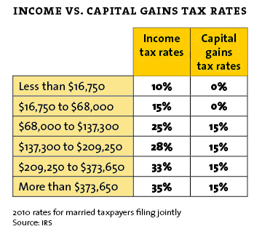
Earned Income vs. Capital Gains
Good to get paid in “Capital Gains” such as stock options & many executive bonus schemes.

Slide 59
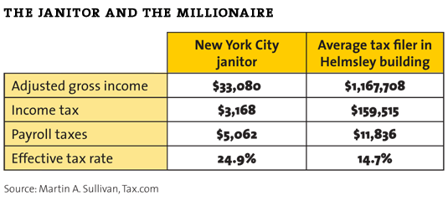
Leona Helmsley: Taxes are for little people
Comparison of real effective tax burden on
Average Filer Living in Helmsley building vs. their Janitor

Slide 60
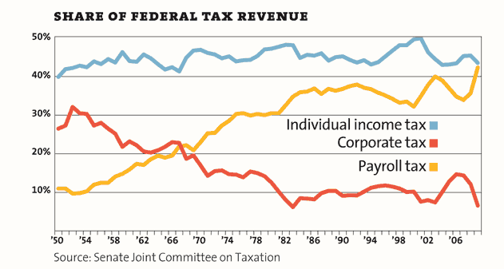
Regressive Taxation:
Overall income tax flat, while rate for high income has come down
Corporate tax share down
Payroll tax – most regressive – Has Steadily Increased

Slide 61
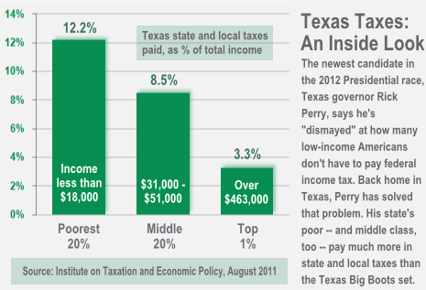
State & Local Taxes often even more Regressive

Slide 62
Corporations

Slide 63
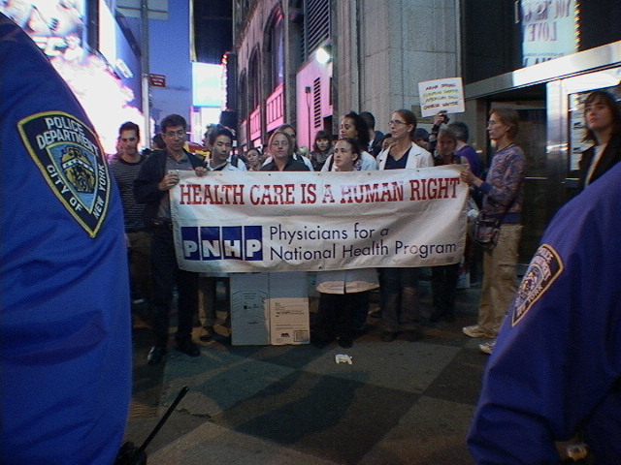
Who is Protecting Who from Whom?

Slide 64

Increase in Productivity Not Going to Middle Class

Slide 65

Economy’s Productivity Gains All Go to Top 1% Large Income Growth
Overall Increases in Economic Productivity
Income of Average Worker Slower to Stagnant

Slide 66


Slide 67

Corporations Still Making Peak Profits
Just not hiring
Holding onto cash; firing workers, stock-buy back (Pfizer NY Times last week)

Slide 68
Big Business & Wall Street Doing Fine
While America Suffers
NY Times Front Page November 22, 2011
“As Layoffs Rise, Stock Buybacks Consume Cash”
http://www.nytimes.com/2011/11/22/business/rash-to-some-stock-buybacks-are-on-the-rise.html
“When Pfizer cut its research budget this year and laid off 1,100 employees, it was not because the company needed to save money. In fact, the drug maker had so much cash left over, it decided to buy back an additional $5 billion worth of stock on top of the $4 billion already earmarked for repurchases in 2011 and beyond.”
“Liberal critics insist the trend is another example of top corporate executives raking in an inordinate share of the nation’s wealth, even as their employees suffer.”
“But spending on capital investments like new plants and infrastructure has stagnated more broadly in corporate America, confounding efforts by the Obama administration to spur economic growth. “
“The principle behind buybacks is simple. With fewer shares in circulation, earnings per share can rise smartly even if the company’s underlying growth is lackluster. In many cases, like that of the medical device maker Zimmer Holdings, executives are able to meet goals for profit growth and earn bigger bonuses despite poor stock performance. “
“It’s clear there’s a conflict of interest,”

Slide 69


Slide 70

What’s It All About?: Income and Inequality
CEO’s Pay Corporate Profits & Wall Street Are Taking all the Money
Workers Pay & Minimum Wage are Flat

Slide 71

GE like many of the largest companies pay very little in Federal Taxes
The official nominal rate – and all discussion of it - is a lie
The loopholes they paid our politicians to get are very effective

Slide 72
Verizon:
Wants workers to take cuts including health benefits
$100 billion in annual revenues and $15 billion in profits
5 top executives took home $258 million in salary and benefits over the last 4-years.
Between 2008 and 2010, Verizon used variety of tax avoidance techniques to receive $951 million in rebates from Federal government
Effective federal tax rate of -2.9%.
At the state level, Verizon paid just 2.6% in taxes, compared to a 6.8% state average.
All of this is unsurprising from a company whose Without a doubt, Verizon represents not just the 1%, but the top one-tenth of 1% of the country. And they are shifting their tax bill to the 99%

Slide 73


Slide 74

Who Owns the Politicians?
Business
(not Labor)

Slide 75

Which Businesses Own the Politicians?

Slide 76

There is no Debt Crisis
There is a:
Recessions decrease revenues crisis
Wars cost a lot crisis,
Tax cuts for wealthy crisis
The Agenda is NOT:
Cutting Taxes
Deregulate
Cutting Programs
More Austerity
The Agenda IS:
Jobs, Wages
Inequality,
Good Government
Healthcare, Education

Slide 77
Americans Perception
What It Really Is versus
What they think wealth distribution is
&
What they would like it to be

Slide 78
Bibliography
Inequality, Corporate Control etc:
Winner-Take-All Politics: How Washington Made the Rich Richer & Turned Its Back on the Middle Class, by Jacob Hacker & Paul Pierson.
Piketty & Saez U.C Berkley Dept of Economics: http://elsa.berkeley.edu/~saez/
EPI www.epi.org & http://stateofworkingamerica.org/
CEPR
Mother Jones
Business Insider
Invisible Hands: The Making of the Conservative Movement from New Deal to Reagan , by Kim Phillips-Fein
Conscience of a Liberal, Paul Krugman
Single Payer
http://www.pnhp.org/facts/single-payer-resources
Do Not Resuscitate & Hijacked by John Geyman, M.D.
The Healing of America, by T.R. Reid

Slide 79
Making the Connection
Inequality and Destruction of Middle Class… and
…Health and Healthcare

Slide 80


Slide 81
Social Determinant of Health
Inequality Kills
http://www.who.int/social_determinants/thecommission/en/
http://www.cdc.gov/socialdeterminants/

Slide 82


Slide 83


Slide 84


Slide 85


Slide 86
What’s Wrong With The U.S. Healthcare System and the
Single Payer
Solution

Slide 87


Slide 88
What Is Wrong With the American Healthcare System?
Same factors as above…
    Corporate greed
    Greed of the upper class elites
    Corrupted politics
…Result in bad system & resistance to real change

Slide 89
The Problem
Americans are rightly afraid they cannot afford to be sick
Costs Too Much: total National, States, Business, Families & Individuals
Rising out of pocket costs even with “insurance”: premium, copay, deductible
Rising number of uninsured in America
Employers dropping or reducing coverage; lose entirely when unemployed
60% of personal bankruptcies involved medical expenses; 75% had insurance.
Each year 1/3 Americans postponed needed health care due to cost
100 million underinsured (out of pocket costs so high as to limit access)
Over 100,000 Americans die every year due to being uninsured (45,000) or insurance denials (55,000)
~1,800 excess deaths per year in North Carolina each year due to uninsurance
Americans pay twice what other developed capitalist democracies countries do for healthcare, but get less
We are the outlier nation: highest costs with mediocre health outcomes.
Other developed capitalist democracies spend half of what we do, yet cover everybody, with better outcomes.
Alone amongst OECD nations, the US relies on private for-profit health insurance companies to cover most of the population

Slide 90
The Problem
Private companies cover the healthier segments of the population while taxpayers pick up the tab for most healthcare expenses
Largest number of individuals are covered by private insurance
→ healthier population, healthy workers and their families
Largest amount of funding comes from taxpayer to insure sickest high risk population that private insurance does not want
→ , elderly, disabled,
Losses are public, profits are private.
Medicare. Federal program. Universal access for 65 & disabled. Care is in similar settings to private insurance. Single payer model.
Medicaid. Administered by states. Variable eligibility. Outpatient care in clinics. Politically vulnerable. Poverty program.
Veterans Affairs & DOD = Socialized medicine model. (recent scandals were actually privatized outsourcing)
Publicly funded national program like Medicare spends 3% on administration/overhead, while private insurance companies profiteer spending 15-30% on administration, profit, CEO salaries

Slide 91


Slide 92


Slide 93

Less administrative overhead, less waste
Notes:
So, in order to run a profitable business you need armies of administrators.
This is why from 1970 to the year 2000 the number of administrators has increased exponentially, especially when compared to the number of physicians.

Slide 94


Slide 95

Why Health Care Was On the Agenda: Escalating Cost
Average Annual Premiums for Single and Family Coverage, 1999-2011
* Estimate is statistically different from estimate for the previous year shown (p<.05).
Source: Kaiser/HRET Survey of Employer-Sponsored Health Benefits, 1999-2011.

Slide 96


Slide 97

Most expensive
Notes:
97

Slide 98

U.S. Spends More on Healthcare But Has Lower Life Expectancy
Not just worse, but inefficiently worse

Slide 99


Slide 100

We Don’t Live as Long…
Life expectancy at birth has increased by more than 10 years in OECD countries since 1960, reflecting a sharp decrease in mortality rates at all ages
Source: OECD Health Data 2009, OECD (http://www.oecd.org/health/healthdata).
Notes:
100

Slide 101


Slide 102


Other Countries Have Universal Coverage…
All OECD countries have achieved universal or near-universal health care coverage, except Turkey, Mexico and the United States
2007
Source: OECD Health Data 2009, OECD (http://www.oecd.org/health/healthdata).
Notes:
102

Slide 103

…And They Spend a Lot Less Than We Do
Health expenditure per capita varies widely across OECD countries.
The United States spends almost two-and-a-half times the OECD average
2007
1. Health expenditure is for the insured population rather than resident population.
2. Current health expenditure.
Source: OECD Health Data 2009, OECD (http://www.oecd.org/health/healthdata).
Notes:
103

Slide 104
Hospital Discharges per 1,000 Population
We Don’t Use Hospitals As Much…
104
* 2008
Source: OECD Health Data 2011 (June 2011).

Slide 105


Slide 106
Average Length of Hospital Stay for Acute Myocardial Infarction
106
...And We Don’t Stay as Long
Days
* 2008
Source: OECD Health Data 2011 (June 2011).

Slide 107
Annual Number of Physician Visits per Capita
107
We Don’t See The Doctor as Often
* 2008
** 2007
Source: OECD Health Data 2011 (June 2011).
Notes:
107

Slide 108
…Poor Access and Poor Quality:
Mortality Amenable to Health Care
Deaths per 100,000 population*
* Countries’ age-standardized death rates before age 75; including ischemic heart disease, diabetes, stroke,
and bacterial infections. Analysis of World Health Organization mortality files and CDC mortality data for U.S, 2006-2007.
Source: Adapted from E. Nolte and M. McKee, “Variations in Amenable Mortality—Trends in 16 High-Income Nations,” Health Policy, published online Sept. 12, 2011.

Slide 109

Poor quality
Worst mortality due to treatable causes
www.pnhpcalifornia.org
Notes:
109

Slide 110

Mediocre Performance
Note: U.S. Just above Slovenia and below Costa Rica

Slide 111

Out-of-Pocket Medical Expenses:
The Major Contributor to Poverty

Slide 112
U.S. world leader in…Medical Bankruptcies!
In 2007, 62% of personal bankruptcies were medical
Increase of ~50% from 2001
Most debtors well educated, homeowners, middle class occupation
78% had health insurance at time of filing ☹
Impossible in other OECD countries
The American Journal of Medicine, 2009

Slide 113
Affordability, Access, and Coordination Experiences in the Past Year, by Age and Insurance Among U.S. Adults: Medicare Works!
113
Percent
Source: 2011 Commonwealth Fund International Health Policy Survey of Sicker Adults in Eleven Countries.

Slide 114


Slide 115

Many Specialists Won’t See Kids With Medicaid
Bisgaier J, Rhodes KV. N Engl J Med 2011;364:2324-2333
Notes:
115
Figure 2 Clinics Scheduling Specialty Care Appointments for Children, According to Type of Insurance. Public insurance was reported by callers as the Illinois Medicaid–Children's Health Insurance Program (CHIP) umbrella program; private insurance was reported by callers as Blue Cross Blue Shield. Each of the 273 clinics was called twice (for a total of 546 calls) by the same caller, with only insurance coverage varying between the two calls: once reporting Medicaid–CHIP coverage and once reporting private coverage. Calls were made 1 month apart, and the order of the reported insurance status was randomly assigned. Asthma clinics included 38 allergy–immunology clinics and 6 pulmonary disease clinics.

Slide 116

Decline in employer-sponsored health coverage accelerated three times as fast in 2009, Elise Gould, September 16, 2010 http://www.epi.org/publications/entry/decline_in_employer-sponsored_health_coverage_accelerated
Erosion of employer-sponsored
commercial insurance

Slide 117


Slide 118
Insurance Companies
You can’t make money insuring sick people; just too expensive
Goal of insurance company is to make money; quarter-on-quarter profit, maximize return to executives and wall street
Goal is to not provide care: medical loss ratio
Do not compete by market efficiency
Compete by avoiding sick people in the first place
Deny coverage, claims, referrals
Push and dump sick people out of coverage
Already in effect being subsidized by having expensive people taken out of potential insurance pool
Medicare took elderly & disabled who have higher costs out of system
Medicaid took very poor (if they meet conditions) out of system
Private health insurance was dying: costs were escalating, premiums too high, employers dumping group insurance, individual coverage completely insane; we said “Do Not Resuscitate”
Mandate: was originally their plan. Use government to force you to buy inherently defective product. Bail-out.

Slide 119


Slide 120

Private insurers’ High Overhead

Slide 121


Slide 122


Slide 123


Slide 124


Slide 125


Slide 126


Slide 127

Drug Companies’ Cost Structure

Slide 128


Slide 129

For-Profit Hospitals Cost 19% More
Source: CMAJ 2004;170:1817

Slide 130

For-Profit Hospitals’ Death Rates are 2% Higher
Source: CMAJ 2002;166:1399

Slide 131


Slide 132
Social/Public vs. Commercial Insurance:
Similar NAMES, different GOALS
Commercial (for-profit) insurance
  Business of slicing and dicing patients according to risk categories and services contracted for, and collect as much money as possible while actively avoiding to pay for services, with the goal of yielding the maximum profit possible for shareholders
  Health care as market good
  Same as TV, cell phone, car, vacation
Social insurance (taxes / payroll ):
  Marriage between social solidarity to protect from medical need and market forces to buy services in bulk, get better prices, and avoid waste (advertising, marketing, shareholders profit, fat CEO salaries)
  Treats health care as a right and social good
  Same as education, roads, police, fire dept, military
Notes:
132

Slide 133
Massachusetts 2006
Window into future of PPACA
No reduction in medical bankruptcies from 2007 to 2009 (7,504 to 10,094), still around 50%
89% had insurance at time of filing!
Least expensive individual policy 56 yr. male, annual income $32,670, 300% of poverty, no subsidies (taxpayers’ $$$!)
  $5,616 (policy)
  $ 2,000 (deductible)
  20% of next $15,000 for covered services
Total: $10,616
Uncovered services (e.g. physical therapy, drugs, home health) are on you!
Least expensive individual policy 56 yr. male: $5,616 (policy) + $ 2,000 (deductible) + 80% of next $15,000 for covered services (annual income 300% of poverty $32,670)
American Journal of Medicine, March 2011

Slide 134

Your Costs under PPACA

Slide 135


Slide 136
Single Payer
Public Insurance with Personal Choice, Private (and competing) delivery of care
Free choice of care: doctors, clinics, hospitals remain independent, private
(no investor owned, for-profit).
Purpose of health insurance should be to spread risk
The healthy always pay for the sick; the sick are too expensive by themselves
Biggest most even and fair pool is the “All American” one
Everybody is in: Pay same (more progressive) federal taxes as national security, homeland security and social security
Universal: Nobody is out: automatic enrollment, no churning, no marketing, much less administration
Monospony: buyer has monopoly; reduce unit price drugs, equipment, hospitals, and doctors fees. Bulk purchase; Power of Economies of Scale (Market Forces!)
to pursue to goal of social solidarity
Capital Planning: based on need, rational service areas, not who and which neighborhoods can pay more. Longer-term planned budgeting
Comprehensive Benefits: All needed care, no co-pays, no point-of-service charges
Public Accountability for cost, administration, quality, but minimal bureaucracy
By law, government transparent in a way private for-profit are not
Government: Career salaried administrators accountable to elected officials,
Private: Bureaucrats salaries dependent on saying no, accountable to corporate executives whose goal is maximize short term profit.

Slide 137


Slide 138
Econometric Analysis http://www.pnhp.org/facts/single-payer-system-cost
Single payer is the only way (necessary not sufficient), to get universal comprehensive quality coverage and control total system costs and individual costs
20 years and dozens of studies by numerous government and independent groups including CBO, GAO, OMB, Lewin, Mathematica, Harvard, MIT….
Even opponents admit it…
Their threat “last chance… if this does not work, single payer”

Slide 139
Percent of Currently Uninsured Who Get Covered
* This was original Hacker proposal with strong public option and other better provision then what passed.
Actual PPACA is calculated by its supporters (RWJF, Commonwealth) to cover 40-60% of uninsured

Slide 140
Change in Federal Government Spending ($ Billions)
(but that’s the wrong measure!)

Slide 141
Change in Total National Health Expenditure ($Billions)
(Cost Less for States, Business, Families & Individuals… and Total U.S.)

Slide 142
Who Pays What
 | Percent Uninsured Covered | Federal Spending (billions) | State & Local Spending (billions) | Employer Spending (billions) | Household Spending (billions) | National Health Expenditures (billions)
Burr (Every American Insured) | 46% | $161.3 | -$52.9 | $7.0 | -$84.3 | $31.1
Enzi (Ten Steps) | 55% | $176.4 | -$21.2 | -$77.6 | -$13.5 | $64.1
Democratic Candidates (Building Blocks) | 92%* | $103.9 | -$32.7 | $86.0 | $139.4 | $17.8
Single Payer (Stark AmeriCare) | 100% | $188.5 | -$83.6 | $61.5 | -$224.5 | -$58.1
* This was original Hacker proposal with strong public option and other better provisions then what passed.
Actual PPACA is calculated by its supporters to increase coverage by 40-60%
Source: The Lewin Group for The Commonwealth Fund:
An-Analysis-of-Leading-Congressional-Health-Care-Bills--2007-2008--Part-I--Insurance-Coverage

Slide 143
Big Savings from Single Payer:
Billing and insurance overhead consume nearly 30 cents of every dollar
Spending through
private insurers
28%
Notes:
143

Slide 144
Covering Everyone with
No Additional Spending
Additional costs
Covering the uninsured and poorly-insured +6.4%
Elimination of cost-sharing and co-pays +5.1%
Savings
Reduced hospital administrative costs -1.9%
Reduced physician office costs -3.6%
Reduced insurance administrative costs -5.3%
Bulk purchasing of drugs & equipment -2.8%
Primary care emphasis & reduce fraud -2.2%
$ B
134
107
241
Total Costs +11.5%
-21
-76
-111
-59
-46 -313
Total Savings -15.8%
Net Savings - 4.3% - 73
Source: Health Care for All Californians Plan, Lewin Group, January 2005
Notes:
144

Slide 145
How Medicare for All Could Be Paid For:
One Example from a Recent Study of a California Plan
Notes:
145

Slide 146

92% of U.S. Census households earned less than $150,000
rSouce: Lewin Group, January 2005
http://pubdb3.census.gov/macro/032008/hhinc/new06_000.htm
Notes:
146

Slide 147

92% of Families Would Save Money
Source: Lewin Group, January 2005
Notes:
147

Slide 148
Bulk purchases, lower prices
Japan
United States
Expenditures per person | $2,249 | $5,711
Practicing physicians per 1000 persons | 1.9 | 2.7
Physician visits per person per year | 16 (Belgium 8; Canada 6.6, Germany 6.2) | 6
MRI units/million persons | 18.8 | 7.6
Population over 65 years | 20% | 12%
www.pnhpcalifornia.org
Organization of Economic Cooperation and Development, OECD 2000/2003
Notes:
148

Slide 149
Risk pooling allows to cross-subsidize for socially useful purposes
In all insurance systems, for profit or non-profit, there is cross-subsidizing, i.e., collective contributions pay for whoever needs services
HOW THE POWER OF CROSS-SUBSIDIZING IS USED DEPENDS ON GOAL OF SYSTEM
  In COMMERCIAL SYSTEM, profit! YOUR POOL MUST BE LARGE AND FULL OF HEALTHY PEOPLE
  In SOCIAL/PUBLIC SYSTEM, to pay for health care!
  YOUR POOL MUST BE LARGE AND INCLUDE ALL SICK AND HEALTHY
Key problem of Medicare: all members of pool need a lot of health care
20% account for 80% of costs
Agency for Healthcare Research and Quality, MEPS, 1999

Slide 150
Who wins and who loses with socialized financing (social insurance)
Winners:
  Businesses can mind their own business! Reduce costs, more competitive, reduce employee turnover, lower costs.
  Patients: health security for self, children, friends and community; no false “choices”, lower costs.
  Health providers: back to real business, providing health care, lower operation costs
Losers:
  For profit insurers: no profit from medically necessary services
  Drug companies: truly need to negotiate prices
  Shareholders: can’t make fortunes from medically necessary services
  Politicians: no tons of money from all of the above
Notes:
150

Slide 151


Slide 152


Slide 153


Slide 154


Slide 155
American People Support This
Media does Not Publicize own Findings; Politicians won’t listen http://wpasinglepayer.org/learn-about-single-payer/poll-results-on-single-payer
October 2003 Washington Post/ABC News Poll:
“Which would you prefer – (the current health insurance system in the United States, in which most people get their health insurance from private employers, but some people have no insurance); or (a universal health insurance program, in which everyone is covered under a program like Medicare that's run by the government and financed by taxpayers?) : 62 % Universal
October 2005 Harris Poll:
“Please indicate whether you support or oppose the policy.“Universal health insurance” = 75% Strongly/Somewhat Favor
February 2007 NY Times/CBS News Poll: Do you think the federal government should guarantee health insurance for all Americans, or isn't this the responsibility of the federal government? 64% - Guarantee
If you had to choose, which do you think is more important for the country to do right now, maintain the tax cuts enacted in recent years or make sure all Americans have access to health care?
76% - Access to health insurance; 18% - Cutting taxes;
December 2007: AP - Yahoo News Poll:
Do you consider yourself a supporter of a single-payer health care system, that is a national health plan financed by taxpayers in which all Americans would get their insurance from a single government plan, or not?
Yes 54%, No 44%
May 2007 CNN/Opinion Research Poll:
Do you think the government should provide a national health insurance program for all Americans, even if this would require higher taxes?
64% - Yes, 35% - No,

Slide 156
More Polling http://wpasinglepayer.org/learn-about-single-payer/poll-results-on-single-payer
December 2007 AP - Yahoo Poll
“Which comes closest to your view?
34% - The United States should continue the current health insurance system in which most people get their health insurance from private employers, but some people have no insurance
65% - The United States should adopt a universal health insurance program in which everyone is covered under a program like Medicare that is run by the government and financed by taxpayers
2009 Kaiser Health Tracking Poll
Do you favor or oppose, "Having a national health plan in which all Americans would get their insurance through an expanded, universal form of Medicare-for all?”
Favor 58%,
July 2009: Time Magazine
“Would you favor or oppose a program that creates a national single-payer plan similar to Medicare for all, in which the government would provide healthcare insurance to all Americans?
Favor 49%, Oppose 46%,
February 2009: Grove Insight Opinion Research
"When given a choice of the current system or one "like Medicare that is run by the government and financed by taxpayers,” 59% say they would prefer a national health insurance program that covers everyone, over the current system of private insurance offered to most through their employer."
February 2009 New York Times/CBS News Poll
59% say the government should provide national health insurance, including 49% who say such insurance should cover all medical problems.

Slide 157


Slide 158


Slide 159
Doctors Support Occupy Wall Street
Because Wall Street Is Occupying Health Care
We support OWS because economic inequality and social injustice make our patients sick. The toxic combination of false and needless bad policies, bad economics and bad politics are responsible for the fact that a majority of people do not enjoy the good health that is biologically possible. Low wages and income, high unemployment, inadequate education, unhealthy food, inappropriate drugs, unaffordable housing, unsafe jobs, a polluted environment, and a lack of access to affordable healthcare sicken and kill our patients. Doctors cannot stand by silently while corporations and a corrupted political system favoring the 1%, sicken and kill our patients.
We support OWS because healthcare is a human right, and everybody in America deserves access to affordable high quality healthcare. The private health insurance industry exemplifies a central tenet of the Occupy movement, that unchecked corporate greed is harming human need. We reject a system that falsely forces us to treat patients differently based on the types of insurance they have and what kinds of treatments they can “afford.” Our duty is to our patients. Corporations are not people and we have no duty to serve them.
We support OWS because we believe in facts and evidence, and the facts and evidence shows that a profit-driven healthcare industry raises costs, lowers quality, and decreases access. It is unhealthy for the 99%; only a few corporate executives, bankers, and lobbyists benefit.
We support OW because our political system– corrupted by corporate money and the undue influence of the selfish rich privileged with power and access – reject evidence-based health policies, including single payer insurance, which would save both lives and money. A healthy society is built on a healthy democracy, and equal treatment of all people before the law. The rights and needs of real people, not corporations, are central to the health of our democracy. The highest duty of the government is to promote and protect the welfare of all its people.
We support OWS because the health care economy – like the overall economy – has more than sufficient resources to take care of 100% of our people, but the resources are siphoned off by a profit-driven system in the interest of the 1%.
We support OWS because we took the oath to do no harm, and we are tired of witnessing our corrupt political and economic systems doing harm to us all. The long-overdue change in the national agenda called for by the Occupy movement inspires us to reclaim the altruism of our profession and to work for a just and healthy society.

Slide 160
Bibliography
Inequality, Corporate Control etc:
Winner-Take-All Politics: How Washington Made the Rich Richer & Turned Its Back on the Middle Class, by Jacob Hacker & Paul Pierson.
Piketty & Saez U.C Berkley Dept of Economics: http://elsa.berkeley.edu/~saez/
EPI www.epi.org & http://stateofworkingamerica.org/
CEPR
Mother Jones
Business Insider
Invisible Hands: The Making of the Conservative Movement from New Deal to Reagan , by Kim Phillips-Fein
Conscience of a Liberal, Paul Krugman
Single Payer
http://www.pnhp.org/facts/single-payer-resources
Do Not Resuscitate & Hijacked by John Geyman, M.D.
The Healing of America, by T.R. Reid

Slide 161


