Slide 1
PHYSICIANS FOR A NATIONAL HEALTH PROGRAM
29 EAST MADISON SUITE 602 CHICAGO, IL 60602 TEL: (312) 782-6006 WWW.PNHP.ORG

Slide 2
Advocating for Single Payer in the South
Garrett Adams, MD, MPH
Associate Professor of Pediatrics, Emeritus
University of Louisville School of Medicine
President, Physicians for a National Health Program

Slide 3
The Rev. Dr. Martin Luther King, Jr.
“ Of all the forms of inequality, injustice in health is the most shocking and inhumane.”

Slide 5
Infant Mortality Rate (Deaths per 1,000 Live Births) by Race/Ethnicity, by State (2004-2006)
Kaiser Family Foundation

Slide 7
Poverty Rates by Race/Ethnicity, States (2008-2009) , U.S. (2009)
Kaiser Family Foundation

Slide 8
Uninsured Rates for the Nonelderly by Race/Ethnicity, States (2008-2009)

Slide 11
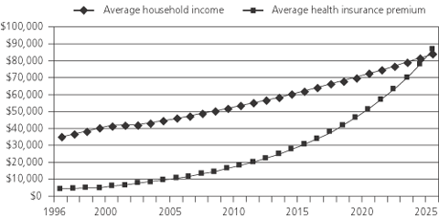
We Can’t Wait Another 16 Years! We Need Real Health Care Reform Before the Premium Takes All our Income!
Today
Source: American Family Physician, November 14, 2005

Slide 12
US Physicians Spend Nearly Four Times As Much Interacting With Payers as Canadians - 1 Potential Savings: US physicians could save approximately $27.6 billion per year if they had administrative costs similar to those of Ontario physicians. http://content.healthaffairs.org/content/30/8/1443.abstract Morra, et al, Helalth Affairs 2011
Comparison of US physician costs and time spent interacting with multiple insurance plans on claims, coverage, billing for patient care and medicine versus single payer interactions in Ontario, Canada…
Morra D, et al, Health Affairs, August 2011

Slide 13
US Physicians Spend Nearly Four Times As Much as Canadians Interacting With Payers - 2
Billing costs: US = $82,975 per physician per year Ontario = $22,205 per physician per year (27%)
Office staff time spent with payers: US - 20.6 hours per physician per week—nearly ten times that of Ontario.
Morra D, et al, Health Affairs, August 2011

Slide 14
US Physicians Spend Nearly Four Times As Much as Canadians Interacting With Payers - 3
If US physicians had administrative costs similar to those of Ontario physicians, the total savings would be approximately $27.6 billion per year.
Morra D, Health Affairs, August 2011

Slide 15
http://www.mindfully.org/Jonik/Big-Insurance-Jonik.htm

Slide 16
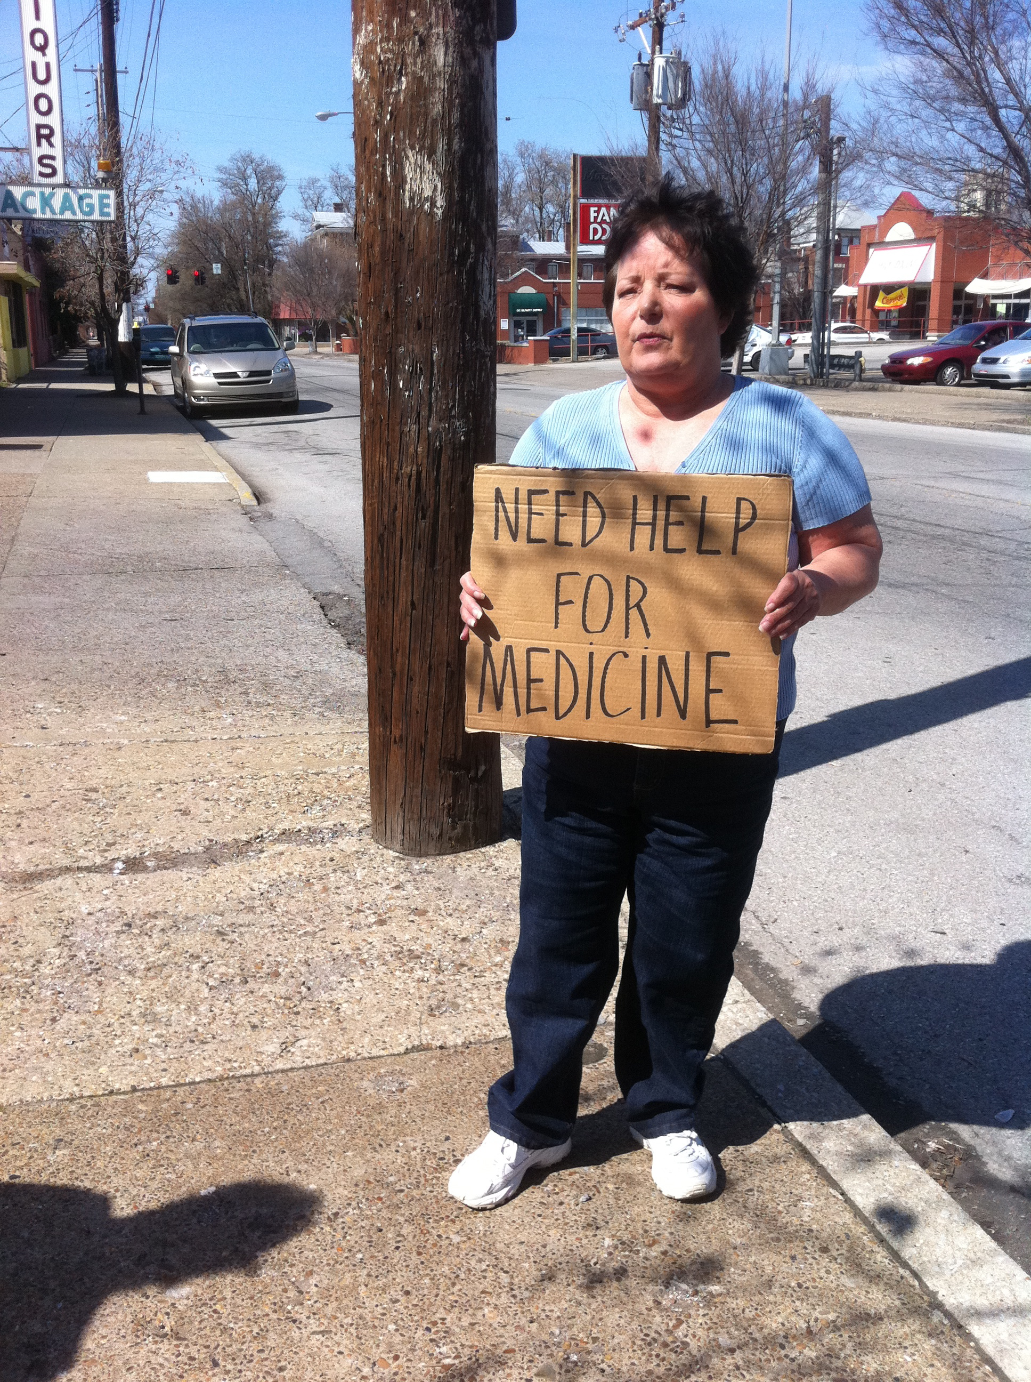

Slide 22
What would NHI look like?
Everyone gets a US NHI card
Comprehensive coverage for all medically necessary care, prescriptions, and home care. No premiums, deductibles, or co-pays
All health care is universal and guaranteed: Everyone is covered for life, regardless of health or employment
Free choice of doctor and hospital
Doctors and health care providers remain independent, deliver health care privately, reimbursed through fee-for-service, salary, etc. - negotiated with state board
Hospitals reimbursed by global budget based on previous year’s expenses - negotiable with state board
NHI processes and pays bills

Slide 23
National Health Insurance Board

Slide 24
PHYSICIANS FOR A NATIONAL HEALTH PROGRAM
29 EAST MADISON SUITE 602 CHICAGO, IL 60602 TEL: (312) 782-6006 WWW.PNHP.ORG

