Slide 1
The History of Opposition to NHI in the United States
October 24, 2009
Theodore M. Brown
Professor of History, Community and Preventive Medicine, and Medical Humanities at the University of Rochester

Slide 2
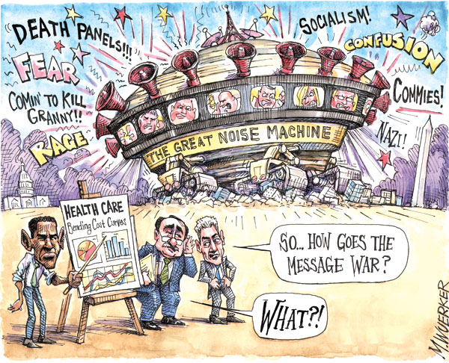

Slide 3
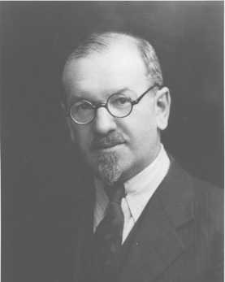
“Labor Insurance”
Isaac Max Rubinow, MD.
Journal of Political Economy. 1904; 12: 362-381.

Slide 4
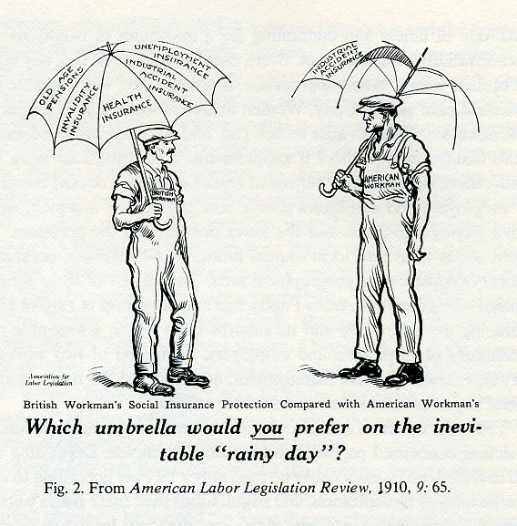

Slide 5
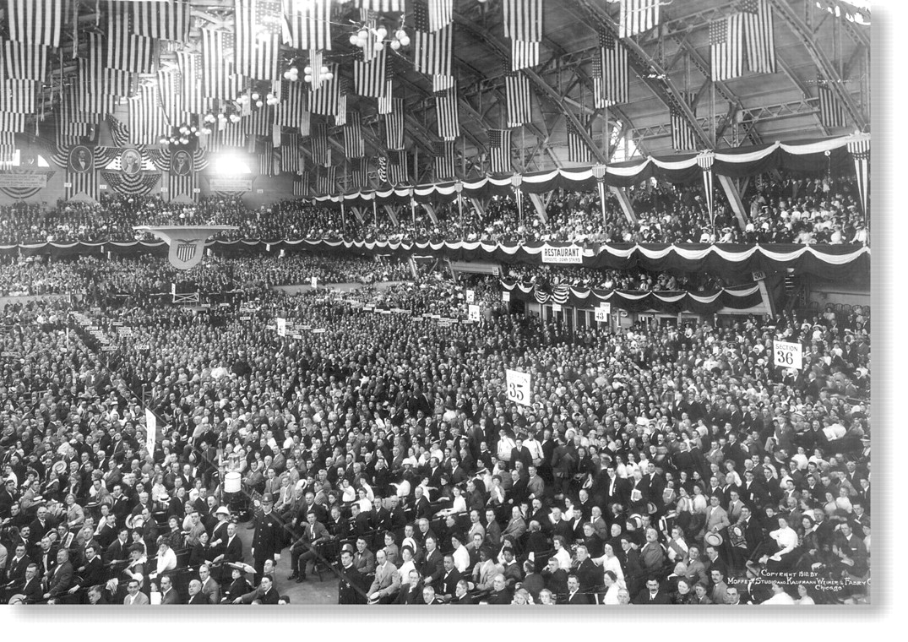
Progressive Party Convention in Chicago, 1912
Copyright ©2003 American Public Health Association

Slide 6
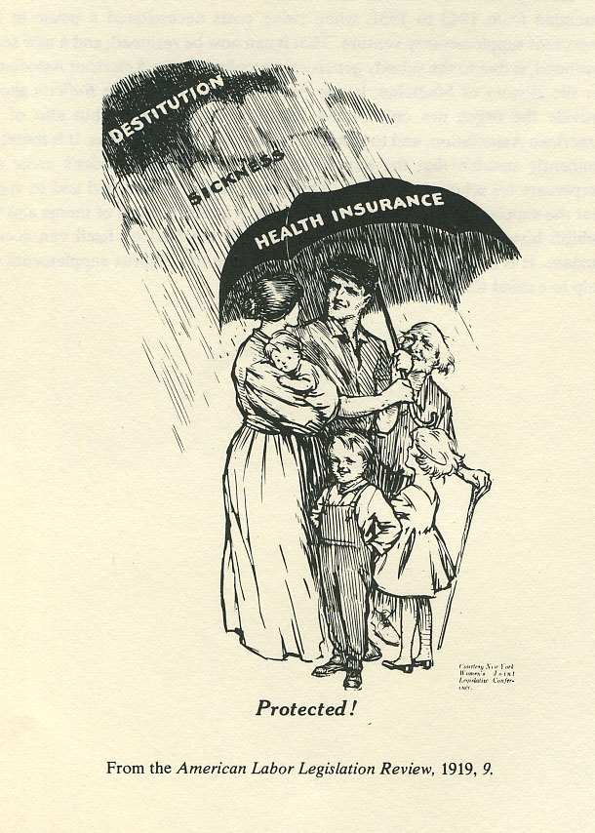

Slide 7
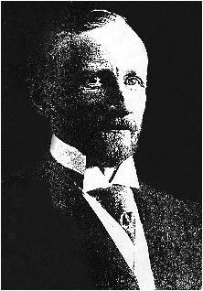
Frederick L. Hoffman

Slide 8
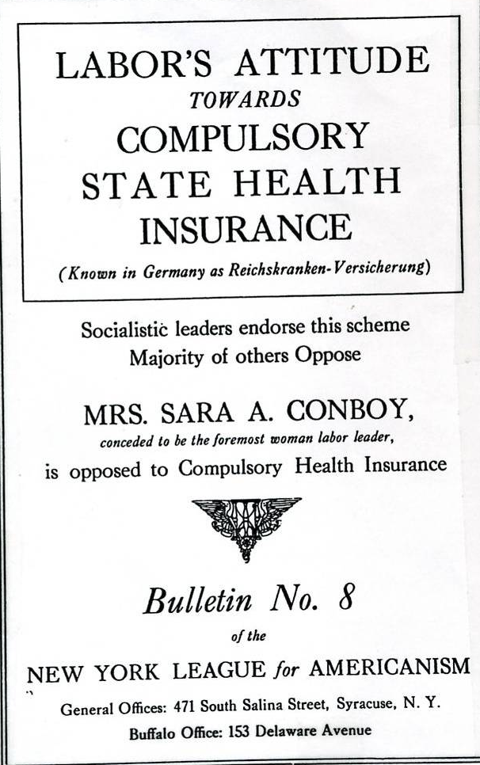

Slide 9
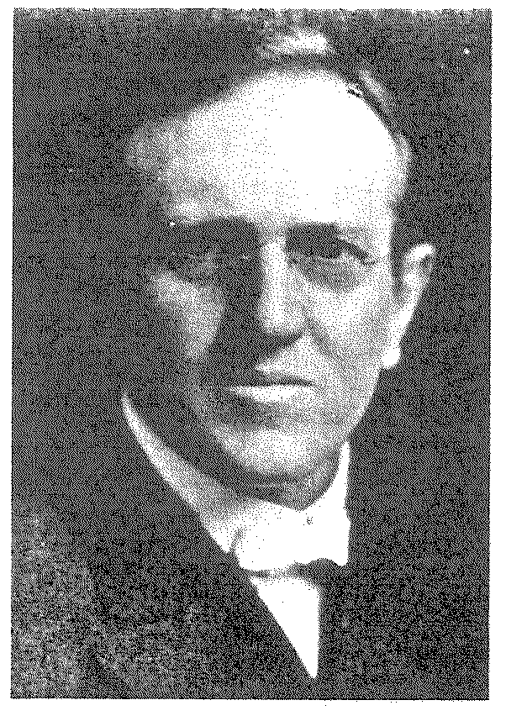
Edward H. Ochsner, MD
Representative of the Chicago Medical Society, and the only one opposed to compulsory health insurance in Dec, 1916 discussion

Slide 10
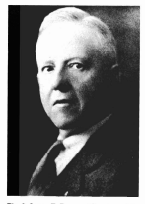
James F. Rooney, M.D.
Albany physician representing the NYS Medical Society

Slide 11
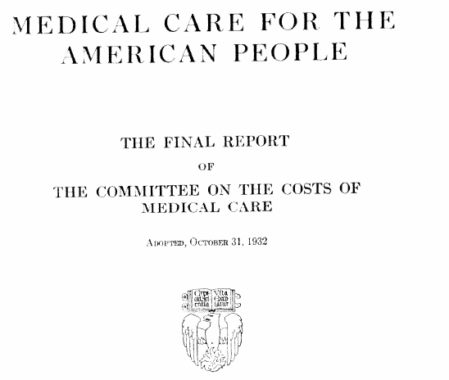

Slide 12

Saturday, December 3, 1932 EDITORIAL
THE COMMITTEE ON THE COSTS OF MEDICAL CARE
"The majority report recommends extension of all basic public health services to make them available to more and more people…. [by] forces representing public health officialdom, social theory – even socialism and communism – inciting to revolution…
The minority report views with alarm further invasion of governmental agencies into the practice of medicine. And what a curse such invasion has been! Who today fails to realize the menace inherent in the expansion of the Veterans' Bureau?
These two reports represent the difference between incitement to revolution and a desire for gradual evolution based on analysis and study, principles found through the centuries to be necessary for the sound practice of medicine…The physicians of this country must not be misled by utopian fantasies of a form of medical practice which would equalize all physicians by placing them in groups under one administration.
The Journal urges, after careful consideration, support of the minority report signed by the representatives of the AMA in the committee. "

Slide 13
Saturday, December 10, 1932 EDITORIAL
THE REPORT OF THE COMMITTEE ON THE COSTS OF MEDICAL CARE
"Physicians throughout the country are reacting vigorously and well-nigh unanimously against the recommendation of the majority report.
Intent on their daily and nightly task of preventing disease, healing the sick and ministering to the afflicted, they have given scant attention and little of their time to a consideration of the way in which their work was being invaded by the octopus of big business. Now the time has come when they can no longer overlook the problems created by this invasion.
There is, moreover, a far greater concern than the rights of the physician to practice as his knowledge and training indicate. There is the question of Americanism versus sovietism for the American people.
Let the efficiency engineers who would make doctors the cogs of their governmental machines give a little of their 60-horse-power brains to realization that Americans prefer to be human beings."

Slide 14
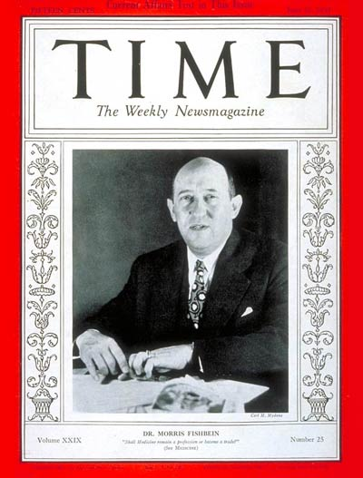

Slide 15

Socialized Medicine
By Morris Fishbein
April 25, 1928 Vol. 126(3277)
"The mechanization of medicine is an evil recognized by every physician as a menace to sound medical practice. Come what may, the intimate personal relationship of physician and patient is essential to complete relief of the patient's ills. Even the periodical physical examination is unsatisfactory when applied on an impersonal basis.
State medicine might provide a standardized diagnosis and treatment for a standardized citizen; but it means the death of individualism, of humanitarianism, and of scientific practice. Until we become a nation of robots with interlocking, replaceable and standardized parts, there will be little need of completely standardized doctors."

Slide 16
Who Fights Health Insurance?
By Geraldine Sartain
June 23, 1945
"The trade association of organized medicine, the American Medical Association has long been the spearhead in the fight against both compulsory national health insurance and state legislation providing the same benefits. It has now united with some drug manufacturers and casualty-insurance companies, and seeks to woo big business in general. In California the State Medical Society, with the help of chambers of commerce and other business groups, was able to bottle up in committee both Gov. Earl Warren's compulsory health-insurance bill and a similar bill put forward by organized labor.
The National Physicians' Committee for the Extension of Medical Service, sponsored by the AMA, has for some time been engaged in a double-barreled, three-year campaign, for which it is raising $1.5 million dollars to kill the Wagner-Murray-Dingell bill and to push health insurance coverage by commercial insurance companies."

Slide 17
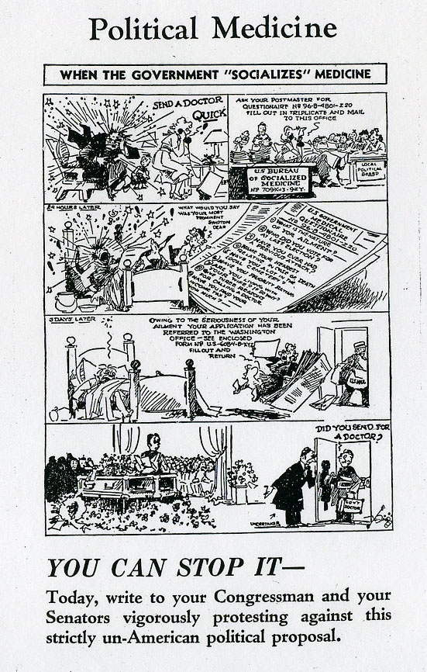

Slide 18
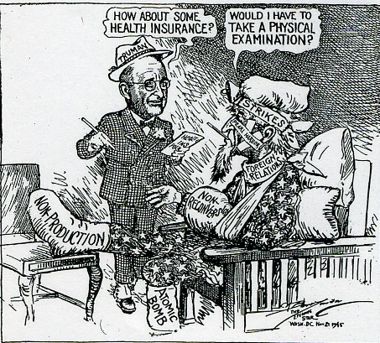

Slide 19
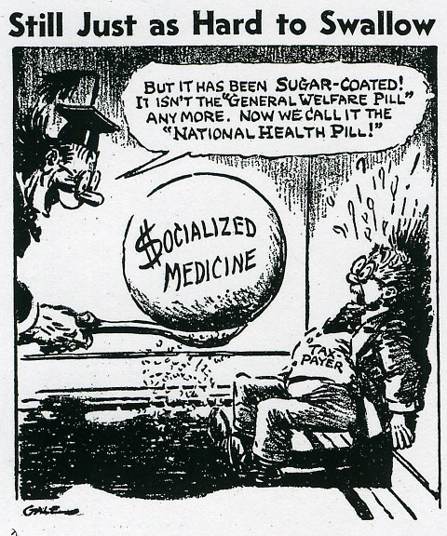

Slide 20
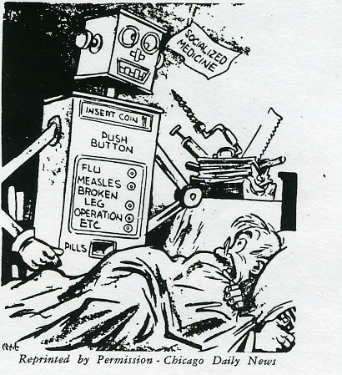

Slide 21
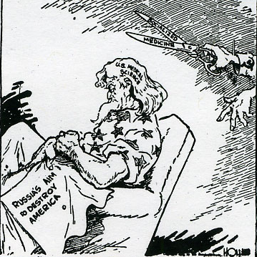

Slide 22
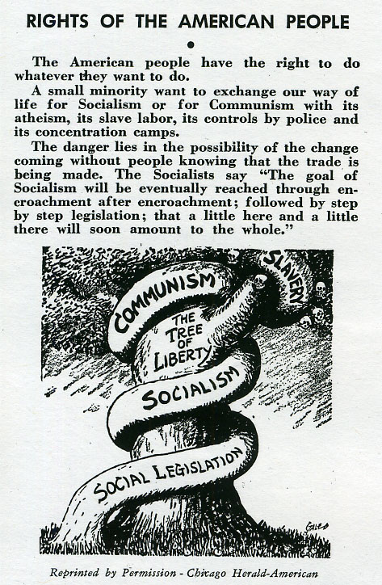

Slide 23
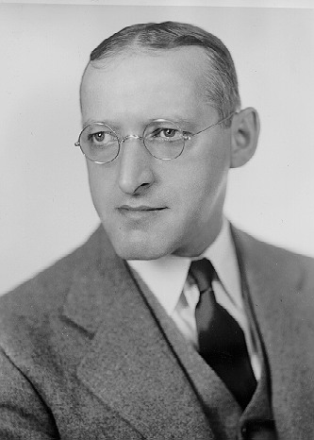
Isidore Sydney Falk

Slide 24
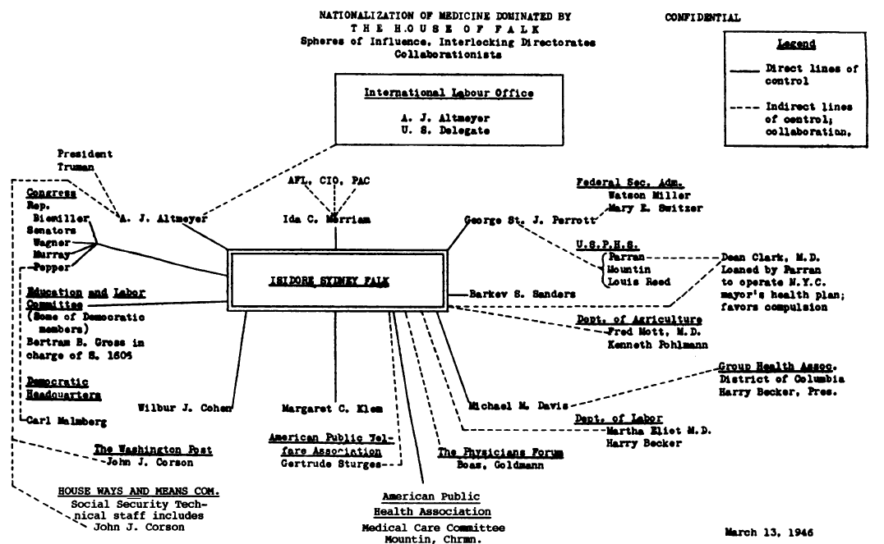

Slide 25
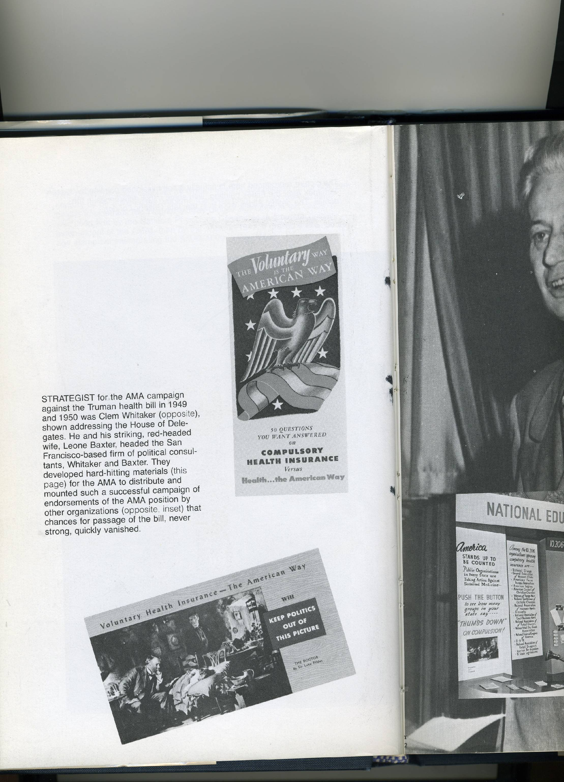

Slide 26
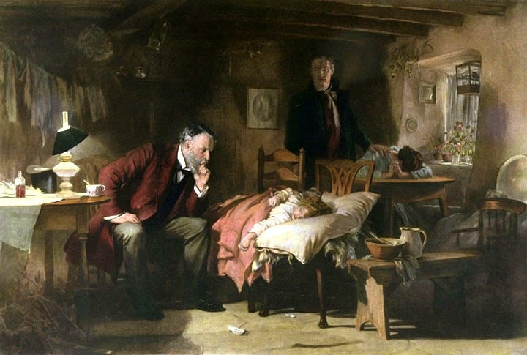

Slide 28
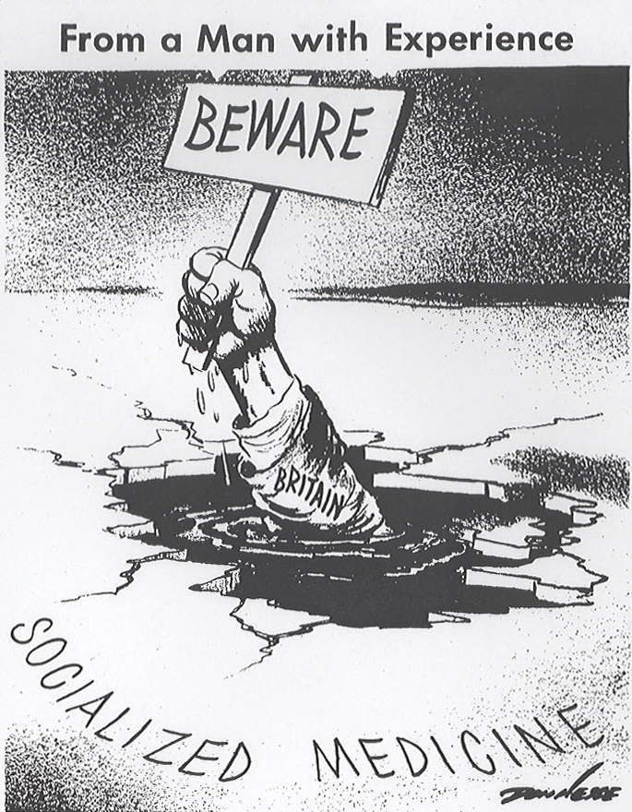

Slide 29
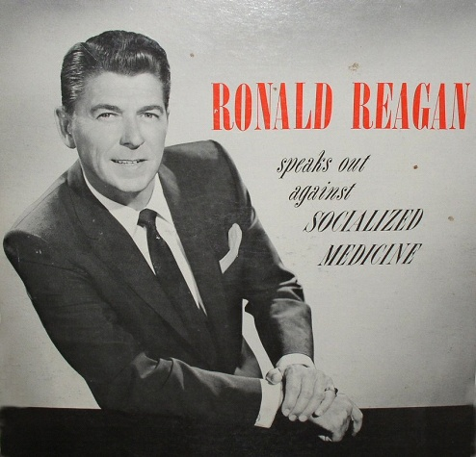

Slide 30
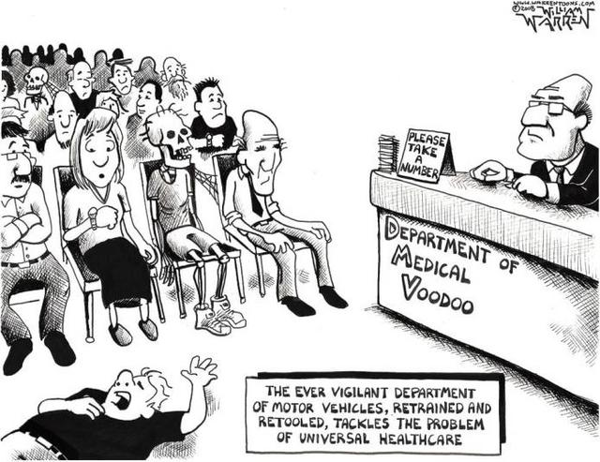

Slide 31
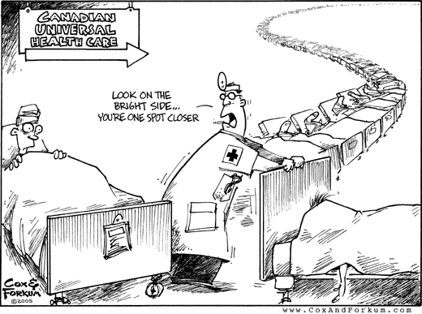

Slide 32
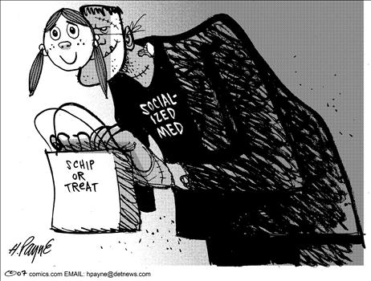

Slide 33
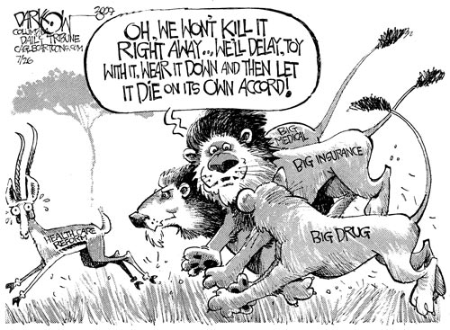

Slide 34
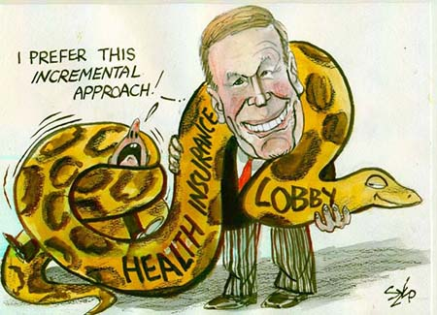

Slide 35
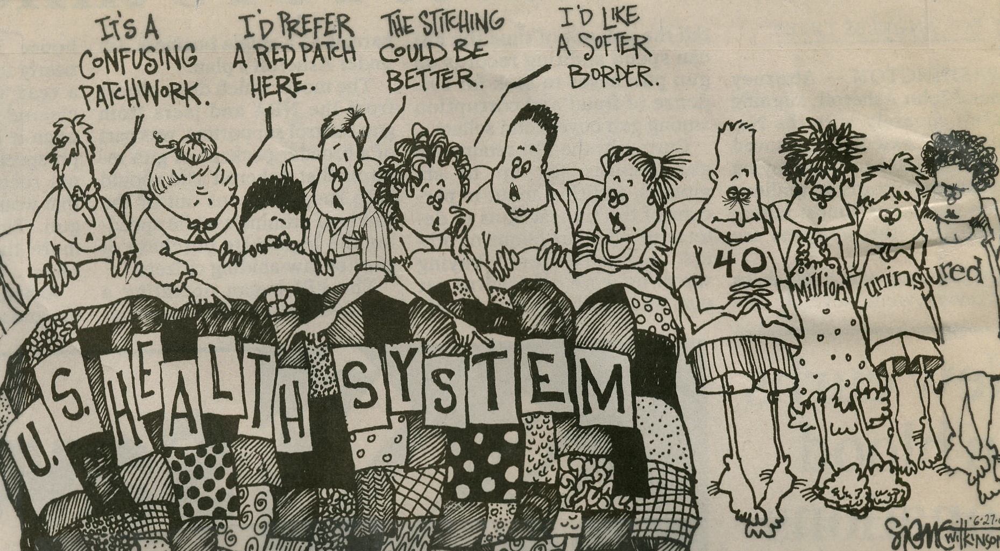
Crazy Quilt

Slide 36
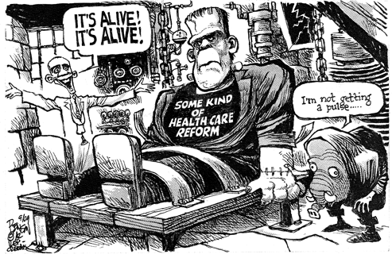

Slide 37
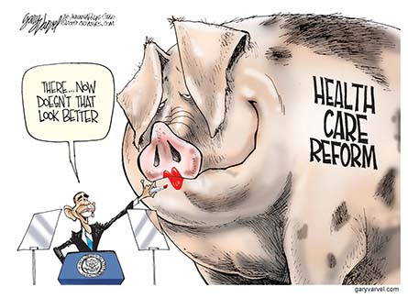

Slide 38
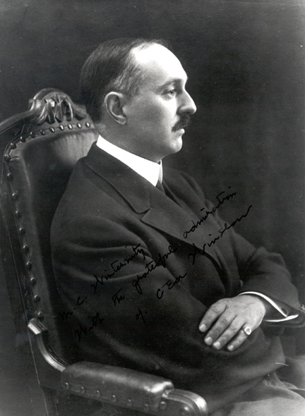
Charles - Edward A. Winslow

Slide 39
The habit of condemning any attempt at intelligent community action by labeling it as "socialistic" and "bureaucratic" is for example unworthy of serious-minded men. Some things are better done by the individual, some better by the state; and catchwords will not help us to determine to which class a given activity belong…..

Slide 40
….Whether we like it or not, however, the tendency of the times makes it clear that some form, or forms, of organized community medical service are coming, as surely as the sun will rise tomorrow.
While we hesitate and consider, the thing is happening all around us. If we place our heads in the sand like the ostrich, or if we emulate King Canute and order back the tides the inevitable will still occur.
C-EA Winslow. Public Health at the Crossroads.
Am Journal of Public Health. 1926. 16(11):1075

Slide 41
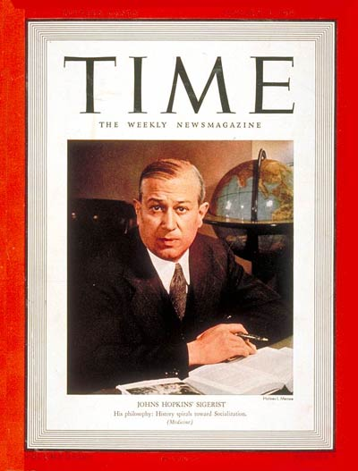

Slide 42
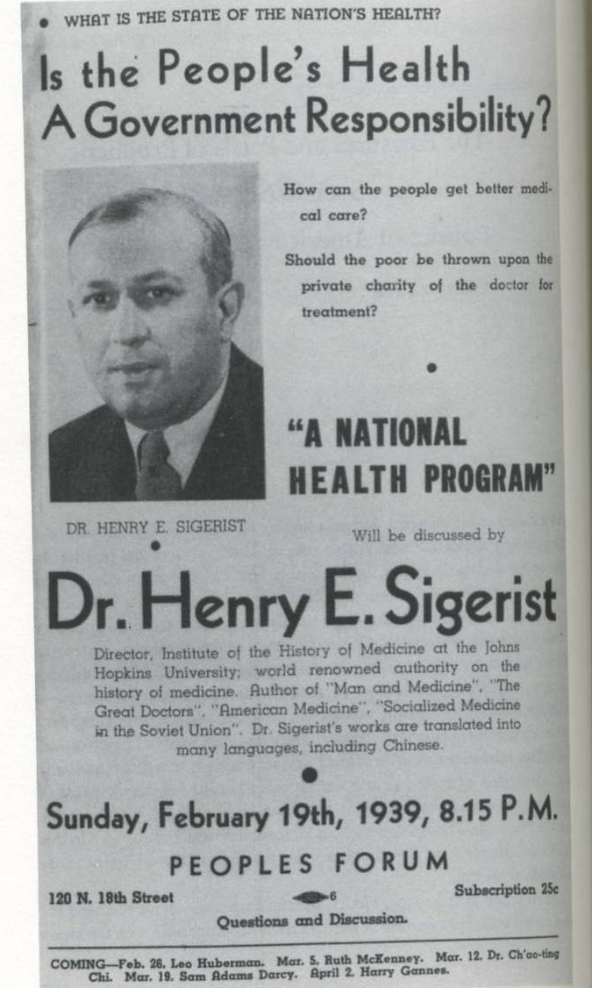

Slide 43
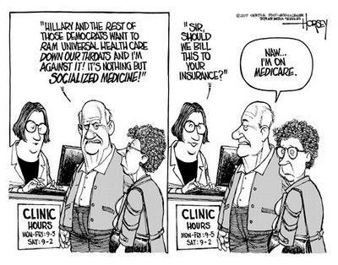

Slide 44
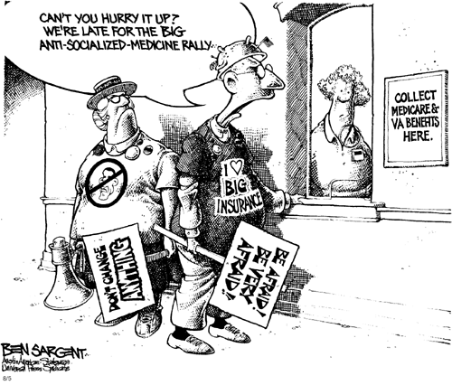

Slide 45
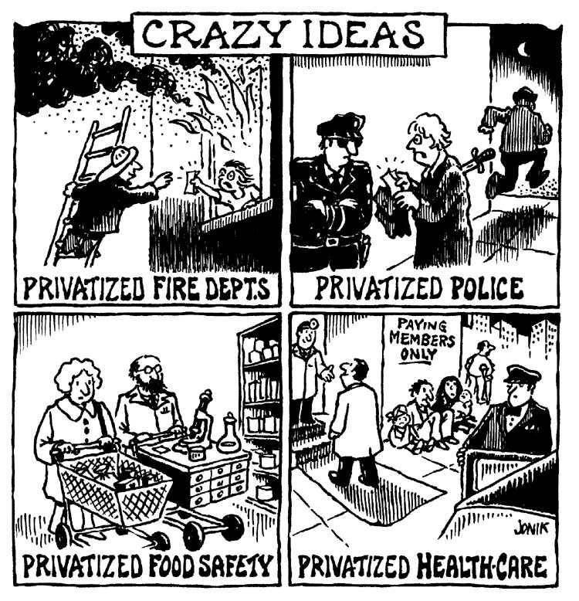

Slide 46
