Slide 1
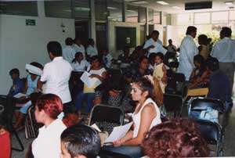
The Uninsured

Slide 2
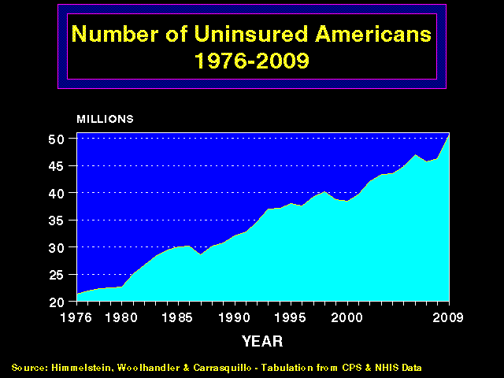
More and More
Uninsured Americans
50
45
40
35
30
25
20
Millions of Uninsured American
1976 | 1980 | 1985 | 1990 | 1995 | 2000 | 2005 | 2011
Source: Himmelstein, Woolhandler & Carrasquilo.
Tabulation from CPS & NHIS data

Slide 3
Uninsured Veterans
Percent of non-elderly Veterans with neither health insurance nor VA care
Source: Woolhandler & Himmelstein.
Analysis of Current Population Survey data.

Slide 4
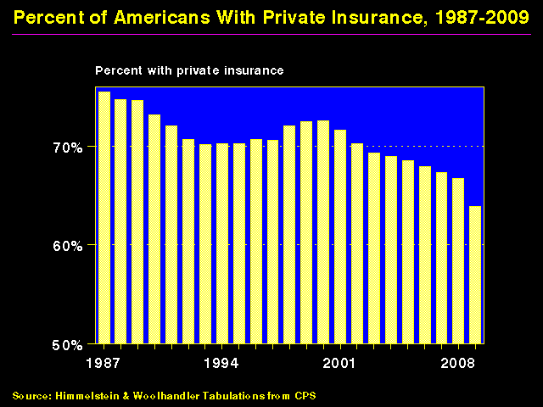
Shrinking Private Insurance, 1960-2011
80%
70%
60%
50%
Percent With Private Insurance
1960 | 1970 | 1980 | 1990 | 2000 | 2011
Source: Himmelstein, & Woolhandler, Tabulation from CPS
Data are not adjusted for minor changes in survey methodology

Slide 5
Shrinking Retiree Coverage
Share of large firms offering retiree health benefits
70%
60%
50%
40%
30%
20%
10%
0%
1988
1995
2000
2005
2011
Source: Kaiser/HRET Employer Survey, 2011

Slide 6
Full Time Jobs Provide
Little Protection for Hispanics
Percent of non-elderly in families with a full-time worker who are uninsured
Source: Commonwealth Fund, 3/2000

Slide 7
Chronically Ill Are Underinsured
Any of the below: 11.4 Million / 15.6%
16.6%
11.9%
15.5%
19.3%
15.4%
Percent with disease
and no insurance
16.1%
Millions of uninsured with disease
Source: Wilper et al. Annals Internal Medicine 2008;149:170.

Slide 8
Lack of Insurance
Kills 44,798 US Adults Annually
State | Percent Uninsured | Excess Deaths
California | 23.9% | 5,302
Texas | 29.7% | 4,675
Florida | 26.0% | 3,925
New York | 17.5% | 2,254
Georgia | 23.6% | 1,841
USA | 15.3% | 44,798
Source: Wilper et al. Am J Public Health 2009.
State tabulations by author

Slide 9

Uninsured Children:
Higher Inpatient Mortality
Adjusted* mortality rate
Source: Abdulah, et al. J Public Health, Oct. 29, 2009.
*Adjusted for gender, race, age, location,
hospital type, admission source

Slide 10
Medicaid Enrollment
50%
40%
30%
20%
10%
1990 | 1995 | 2000 | 2005 | 2010
Source: Bureau of the Census

Slide 11
Many Specialists Won’t See
Kids With Medicaid
% of Clinics Scheduling
Appointments for Children
Bisgaier J, Rhodes KV.
N Engl J Med 2011;364:2324-2333
Notes:
11
Figure 2 Clinics Scheduling Specialty Care Appointments for Children, According to Type of Insurance. Public insurance was reported by callers as the Illinois Medicaid–Children's Health Insurance Program (CHIP) umbrella program; private insurance was reported by callers as Blue Cross Blue Shield. Each of the 273 clinics was called twice (for a total of 546 calls) by the same caller, with only insurance coverage varying between the two calls: once reporting Medicaid–CHIP coverage and once reporting private coverage. Calls were made 1 month apart, and the order of the reported insurance status was randomly assigned. Asthma clinics included 38 allergy–immunology clinics and 6 pulmonary disease clinics.

Slide 12
Medicaid Improves Care
An RCT in Oregon
NBER Working Paper #17190, 2011

Slide 13
Suffering Among The Insured

Slide 14
Increasing Un- and Under- Insurance
Insured
Under-Insured
Uninsured
Commonwealth Fund, Sept. 8, 2011

Slide 15
Uninsured and Under-Insured
Delay Seeking Care for Heart Attacks
Odds ratio for delayed care*
Source: JAMA April 15, 2010. 303:1392
*Adjusted for age, sex, race, clin. charact., hlth status, social/psych fx, urban/rural. Under-insured=had coverage
but patient concerned about cost

Slide 16
Higher Medication Co-Pays =
Worse Asthma Outcomes
Children age 5-18
Source: JAMA 2012;307:1284

Slide 17
Breast Cancer Patients with Higher Copayments Less Likely to Take Aromatase Inhibitors
Odds ratio for continuing Aromatase Inhibitor
90-Day Medication Copayment
Source: J Clin Oncol 2011;29:2534

Slide 18
Medicare HMO Copayments Drive
Less Office Visits, More Hospitalizations
Difference between plans that did and didn’t raise copays
Outpatient Visits | Hospital Admissions | Hospital Days
Source: NEJM 2010;362:320
All figures are per 100 enrollees

Slide 19
Underinsurance = Poor Access + Financial Stress
Source: Commonwealth Fund, Sept, 2011.
*Skipped Rx, test, treatment, follow-up, or visit because of cost

Slide 20
Who Pays for Nursing Home Care?
Source: NCHS – figures are projected 2013

Slide 21
Most of the Medically Bankrupt Had Coverage
Insurance at Illness Onset
Source: Himmelstein et al. Am J Med: August, 2009

Slide 22



Even Congressmen Aren’t Protected
“Rep. Jackson and his wife have made the decision to sell their townhouse in Washington, DC to defray medical expenses Jackson has acquired for his depression and bipolar disorders.”

Slide 23

Planning for Retirement?
Don’t Forget Health Care Costs
“Medicare covers only 51% of health care services….
For a 65 year old couple retiring this year, the cost of health care in retirement will be $240,000.”
New York Times. Wealth Matters

Slide 24
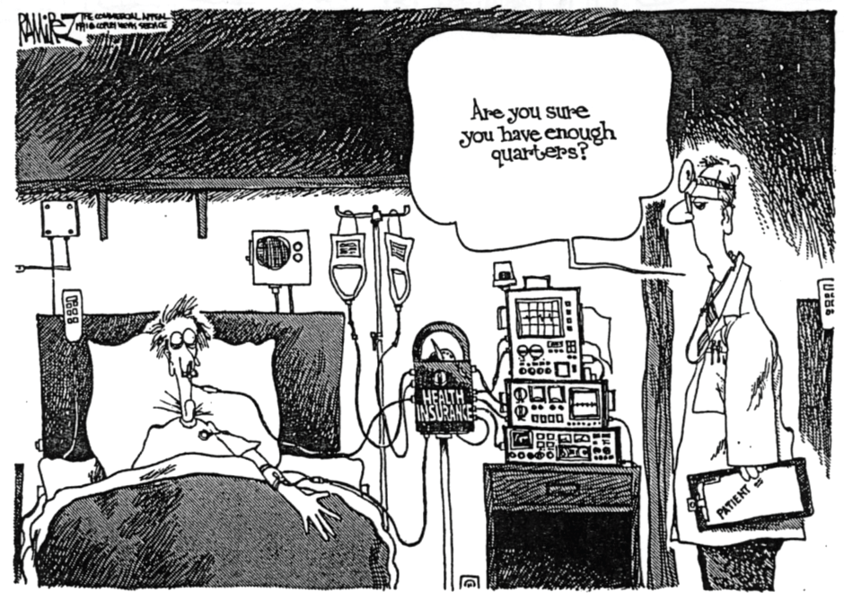
High Deductible Insurance
Except for the
healthy and wealthy,
it’s unwise.
Are you sure
you have
enough quarters?

Slide 25
Americans Lack Assets to
Pay High Deductibles
Median Net Financial Assets
Note: FPL = Federal Poverty Level
Source: Jacobs & Claxton. Health Affairs 2008;W:214

Slide 26
High Deductible Plans
Financial Suffering for the Chronically Ill
Percent of families with chronic conditions
Source: Health Affairs 2011;30:322
Note: High Deductible = >$1000
Note: “Can’t pay basic bills” refers to inability to pay other bills due to medical costs

Slide 27
Higher Copayments =
Kids Without Care
Percentage of children without physician visit in year
Source: Rand Experiment. Pediatrics 1985;75:942

Slide 28
High Deductible Health Plans:
A $1,000 Pay Cut for Women
Median Health Expenditure (2006)
Source: Woolhandler and Himmelstein – JGIM 6/07

Slide 29
Rising
Economic Inequality

Slide 30
Change in Real Family Income 1979-2011
Source: Bureau of the Census

Slide 31
Income of the Wealthiest 0.01%
As Multiple of Average Income, 1920-2008
700
600
500
400
300
200
100
1920 | 1930 | 1940 | 1950 | 1960 | 1970 | 1980 | 1990 | 2000
Includes capital gains
Source: Piketty & Saez, http://elsa.berkeley.edu/~saez/tabfig2005prel.xls

Slide 32
Widening Gap in Life Expectancy Between High and Low Earners
Remaining Life Expectancy for Men Turning 60
Waldron. ORES, Social Security Admin, #108, 2007

Slide 33
Labor’s Share
Of National Income Is Shrinking
65%
60%
55%
50%
45%
40%
Wages and salaries as percent of national income
1929
1970
2011
Source: US Commerce Department – “National Income by Type of Income”

Slide 34
Number of People in Poverty
50
40
30
20
10
Millions
1960 | 1970 | 1980 | 1990 | 2000 | 2011
Source: Census Bureau

Slide 35
Child Poverty Rates
Denmark
Sweden
France
Germany
Netherlands
UK
Canada
US
0% | 5% | 10% | 15% | 20% | 25%
Source: OECD 2011
Note: Figures are for 2009 or most recent available

Slide 36
Incarceration Rates
Prisoners per 100,000 population
Source: Walmsley – World Prison Population List, 9th Ed.

Slide 37

Persistent Racial Inequalities

Slide 38
Employment Discrimination
White felons get more job offers than Blacks with clean records
30%
20%
10%
0
Percentage called back for interview
White Applicants | Black Applicants
Clean record | Felony conviction
Researcher sent well-groomed Black and White college students to apply for jobs
All had identical resumes, except half listed a cocaine conviction
Source: New York Times 3/20/2004

Slide 39
Wealth and Income:
The White / Minority gap
Source: Census Bureau and Pew Center, 2011

Slide 40
Excess Deaths Among African Americans
83,369 fewer would have died in 2000 if racial gap were eliminated
Excess African American deaths
Source: Satcher et al. Health Affairs 2005;24:459

Slide 41
Causes of Black/White Disparity
In Life Expectancy
Source: MMWR 2001;50:780

Slide 42
Blacks Less Likely to Get
Voice Preservation Therapy
Odds ratio for receiving radiation therapy as initial treatment among laryngeal cancer patients
*Adjusted for age, year, sex, and tumor characteristics
Source: Arch Otolaryng-Head and Neck Surg 2012;138:644

Slide 43
Black Enrollment in US Medical Schools
20%
15%
10%
5%
AAMC Goal
%Blacks in 1st Year Class
1976 | 1981 | 1986 | 1991 | 1996 | 2001 | 2006 | 2011
Source: RWJ Fdn. 1987, AAMC, and
JAMA Annual Medical Education Special Issue

Slide 44
Physicians/Population by Race/Ethnicity
Physicians per 1000 population
Data are for 2008
Source: AMA and Census Bureau

Slide 45
Immigrants Get Little Care
Health Care
$ per capita
*Adjusted for ethnicity, poverty, age, insurance status, patient/parent-reported health status
Source: Mohanty et al. Am J Public Health 2005;95:1431

Slide 46
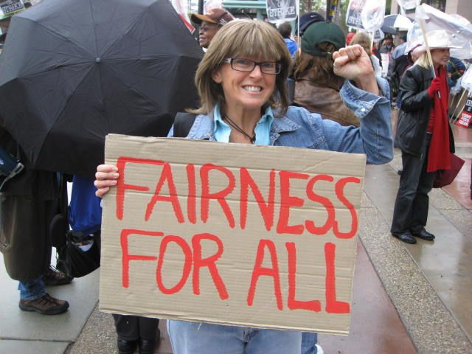
Rationing Amidst a Surplus of Care

Slide 47
Unnecessary Procedures
Percent of Procedures
Source: Commonwealth Fund.
Quality of Healthcare in the U.S. Chartbook 2002

Slide 48
22.5% of 111,707 Defibrillator Implants
Were Not Evidence-Based
Sometimes Lethal
Death rates 3.17 times higher (0.57% vs. 0.18%)
No improvement in rates over time
Note: In-hospital death rate for non-evidence-based ICD implantation was 0.6%. Cost of ICD implant ~$25,000
Source: JAMA 2011;305:43

Slide 49
Fewer CABGs, but More Hospitals are Competing to Perform This Lucrative Surgery
Source: Lucas F L et al. Health Aff 2011;30:1569-1574
Notes:
Number Of Bypass Surgeries Among Medicare Beneficiaries And Number Of Hospitals Performing Bypass Surgeries, 1993–2004

Slide 50
Most of the 301 New CABG Programs Opened Between 1993 and 2004 Were Duplicative
New General Programs
Distance from existing programs
New Specialty Programs
Distance from existing programs
Note: Cardiac services are lucrative, contributing 25-40% of hospitals’ net revenues
Note: States with CON programs experienced less duplication
Source: Health Affairs 2011;30:1569

Slide 51
Outcomes of New vs. Old
Hip/Knee Prosthetic Joints
28% of newly-introduced prostheses worsened outcomes
0% improved outcomes
Note: Comparison is to prostheses that had been available for >5 years
Source: J Bone Joint Surg 2011;suppl3(e):51-4.
Data from Australian Orthopedic Assoc.

Slide 52
Growth of Physicians and Administrators
3000%
2500%
2000%
1500%
1000%
500%
0
Growth Since 1970
1970 | 1980 | 1990 | 2000 | 2010
Physicians
Administrators
Source: Bureau of Labor Statistics; NCHS; Himmelstein/Woolhandler analysis of CPS

Slide 53
Rising Overhead of Malpractice Insurance
Doctors Pay a Lot, Patients Get Little
Percent of premiums paid to patients
Source: National Association of Insurance Commissioners
www.naic.org/documents/research_stats_medical_malpractice.pdf accessed 11/8/2012

Slide 54
Malpractice Is 2% of Healthcare Costs
Malpractice estimate includes 2008 cost of
Actual payouts
Administration
Legal
Defensive medicine
Dollars (billions)
Source: Health Affairs 2010;29:1569

Slide 55

ACOs:
A Rerun of the HMO Experience?

Slide 56
Why the ACO/HMO
Concept Resonates
Lots of redundant high tech facilities and useless, even harmful interventions
Neglect of primary care, public health, prevention, mental health
Lack of teamwork
Quality problems that need system solutions
Inadequate public accountability

Slide 57
HMO-ACO Logic
FFS is the problem;
But . . . small clinics and hospitals can’t bear risk,
Shifting risk creates incentive to deny care, so
Capitation (shifting insurance risk) is the solution.
Report cards and risk adjustment are necessary.
So consolidation is necessary.

Slide 58

Profit-Driven ACO’s:
A Cautionary Tale from Medicare HMOs

Slide 59
Can Seniors Make Informed HMO Choices?
Proportion with knowledge of how HMOs work
Note: Reading level needed to understand insurance policy descriptions = college
Source: AARP Survey – Health Affairs 1998;17(6):181
EBRI Notes 10/2006
Notes:
59

Slide 60
Medicare Enrollees
Choose Poorly Among Drug Plans
<16% enrolled in economically optimal Part D plan*
Note: Economically Optimal = Plan that minimized costs.
Analysis based upon 2008 data
Source: NBER 18166 – June, 2012
Notes:
60

Slide 61

“I just hope that when your mother is as old as I am
you’ll be able to help her figure out Medicare Part D”

Slide 62
Private Medicare Advantage Plans’
High Overhead
Overhead
per enrollee
2008
Source: US House Committee on Energy and Commerce. December, 2009

Slide 63
Despite Medicare’s lower overhead,
Enrollment of
Medicare Patients
In Private Plans
Has Grown

Slide 64
Medicare HMO Enrollment
14
12
10
8
6
4
2
0
Medicare HMO enrollment (Millions)
1985 | 1990 | 1995 | 2000 | 2005 | 2012
Source: CMS

Slide 65
A Few Sick People
Account for Most Health Dollars
Percent of total health spending accounted for by decile
Top 2 deciles account for 78.3%
Decile of Privately Insured
Source: MEPS Data, from Thorpe and Reinhart

Slide 66
Medicare HMOs:
The Healthy Go In, The Sick Go Out
Inpatient costs as percentage of FFS Medicare
High medical needs when they leave
Healthier patients join
Source: NEJM 1997;337:169

Slide 67
The Achilles Heel of Risk Adjustment, and hence ACOs and P4P:
Up-Coding
By maximizing the number
of coded diagnoses and comorbidities,
hospitals, doctors and HMOs/ACOs
can make their outcomes look better,
and when payment is risk adjusted,
make more money.

Slide 68
The Science of Making Patients Look Sicker on Paper
Up-Coding
No Extra Severity Payment |  | Equivalent but Extra Credit
Acute Kidney Insufficiency |  | Acute Renal Failure
Mg = 1.6 |  | Hypomagnesemia
Delirium |  | Encephalopathy
Anemia 2⁰ to GI Bleed |  | Anemia 2⁰ to Acute Blood Loss
Malnourished |  | Moderately Malnourished
COPD Exacerbation |  | Acute Respiratory Decompensation
Polysubstance Abuse |  | Continuing Polysubstance Abuse

Slide 69
Medicare’s Attempt to
Risk- Adjust HMO Payment
Pre-2004
HMOs were “cherry-picking” when payment adjusted only for age, sex and other demographics
Starting in 2004
Risk adjustment formula
added 70 diagnoses

Slide 70
Risk Adjustment Increased
Medicare HMO Overpayment
$4,000
$3,000
$2,000
$1,000
0
Overpayments
due to
Cherry Picking
Overpayment to HMOs per Medicare Enrollee
Congress-mandated overpayments
Payments adjusted for age, sex, and ESRD
Same plus 70 diagnoses adjusted
Actual impact of 2004 change in Risk Adjustment formula
Source: NBER Working Paper 16799, April 2011

Slide 71
How Could a Medicare HMO
Profit on CHF Patients?
A CHF diagnosis increases the HMO’s capitation rate by 41%
Among Fee-for-Service Medicare enrollees with CHF:
    The costliest 5% averaged > $37,000/year
    The least costly 5% averaged $115/year
Universal echocardiogram screening would label many asymptomatic seniors as having CHF
Source: MedPAC data for 2008

Slide 72
Patients in High-Cost Regions
Are Labeled with More Diagnoses
Percent increase in number of diagnoses over 7 years
High-cost providers
ferret out more diagnoses and gain from risk adjustment
*Patient moved to region with lower average Medicare cost/intensity
**Patient moved to region with higher average Medicare cost/intensity
Source: Song Y et al. NEJM 2010;363:45

Slide 73
VA Subsidizes Medicare HMOs
Medicare pays the plan, VA delivers the care, nobody pays the VA
$3 billion
$2 billion
$1 billion
Annual uncompensated cost to VA of care for Medicare HMO enrollees
2004 | 2005 | 2006 | 2007 | 2008 | 2009
Note: VA cost for Medicare HMO patients’ care = 10% of VA budget in 2009
Source: Trivedi et al. JAMA 2012;308:67

Slide 74
Medicare Overpays HMOs
Overpayments Total $283 Billion Since 1985
$40
$30
$20
$10
Medicare HMO overpayments as compared to FFS costs for similar patients ($Billion)
1985 | 1990 | 1995 | 2000 | 2005 | 2012
VA
Cherry Picking
Legislated
PNHP Report 10/2012 based on data from MedPAC, Commonwealth Fund, Trivedi et al.
VA = Cost of VA uncompensated care provided to Medicare HMO enrollees
Legislated = Congressionally-mandated excess payments to Medicare HMOs

Slide 75
Failure of Medicare HMO Risk Adjustment
Implications
For ACOs
Resources transferred from sick to healthy
Biggest cheaters are biggest winners, undermines ethical behavior
ACOs that embrace problem patients driven from the market
No net savings, probable increased costs
More risk adjustment leads to MORE, not less cherry picking – i.e. selecting healthier patients within each risk stratum
Intensive coding makes patients appear sicker on paper, ups risk-adjusted capitation fee and factitiously raises quality scores
ACOs that fail to cherry pick or intensify coding will get low payments, and factitiously poor quality scores
Risk Adjustment
Intensive Coding
Impact on ACOs

Slide 76
Profit-Driven Up-coding Makes
Accurate Risk Adjustment Impossible
High cost providers inflate both reimbursement and quality scores by making patients look sicker on paper

Slide 77
Risk Adjustment Increased
Medicare HMO Overpayment
25%
20%
15%
10%
5%
Annual Increase
3637%
2254%
1970 | 1980 | 1990 | 2000 | 2010
Medicare
Private Insurance
National Health Accounts – Historical Series, Table 16

Slide 78
Predicting the Impact of ACOs
Track record of HMOs
Results of Medicare’s Physician Group Practice Demonstration, 2005-2010
Evidence on tools ACOs likely to use:
  Prevention and Disease Management
  “Care Coordination”
  Report Cards and P4P schemes
  Electronic Medical Records

Slide 79
High Risk HMO Patients
Fared Poorly in the RAND Experiment
HMO
Free Fee-For-Service
Source: RAND Health Insurance Experiment, Lancet 1988;1:1017
Note: High Risk = 20% of population with lowest income
+ highest medical risk

Slide 80
Depressed Patients:
Fee-For-Service vs. Managed Care
Primary Care Patients
Patients Seeing Psychiatrist
# of Functional Limitations
Fee-For-Service
Managed Care
Source: Medical Outcomes Study. JAMA 1989; 262:3298
Arch Gen Psych 1993; 50:517

Slide 81
Investor-Owned HMOs
Provide Lower Quality of Care
Source: Himmelstein, Woolhandler & Wolfe.
JAMA 1999; 282:159

Slide 82
For-Profit Medicare HMOs:
Worse Quality Rheumatoid Arthritis Care
Percent of RA patients who received a DMARD
DMARD = Disease Modifying Agent
Receipt of DMARD is a HEDIS measure
Source: JAMA 2011;305:480

Slide 83
Investor-Owned Medicaid HMOs:
Higher Administrative Costs, Lower Quality
Note: Publicly Traded = Publicly traded Medicaid-only plans
Source: McCue. Commonwealth Fund, June, 2011

Slide 84
US Healthcare Physician Gag Clause
“Each physician must be supportive of the philosophy and concept of U.S. Healthcare.”
“Physician shall agree not to take any action or make any communication which undermines or could undermine the confidence of enrollees, potential enrollees, their employers, their unions, or the public in U.S. Healthcare or the quality of U.S. Healthcare coverage.”
“Physician shall keep the Proprietary Information (payment rates, utilization review procedures, etc.) and This Agreement strictly confidential.”
Source: US Healthcare 1994 Physician Contract

Slide 85

Doctors Urged to Shun the Sick
Letter to faculty from University of California Irvine Hospital Chief
“[We can] no longer tolerate patients with complex and expensive-to-treat conditions being encouraged
to transfer to our group.”
Source: Modern Healthcare 9/21/95:172

Slide 86


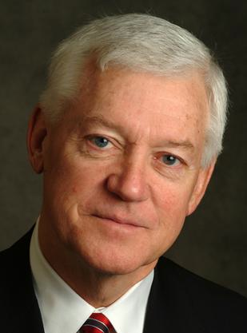

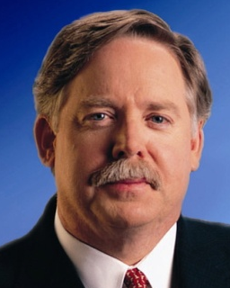
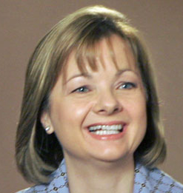
HMO CEO’s 2011 Pay
David Cordani
Mark Bertolini
Allen Wise
Cigna
$19.1 Million
Aetna
$10.6 Million
Coventry
$13.0
Million
Steve Hemsley
Michael McCallister
Angela Braly
United HC
$13.4 Million
Humana
$7.3 Million
Wellpoint
$13.3 Million
Source: AFL/CIO CEO Pay database

Slide 87
HMO Overhead, 2012
SEC Filings/Reports to Shareholders. Data for Q1 or Q2
Calculated as 100% – Medical Loss Ratio
Note Medicare/Medicaid enrollees included in some figures

Slide 88
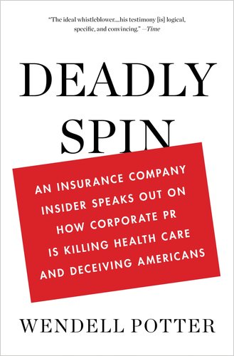
Spinning the Research Findings
On ACO Costs

Slide 89
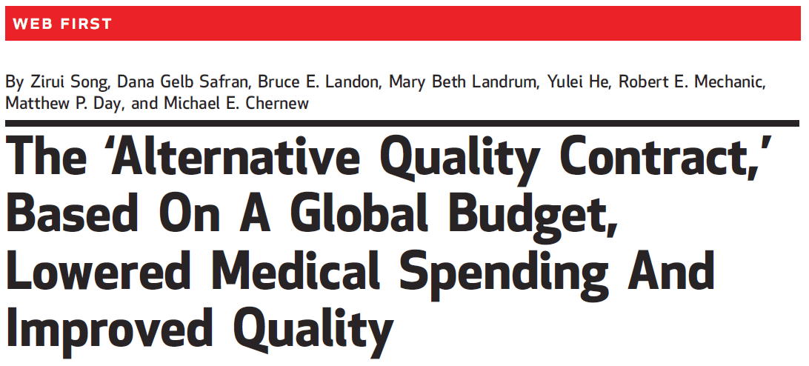
The Headline
On Massachusetts ACO Results
“Overall, participation in the contract over two years led to savings of 2.8% (1.9% in year 1 and 3.3% in year 2).
Source: Song et al. Health Affairs 2012;31:1885

Slide 90
But Buried in the Text
“Our findings do not imply that overall spending fell. . . . [because] ten of the eleven organizations [earned] a budget surplus payment. . . .
“All organizations earned a 2010 quality bonus, and most received infrastructure support.
“This result makes it likely that total Blue Cross Blue Shield payments to groups in 2010 exceeded medical savings.”
Source: Song et al. Health Affairs 2012;31:1885

Slide 91
Medicare’s PGP/ACO Demo. Project:
Gaming, But No Savings
“The model for the ACO program… has been tested in the PGP Demonstration Project…
“Diagnosis coding changes the PGP sites initiated… produced apparent savings that resulted in shared savings payments to some of the demonstration sites, but not actually fewer dollars spent”
Berenson RA. Am J. Managed Care, 2010; 16:721-726.

Slide 92
JAMA Analysis of ACO Demonstration
Omitted the Bonuses Paid to ACOs
Average annual increase in Medicare payment/beneficiary
$1,296
$1,230
$1,206
$1,230
FFS Payments
Bonuses
*LVCs=incident stroke, MI, hip fracture, colon cancer
Source: Colla et al. JAMA 2012;308:1015

Slide 93
ACOs = Medical Practices Owned by
Corporate Oligopolies

Slide 94
For-Profit HMOs Increasingly Dominant
75%
50%
25%
0
% of HMO Enrollment as For-Profit
1980
1985 | 1990 | 1995 | 2000
2003
Source: Interstudy

Slide 95
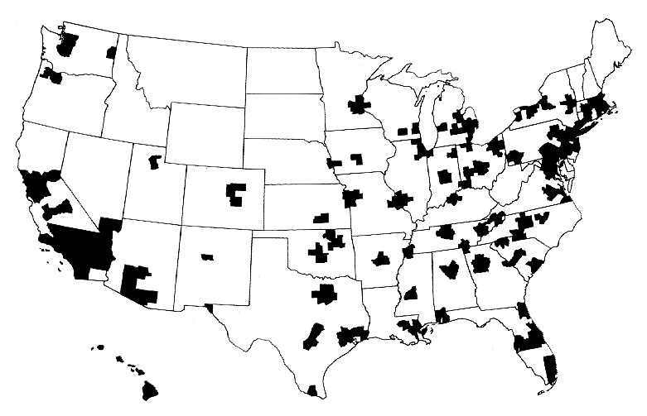
Half of Americans Live Where
Population Is Too Low for Competition
A town’s only hospital will not compete with itself
Highlighted areas are health markets with populations greater than 360,000
Source: Kronick R et al. N Engl J Med 1993;328:148-152.

Slide 96
Insurers Morphing into ACOs:
Purchases of Clinics and Practices, 2011
UnitedHealth bought Monarch Healthcare – a Pioneer Medicare ACO with 2,300 physicians
Wellpoint paid $800 million for CareMore – a chain of 28 clinics with employed physicians
Humana purchased SeniorBridge – an in-home care manager with 1500 providers - and Concentra for $790 million – an urgent care and occupational health clinic firm
Source: Business Insurance, 1/15/12

Slide 97
More Doctors Are
Hospital Employees
Percent of newly hired physicians employed by hospitals
Source: Medscape July 9, 2012

Slide 98
Fees Rise
When Hospitals Buy Practices
Medicare payment
Source: Wall Street Journal. Aug. 27, 2012

Slide 99
ACO Cost-Cutting Armamentarium
Prevention
Disease management
“Care Coordination”
  Consolidation
  Gate-keeping
  Utilization Review
Electronic medical records
Report cards and P-4-P

Slide 100
Prevention Saves Lives,
But Not Money
“Although some preventive services do save money, the vast majority reviewed in the health economics literature do not.”
Cohen JT et al,
NEJM, 2008;358:661-663
“It’s a nice thing to think, and it seems like it should be true, but I don’t know of any evidence that preventive care actually saves money.”
Gruber J, quoted in
“Free lunch on health? Think again,”
NY Times, August 8, 2007: C 2.

Slide 101
Chronic Disease Management, Randomized Controlled Trial
No Savings at 14 of 15 Sites
Change in total Medicare expenditures, intervention vs. control group
15 Independent Sites
Source: JAMA 2009;301:603

Slide 102
EMR: No Savings on Diagnostic Tests
Odds ratio of test ordering, MDs with electronic access to result vs no electronic access
1.7
1.4
1.2
Source: McCormick, Bor, Woolhandler, Himmelstein. Health Affairs 2012;31:488

Slide 103
Hospitals That Got Federal HIT Bonuses Raised ED Billings: EMRs Facilitate Upcoding
50%
40%
30%
20%
10%
+47%
Annual increase in claims coded at the highest levels
Hospitals receiving incentives for electronic recordkeeping
+32%
Other hospitals
2006 | 2007 | 2008 | 2009 | 2010
Source: NY Times 9/21/12

Slide 104
EMRs Have No Impact
On Mortality, Cost, or Efficiency
30-day Adjusted Death Rate
Observed/Expected Cost
No impact on death rates
No impact
on cost
Comprehensive EMR
Basic EMR
No EMR
Data from 3,049 hospitals
Source: DesRoches, C et al. Health Affairs 29, No. 4 (2010):639-646.

Slide 105
Medical Homes and Enhanced Primary Care
Do Not Require ACOs
Medical Homes” that integrate more nurses, social workers etc. into primary care and cut physicians’ panel size may improve care and reduce ED and inpatient utilization, possibly enough to offset the additional personnel costs.
This intervention does not require
recycling the HMO experiment.

Slide 106
Assumptions Implicit in
“Pay for Performance” (“P4P”)
1. Performance can be accurately ascertained
2. Individual variation is caused by variation in motivation
3. Financial incentives will add to intrinsic motivation
4. Current payment system is too simple
5. Hospitals/MDs delivering poor quality care should get fewer resources

Slide 107
Performance Can Be Accurately Ascertained
P4P Assumption #1
The variance attributable to an
individual doctor
can be clearly identified
(as opposed to his or her patients and
the circumstances surrounding the work),
and will not and cannot be gamed.

Slide 108
Quality Scores Tell More About Patients than Physicians
Harvard physicians with poorer/minority patients score low
Patient characteristics in panels of
high- and low-scoring physicians
Source: Hong C et al. JAMA 9/8/2010. 304:10;1107.

Slide 109
Hospitals Scoring Higher on Leapfrog Quality Measures Have No Lower Mortality
Safe Practice Score Quartile
Note: Analyses of high risk patients, those >65, and other leapfrog measures yielded same results
Source: JAMA 2009;301:1341

Slide 110
Individual Variation Is Caused by
Variation in Motivation
P4P Assumption #2
Poor performance
is a matter of intention.
Change in motivation
is therefore likely
to improve performance.
If poor performance
is not “willed”, incentives
cannot change it.

Slide 111
Financial Incentives
Will Add to Intrinsic Motivation
P4P Assumption #3
If financial incentives undermine
intrinsic motivation
they may actually
worsen performance.

Slide 112
P4P Can Dissociate
People From Their Work
“I do not think it’s true that the way to get better doctoring and better nursing is to put money on the table in front of doctors and nurses. I think that's a fundamental misunderstanding of human motivation.
“I think people respond to joy and work and love and achievement and learning and appreciation and gratitude - and a sense of a job well done. I think that it feels good to be a doctor and better to be a better doctor.
“When we begin to attach dollar amounts to throughputs and to individual pay we are playing with fire. The first and most important effect of that may be to begin to dissociate people from their work.”
Source: Health Affairs 1/12/2005
Don Berwick, M.D.

Slide 113
Money Undermines Altruism
A Randomized Controlled Trial in Blood Banking
Percent responding to a call for blood donation
Source: Upton WE. Altruisim, Attribution,
and Intrinsic Motivation in the Recruitment of Blood Donors

Slide 114
Medicare’s Premier Demonstration:
A P4P Failure at 252 Hospitals
Worse
5-year outcomes show no effect on mortality
Change from baseline in 30-day mortality
Better
Note: P4P failed even among poor performers at baseline
Source: NEJM march 28, 2012

Slide 115
P4P Among UK Primary Care Doctors
Multiple quality parameters were documented using a computerized medical record and summed in a point system.
Virtually all practices achieved most of the quality points within one year of implementation
Generated a much welcomed 25% increase in GP incomes
Source: NEJM 7/23/2009:368

Slide 116
P4P: Scores on Whatever You Pay for Improves, but…
“The [British P4P] scheme accelerated improvements in quality for 2 of 3 chronic conditions in the short term.
“However, once targets were reached, the improvement . . . slowed, and the quality of care declined for 2 conditions that had not been linked to incentives.”
Source: NEJM 7/23/2009:368

Slide 117
High P4P Scores, But No Improvement
In HTN Outcomes in UK
20%
16%
12%
8%
4%
0
Pay for Performance Introduced
Composite end point of all-cause mortality and adverse HTN-related outcomes
Jan 2001 | Jun 2001 | Oct 2003 | Mar 2005 | Jul 2006
Note: HTN-related adverse outcomes = MI, CVA, kidney failure, CHF Source: Serumaga. BMJ 2011;342:d108

Slide 118

A $75 Million RCT of P4P in
New York City Schools
200 high-needs New York City schools employing more than 20,000 teachers.
Incentives of up to $3,000 per teacher
Based on students’ test scores, graduation and attendance rates, and learning environment surveys.
Source: Fryer RG. Teacher incentives and student achievement: evidence from New York City public schools. NBER Working Paper No 16850. Cambridge, MA: National Bureau of Economic Research, March, 2011.

Slide 119
P4P for Teachers Lowered Test Scores
Results of an RCT
.10
.05
0
-.05
-.10
-.15
-.20
Change in baseline vs controls (Standard deviations)
Elementary Math | Elementary Reading | Middle School Math | Middle School Reading
One Year
Three Years
Source: Fryer RG. Teacher incentives and student achievement: evidence from New York City public schools. NBER Working Paper No 16850. Cambridge, MA: National Bureau of Economic Research, March, 2011.

Slide 120
High P4P Scores, But No Real Improvement in Hypertension in the UK
200
160
120
80
40
0
Pay for Performance Introduced
Systolic blood pressure
120
100
80
60
40
20
0
Diastolic blood pressure
1 | 3 | 5 | 7 | 9 | 11 | 13 | 15 | 17 | 19 | 21 | 23
Quarter
Blood pressure in mmHG
Source: Serumaga. BMJ 2011;342:d108

Slide 121

Cochrane Review of
“Paying for Performance”
“We found no evidence
that financial incentives
can improve patient outcomes.”
July 6, 2011
Flodgren et al. “An overview of reviews evaluating the effectiveness of financial incentives in changing healthcare professional behaviors and patient outcomes.

Slide 122
ACOs and P4P
Implementation Without Evidence
P4P is official Medicare policy, widely adopted by private payers
    No RCTs showing improved outcomes.
    No improvement in largest demonstration project.
    Concern about negative side effects.
ACOs are the newest health policy panacea
    No RCTs
    No savings in largest demonstration project.
    Disturbing HMO experience.
Implementing everywhere interventions
– which have been proven nowhere –
risks failure on a colossal scale

Slide 123
ACOs and HMOs:
Faith-Based Solutions
Capitation as magic bullet
Consolidation among providers cuts costs
Prevention, care management & EMR/computers save money
Risk adjustment can overcome gaming (up-coding of diagnoses)
P-4-P encourages global quality

Slide 124
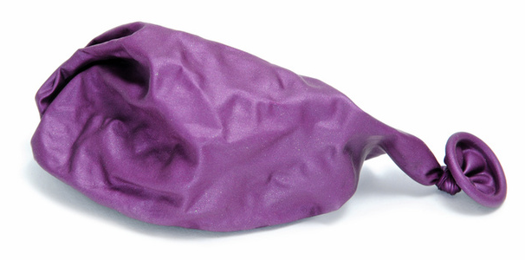
Investor-Owned Care:
Inflated Costs,
Inferior Quality

Slide 125
Extent of For-Profit Ownership
For-Profit Firms’ Share of Total Revenue
*Data are for share of establishments
Source: Commerce Department, Service Annual Survey 2009
Health Af 2012;31:1286

Slide 126
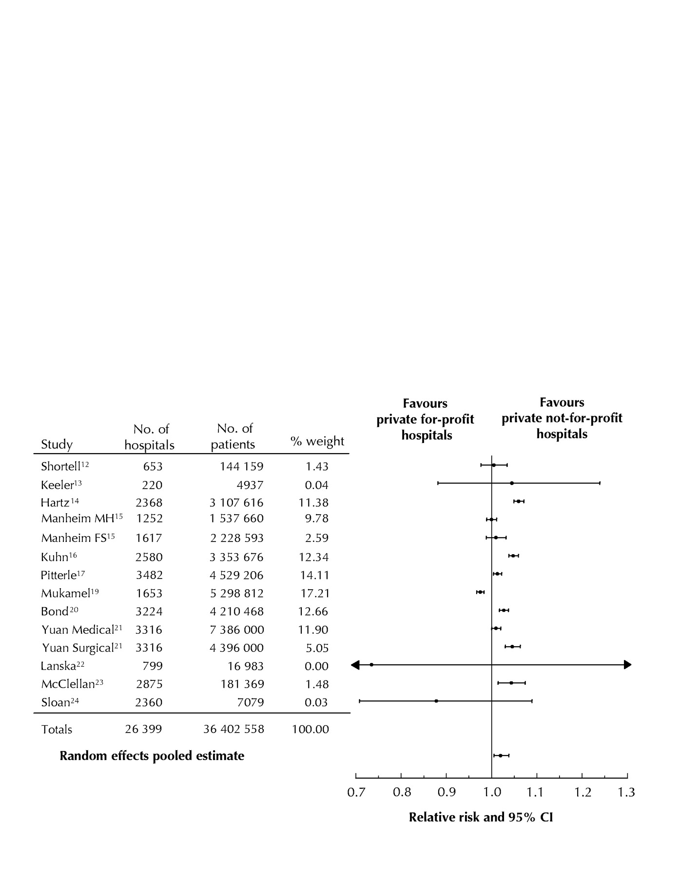
For-Profit Hospitals’
Death Rates Are 2% Higher
Favors
for-profit hospitals
Favors
not-for-profit hospitals
Relative risk and 95% CI
Relative risk of hospital mortality for adult patients in private for-profit hospitals relative to private not-for-profit hospitals
Source: CMAJ Devereaux et al. 166 (11): 1399.

Slide 127
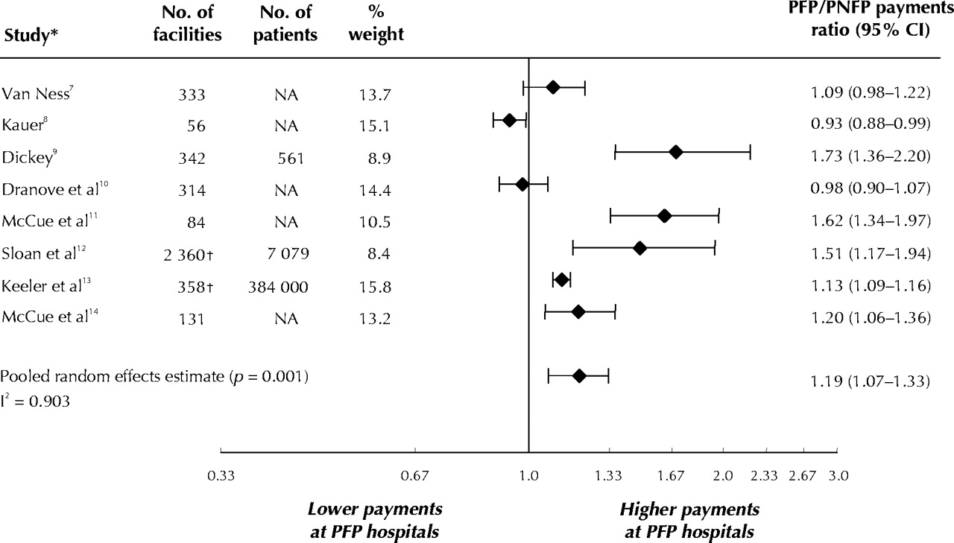
For-Profit Hospitals Cost 19% More
Lower payments at PFP Hospitals
Higher payments at PFP Hospitals
PFP/PNFP Payments Ratio (95% CI)
Relative payments for care at private for-profit (PFP)
and private not-for-profit (PNFP) hospitals
Source: CMAJ Devereaux et al. 170 (12): 1817.

Slide 128
Quality Measures for MI, CHF, Pneumonia:
For Profit Hospitals Are Worst; VA is Best
Odds ratio
of meeting composite quality measures (Higher = Better)
Source: Arch Int Med 2006;166:2511

Slide 129
Low Quality Hospitals
More Likely to be For-Profit
For-Profit
Non-Profit / Government
Source: Health Affairs 2011;30:1904.
Quality rating based on Medicare’s Hospital Compare data

Slide 130
For-Profit Hospitals’ Quality Lowest
More Nurses = Higher Quality Rating
Percent of patients giving hospital highest quality rating
Source: NEJM 10/31/2008

Slide 131
Higher Death Rates
When Nurse Staffing Is Inadequate
Hazard ratio per shift of patient exposure
Source: NEJM 2011;364:1037

Slide 132
Tenet (AKA “NME”)
1985-1993: Recurrent criminal activity. Bribing state officials, kickbacks for referrals, and kidnapping psychiatric patients
1994-1995: Pays $379M Federal fine for insurance fraud/kickbacks. Pays more than $200M in private settlements.
CEO Richard Esmer retires with annual pension of $822,670 plus lump sum payment of $2.6M
1995: New CEO J. Barbakow appointed
2002-2003: FBI raids Tenet hospital re: unnecessary heart surgery + Medicare fraud
2003: Barbakow forced out (total compensation = $400M)
2003-2004: Pays $449M for unneeded heart surgery settlement
2006: Pays $215M + $900M for Medicare outlier fraud + $80M for improperly deducting previous fines from taxes
Mod Hlthcr 3/29/85,4/26/85, 9/6/93, 7/4/94, 11/4/02, 1/16/06, 11/27/06; NYT 10/22/91, 7/31/94, 11/1/02, 6/30/06; USA Today 8/26/02

Slide 133
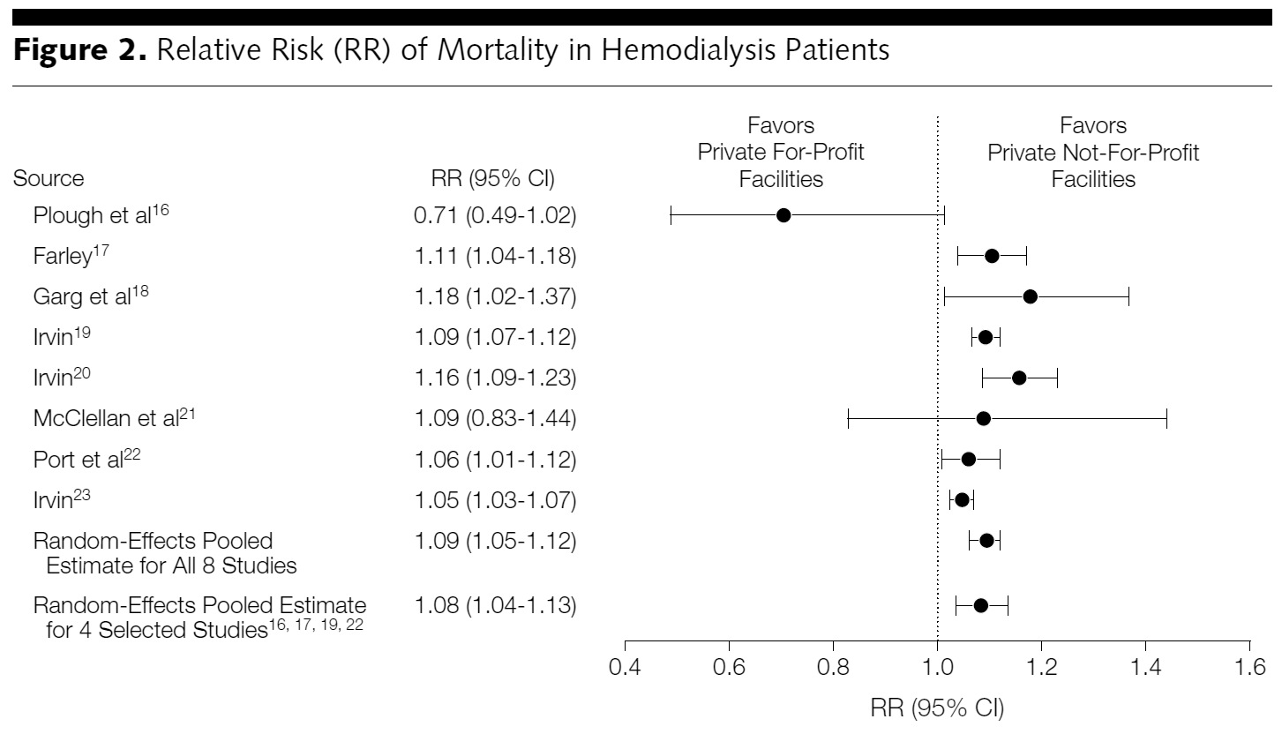
For-Profit Dialysis Clinics’
Death Rates Are 9% Higher
Relative Risk (RR) of mortality in hemodialysis patients
Source: Devereaux P. JAMA. 2002;288(19):2449-2457.

Slide 134
During era when more EPO = more profit
For-Profit Dialysis Facilities
Overdosed Patients with EPO
50,000
40,000
30,000
20,000
10,000
0
Weekly EPO units for patients with HCT <33%
Non-Profit | For-Profit | Hospital-Based
Note: Higher EPO dose associated with higher CV death rate
Similar pattern was observed among patients with HCT.33%
Source: JAMA 2007;297:1667

Slide 135
Quality Better at
Non-Profit Nursing Homes
1
4
0
1
A meta-analysis including every published study
0
0
0
0
Results favor for-profits
Results favor non-profits
Most studies with non-significant results also favored non-profits
Parenthetic numbers = N
Source: BMJ 2009;33:B2732

Slide 136
For-Profit Nursing Homes:
More Inappropriate Feeding Tubes
Rate of feeding tubes in patients with advanced cognitive impairment
Note: Adjusted odds ratio for for-profits = 1.09
Source: JAMA 2003;290:73

Slide 137
Drug Companies’ Cost Structure
Marketing and Admin
35%
Manufacturing
27%
Profits
(After Taxes)
18%
R&D
13%
Source: Health Affairs 2001;20(5):136

Slide 138
2012 Fraud/Civil Fines
Against Drug Firms
Glaxo - $3 billion
Johnson & Johnson – over $2 billion
Abbott - $1.6 billion
Illegal promotion (Paxil and Wellbutrin)
Illegal marketing (Risperidal)
Illegal marketing (Depakote)
Hiding safety problems (Avandia)
Source: NYT 7/3/2012; Fiscal Times 8/31/2012

Slide 139

Drug Firms’ Fraud:
Pay the Ticket, Keep on Speeding
“In April [2010], AstraZeneca became the fourth major drug company in three years to settle a government investigation with a hefty payment…
“$520 million for what federal officials described as an array of illegal promotions of antipsychotics for children, the elderly, veterans and prisoners.
“Still, the payment amounted to just 2.4 percent of the $21.6 billion AstraZeneca made on Seroquel sales from 1997 to 2009.”
New York Times – 10/3/10

Slide 140
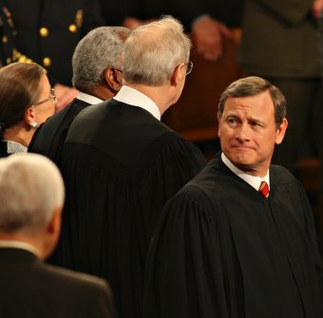
Mandate Model for Reform:
Keeping Private Insurers
In Charge

Slide 141
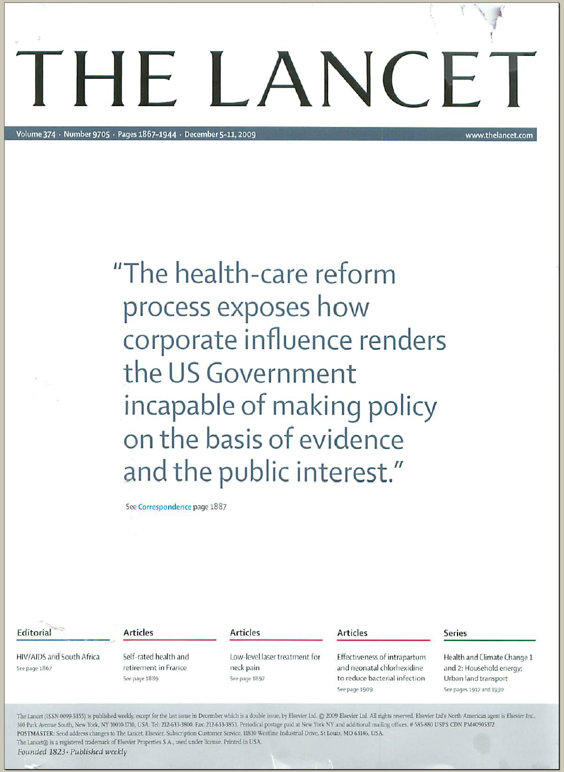
The Lancet Put It On Their Cover
“The health-care reform process exposes how corporate influence renders the US Government incapable of making policy on the basis of evidence and the public interest.”
Source: Lancet Dec 5, 2009. Cover of vol. 374.

Slide 142
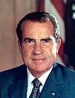
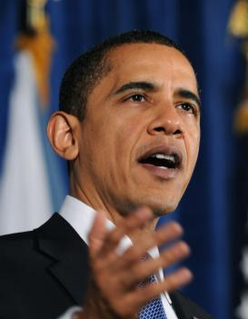
“Mandate” Model for Reform
Expanded Medicaid-like program
  Free for poor
  Subsidies for low income
  Buy-in without subsidy for others
Employer mandate +/- individuals
Managed Care / Care Management
Notes:
142

Slide 143
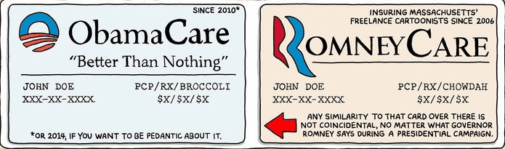
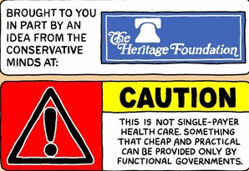

Slide 144
Crimes and Punishments in Massachusetts
The Crime | The Fine
Violation of Child Labor Laws | $50
Employers Failing to Partially Subsidize a Poor Health Plan for Workers | $295
Illegal Sale of Firearms, First Offense | $500 max.
Driving Under the Influence, First Offense | $500 min.
Domestic Assault | $1000 max.
Cruelty to or Malicious Killing of Animals | $1000 max.
Communication of a Terrorist Threat | $1000 min.
Being Uninsured In Massachusetts | $1260

Slide 145

Massachusetts:
Requires 70% Actuarial Value Coverage
Premium: $5,616 annually
Deductible: $2000 annually
Co-insurance: 20% after deductible is reached for next $15,000 of care
Example shown is a 56 year-old male
with annual income over $32,000
Notes:
145

Slide 146
Massachusetts Health Reform:
Little Impact on Medical Bankruptcy
Source: Himmelstein, Thorne, Woolhandler.
Am J Med 2011;124:224

Slide 147
Massachusetts’ Reform:
More Bureaucrats, No More Caregivers
Change in health employment, 2005/06 to 2008/09
Source: Staiger DO et al. NEJM 2011:e24(1)

Slide 148
Federal Taxpayers Paid for MA’s Reform
Source: Boston Globe 6/26/2011:A9
(From Executive Office of Administration and Finance)

Slide 149
Impact of ACA on the Uninsured
Reduced from ~50M to ~30M in 2019, i.e., from 17% to 11% of population.
Safety-Net Hospitals
Community Health Centers
Number of Uninsured
Funding through Medicare cut by $36 billion through 2019.
Receive extra $1 billion annually – maybe!

Slide 150
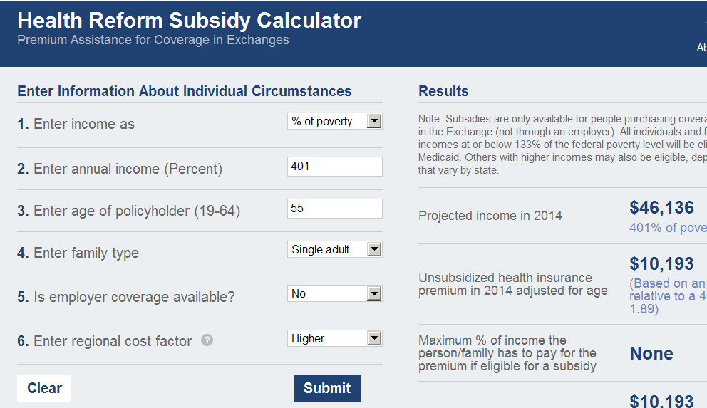
Example of an ACA Calculation
Profile | 55 years old, single adult
Annual Income | $46,136
Premium | $10,193
Out-of-pocket max | Additional $6,250
Subsidies and tax credits | $0
Total exposure (dollars) | $16,443
Total exposure (% of income) | 36%

Slide 151
Impact of Health Reform On:
The Under-Insured
If you like your current coverage, you can keep it.
If you don’t like your current job-based coverage, you have to keep it.
Policies are required to cover at least 60% of expected health costs, e.g., $2,000 deductible + 20% co-insurance for next $15,000 of care.

Slide 152

Public Money, Private Control

Slide 153
US Public Spending per Capita
Exceeds Total Spending in Other Nations
Our Public Spending Exceeds
Everyone Else's’ Total Spending
2010 healthcare spending per capita
Data are for 2010
Sources: OECD 2012; Health Affairs 2002 21(4)88

Slide 154
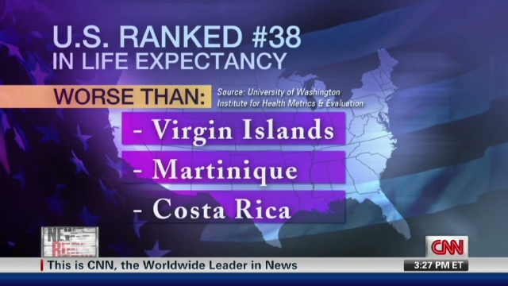
The U.S. Trails Other Nations

Slide 155
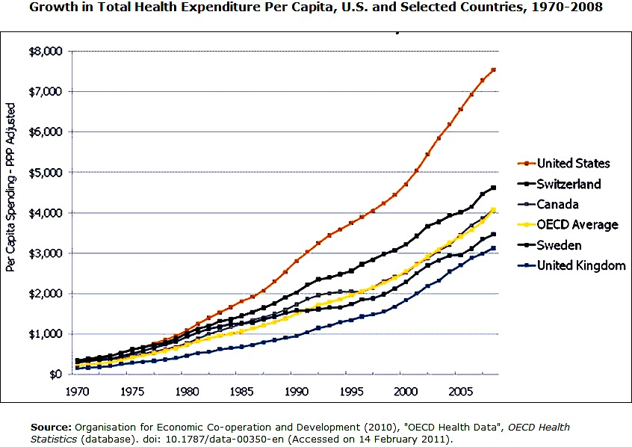
Growth in Total Health Expenditure
$8,000
$7,000
$6,000
$5,000
$4,000
$3,000
$2,000
$1,000
Per capita spend
1970 | 1975 | 1980 | 1985 | 1990 | 1995 | 2000 | 2005
Source: OECD 2010, doi: 10.1787/data-00350-en
Accessed Feb. 14, 2011

Slide 156
Cost and Access Problems Among Sicker Adults
U.S. Access Is Worse
50%
40%
30%
20%
10%
0
Percent Reporting Problems (Among Sicker Adults)
UK | France | Canada | Austral. | N. Zeal. | USA
Hard to Pay Med Bills
Cost Was Access Problem
Source: Health Affairs 2011;30:2437

Slide 157
Life Expectancy
Years
Note: Data are for 2010 or most recent year available
Source: OECD, 2012

Slide 158
Potential Years of Life Lost
Per 100 People for All Causes
Years
Note: Data are for 2009 or most recent year available
Source: OECD, 2011

Slide 159
US Now Worst on Preventable Deaths
France
Australia
Italy
Japan
Sweden
Norway
Austria
Netherlands
Finland
Germany
Greece
Ireland
New Zealand
Denmark
UK
US
0 | 200 | 400 | 600 | 800 | 100 | 1200
Age adjusted deaths/100,000 from potentially preventable causes
1997/1998
2006/2007
Source: Health Affairs 2008;27(1):58 and on-line 9/12/11

Slide 160
Infant Mortality
Deaths in First Year of Life Per 1,000 Live Births
Note: Data are for 2010 or most recent year available
Source: OECD, 2012

Slide 161
Maternal Mortality
Deaths per 100,000 Live Births
Note: Data are for 2009 or most recent year available
Source: OECD, 2011

Slide 162
Smoking Prevalence
Percent of population over age 15 who smoke daily
Note: Data are for 2010 or most recent year available
Source: OECD, 2012

Slide 163
Percent Elderly
Percent of population over age 64
Note: Data are for 2011 or most recent year available
Source: OECD, 2012

Slide 164
Hospital Inpatient Days per Capita
Note: Data are for 2010 or most recent year available
Source: OECD, 2012

Slide 165
Physician Visits per Capita
Note: Data are for 2010 or most recent year available
Source: OECD, 2012

Slide 166
Nurses per 1,000 Population
Note: Data are for 2009 or most recent year available
Source: OECD, 2011

Slide 167
Hip Replacements per 1,000 Population
Note: Data are for 2010 or most recent year available
Source: OECD, 2012

Slide 168
US Renal Failure Patients Are
Less Likely to Get Transplants
Percent
of ESRD Patients with Functioning Transplant
Note: Data are for 2010 or most recent year available
Source: OECD, 2012

Slide 169
Acute MI Outcomes
In-Hospital 30-Day Case-Fatality Rate
Deaths per 100 patients
Note: Short LOS may cause understatement of US in-hospital fatality rate
Source: OECD, 2012

Slide 170
Hemorrhagic Stroke Mortality
In-Hospital 30-Day Case-Fatality Rate
Deaths per 100 patients
Note: Short LOS may cause understatement of US in-hospital fatality rate
Data is age/sex standardized
Source: OECD, 2012

Slide 171
Out-of-Pocket Payments
Dollars per Capita
Note: Data are for 2010 or most recent year available
Figures adjusted for Purchasing Power Parity
Source: OECD, 2012

Slide 172
Recession Caused More in USA to
Cut Care Than in Other Nations
Net change in use of routine medical care since start of economic crisis
Based on survey of 5,437 individuals
Source: Lusardi, Schneider & Tufano. NBER Working Paper 15843, March 2010

Slide 173
Clinical Medicine Articles
1992-2002 per Thousand Population
Source: Lancet 2004;363:250

Slide 174
Insurance Overhead
Dollars per Capita
Note: Data are for 2010 or most recent available
Figures adjusted for Purchasing Power Parity
Source: OECD, 2012

Slide 175
USA Physicians Have the
Best Access to Technology
Percent of physicians saying access to latest medical equipment is a major problem
Source: Health Affairs 2001;20(3):236

Slide 176
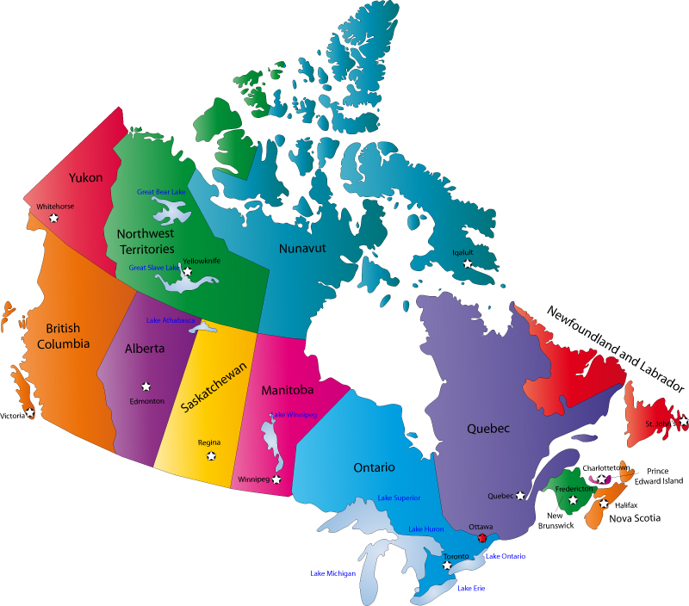
Canada’s National Health Insurance Program

Slide 177
Minimum Standards for
Canada’s Provincial Programs
Universal coverage that does not impeded, either directly or indirectly, whether by charges or otherwise, reasonable access.
Portability of benefits from province to province
Coverage for all medically necessary services
Publicly administered, non-profit program

Slide 178
Less People in Quebec with Serious Symptoms
Went Without a Physician Visit After NHP
Percent of people with serious symptoms not seeing a physician
Source: NEJM 1973;289:1174

Slide 179
% of People with an Unmet Health Need
Canadians and US Insured Are Similar
Source: Joint Canada/US Survey of Health, 2002-03.
CDC and Statistics Canada

Slide 180
Waiting Times for Doctor Appointments
Boston and Canada
Mean wait time in weeks for non-urgent visit
*US Ortho figure represents semi-urgent request for visit
Sources: Canadian Medical Association 2007 National Physician Survey.
Merritt Hawkins 2009 Survey

Slide 181
Mental Health Treatment, US & Canada
Severely Ill in Canada Get More Care
Percent receiving treatment
Source: Health Affairs May/June, 2003:128

Slide 182
Quality of Care Slightly Better in Canada Than US
Meta-Analysis of Patients Treated for Same Illnesses
High Quality Studies
Low
Quality Studies
Results
favored US
Results
favored Canada
Mixed or
equivocal results
US studies included mostly insured patients
Source: Guyatt et al, Open Medicine, April 19, 2007

Slide 183
Infant Mortality
30
20
10
Deaths per 1,000 Live Births
First province implements NHP
USA
Canada
1955 | 1965 | 1975 | 1985 | 1995 | 2009
Sources: Statistics Canada, Canadian Institute for Health Information, National Center for Health Statistics

Slide 184
Canadians’ Life Expectancy
Growing Faster than Americans’
80
75
70
65
Life expectancy at birth
1950 | 1960 | 1970 | 1980 | 1990 | 2000 | 2005
Canada
USA
Sources: StatCan & NCHS

Slide 185
Health Costs as % of GDP
17%
15%
13%
11%
9%
7%
5%
Canada’s NHP Enacted
USA
Health costs % of GDP
NHP Fully Implemented
“Uniquely American”
Canada
1960 | 1970 | 1980 | 1990 | 2000 | 2010
Source: Statistics Canada, Canadian Institute for Health Info, and NCHS/Commerce Dept.

Slide 186
US Medicare Coverage
Much Worse than Canada’s
Percent of seniors’ total medical expenses covered
Note: Not comparable to figures for employer coverage because of high LTC needs in elderly
Source: EBRI and Himmelstein/Woolhandler analysis of Health Canada data

Slide 187
Cost Control in a Parallel Universe
Growth in Medicare Spending Per Senior
Source: Himmelstein & Woolhandler
Arch Intern Med, December, 2012

Slide 188
How Has Canada Controlled Costs?
Lower administrative costs via single payer - 16.7% of total health spending vs. 31.0% in the U.S.
Lump-sum, global budgets for hospitals
Stringent controls on capital spending for new buildings and expensive new equipment
Single buyer purchasing reins in drug/device prices
Low litigation and malpractice costs
Emphasis on primary care
Exclusion of private insurers - private plans overcharged U.S. Medicare by $34 billion in 2012
Source: Himmelstein & Woolhandler
Arch Intern Med, December, 2012

Slide 189
Hospital Billing and Administration
Dollars per capita, 2011
Source: Woolhandler/Himmelstein/Campbell
NEJM 2003;349:769 (updated 2012)

Slide 190
Physicians’ Billing and Office Expenses
Dollars per capita, 2011
Source: Woolhandler/Himmelstein/Campbell
NEJM 2003;349:769 (updated 2012)

Slide 191
Overall Administrative Costs
Dollars per capita, 2011
Source: Woolhandler/Himmelstein/Campbell
NEJM 2003;349:769 (updated 2012)

Slide 192
Difference in Health Spending
Per capita data.
Sources: Woolhandler/Himmelstein/Campbell NEJM 2003;349:769 (updated 2012). NCHS and CIHI

Slide 193
Aortic Aneurysm Repair Costs
Overhead Accounts for Most of the Difference
$13,432
$8,647
Note: Hospital costs only; outcomes were equivalent
Source: Brox et al. Arch Intern Med 2003;153:2500

Slide 194
Few Canadians Seek Care in the US
40% of US ambulatory facilities near border treated no Canadians last year; another 40% <1/month
Michigan + New York + Washington hospitals treated a total of 909 Canadians/year (only 17% of them elective).
Of “America’s Best Hospitals”, only one reported treating more than 60 Canadians/year.
In a survey of 18,000 Canadians, 90 had received any medical care in the US last year – only 20 had gone to the US seeking care.
Surveys of US ambulatory providers near the border,
hospital discharges, and Canadian citizens
Source: Health Affairs 2002;21(3):19

Slide 195
Few Canadian Physicians Emigrate
Net loss (number moving abroad – number returning)
A negative number indicates that more physicians returned from abroad then moved abroad
Source: Canadian Institute for Health Information

Slide 196
Canadian Physicians’ Incomes
Specialty | 2009/10 Income
Family Medicine | $248,716
Internal Med | $354,490
Pediatrics | $263,545
Psychiatry | $203,152
Dermatology | $391,686
OB-GYN | $429,954
General Surgery | $404,847
Thoracic Surgery | $528,266
Ophthalmology | $551,666
All Physicians | $293,472
Reduced administrative burdens
in practice, saving $60-80,000 per MD
Reduced malpractice expense
(cost of future care not needed in payments)
Source: Canadian Institute for Health Information

Slide 197
Canadian Malpractice Insurance Costs
Specialty | Ontario* | Quebec | Other Provinces
FP/GP/Psych | $648 | $1,373 | $1,152
Cardiology | $1,428 | $2,747 | $1,728
Anesthesia | $4,896 | $7,377 | $3,552
Neurosurgery | $4,896 | $31,575 | $23,256
OB-GYN$4896 | $4,896 | $36,140 | $14,292
*Ontario reimburses physicians for premiums about 1986 level
Source: Canadian Medical Protective Association
www.cmpa-acpm.ca

Slide 198

Applicants per Medical School Place
Source: AAMC and
Association of Faculties of Medicine of Canada

Slide 199
What’s OK in Canada?
Compared to the USA…
Life expectancy 2 years longer
Infant deaths 25% lower
Universal comprehensive coverage
More physician visits, hospital care; less bureaucracy
Quality of care equivalent to insured Americans’
Free choice of doctor and hospital
Health spending half of USA level

Slide 200
What’s the Matter in Canada?
The wealthy lobby for private funding and tax cuts; they resent subsidizing care for others.
Result: government funding cuts (e.g., 30% of hospital beds closed during the 1990s) causing dissatisfaction and waits for care.
USA and Canadian firms seek profit opportunities in health care privatization
Conservative foes of public services own many Canadian newspapers
Misleading waiting list surveys by right wing Fraser Institute

Slide 201
Americans Want NHI
“Would you favor the current health insurance system… or a universal coverage program like Medicare that is government run and financed by taxpayers?”
Source: ABC News Poll; USA Today; Kaiser Survey 9/06

Slide 202
The Rising Popularity
Of National Health Insurance
“Who should provide coverage?”
1979
2009
Government
40%
Private
Enterprise
48%
Government
59%
Private
Enterprise
32%
Don’t
Know
12%
Don’t
Know
9%
Source: CBS News / New York Times Poll, Feb. 1, 2009

Slide 203
The Rising US Popularity of
National Health Insurance
“Who should provide coverage?”
Source: CBS News / New York Times Poll, Feb. 1, 2009

Slide 204
Growing Physician Support for NHI
59% of physicians support NHI
Surveys of random samples of US physicians
Source: Carroll and Ackerman. Ann Int Med 2008;148:566

Slide 205
Massachusetts Doctors
Favor Single Payer
Source: Massachusetts Medical Society Survey
October 2010

Slide 206
More Health Economists
Favor Single Payer
50%
40%
30%
20%
10%
0
Percent agreeing the US should adopt…
Canada-Style Reform | Employer Mandate | Refundable Tax Credit
Source: J Hlth Policy Politics & Law 2008;33:707

Slide 207

A National Health Program for the
USA

Slide 208
National Health Insurance
Universal – covers everyone
Comprehensive – all needed care, no co-pays
Single, public payer – simplified reimbursement
No investor-owned HMOs, hospitals, etc.
Improved health planning
Public accountability for quality and cost, but minimal bureaucracy
Proposal of the Physicians Working Group for Single Payer NHI
JAMA 2003;290:798

Slide 209
Funding for the NHP
Revenue Sources
NHP
Fund
Recipients of Money
Medicare and Medicaid
Hospital Operating Costs
Hospital Capital Costs
State /Local Governments
HMOs
Employers
Fee-for-Service Physicians
Private Insurance Revenues
Home Care Agencies
New Taxes
Long-Term Care
Source: NEJM 1989;320:102

Slide 210
Hospital Payment Under an NHP
Hospitals remain privately owned.
Capital purchases/expansion budgeted separately based on health planning goals.
Negotiated global budget for operating costs. Operating funds cannot be diverted to capital.
Himmelstein and Woolhandler. NEJM 1989;320:102

Slide 211
Three Options for Physician and Ambulatory Care Payment Under the NHP
Fee for
Service
Mandatory assignment
Simplified negotiated fee schedule
Capitation for Institutions
With Salaried Docs
Free disenrollment
Capitation for operating costs, not capital purchases, profits or doc incentives
No selective enrollment period
Inpatient care under hospital’s global budgets
Globally Budgeted Institutions
Hospitals
Clinics
Home care agencies
Institutions with salaried physicians
Source: Himmelstein and Woolhandler. NEJM 1989;320:102

Slide 212
America Can Do This.
Excellent hospitals, empty beds
Enough well-trained professionals
Superb
research
Current spending
is sufficient
We already have what it takes

