Slide 1
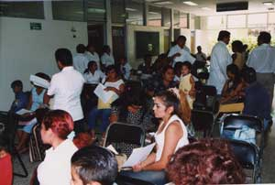
The Uninsured

Slide 2
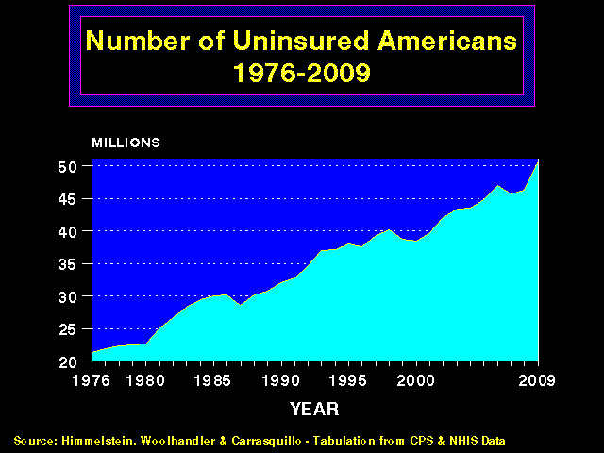
More and More
Uninsured Americans
50
45
40
35
30
25
20
Millions of Uninsured American
1976 | 1980 | 1985 | 1990 | 1995 | 2000 | 2005 | 2011
Source: Himmelstein, Woolhandler & Carrasquilo.
Tabulation from CPS & NHIS data

Slide 3
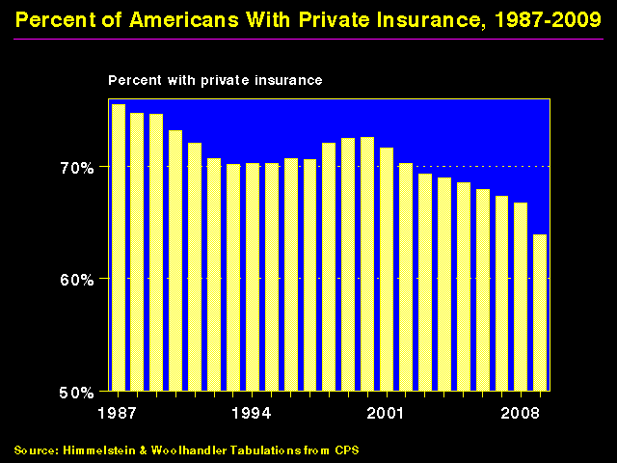
Shrinking Private Insurance, 1960-2011
80%
70%
60%
50%
Percent With Private Insurance
1960 | 1970 | 1980 | 1990 | 2000 | 2011
Source: Himmelstein, & Woolhandler, Tabulation from CPS
Data are not adjusted for minor changes in survey methodology

Slide 4
Lack of Insurance
Kills 44,798 US Adults Annually
State | Percent Uninsured | Excess Deaths
California | 23.9% | 5,302
Texas | 29.7% | 4,675
Florida | 26.0% | 3,925
New York | 17.5% | 2,254
Georgia | 23.6% | 1,841
USA | 15.3% | 44,798
Source: Wilper et al. Am J Public Health 2009.
State tabulations by author

Slide 5
Many Specialists Won’t See
Kids With Medicaid
% of Clinics Scheduling
Appointments for Children
Bisgaier J, Rhodes KV.
N Engl J Med 2011;364:2324-2333
Notes:
5
Figure 2 Clinics Scheduling Specialty Care Appointments for Children, According to Type of Insurance. Public insurance was reported by callers as the Illinois Medicaid–Children's Health Insurance Program (CHIP) umbrella program; private insurance was reported by callers as Blue Cross Blue Shield. Each of the 273 clinics was called twice (for a total of 546 calls) by the same caller, with only insurance coverage varying between the two calls: once reporting Medicaid–CHIP coverage and once reporting private coverage. Calls were made 1 month apart, and the order of the reported insurance status was randomly assigned. Asthma clinics included 38 allergy–immunology clinics and 6 pulmonary disease clinics.

Slide 6

Under-Insurance

Slide 7
Increasing Un- and Under- Insurance
Insured
Under-Insured
Uninsured
Commonwealth Fund, Sept. 8, 2011

Slide 8
Uninsured and Under-Insured
Delay Seeking Care for Heart Attacks
Odds ratio for delayed care*
Source: JAMA April 15, 2010. 303:1392
*Adjusted for age, sex, race, clin. charact., hlth status, social/psych fx, urban/rural. Under-insured=had coverage
but patient concerned about cost

Slide 9
Most of the Medically Bankrupt Had Coverage
Insurance at Illness Onset
Source: Himmelstein et al. Am J Med: August, 2009

Slide 10

Planning for Retirement?
Don’t Forget Health Care Costs
“Medicare covers only 51% of health care services….
For a 65 year old couple retiring this year, the cost of health care in retirement will be $240,000.”
New York Times. Wealth Matters

Slide 11
Rising
Economic Inequality

Slide 12
Change in Real Family Income 1979-2011
Source: Bureau of the Census

Slide 13
Widening Gap in Life Expectancy Between High and Low Earners
Remaining Life Expectancy for Men Turning 60
Waldron. ORES, Social Security Admin, #108, 2007

Slide 14

Persistent Racial Inequalities

Slide 15
Wealth and Income:
The White / Minority gap
Source: Census Bureau and Pew Center, 2011

Slide 16
Excess Deaths Among African Americans
83,369 fewer would have died in 2000 if racial gap were eliminated
Excess African American deaths
Source: Satcher et al. Health Affairs 2005;24:459

Slide 17
Blacks Less Likely to Get
Voice Preservation Therapy
Odds ratio for receiving radiation therapy as initial treatment among laryngeal cancer patients
*Adjusted for age, year, sex, and tumor characteristics
Source: Arch Otolaryng-Head and Neck Surg 2012;138:644

Slide 18
Immigrants Get Little Care
Health Care
$ per capita
*Adjusted for ethnicity, poverty, age, insurance status, patient/parent-reported health status
Source: Mohanty et al. Am J Public Health 2005;95:1431

Slide 19
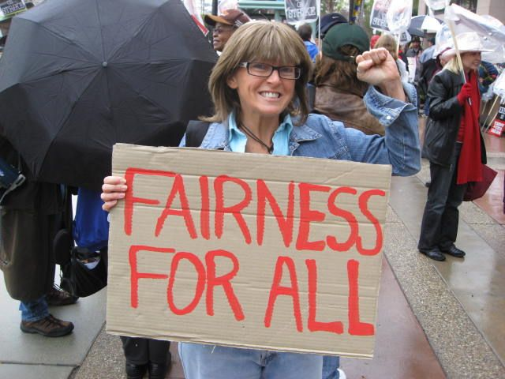
Rationing Amidst a Surplus of Care

Slide 20
Unnecessary Procedures
Percent of Procedures
Source: Commonwealth Fund.
Quality of Healthcare in the U.S. Chartbook 2002

Slide 21
22.5% of 111,707 Defibrillator Implants
Were Not Evidence-Based
Sometimes Lethal
Death rates 3.17 times higher (0.57% vs. 0.18%)
No improvement in rates over time
Note: In-hospital death rate for non-evidence-based ICD implantation was 0.6%. Cost of ICD implant ~$25,000
Source: JAMA 2011;305:43

Slide 22
Outcomes of New vs. Old
Hip/Knee Prosthetic Joints
28% of newly-introduced prostheses worsened outcomes
0% improved outcomes
Note: Comparison is to prostheses that had been available for >5 years
Source: J Bone Joint Surg 2011;suppl3(e):51-4.
Data from Australian Orthopedic Assoc.

Slide 23
Growth of Physicians and Administrators
3000%
2500%
2000%
1500%
1000%
500%
0
Growth Since 1970
1970 | 1980 | 1990 | 2000 | 2010
Physicians
Administrators
Source: Bureau of Labor Statistics; NCHS; Himmelstein/Woolhandler analysis of CPS

Slide 24

Profit-Driven ACO’s:
A Cautionary Tale from Medicare HMOs

Slide 25
Private Medicare Advantage Plans’
High Overhead
Overhead
per enrollee
2008
Source: US House Committee on Energy and Commerce. December, 2009

Slide 26
Despite Medicare’s lower overhead,
Enrollment of
Medicare Patients
In Private Plans
Has Grown

Slide 27
Medicare HMO Enrollment
14
12
10
8
6
4
2
0
Medicare HMO enrollment (Millions)
1985 | 1990 | 1995 | 2000 | 2005 | 2012
Source: CMS

Slide 28
A Few Sick People
Account for Most Health Dollars
Percent of total health spending accounted for by decile
Top 2 deciles account for 78.3%
Decile of Privately Insured
Source: MEPS Data, from Thorpe and Reinhart

Slide 29
Medicare HMOs:
The Healthy Go In, The Sick Go Out
Inpatient costs as percentage of FFS Medicare
High medical needs when they leave
Healthier patients join
Source: NEJM 1997;337:169

Slide 30
Medicare’s Attempt to
Risk- Adjust HMO Payment
Pre-2004
HMOs were “cherry-picking” when payment adjusted only for age, sex and other demographics
Starting in 2004
Risk adjustment formula
added 70 diagnoses

Slide 31
Risk Adjustment Increased
Medicare HMO Overpayment
$4,000
$3,000
$2,000
$1,000
0
Overpayments
due to
Cherry Picking
Overpayment to HMOs per Medicare Enrollee
Congress-mandated overpayments
Payments adjusted for age, sex, and ESRD
Same plus 70 diagnoses adjusted
Actual impact of 2004 change in Risk Adjustment formula
Source: NBER Working Paper 16799, April 2011

Slide 32
How Could a Medicare HMO
Profit on CHF Patients?
A CHF diagnosis increases the HMO’s capitation rate by 41%
Among Fee-for-Service Medicare enrollees with CHF:
    The costliest 5% averaged > $37,000/year
    The least costly 5% averaged $115/year
Universal echocardiogram screening would label many asymptomatic seniors as having CHF
Source: MedPAC data for 2008

Slide 33
VA Subsidizes Medicare HMOs
Medicare pays the plan, VA delivers the care, nobody pays the VA
$3 billion
$2 billion
$1 billion
Annual uncompensated cost to VA of care for Medicare HMO enrollees
2004 | 2005 | 2006 | 2007 | 2008 | 2009
Note: VA cost for Medicare HMO patients’ care = 10% of VA budget in 2009
Source: Trivedi et al. JAMA 2012;308:67

Slide 34
Medicare Overpays HMOs
Overpayments Total $283 Billion Since 1985
$40
$30
$20
$10
Medicare HMO overpayments as compared to FFS costs for similar patients ($Billion)
1985 | 1990 | 1995 | 2000 | 2005 | 2012
VA
Cherry Picking
Legislated
PNHP Report 10/2012 based on data from MedPAC, Commonwealth Fund, Trivedi et al.
VA = Cost of VA uncompensated care provided to Medicare HMO enrollees
Legislated = Congressionally-mandated excess payments to Medicare HMOs

Slide 35

ACOs:
A Rerun of the HMO Experience?

Slide 36
High Risk HMO Patients
Fared Poorly in the RAND Experiment
HMO
Free Fee-For-Service
Source: RAND Health Insurance Experiment, Lancet 1988;1:1017
Note: High Risk = 20% of population with lowest income
+ highest medical risk

Slide 37
Investor-Owned HMOs
Provide Lower Quality of Care
Source: Himmelstein, Woolhandler & Wolfe.
JAMA 1999; 282:159

Slide 38
For-Profit Medicare HMOs:
Worse Quality Rheumatoid Arthritis Care
Percent of RA patients who received a DMARD
DMARD = Disease Modifying Agent
Receipt of DMARD is a HEDIS measure
Source: JAMA 2011;305:480

Slide 39

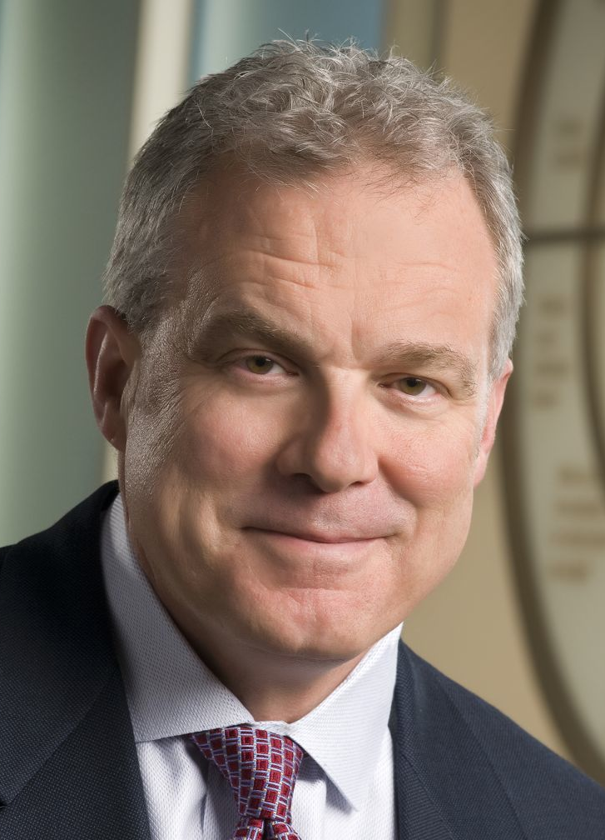
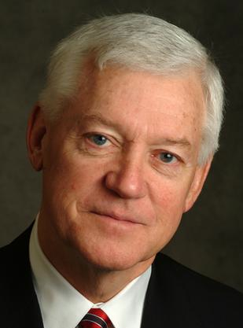
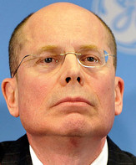
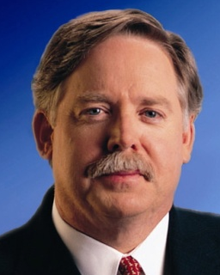
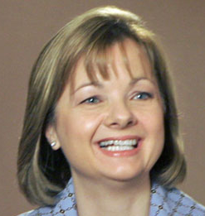
HMO CEO’s 2011 Pay
David Cordani
Mark Bertolini
Allen Wise
Cigna
$19.1 Million
Aetna
$10.6 Million
Coventry
$13.0
Million
Steve Hemsley
Michael McCallister
Angela Braly
United HC
$13.4 Million
Humana
$7.3 Million
Wellpoint
$13.3 Million
Source: AFL/CIO CEO Pay database

Slide 40
HMO Overhead, 2012
SEC Filings/Reports to Shareholders. Data for Q1 or Q2
Calculated as 100% – Medical Loss Ratio
Note Medicare/Medicaid enrollees included in some figures

Slide 41
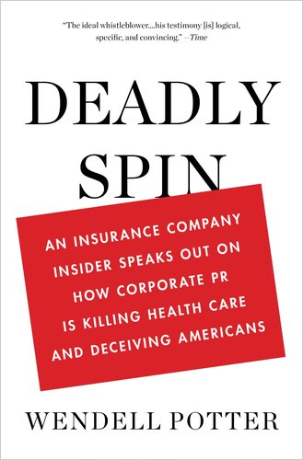
Spinning the Research Findings
On ACO Costs

Slide 42
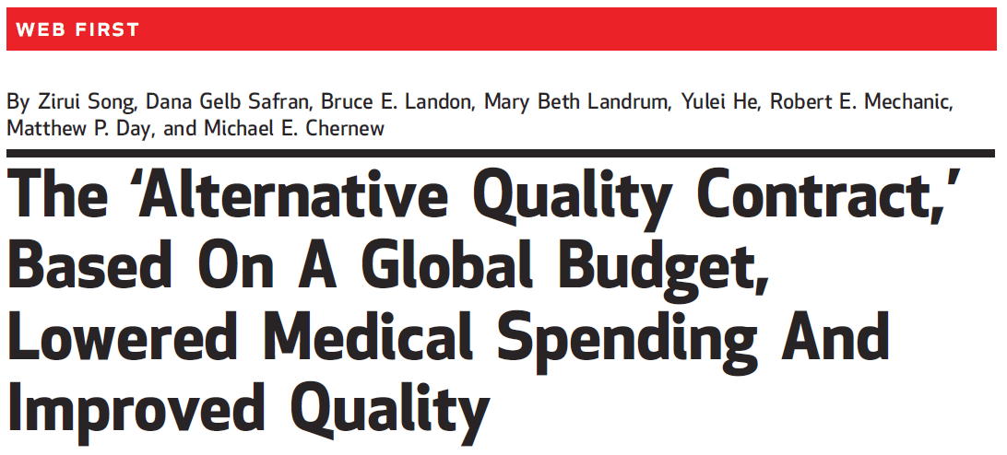
The Headline
On Massachusetts ACO Results
“Overall, participation in the contract over two years led to savings of 2.8% (1.9% in year 1 and 3.3% in year 2).
Source: Song et al. Health Affairs 2012;31:1885

Slide 43
But Buried in the Text
“Our findings do not imply that overall spending fell. . . . [because] ten of the eleven organizations [earned] a budget surplus payment. . . .
“All organizations earned a 2010 quality bonus, and most received infrastructure support.
“This result makes it likely that total Blue Cross Blue Shield payments to groups in 2010 exceeded medical savings.”
Source: Song et al. Health Affairs 2012;31:1885

Slide 44
ACOs = Medical Practices Owned by
Corporate Oligopolies

Slide 45
Insurers Morphing into ACOs:
Purchases of Clinics and Practices, 2011
UnitedHealth bought Monarch Healthcare – a Pioneer Medicare ACO with 2,300 physicians
Wellpoint paid $800 million for CareMore – a chain of 28 clinics with employed physicians
Humana purchased SeniorBridge – an in-home care manager with 1500 providers - and Concentra for $790 million – an urgent care and occupational health clinic firm
Source: Business Insurance, 1/15/12

Slide 46
For-Profit HMOs Increasingly Dominant
75%
50%
25%
0
% of HMO Enrollment as For-Profit
1980
1985 | 1990 | 1995 | 2000
2003
Source: Interstudy

Slide 47
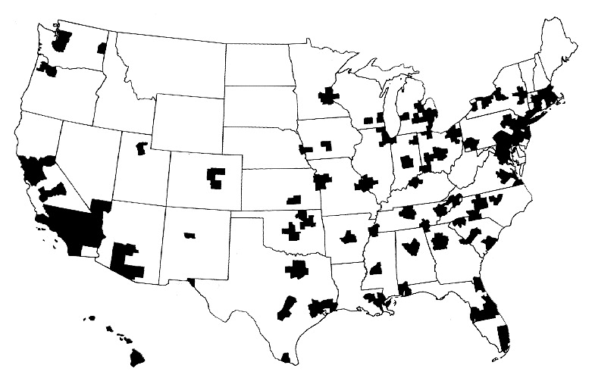
Half of Americans Live Where
Population Is Too Low for Competition
A town’s only hospital will not compete with itself
Highlighted areas are health markets with populations greater than 360,000
Source: Kronick R et al. N Engl J Med 1993;328:148-152.

Slide 48
P4P Can Dissociate
People From Their Work
“I do not think it’s true that the way to get better doctoring and better nursing is to put money on the table in front of doctors and nurses. I think that's a fundamental misunderstanding of human motivation.
“I think people respond to joy and work and love and achievement and learning and appreciation and gratitude - and a sense of a job well done. I think that it feels good to be a doctor and better to be a better doctor.
“When we begin to attach dollar amounts to throughputs and to individual pay we are playing with fire. The first and most important effect of that may be to begin to dissociate people from their work.”
Source: Health Affairs 1/12/2005
Don Berwick, M.D.

Slide 49
Assumptions Implicit in
“Pay for Performance” (“P4P”)
1. Performance can be accurately ascertained
2. Individual variation is caused by variation in motivation
3. Financial incentives will add to intrinsic motivation
4. Current payment system is too simple
5. Hospitals/MDs delivering poor quality care should get fewer resources

Slide 50
Quality Scores Tell More About Patients than Physicians
Harvard physicians with poorer/minority patients score low
Patient characteristics in panels of
high- and low-scoring physicians
Source: Hong C et al. JAMA 9/8/2010. 304:10;1107.

Slide 51
Medicare’s Premier Demonstration:
A P4P Failure at 252 Hospitals
Worse
5-year outcomes show no effect on mortality
Change from baseline in 30-day mortality
Better
Note: P4P failed even among poor performers at baseline
Source: NEJM march 28, 2012

Slide 52

Cochrane Review of
“Paying for Performance”
“We found no evidence
that financial incentives
can improve patient outcomes.”
July 6, 2011
Flodgren et al. “An overview of reviews evaluating the effectiveness of financial incentives in changing healthcare professional behaviors and patient outcomes.

Slide 53
Extent of For-Profit Ownership
For-Profit Firms’ Share of Total Revenue
*Data are for share of establishments
Source: Commerce Department, Service Annual Survey 2009
Health Af 2012;31:1286

Slide 54
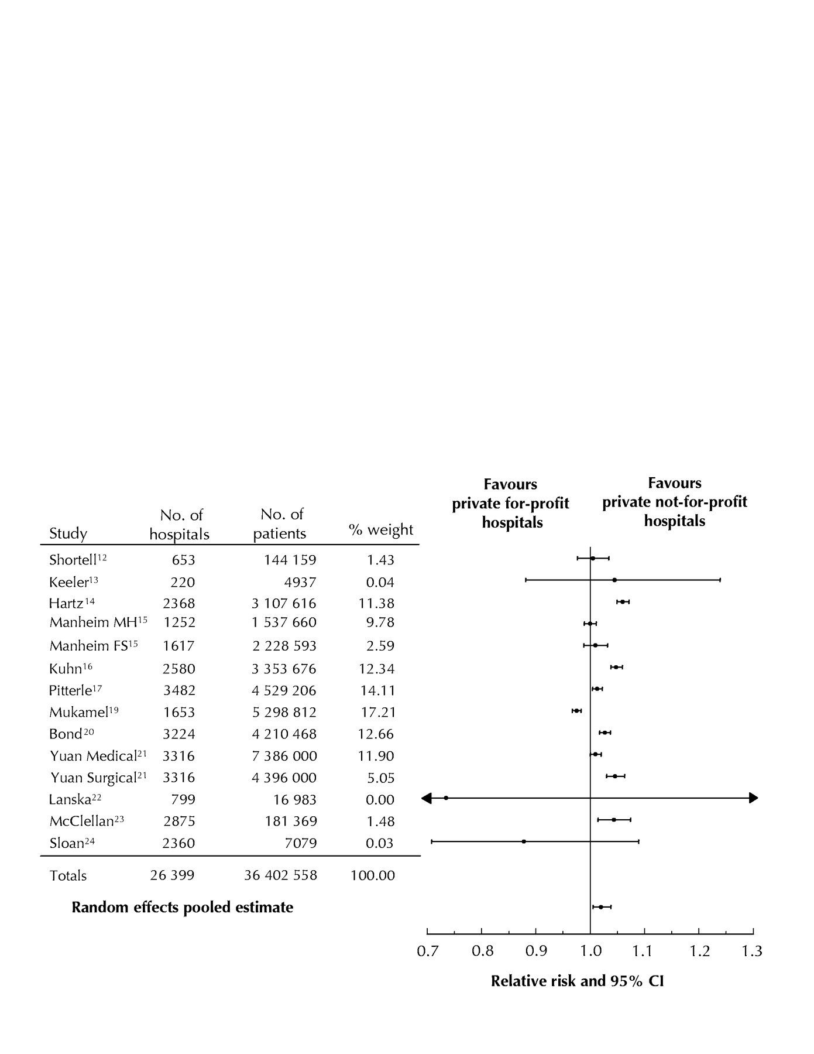
For-Profit Hospitals’
Death Rates Are 2% Higher
Favors
for-profit hospitals
Favors
not-for-profit hospitals
Relative risk and 95% CI
Relative risk of hospital mortality for adult patients in private for-profit hospitals relative to private not-for-profit hospitals
Source: CMAJ Devereaux et al. 166 (11): 1399.

Slide 55
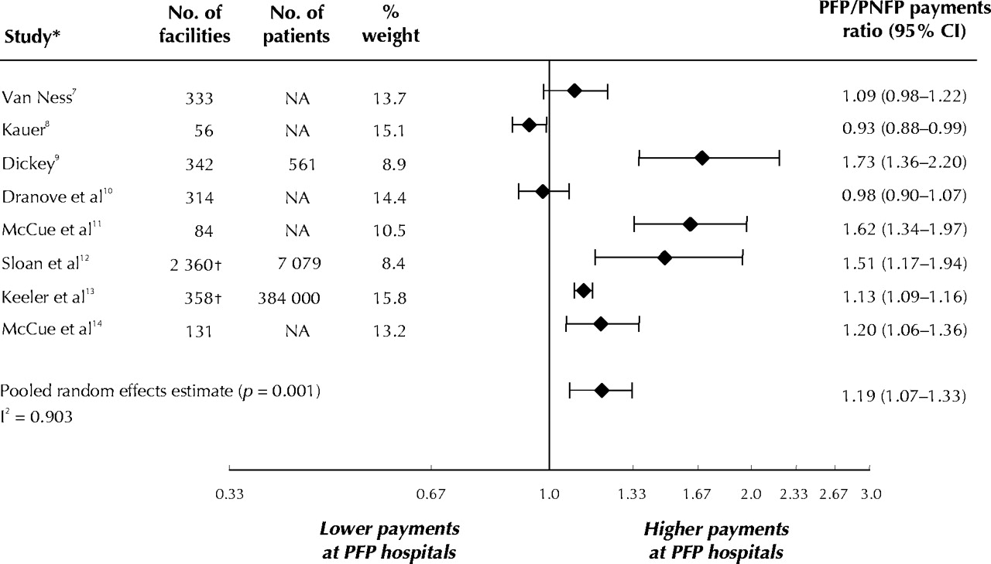
For-Profit Hospitals Cost 19% More
Lower payments at PFP Hospitals
Higher payments at PFP Hospitals
PFP/PNFP Payments Ratio (95% CI)
Relative payments for care at private for-profit (PFP)
and private not-for-profit (PNFP) hospitals
Source: CMAJ Devereaux et al. 170 (12): 1817.

Slide 56
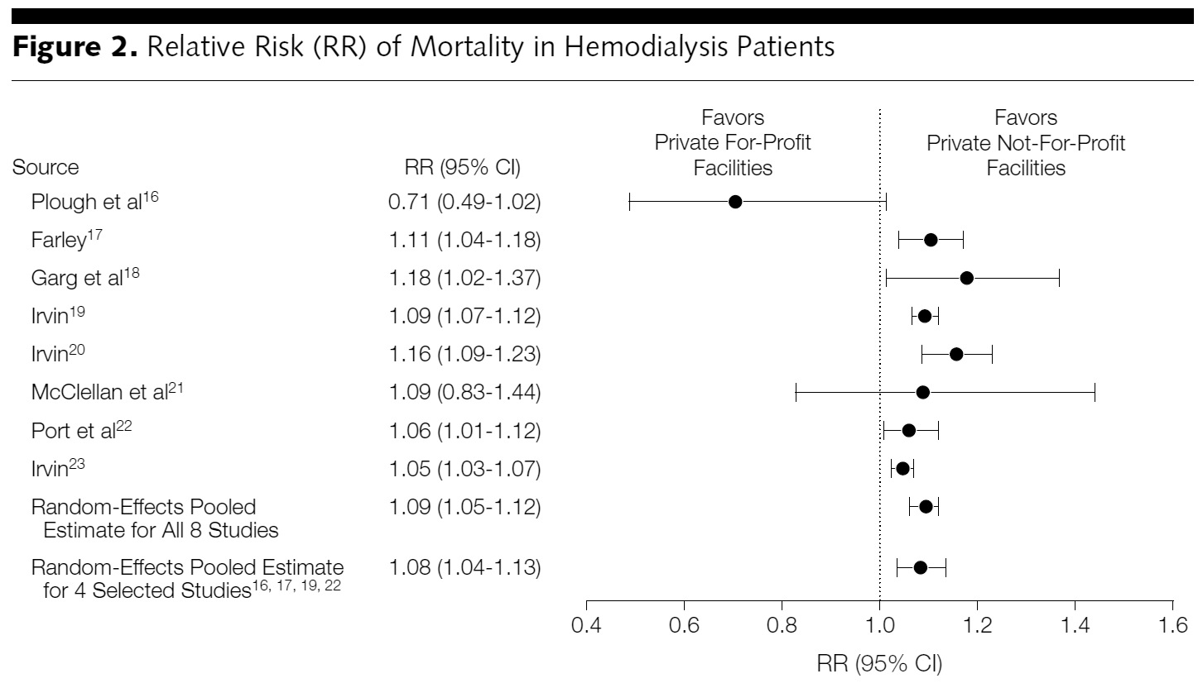
For-Profit Dialysis Clinics’
Death Rates Are 9% Higher
Relative Risk (RR) of mortality in hemodialysis patients
Source: Devereaux P. JAMA. 2002;288(19):2449-2457.

Slide 57
2012 Fraud/Civil Fines
Against Drug Firms
Glaxo - $3 billion
Johnson & Johnson – over $2 billion
Abbott - $1.6 billion
Illegal promotion (Paxil and Wellbutrin)
Illegal marketing (Risperidal)
Illegal marketing (Depakote)
Hiding safety problems (Avandia)
Source: NYT 7/3/2012; Fiscal Times 8/31/2012

Slide 58
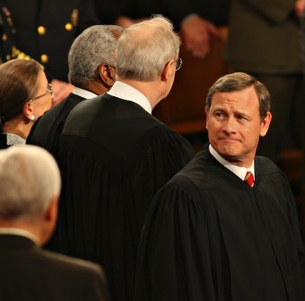
Mandate Model for Reform:
Keeping Private Insurers
In Charge

Slide 59
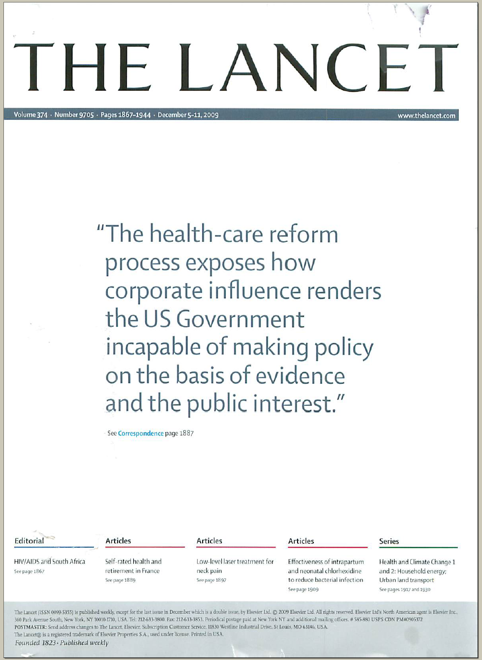
The Lancet Put It On Their Cover
“The health-care reform process exposes how corporate influence renders the US Government incapable of making policy on the basis of evidence and the public interest.”
Source: Lancet Dec 5, 2009. Cover of vol. 374.

Slide 60
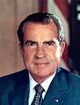
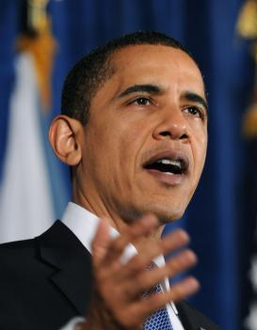
“Mandate” Model for Reform
Expanded Medicaid-like program
  Free for poor
  Subsidies for low income
  Buy-in without subsidy for others
Employer mandate +/- individuals
Managed Care / Care Management
Notes:
60

Slide 61
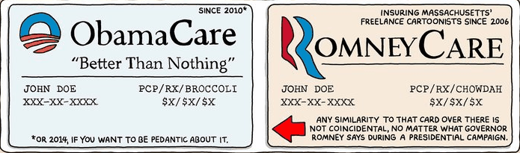
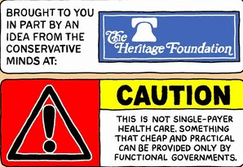

Slide 62

Massachusetts:
Requires 70% Actuarial Value Coverage
Premium: $5,616 annually
Deductible: $2000 annually
Co-insurance: 20% after deductible is reached for next $15,000 of care
Example shown is a 56 year-old male
with annual income over $32,000
Notes:
62

Slide 63
Massachusetts Health Reform:
Little Impact on Medical Bankruptcy
Source: Himmelstein, Thorne, Woolhandler.
Am J Med 2011;124:224

Slide 64
Federal Taxpayers Paid for MA’s Reform
Source: Boston Globe 6/26/2011:A9
(From Executive Office of Administration and Finance)

Slide 65
Impact of ACA on the Uninsured
Reduced from ~50M to ~30M in 2019, i.e., from 17% to 11% of population.
Safety-Net Hospitals
Community Health Centers
Number of Uninsured
Funding through Medicare cut by $36 billion through 2019.
Receive extra $1 billion annually – maybe!

Slide 66
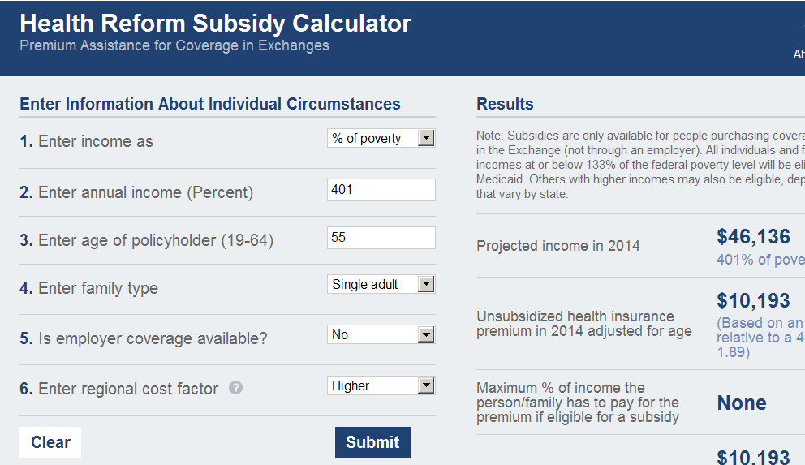
Example of an ACA Calculation
Profile | 55 years old, single adult
Annual Income | $46,136
Premium | $10,193
Out-of-pocket max | Additional $6,250
Subsidies and tax credits | $0
Total exposure (dollars) | $16,443
Total exposure (% of income) | 36%

Slide 67

Public Money, Private Control

Slide 68
US Public Spending per Capita
Exceeds Total Spending in Other Nations
Our Public Spending Exceeds
Everyone Else's’ Total Spending
2010 healthcare spending per capita
Data are for 2010
Sources: OECD 2012; Health Affairs 2002 21(4)88

Slide 69
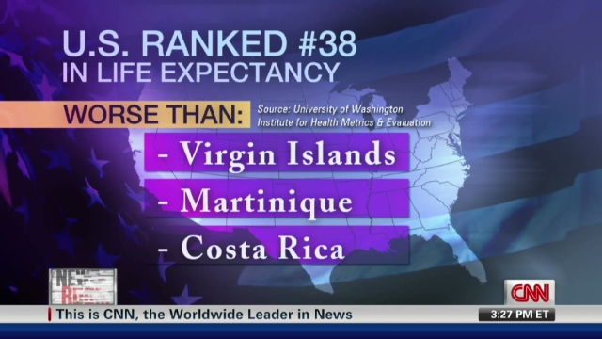
The U.S. Trails Other Nations

Slide 70
Life Expectancy
Years
Note: Data are for 2010 or most recent year available
Source: OECD, 2012

Slide 71
Infant Mortality
Deaths in First Year of Life Per 1,000 Live Births
Note: Data are for 2010 or most recent year available
Source: OECD, 2012

Slide 72
Maternal Mortality
Deaths per 100,000 Live Births
Note: Data are for 2009 or most recent year available
Source: OECD, 2011

Slide 73
Smoking Prevalence
Percent of population over age 15 who smoke daily
Note: Data are for 2010 or most recent year available
Source: OECD, 2012

Slide 74
Hospital Inpatient Days per Capita
Note: Data are for 2010 or most recent year available
Source: OECD, 2012

Slide 75
Physician Visits per Capita
Note: Data are for 2010 or most recent year available
Source: OECD, 2012

Slide 76
Acute MI Outcomes
In-Hospital 30-Day Case-Fatality Rate
Deaths per 100 patients
Note: Short LOS may cause understatement of US in-hospital fatality rate
Source: OECD, 2012

Slide 77
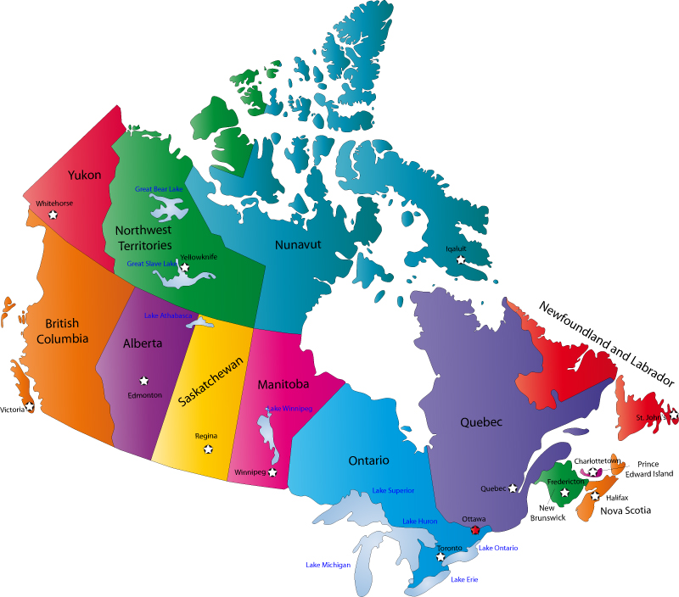
Canada’s National Health Insurance Program

Slide 78
Minimum Standards for
Canada’s Provincial Programs
Universal coverage that does not impeded, either directly or indirectly, whether by charges or otherwise, reasonable access.
Portability of benefits from province to province
Coverage for all medically necessary services
Publicly administered, non-profit program

Slide 79
% of People with an Unmet Health Need
Canadians and US Insured Are Similar
Source: Joint Canada/US Survey of Health, 2002-03.
CDC and Statistics Canada

Slide 80
Infant Mortality
30
20
10
Deaths per 1,000 Live Births
First province implements NHP
USA
Canada
1955 | 1965 | 1975 | 1985 | 1995 | 2009
Sources: Statistics Canada, Canadian Institute for Health Information, National Center for Health Statistics

Slide 81
Health Costs as % of GDP
17%
15%
13%
11%
9%
7%
5%
Canada’s NHP Enacted
USA
Health costs % of GDP
NHP Fully Implemented
“Uniquely American”
Canada
1960 | 1970 | 1980 | 1990 | 2000 | 2010
Source: Statistics Canada, Canadian Institute for Health Info, and NCHS/Commerce Dept.

Slide 82
US Medicare Coverage
Much Worse than Canada’s
Percent of seniors’ total medical expenses covered
Note: Not comparable to figures for employer coverage because of high LTC needs in elderly
Source: EBRI and Himmelstein/Woolhandler analysis of Health Canada data

Slide 83
Cost Control in a Parallel Universe
Growth in Medicare Spending Per Senior
Source: Himmelstein & Woolhandler
Arch Intern Med, December, 2012

Slide 84
Hospital Billing and Administration
Dollars per capita, 2011
Source: Woolhandler/Himmelstein/Campbell
NEJM 2003;349:769 (updated 2012)

Slide 85
Physicians’ Billing and Office Expenses
Dollars per capita, 2011
Source: Woolhandler/Himmelstein/Campbell
NEJM 2003;349:769 (updated 2012)

Slide 86
Difference in Health Spending
Per capita data.
Sources: Woolhandler/Himmelstein/Campbell NEJM 2003;349:769 (updated 2012). NCHS and CIHI

Slide 87
Few Canadians Seek Care in the US
40% of US ambulatory facilities near border treated no Canadians last year; another 40% <1/month
Michigan + New York + Washington hospitals treated a total of 909 Canadians/year (only 17% of them elective).
Of “America’s Best Hospitals”, only one reported treating more than 60 Canadians/year.
In a survey of 18,000 Canadians, 90 had received any medical care in the US last year – only 20 had gone to the US seeking care.
Surveys of US ambulatory providers near the border,
hospital discharges, and Canadian citizens
Source: Health Affairs 2002;21(3):19

Slide 88
Few Canadian Physicians Emigrate
Net loss (number moving abroad – number returning)
A negative number indicates that more physicians returned from abroad then moved abroad
Source: Canadian Institute for Health Information

Slide 89
Canadian Physicians’ Incomes
Specialty | 2009/10 Income
Family Medicine | $248,716
Internal Med | $354,490
Pediatrics | $263,545
Psychiatry | $203,152
Dermatology | $391,686
OB-GYN | $429,954
General Surgery | $404,847
Thoracic Surgery | $528,266
Ophthalmology | $551,666
All Physicians | $293,472
Reduced administrative burdens
in practice, saving $60-80,000 per MD
Reduced malpractice expense
(cost of future care not needed in payments)
Source: Canadian Institute for Health Information

Slide 90
Canadian Malpractice Insurance Costs
Specialty | Ontario* | Quebec | Other Provinces
FP/GP/Psych | $648 | $1,373 | $1,152
Cardiology | $1,428 | $2,747 | $1,728
Anesthesia | $4,896 | $7,377 | $3,552
Neurosurgery | $4,896 | $31,575 | $23,256
OB-GYN$4896 | $4,896 | $36,140 | $14,292
*Ontario reimburses physicians for premiums about 1986 level
Source: Canadian Medical Protective Association
www.cmpa-acpm.ca

Slide 91
What’s OK in Canada?
Compared to the USA…
Life expectancy 2 years longer
Infant deaths 25% lower
Universal comprehensive coverage
More physician visits, hospital care; less bureaucracy
Quality of care equivalent to insured Americans’
Free choice of doctor and hospital
Health spending half of USA level

Slide 92
What’s the Matter in Canada?
The wealthy lobby for private funding and tax cuts; they resent subsidizing care for others.
Result: government funding cuts (e.g., 30% of hospital beds closed during the 1990s) causing dissatisfaction and waits for care.
USA and Canadian firms seek profit opportunities in health care privatization
Conservative foes of public services own many Canadian newspapers
Misleading waiting list surveys by right wing Fraser Institute

Slide 93
The Rising US Popularity of
National Health Insurance
“Who should provide coverage?”
Source: CBS News / New York Times Poll, Feb. 1, 2009

Slide 94
Growing Physician Support for NHI
59% of physicians support NHI
Surveys of random samples of US physicians
Source: Carroll and Ackerman. Ann Int Med 2008;148:566

Slide 95

A National Health Program for the
USA

Slide 96
National Health Insurance
Universal – covers everyone
Comprehensive – all needed care, no co-pays
Single, public payer – simplified reimbursement
No investor-owned HMOs, hospitals, etc.
Improved health planning
Public accountability for quality and cost, but minimal bureaucracy
Proposal of the Physicians Working Group for Single Payer NHI
JAMA 2003;290:798

