Slide 1
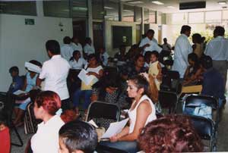
The Uninsured
Notes:
Three aspects of health care system – access, quality and cost (some add choice). I will discuss the shortcomings of our health care system in all 3 areas and compare it to a system with a national health insurance system – Canada.

Slide 2
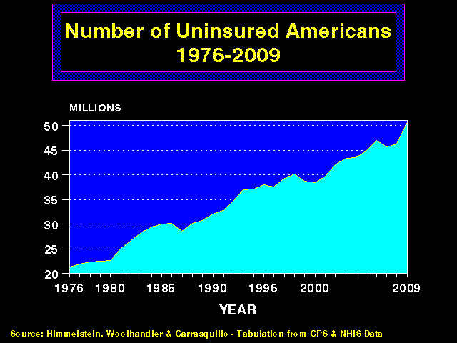
More and More
Uninsured Americans
50
45
40
35
30
25
20
Millions of Uninsured American
1976 | 1980 | 1985 | 1990 | 1995 | 2000 | 2005 | 2011
Source: Himmelstein, Woolhandler & Carrasquilo.
Tabulation from CPS & NHIS data
Notes:
Even those with insurance – private only about 65%, governemnt – Medicare, Medicaid, VA, HIS the rest.

Slide 3
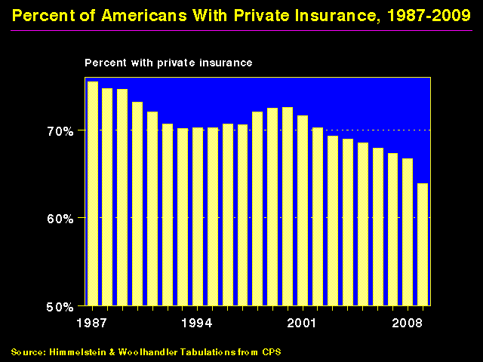
Shrinking Private Insurance, 1960-2011
80%
70%
60%
50%
Percent With Private Insurance
1960 | 1970 | 1980 | 1990 | 2000 | 2011
Source: Himmelstein, & Woolhandler, Tabulation from CPS
Data are not adjusted for minor changes in survey methodology

Slide 4
Lack of Insurance
Kills 44,798 US Adults Annually
State | Percent Uninsured | Excess Deaths
California | 23.9% | 5,302
Texas | 29.7% | 4,675
Florida | 26.0% | 3,925
New York | 17.5% | 2,254
Georgia | 23.6% | 1,841
USA | 15.3% | 44,798
Source: Wilper et al. Am J Public Health 2009.
State tabulations by author
Notes:
Delays in seeking care. Now gettting into cost of care.

Slide 5
Most of the Medically Bankrupt Had Coverage
Insurance at Illness Onset
Source: Himmelstein et al. Am J Med: August, 2009
Notes:
Underinsurance a huge problem. Increasing copays and deductibles to consumers, 16% underinsured according to the Commonwealth Fund in 2010, increasing rapidly. Even for the elderly, Medicare now covers only 51% of medical care costs.

Slide 6
Excess Deaths Among African Americans
83,369 fewer would have died in 2000 if racial gap were eliminated
Excess African American deaths
Source: Satcher et al. Health Affairs 2005;24:459
Notes:
Disparity depending on ethnicity, income (getting worse with rising income inequality), immigration status.

Slide 7
Unnecessary Procedures
Percent of Procedures
Source: Commonwealth Fund.
Quality of Healthcare in the U.S. Chartbook 2002
Notes:
Quality of care issues. Overuse of imaging procedures, joiny replacements and many others. Idea that doing something is always better than waiting. Risk of unnecessary testing, procedures.

Slide 8
Growth of Physicians and Administrators
3000%
2500%
2000%
1500%
1000%
500%
0
Growth Since 1970
1970 | 1980 | 1990 | 2000 | 2010
Physicians
Administrators
Source: Bureau of Labor Statistics; NCHS; Himmelstein/Woolhandler analysis of CPS

Slide 9
Private Medicare Advantage Plans’
High Overhead
Overhead
per enrollee
2008
Source: US House Committee on Energy and Commerce. December, 2009
Notes:
ACA and ACOs – remembrance of things past – HMOs.
Medicare HMO enrollment has grown. Old data and new paper showing when people are healthy, they sign with Medicare Advantage, and leave for traditional Medicare when sick.

Slide 10
A Few Sick People
Account for Most Health Dollars
Percent of total health spending accounted for by decile
Top 2 deciles account for 78.3%
Decile of Privately Insured
Source: MEPS Data, from Thorpe and Reinhart
Notes:
Chronically ill, severe acute disease.

Slide 11
Risk Adjustment Increased
Medicare HMO Overpayment
$4,000
$3,000
$2,000
$1,000
0
Overpayments
due to
Cherry Picking
Overpayment to HMOs per Medicare Enrollee
Congress-mandated overpayments
Payments adjusted for age, sex, and ESRD
Same plus 70 diagnoses adjusted
Actual impact of 2004 change in Risk Adjustment formula
Source: NBER Working Paper 16799, April 2011
Notes:
Many attempts to risk-adjust payments to prevent cheery-picking. Initially done just with age and gender and ESRD, then many diagnoses added. Problem got worse. Procedures done to make people appear sicker – ie ultrasound to detect evidence of CHF.
RAND experiment – eople in HMOs had lower quality care. HMO overhead between 15-25% (limited to 20% by ACA).

Slide 12

ACOs:
A Rerun of the HMO Experience?

Slide 13
ACOs = Medical Practices Owned by
Corporate Oligopolies
Notes:
Original data looked at ACOs run by primary care physicians, improved quality and access. Not how things are turning out – insurance companies and hospitals.

Slide 14
Insurers Morphing into ACOs:
Purchases of Clinics and Practices, 2011
UnitedHealth bought Monarch Healthcare – a Pioneer Medicare ACO with 2,300 physicians
Wellpoint paid $800 million for CareMore – a chain of 28 clinics with employed physicians
Humana purchased SeniorBridge – an in-home care manager with 1500 providers - and Concentra for $790 million – an urgent care and occupational health clinic firm
Source: Business Insurance, 1/15/12

Slide 15
Assumptions Implicit in
“Pay for Performance” (“P4P”)
1. Performance can be accurately ascertained
2. Individual variation is caused by variation in motivation
3. Financial incentives will add to intrinsic motivation
4. Current payment system is too simple
5. Hospitals/MDs delivering poor quality care should get fewer resources
Notes:
Part of ACA – change how physicians are hospitals are paid – bundled care, outcome of care, readmission rates.
Patient satisfaction – depends more on patient characteristics than physician – insurance status, SES

Slide 16
P4P Can Dissociate
People From Their Work
“I do not think it’s true that the way to get better doctoring and better nursing is to put money on the table in front of doctors and nurses. I think that's a fundamental misunderstanding of human motivation.
“I think people respond to joy and work and love and achievement and learning and appreciation and gratitude - and a sense of a job well done. I think that it feels good to be a doctor and better to be a better doctor.
“When we begin to attach dollar amounts to throughputs and to individual pay we are playing with fire. The first and most important effect of that may be to begin to dissociate people from their work.”
Source: Health Affairs 1/12/2005
Don Berwick, M.D.

Slide 17
Medicare’s Premier Demonstration:
A P4P Failure at 252 Hospitals
Worse
5-year outcomes show no effect on mortality
Change from baseline in 30-day mortality
Better
Note: P4P failed even among poor performers at baseline
Source: NEJM march 28, 2012
Notes:
Cochrane- we found no evidence that financial incentives can improve patient outcome.

Slide 18
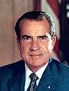
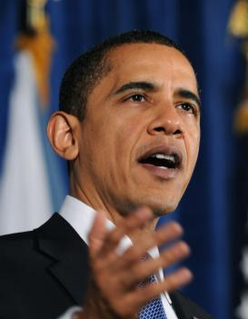
“Mandate” Model for Reform
Expanded Medicaid-like program
  Free for poor
  Subsidies for low income
  Buy-in without subsidy for others
Employer mandate +/- individuals
Managed Care / Care Management
Notes:
18
Keeping private insurance companies in charge.

Slide 19
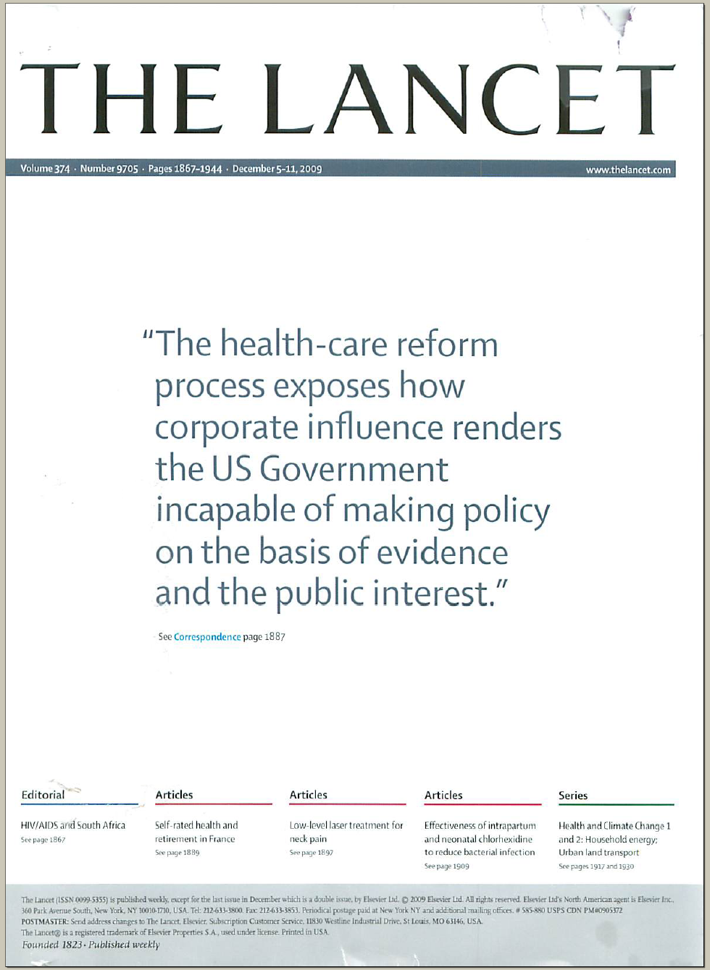
The Lancet Put It On Their Cover
“The health-care reform process exposes how corporate influence renders the US Government incapable of making policy on the basis of evidence and the public interest.”
Source: Lancet Dec 5, 2009. Cover of vol. 374.

Slide 20
Impact of ACA on the Uninsured
Reduced from ~50M to ~30M in 2019, i.e., from 17% to 11% of population.
Safety-Net Hospitals
Community Health Centers
Number of Uninsured
Funding through Medicare cut by $36 billion through 2019.
Receive extra $1 billion annually – maybe!
Notes:
Reccent numbers are worse, due to empolyers dropping coverage and paying “fine”.

Slide 21
US Public Spending per Capita
Exceeds Total Spending in Other Nations
Our Public Spending Exceeds
Everyone Else's’ Total Spending
2010 healthcare spending per capita
Data are for 2010
Sources: OECD 2012; Health Affairs 2002 21(4)88
Notes:
Is there another way?

Slide 22
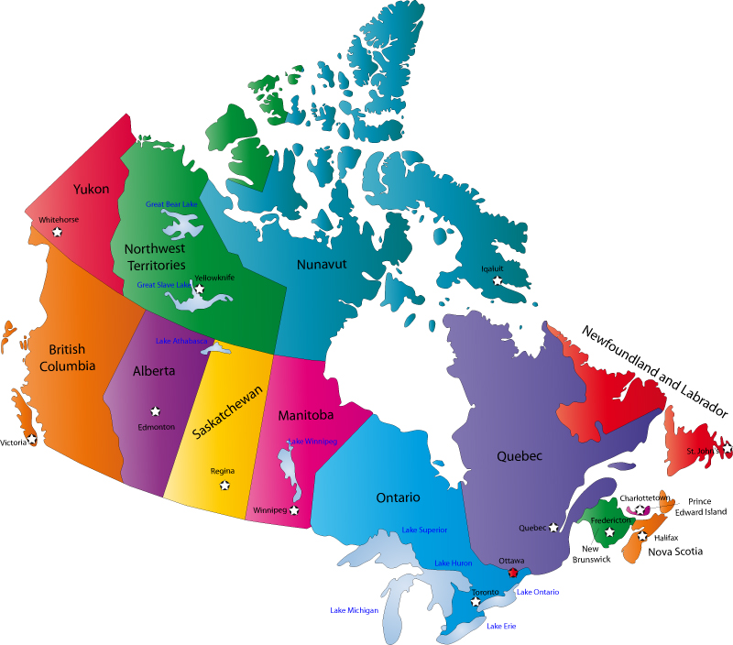
Canada’s National Health Insurance Program

Slide 23
Minimum Standards for
Canada’s Provincial Programs
Universal coverage that does not impeded, either directly or indirectly, whether by charges or otherwise, reasonable access.
Portability of benefits from province to province
Coverage for all medically necessary services
Publicly administered, non-profit program
Notes:
Paid for through a progressive income tax.

Slide 24
% of People with an Unmet Health Need
Canadians and US Insured Are Similar
Source: Joint Canada/US Survey of Health, 2002-03.
CDC and Statistics Canada
Notes:
Access.

Slide 25
Health Costs as % of GDP
17%
15%
13%
11%
9%
7%
5%
Canada’s NHP Enacted
USA
Health costs % of GDP
NHP Fully Implemented
“Uniquely American”
Canada
1960 | 1970 | 1980 | 1990 | 2000 | 2010
Source: Statistics Canada, Canadian Institute for Health Info, and NCHS/Commerce Dept.

Slide 26
Cost Control in a Parallel Universe
Growth in Medicare Spending Per Senior
Source: Himmelstein & Woolhandler
Arch Intern Med, December, 2012
Notes:
Cost.

Slide 27
Hospital Billing and Administration
Dollars per capita, 2011
Source: Woolhandler/Himmelstein/Campbell
NEJM 2003;349:769 (updated 2012)
Notes:
Single payer – less administration. True for physicians as well.

Slide 28
Few Canadians Seek Care in the US
40% of US ambulatory facilities near border treated no Canadians last year; another 40% <1/month
Michigan + New York + Washington hospitals treated a total of 909 Canadians/year (only 17% of them elective).
Of “America’s Best Hospitals”, only one reported treating more than 60 Canadians/year.
In a survey of 18,000 Canadians, 90 had received any medical care in the US last year – only 20 had gone to the US seeking care.
Surveys of US ambulatory providers near the border,
hospital discharges, and Canadian citizens
Source: Health Affairs 2002;21(3):19

Slide 29
Few Canadian Physicians Emigrate
Net loss (number moving abroad – number returning)
A negative number indicates that more physicians returned from abroad then moved abroad
Source: Canadian Institute for Health Information

Slide 30
What’s OK in Canada?
Compared to the USA…
Life expectancy 2 years longer
Infant deaths 25% lower
Universal comprehensive coverage
More physician visits, hospital care; less bureaucracy
Quality of care equivalent to insured Americans’
Free choice of doctor and hospital
Health spending half of USA level
Notes:
Hospitals given a global budget, capital expenses and operating expenses.

Slide 31
What’s the Matter in Canada?
The wealthy lobby for private funding and tax cuts; they resent subsidizing care for others.
Result: government funding cuts (e.g., 30% of hospital beds closed during the 1990s) causing dissatisfaction and waits for care.
USA and Canadian firms seek profit opportunities in health care privatization
Conservative foes of public services own many Canadian newspapers
Misleading waiting list surveys by right wing Fraser Institute

Slide 32
Growing Physician Support for NHI
59% of physicians support NHI
Surveys of random samples of US physicians
Source: Carroll and Ackerman. Ann Int Med 2008;148:566
Notes:
Support of American people as well.

Slide 33
National Health Insurance
Universal – covers everyone
Comprehensive – all needed care, no co-pays
Single, public payer – simplified reimbursement
No investor-owned HMOs, hospitals, etc.
Improved health planning
Public accountability for quality and cost, but minimal bureaucracy
Proposal of the Physicians Working Group for Single Payer NHI
JAMA 2003;290:798

