Slide 1
Politics and Public Health:
How to Frame Single Payer Arguments
Students for a National Health Program Summit
February 14, 2015
Presented by Jawad Husain
MS2, Boston University School of Medicine
Adapted from Allyson Baughman’s presentation

Slide 2
Objectives
Explain the psychological theory of "framing.“
Understand how framing influences public perception of health policy.
Apply framing strategies by making a 1-2 min pitch on single payer reform.

Slide 3
Agenda
1:15-1:25 – Intro
1:25-1:40 – Framing 101
1:40-2:00 – Create your own pitch
2:00-2:15 – Pitch presentations

Slide 4

Obamacare vs ACA
Notes:
Ask for thoughts on the clip and discuss the following questions :
-Why do people like the ACA better than Obamacare ?
-Why do people tend to agree with the policy changes of the ACA, but not agree with Obamacare?
-What is influencing the opinions of these people ?
-What sort of responses do you think you would you get if you asked the general public if they liked the Affordable Care Act or single payer national health insurance ?

Slide 5
Important Questions
How do we, as advocates, get people to think about our issues? How does an issue become a public problem?
How do we get them to think about our issues in such a way that they will want to solve them through policy and not individual action?
How do we get them to think about our issues in such a way that they will want to solve them through the policy that we support?
(Source: Framing Public Issues, Frameworks Institute, 2002)
Notes:
Framing is the symbolic side of policy making (Stone, Edelman)
Framing is the mechanism that animates the policy process

Slide 6
What do we know about how people think and make decisions?
18th Century Brain
21st Century Brain
Rooted in the Enlightenment Movement and Rationalism
All individuals are rational (we can govern ourselves)
Emotion interferes with rationality
Facts/Science are the key to optimal decision making
All thought is literal (language is neutral)
All thought is conscious
Rooted in Cognitive Science and Behavioral Economics
Two parts to the brain- fast/slow, emotional/logical
98% of thinking is unconscious
People use mental shortcuts to make sense of the world (frames, heuristics)
Incoming information provides cues to people about where to file it mentally
Conscious thought is structured by unconscious frames
People react differently to choices depending on how they are framed

Slide 7
What do we know about how people think and make decisions?
98% of thinking is unconscious
People use mental shortcuts to make sense of the world (frames, heuristics)
Incoming information provides cues to people about where to file it mentally
Conscious thought is structured by unconscious frames
Over time, we develop habits of thought and expectation and configure incoming information to conform to the dominant frame
People react differently to choices depending on whether they are presented as losses or gains
Notes:
“Frames are organizing principles that are socially shared and persistent over time, that work symbolically to meaningfully structure the social world.” Stephen D. Reese, Framing Public Life, 2001
FrameWorks’ approach to communications – is based on a decade of research in the social and cognitive sciences that demonstrates that the answers to these questions relates to what Walter Lippmann called “the pictures in our heads.” People use mental shortcuts to make sense of the world. These mental shortcuts rely on “frames,” or a small set of internalized concepts and values that allow us to accord meaning to unfolding events and new information. These frames can be triggered by various elements, such as language choices and different messengers or images. These communications elements, therefore, have a profound influence on decision outcomes.

Slide 8
Frames are…
Normal
A conceptual bedrock for understanding
System that gives words, images, actions meaning
Labels the mind uses to find what it knows
Composition of elements that trigger an idea
Real neural-cognitive structures that guide the perception and representation of reality
Organizing principles that are socially shared and persistent over time
(Source: Goffman, 1974; Lakoff 1996, Reese, 2001; Gilliam, 2003)
Notes:
Our conceptual framing can be unconscious- we may not be aware of the frames we are using
Deborah Tannen’s explanation of how frames work: “People approach the world not as naïve, blank-slate receptacles who take in stimuli …in some independent and objective way, but rather as experienced and sophisticated veterans of perception who have stored their prior experiences as an organized mass. This prior experience then takes the form of expectations about the world, and in the vast majority of cases, the world, being a systematic place, confirms these expectations, saving the individual the trouble of figuring things out anew all the time.”

Slide 10
Hierarchy of Frames
Ideas come in hierarchies
Higher frames act as primes for lower-level frames
Higher frames map their values onto the lower-level frames
Level One
  BIG ideas and values
Level Two
  Issue-types
Level Three
  Specific issues
1
2
3
Notes:
LEVEL ONE: Big ideas, like freedom, justice, community, success, prevention, responsibility
LEVEL TWO: Issue-types, like the environment or child care
LEVEL THREE: Specific issues, like rainforests or earned income tax credits
Reframes are only possible because ideas and issues come in hierarchies. The cognitive
sciences teach us that these hierarchies, or levels of thought, track and direct our thinking.
Higher-level frames act as primes for lower-level frames, and higher-level frames map their
values and reasoning onto the lower-level frames.
By appealing to higher-level values to reframe, we can signal to people how to think about
various social issues.
Can you map single payer into level one, two, and three frames?

Slide 11
Take Home Ideas
Remember the 21st Century brain
Repetition is crucial for framing
Once a frame is established, it will always trump facts, figures, numbers, and statistics
  If the facts don’t fit the frame, it is the facts that are rejected, NOT the frame
  Facts are important, but they must be framed in terms of your values
When you are framing, start with a value
Don’t use the opposition’s language
  Negating a frame activates the frame
If you don’t frame your issues, someone else will
Notes:
• People are not blank slates
• Communication resonates with people’s deeply held values and worldviews
• Communication is frame-based
• When communication is inadequate, people default to the “pictures in their heads”
• When communication is effective, people can see an issue from a different perspective
In this way, the challenge f communications becomes reframing – providing a different lens for the processing of new information. By identifying and empowering rival frames in your communications, you can signal to the public how to think about a given social issue.

Slide 12
Case Study: Obamacare
2007
2009
2011
2012
2013
2010
First use of “Obamacare”
Use on the campaign trail
Use in Congress
and the media
ACA signed into
law
Use by Democrats and
President Obama;
Presidential Campaign
Notes:
When you hear obamacare, what comes to mind?
By repeating the frame of socialism with obamacare, republicans have effectively framed the debate.

Slide 13
Numbers
Once a frame is established, it will “trump” numbers.
• Most people cannot judge the size or meaning of numbers; they need cues.
• Numbers alone often fail to create “pictures in our heads.”
(Source: Framing Public Issues, Frameworks Institute, 2002)
Notes:
An important finding from the cognitive sciences is the ability of the frame to overpower the
numbers that follow. In other words, if the facts don’t fit the frame, it’s the facts that are
rejected, not the frame. Confronted with facts that one might presume would cause the
group to reconsider its position, people opt instead to adhere to their original position and
to ignore the conflicting data.
As many have come to realize, both numbers and narratives evoke frames. The trick is how
to combine them so that they work together to evoke a frame of collective responsibility and
public policy. Here are some simple suggestions for integrating narrative and numbers:
First, never provide numbers without telling what they mean. While scientists concerned with
objectivity may feel it important to “put the numbers out there and let the facts fall where
they may,” they are setting the stage for public misunderstanding, public boredom, or public
manipulation by those who do not hold back from interpretation.
Moreover, the ratio of numbers to narrative should be relatively low. Embed the statistics in
a tight little story that tells what is happening, how big a problem this is and what can and
should be done about it.

Slide 14
How to use numbers effectively
• Use numbers sparingly. When you use dramatic numbers, you may have the inadvertent effect of making the problem seem too big, too scary, or too far away.
• Provide the meaning first, then the numbers. Use social math to reinforce that meaning.
• Use numbers strategically: not simply to establish the size of the problem, but to convey the cost of ignoring it.
• Use numbers to underscore efficacy, demonstrating cost-effectiveness.
(Source: Framing Public Issues, Frameworks Institute, 2002)
Notes:
Second, try to provide the interpretation first, then the data. That way, your numbers connect to an idea. By raising the broader principle first, you allow people to hear your numbers as evidence, not as raw data.
It is imperative that those who seek to engage and educate the public find ways to help
people imagine the reality the numbers represent, so that they can appropriately assess
what’s at stake. The Advocacy Institute and Berkeley Media Studies Group have pioneered
an approach to communicating statistics that they call “social math.” By this, they mean
“making large numbers comprehensible and compelling by 'them in a social context
that provides meaning.”
e.g. “Studies have shown that not having insurance actually increases your risk for death, even when you control for socioeconomic factors like income, and health behaviors like smoking. 45,000 Americans die every year from uninsurance. That’s over 120 people dead every day. That’s even more than the number of people who die from breast cancer or prostate cancer. That’s more than the number of people who die each day from drug overdose.”

Slide 15
Metaphors
Metaphors and models complete ways of thinking that include patterns of reasoning.
They allow us to make extensive inferences beyond the words actually used.
They are highly quotable for news media.
They offer effective alternatives to other storytelling devices.
(Source: Framing Public Issues, Frameworks Institute, 2002)
Notes:
According to researchers associated with Cultural Logic, numerous studies in the cognitive
sciences have established that both the development and the learning of complex, abstract
or technical concepts typically rely on analogies. “An explanation that reduces a complex
problem to a simple, concrete analogy or metaphor contributes to understanding by helping
people organize information into a clear picture in their heads, including facts and ideas
previously learned but not organized in a coherent way,” says psychological anthropologist
Axel Aubrun. Once this analogical picture has been formed, it becomes the basis for new
reasoning about the topic. Better understanding also leads to an increase in engagement
and motivation.
Example: Berwick, a former administrator of the Centers for Medicare & Medicaid Services, says a single payer system is a way to reduce waste in large medical systems. He says the current way medical payments work in the state is as if a commuter had to have a different form of payment for each stop in the MBTA network — a certain card to get on at Park Street, another form of payment required to board at Ashmont — and only sometimes knew the price when he or she boarded. He said the current medical payment system lacked consistency and transparency.
Single-payer, he said, is like a CharlieCard: It’s “one route of entry into the system and everybody has it.”

Slide 16
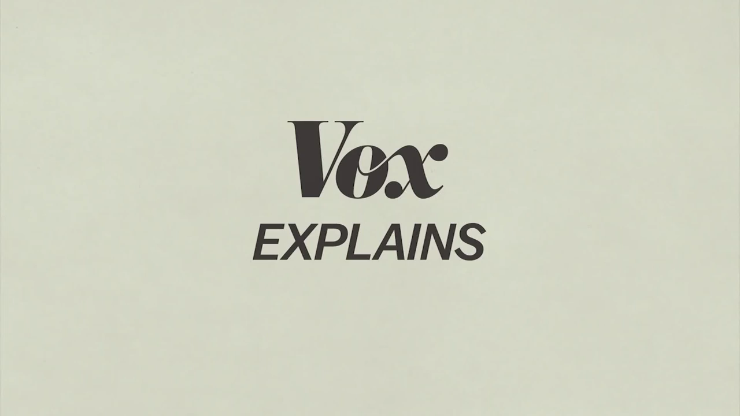
Example

