Slide 1
The Uninsured

Slide 2
Uninsured All Year, 1940-2024
Medicare / Medicaid
Millions
Projected
Source: Social Security Bul, HIAA, CPS, and CBO estimate

Slide 3
37,117 Deaths During 2017 Due to Uninsurance
State | % Uninsured | Excess Deaths
Texas | 17.3 | 6,264
California | 7.2 | 3,637
Florida | 12.9 | 3,480
Georgia | 13.5 | 1,788
New York | 5.7 | 1,447
USA | 8.8% | 37,117
Woolhandler & Himmelsetin. Ann Int Med 2017;167:424
Based on best estimate from multiple studies of 1 death per 769 uninsured/year

Slide 4
Medicaid: Poor Access, But Better Than Nothing

Slide 5
Medicaid Enrollment, 1987-2018
Millions of Americans
Bureau of the Census and Kaiser Foundation

Slide 6
Many Specialists Won’t See Kids With Medicaid
% of Clinics Scheduling
Appointments for Children
Bisgaier J, Rhodes KV.
N Engl J Med 2011;364:2324-2333
Notes:
6
Figure 2 Clinics Scheduling Specialty Care Appointments for Children, According to Type of Insurance. Public insurance was reported by callers as the Illinois Medicaid–Children's Health Insurance Program (CHIP) umbrella program; private insurance was reported by callers as Blue Cross Blue Shield. Each of the 273 clinics was called twice (for a total of 546 calls) by the same caller, with only insurance coverage varying between the two calls: once reporting Medicaid–CHIP coverage and once reporting private coverage. Calls were made 1 month apart, and the order of the reported insurance status was randomly assigned. Asthma clinics included 38 allergy–immunology clinics and 6 pulmonary disease clinics.

Slide 7
Underinsurance Impedes Access, Worsens Health, Bankrupts Families

Slide 8
Under-Insurance Growing
Percent of Adults 19-64 under-insured*
Commonwealth Fund Health insurance Survey 2016
*Under-insurance = OOP >10% of income, or >5% of income if low income, or deductible >5% of income

Slide 9
Many Plans Now Pay Nothing for Out of Network Care
Small Group Plans
Percent with any out-of-network benefit
Individual Plans
Source: RWJF 10/4/2018

Slide 10
Uninsured and Under-Insured Delay Seeking Care for Heart Attacks
Odds ratio for delayed care*
Source: JAMA April 15, 2010. 303:1392
*Adjusted for age, sex, race, clin. charact., hlth status, social/psych fx, urban/rural.
Under-insured=had coverage but patient concerned about cost

Slide 11
Higher Medication Co-Pays = Worse Pediatric Asthma Outcomes
Children age 5-18
Source: JAMA 2012;307:1284

Slide 12
Prisoners Face Copays for Care
42 states and federal prison system charge copays for a visit.
Average copay = $3.47/visit.
Oklahoma example
Prisoners earn 5 cents per hour
$4 copay per visit = 80 hours of work income
Copay is equivalent of $580 at minimum wage
Source: The Marshall Project. May 30, 2018

Slide 13
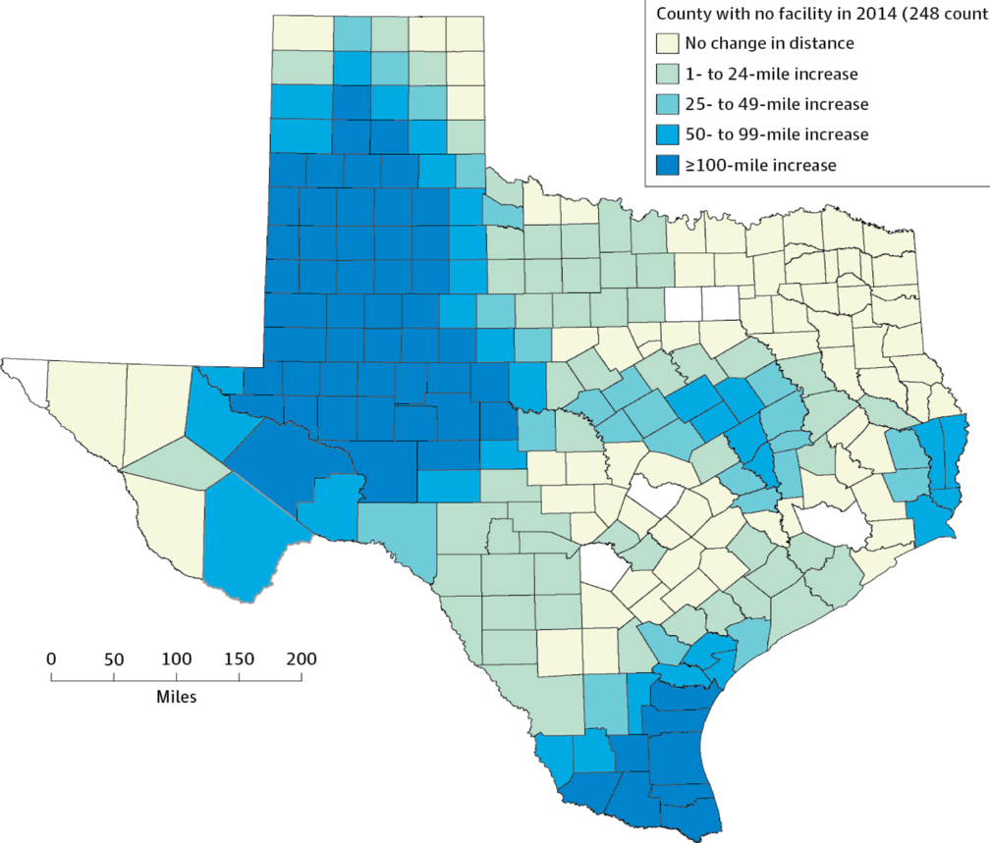
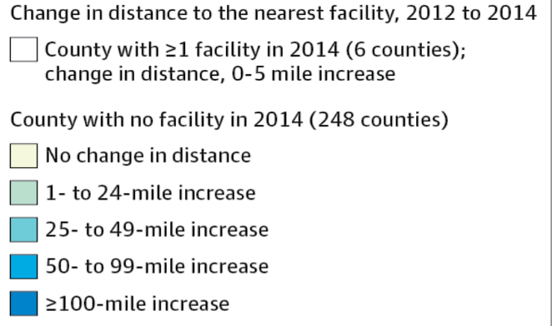
Texas Is Putting Abortion Facilities Out of Reach: Forcing Women to Travel 100 Miles Further
Copyright © 2012 American Medical Association.
All rights reserved

Slide 14
Medical Bills Are Most Common Reason for Collection Calls
Percent of Consumers Receiving Collection Calls with Specific Type of Debt
Medical collection calls were the only category which did not differ by income
Consumer Financial Protection Bureau, January 2017

Slide 15
Medicare Needs Improvement
Percent of seniors spending at least 20% of income on premiums and out-of-pocket costs
For many seniors,
medical costs consume
more than 1/5th of income
Income Group (% of Federal Poverty Level)
Commonwealth Fund, May 12, 2017

Slide 16
Rising Economic and Health Inequality

Slide 17
Mean Family Income for Each Fifth: 1966 – 2016 (Inflation Adjusted)
Income
Source: Bureau of the Census
Constant USD, 2015

Slide 18
Widening Gap in Life Expectancy Between High and Low Earners
Remaining Life Expectancy for Men Turning 60
Source: Waldron. ORES, Social Security Admin, #108, 2007

Slide 19
Progress on Mortality Halted
Age adjusted mortality per 100,000
Source: NCHS
Note: Data for 2017 is preliminary

Slide 20
Persistent Racial Inequalities

Slide 21
Black Americans Die Younger
Life Expectancy at birth
CDC, 2015 – Final Mortality Data for 2013
*Hispanics can be of any race, and Blacks and Whites include some Hispanics

Slide 22
Racial Differences in Maternal Mortality
Deaths per 100,000
Data for 2011-2014
Source: CDC, 2018

Slide 23
Median Family Income
Median income
(Inflation Adjusted, 2015 $s)
Whites
Blacks
Bureau of the Census, 2016 data

Slide 24
Police More Likely to Kill Minority Men
Police killings per day in USA: 2.8
Police killings account for
8% of all USA homicides
Police killings per 100,000 men
Source: AJPH 2018;108:1241

Slide 25
Black Enrollment in U.S. Medical Schools, 1976-2017
AAMC Goal:
11.7%
Percent Blacks in 1st Year Medical School Class
RWJ Fdn. 1987; AAMC;
JAMA Annual Medical Education Special Issue

Slide 26
Minority Children and Youth Get Few Psychiatrist Visits
Psychiatrist visits per year per 1,000 population
Source: Marrast, Himmelstein, Woolhandler. Int J Hlth Serv 2016

Slide 27
Blacks in VA: No Health Disadvantage
Odds ratio for Black vs White Vets
(<1 indicates lower rate for Blacks)
Kovesdy et al. Circulation 9/18/2015
Longitudinal study of 3,072,966 Vets cared for at VAs

Slide 28
Immigrants Get Little Care
Total Health Care
ED Care
Children
Health Care
$ per capita
*Adjusted for ethnicity, poverty, age, insurance status, patient/parent-reported health status
Source: Mohanty et al. Am J Public Health 2005;95:1431

Slide 29
Low Birth Weight Increased in Iowa After a Massive Immigration Raid
Relative Risk of Low Birth Weight
Int J Epidemiol 2017;839
Note: 2008 Postville, Iowa raid was the largest single-site immigration raid in history. 900 agents handcuffed and chained all Latinos at meatpacking plant.

Slide 30
Immigrants Keep Medicare Afloat
$3.7 Billion
$10.1 Billion
Net contribution to Medicare Trust Fund, 2009
-$30.9 Billion
Source: Zallman et al, Health Affairs 2013;32:1153

Slide 31
Administrative Overhead Rising

Slide 32
Growth of Physicians and Administrators
Growth since 1970
Bureau of Labor Statistics; NCHS; Himmelstein/Woolhandler analysis of CPS
Managers shown as moving average of current year and two previous years

Slide 33
Doctors Spend Twice as Much Time on EHR/Desk Work as With Patients
Source: Sinsky et al. Ann Int Med 9/6/2016 – based on time/motion observation + home diary
Note: Figures are percent of office hours – exclude the 1-2 hrs/night of home EHR/desk work

Slide 34
EPIC EHR Notes Longer in US Documentation Driven by Payment Complexity
International
USA
Number of Institutions
Average Number of Characters per Ambulatory Note
Source: Ann Intern Med 2018; 169:51
13 international organizations represent 140,000 notes from Canada, the UK, Australia, the Netherlands, Denmark, the United Arab Emirates, and Singapore.
254 organizations within the United States represent 10 million notes.

Slide 35
Investor-Owned Care: Inflated Costs, Inferior Quality

Slide 36
Extent of For-Profit Ownership
Commerce Dept. Service Annual Surveys & MedPac. Data are Q1, 2017 or most recent available.
* Data are for non-government-owned hospitals
** Data are for share of establishments

Slide 37
Health Industry Profits, 2017
Pharmaceuticals | $44.4 B
Insurers | $21.8 B
Pharmacy / Lab Benefit Mgr. | $14.3 B
Equipment / Supplies | $7.7 B
Distributors / Wholesalers | $7.4 B
Fortune 500, 2018
Note: Pharma profits reflect one time tax charges for repatriated profits

Slide 38
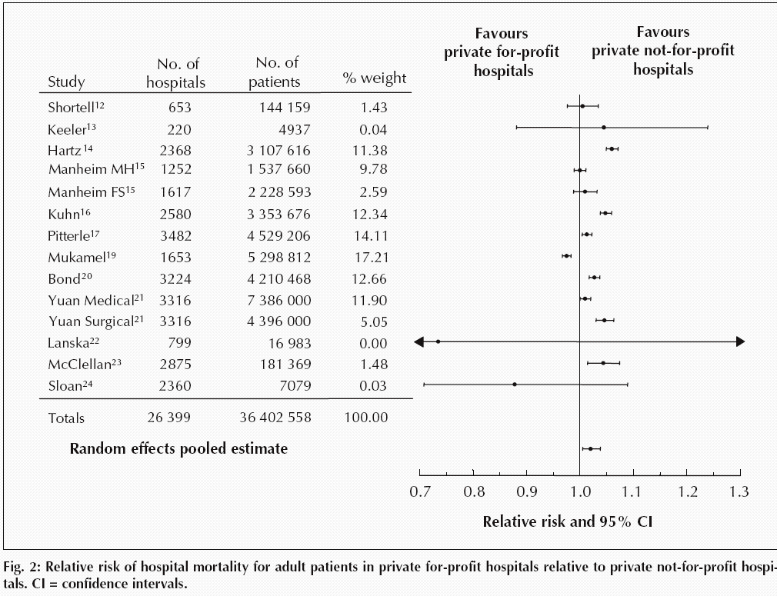
For-Profit Hospitals’ Death Rates Are 2% Higher
Relative risk of hospital mortality for adult patients in private for-profit hospitals relative to private not-for-profit hospitals
Source: CMAJ Devereaux et al. 166 (11): 1399.

Slide 39
For Profit Hospitals Have Highest Readmission Rates for Every Condition
Readmission
rate adjusted
for severity
(Expected
rate = 1.0)
Source: PLOS One 9/18/2018 – based on Medicare data 2012-2015

Slide 40
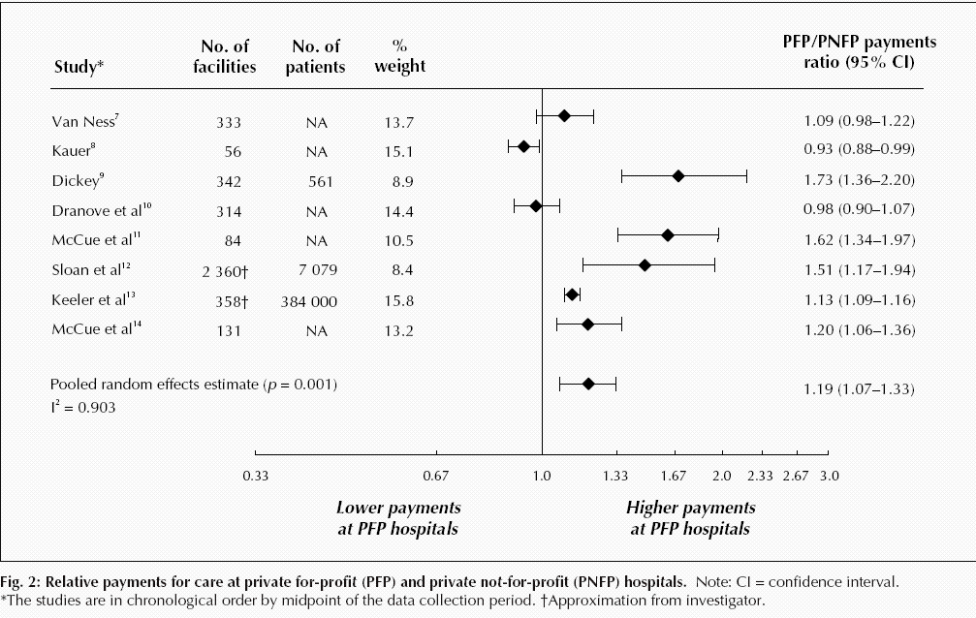
For-Profit Hospitals Cost 19% More
Relative payments for care at private for-profit (PFP) and private not-for-profit (PNFP) hospitals
Source: CMAJ Devereaux et al. 170 (12): 1817.

Slide 41
For-Profit Hospitals’ Administrative Costs Are Higher
Percentage spent on administration
Himmelstein and Woolhandler
Analysis of 2011 Medicare hospital cost reports

Slide 42
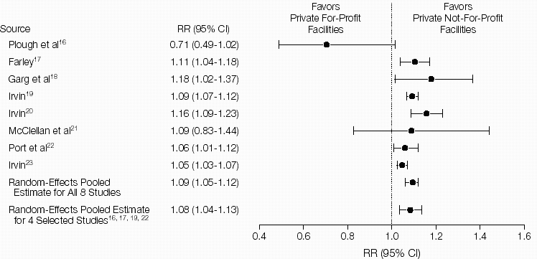
For-Profit Dialysis Clinics’ Death Rates Are 9% Higher
Relative Risk (RR) of Morality in Hemodialysis Patients
Source: JAMA 2002;288:2449
Notes:
42

Slide 43
Investor-Owned Nursing Homes: Worse Quality
Deficiencies per Nursing Home,
or % of Nursing Homes with 1 or more deficiencies
Inspections found more,
and more severe,
deficiencies
Source: CMS – Nursing Home Data Compendium 2015
”Severe” defined as actual harm or immediate jeopardy to patients

Slide 44
Hospice Goes For-Profit
Percent of hospices under for-profit ownership
Source: MEDPAC annual report, 2018 and previous reports
Profit rate: for-profits = 16.4%; non-profits = .1%.
Mean LOS: for-profits = 106 days; non-profits = 66 days

Slide 45
For-Profit Hospices Avoid Unprofitable Patients
Likelihood of accepting all patients, regardless of care needs
(and profitability)
Source: Health Affairs 2012;31:2690
Note: Based upon accepting patients on chemo, TPN, transfusions, tube feeds, intrathecal cath, palliative radiation, or living alone

Slide 46
USA Spends the Most on Drugs Double the OECD Average
Per capita spending on prescription drugs
Sources: OECD, 2018
Note: Data are for 2016 or most recent year available.

Slide 47
Insulin Cost Tripled 2006-2013
Average cost per patient in 2013:
$736
Mean expenditure per patient for insulin
Source: JAMA 2016;315:1400

Slide 48
Drug Company Profits
Return on Revenue (%)
Fortune 500 rankings for 1995-2017
Total drug company profits, 2017= $44.4 billion. Depressed by one-time charges for repatriated profits

Slide 49
Goldman Sachs asks in biotech research report: “Is Curing Patients a Sustainable Business Model?”
“The success of its [Gilead’s] hepatitis C franchise has gradually exhausted the available pool of treatable patients…
“In the case of infectious diseases such as hepatitis C, curing existing patients also decreases the number of carriers able to transmit the virus to new patients.”
CNBC Investing
Tae Kim @firstadopter. Published 3:15 PM ET Wed, 11 April 2018. Updated 7:20 PM ET Wed, 11 April 2018

Slide 50
Insurance Overhead, 2018
Medical Loss Ratio
SEC filings for first or second quarters, 2018
Note: Medical Loss Ratio = 1 – (medical benefits/premiums)

Slide 51
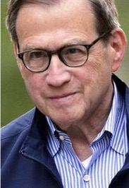
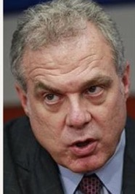
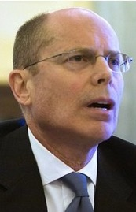
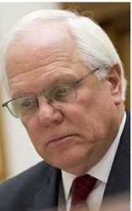
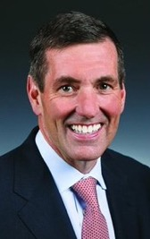
Health Insurance Company CEOs’ Totay Direct Compensation, 2016
Michael Neidorff | David Cordani | Mark Bertolini
Steve Helmsley | Joseph Swedish | Bruce Broussard
Centene
Annual Comp:
$32.2 M
Pay/Day:
$123,225
Cigna
Annual Comp:
$21.9 M
Pay/Day:
$84,017
Aetna
Annual Comp:
$ 41.7M
Pay/Day:
$159,647
Median earnings of full-time
wage and salary workers in 2016:
$43,264
United
Annual Comp:
$31.3 M
Pay/Day:
$119,918
Wellpoint
Annual Comp:
$17.1 M
Pay/Day:
$65,356
Humana
Annual Comp:
$17.0M
Pay/Day:
$65,208
Sources: DEF 14A Schedules, SEC; Bureau of Labor Statistics; Current Population Survey.
Annual CEO compensation includes salary, non-equity incentive pay, other compensation, and value of stock options exercised and stock awards that vested. In addition, these CEOs were given stock and option awards totaling $78.6 million (in aggregate) this year, which will provide value in future years.

Slide 52
Medicare: More Efficient than Private Insurers

Slide 53
Medicare Advantage Plans’ High Overhead
Sources: GAO 12/2013 and Medicare Trustees Report 2012 – Figures are for 2011
Note: MA overhead = $905/enrollee; profit = $447/enrollee
Total MA profit = $3.3 Billion

Slide 54
Medicare Advantage Plans’ Narrow Networks
More than a third of all Medicare Advantage plans lack an NCI cancer center.
49% of narrow networks exclude academic med centers.
Sources: Kaiser Family Foundation June, 2016
Note: “Narrow” = <30% of hospitals; “Medium Small” = 20-49%; “Medium” = 50-69%; “Broad” = >69%

Slide 55
Despite Medicare’s Lower Overhead, Medicare Advantage Plans Outcompete Traditional Medicare by Cherry Picking, Upcoding, and Lobbying for Overpayment

Slide 56
Medicare HMO Enrollment
Medicare HMO Enrollees (millions)
Source: CMS

Slide 57
Medicare and Medicaid Keep Private Insurers Afloat
Revenues of five largest private insurers,
$ Billions
Private
Medicare and Medicaid
Source: Health Affairs 2017;36:2185
Notes:
Aetna, Anthem, CIGNA, Humana, and United Healthcare
Figures exclude government payments for public workers’ coverage

Slide 58
A Few Sick People Account for Most Health Spending
Percent of total spending accounted for by each decile among non-institutionalized Americans
81.5%
Decile of Health Spending
Source: JAMA 2016;316:1348

Slide 59
Sickest Patients Switch Out of Medicare Advantage
Percent switching out during 2011
Plan switched out of:
Traditional Medicare
Medicare Advantage
Health Affairs 2015;34:1675
Similar results for patients with hospital or home care use, more marked among dual eligibles

Slide 60
CMS Payment to MA Plans: Same Patient, Different Coding
Original Coding
Base rate | $3,950
DM 2, uncomplicated | $1,040
Chronic Kidney Disease | $0
Obesity | $0
Depression | $0
Coronary Art. Dis., Chronic | $0
Total | $4,990
Enhanced Coding
Base rate | $3,950
DM 2 with Diabetic CKD | $3,180
CKD Stage 4 | $2,370
Morbid Obesity | $2,730
Major Depression | $3,950
CAD with Angina | $1,400
Total | $17,580
Enhanced Coding
Base rate | $3,950
DM 2 with Diabetic CKD | $3,180
CKD Stage 4 | $2,370
Morbid Obesity | $2,730
Major Depression | $3,950
CAD with Angina | $1,400
Enhanced Coding
Base rate | $3,950
DM 2 with Diabetic CKD | $3,180
CKD Stage 4 | $2,370
Morbid Obesity | $2,730
Major Depression | $3,950
Enhanced Coding
Base rate | $3,950
DM 2 with Diabetic CKD | $3,180
CKD Stage 4 | $2,370
Morbid Obesity | $2,730
Enhanced Coding
Base rate | $3,950
DM 2 with Diabetic CKD | $3,180
CKD Stage 4 | $2,370
Enhanced Coding
Base rate | $3,950
DM 2 with Diabetic CKD | $3,180
Enhanced Coding
Base rate | $3,950
SGIM Forum, 2017

Slide 61
Audits Found Massive Overpayments to MA Plans
Audits of 5 plans – Aetna, Humana, UnitedHealthcare, Independence Blue X, Lovelace
Plans overstated risk score for >80% of patients, resulting in overpayments for 58% of enrollees. Only 7.5% were “under-coded”.
Overcoding caused overpayment of $3,300/enrollee
Schulte. Center for Public Integrity, 7/10/15

Slide 62
Medicare Overpays Private Plans
Overpayments ($ Billions)
Total overpayments 2008-2016:
$173.7 Billion
Source: MedPAC and Geruso and Layton, 2015

Slide 63
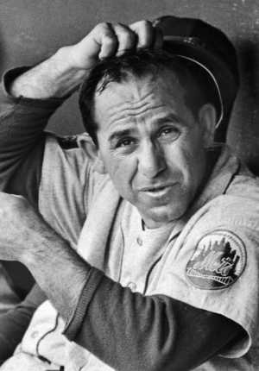
ACOs: Warmed Over Managed Care

Slide 64
HMO and ACO Similarities
Diagnosis:
FFS and “Fragmentation”
Rx:
Invert FFS incentives
Shift insurance risk to providers
Protect” patients with P4P
Consolidate providers into entities large enough to be “held accountable” for cost (via capitation)

Slide 65
ACOs’ Explosive Growth Since 2010
Number of ACOs
Sources: Health Affairs Blog 10/31/13 and 3/31/15. Leavitt Partners 6/28/17

Slide 66
Physician-Leadership of ACOs Waning
Share of ACOs led by physicians
Source: Modern Healthcare 2/5/18:18
Physician-led = no formal affiliation with a hospital

Slide 67
Poll: Patients Reject ACOs
“Here are two different ways Medicare could pay doctors.
Which of these do you think
would be better for you?”
NEJM 2013;369:1066 – Kaiser/RWJ/Harvard Survey, 201

Slide 68
Claims for ACO Savings Ignore Bonuses ACOs Slightly Increased Medicare’s Costs, 2013-2017
Medicare Payments
to ACOs,
2013-2017
$ Millions
2013
Total:
-$2,701
Million
2014
2015
2016
2017
Source: DHHS Inspector General, August 2017, and CMS 9/2018

Slide 69
Hospitals Merging
System-Owned
Proportion of Hospitals That Are System-Owned vs. Independent
Independent
Source: Sanofi Hospital/Systems Digest, 2016

Slide 70
Hospitals and Health Systems Are Buying Up Primary Care Practices
50%
40%
30%
20%
10%
0
Hospital or Health Care System
Practice Ownership
Solo Practice
Medical Group
2010 | 2011 | 2012 | 2013 | 2014 | 2015 | 2016
Trands in Practice Ownership
Brent D. Fulton Health Aff 2017;36:1530-1538
Notes:
Percentages of primary care physicians working in organizations, by ownership type, 2010–16

Slide 71
Hospital-Owned Practices: More IT, Higher Costs, More Readmissions
Rate compared to physician-owned practices
Source: Health Services Research – Online ahead of print July 5, 2018
Note: Comparisons are adjusted for multiple patient characteristics

Slide 72
The Toxicity of Pay for Performance (P4P)

Slide 73
Assumptions Implicit in P4P
Performance can be accurately ascertained
Individual variation is caused by variation in motivation
Financial incentives will add to intrinsic motivation
Current payment system is too simple
Hospitals/MDs delivering poor quality care should get fewer resources

Slide 74
Quality Scores Tell More About Patients than Physicians Harvard physicians with poorer/minority patients score low
Patient characteristics in panels of high-
and low-scoring physicians
Source: Hong C et al. JAMA 9/8/2010. 304:10;1107.

Slide 75
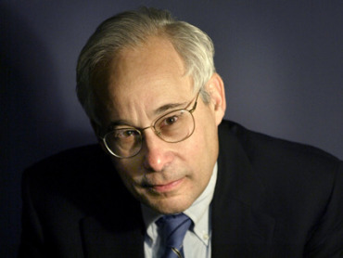
Pay for Performance?
“I do not think it’s true that the way to get better doctoring and better nursing is to put money on the table in front of doctors and nurses. I think that's a fundamental misunderstanding of human motivation.
“I think people respond to joy and work and love and achievement and learning and appreciation and gratitude – and a sense of a job well done. I think that it feels good to be a doctor, and better to be a better doctor.
“When we begin to attach dollar amounts to throughputs and to individual pay, we are playing with fire. The first and most important effect of that may be to begin to dissociate people from their work.”
– Don Berwick M.D.
Health Affairs. 1/12/2005

Slide 76
95% of Plans Cheat on HEDIS Quality Measures
Medicare Advantage plans failing to cheat fall in rankings
Percent of elderly patients prescribed drugs that should be avoided
Annals of Internal Medicine 2013;159:456
Researchers compared reported HEDIS scores for high risk prescribing to actual Medicare Part D payment records for all enrollees and for enrollees sampled for HEDIS scoring

Slide 77
Performance Monitoring Increased Documentation of Alcohol Counseling, But Not Real Counseling Rate
Alcohol counseling rate among patients screening positive for unhealthy use
Source: JGIM 2017;33:268

Slide 78
Medicare’s Readmission Penalties: Fewer CHF Readmissions, More Deaths
Source: Gupta et al. JAMA Cardiology. Posted online 11/12/2017
Note: Analysis based on 115,245 CHF discharges, 2008-2014

Slide 79
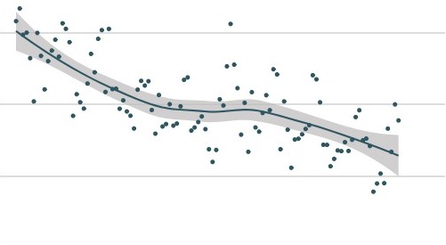
Did Readmission Penalties Slow Improvement in MI Mortality?
10%
9%
8%
7%
In-Hospital Mortality Rate
Readmission Penalties Announced
2006 | 2008 | 2010 | 2012 | 2014 | 2016
Source: JAMA Network Open. 2018;1(5):e182777

Slide 80
The ACA:
Modest Improvement in Access;
Raised Administrative Costs

Slide 81
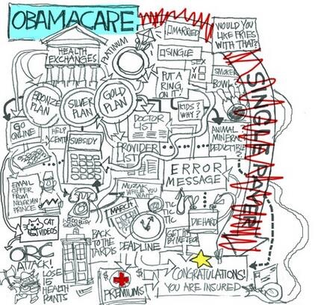
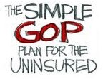

Slide 82
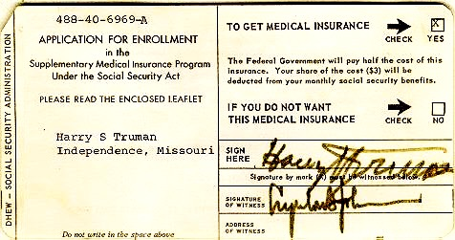
Medicare’s “Software” 18.9 million seniors enrolled within 11 months

Slide 83
ACA Decreased Incidence of Unmet Medical Needs Due to Cost
Better, but still not good.
Percent of Adults
Ages 18-64
Reporting an Unmet Health Need (Past 12 Months)
Income as Percent of Federal Poverty Level
Health Affairs 2017;36:1656

Slide 84
Administrative Costs Rising Quickly Since ACA’s Passage
Average rate of increase annually, 2009-2017
Himmelstein & Woolhandler, unplublished analysis based on NHEA and Medicare cost reports
Note: Hospital figure is for 2009-2016

Slide 85
Trump’s Health Financing Actions
Expand “association” and “short term” junk insurance – Increase under-insurance, undermine ACA risk pool raising cost for sicker people.
Let employers deny coverage for birth control.
Obstruct ACA enrollment.
Allow states to implement punitive Medicaid changes.
“Public charge” rule threatens documented immigrants if anyone in family uses Medicaid or nutrition services.

Slide 86
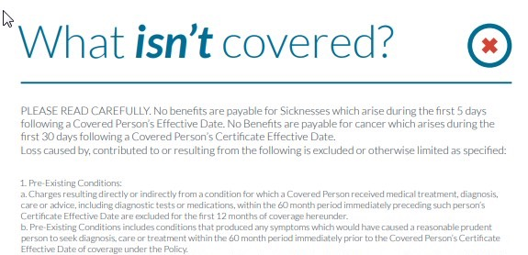
53…mountain climbing, bungee jumping, scuba diving....
…Also excluded is injury received while practicing, exercising, undergoing conditional or physical preparation for such activity.
Notes:
53. Participating in hazardous occupations or other activity including participating, instructing, demonstrating, guiding or accompanying others in the following: operation of a flight in an aircraft other than a regularly scheduled flight by a commercial airline, professional or semi-professional sports, extreme sports, parachute jumping, hot-air ballooning, hang-gliding, base jumping, mountain climbing, bungee jumping, scuba diving, sail gliding, parasailing, parakiting, rock or mountain climbing, cave exploration, parkour, racing including stunt show or speed test of any motorized or non-motorized vehicle, rodeo activities, or similar hazardous activities. Also excluded is injury received while practicing, exercising, undergoing conditional or physical preparation for such activity.

Slide 87
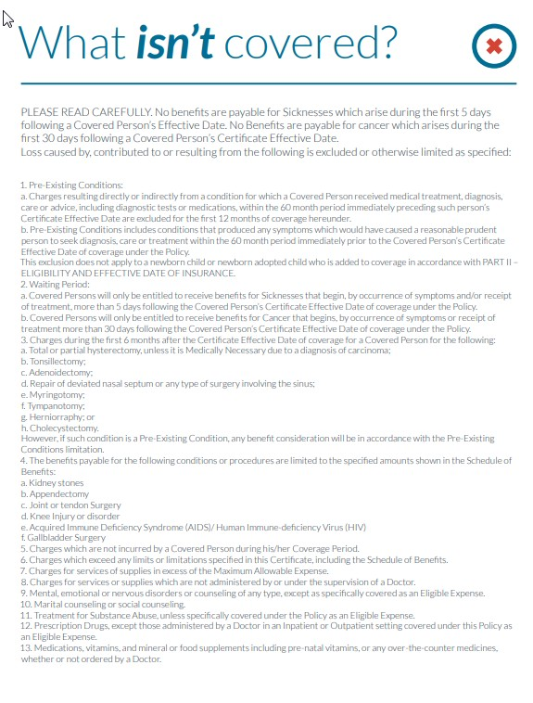
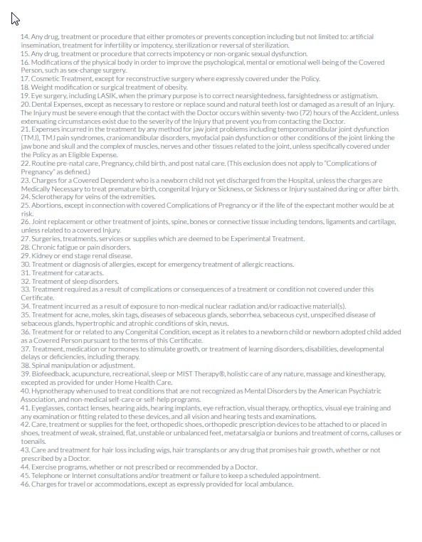
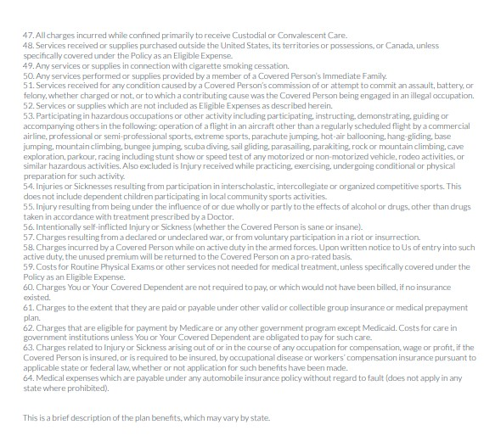
53. Participating in hazardous occupations or other activity including participating, instructing, demonstrating, guiding or accompanying others in the following: operation of a flight in an aircraft other than a regularly scheduled flight by a commercial airline, professional or semi-professional sports, extreme sports, parachute jumping, hot-air ballooning, hang-gliding, base jumping, mountain climbing, bungee jumping, scuba diving, sail gliding, parasailing, parakiting, rock or mountain climbing, cave exploration, parkour, racing including stunt show or speed test of any motorized or non-motorized vehicle, rodeo activities, or similar hazardous activities. Also excluded is injury received while practicing, exercising, undergoing conditional or physical preparation for such activity.

Slide 88
American Taxpayers Already Pay More Than People in Nations With National Health Insurance

Slide 89
US Public Spending per Capita for Health Exceeds Total Spending in Other Nations
USA Total:
$10,720
Total Spending
USA Public
USA Private
Note: “Public” includes benefit costs for gvt employees and tax subsidies for private insurance
OECD 2018; NCHS; AJPH 2016;106:449 (updated) – Data are for 2017

Slide 90
The USA Trails Other Nations

Slide 91
Life Expectancy
Years
OECD, 2018
Note: Data are for 2016 or most recent year available

Slide 92
Infant Mortality
Deaths in First Year of Life / 1000 Live Births
OECD, 2018
Note: Data are for 2016 or most recent year available

Slide 93
Maternal Mortality
Deaths per 1000 Live Births
OECD, 2017 and Global Burden of Disease, 2015
Note: Data are for 2016 or most recent year available

Slide 94
High U.S. Costs Do Not Result From
Bad Health Habits
Aging
Overuse of Care

Slide 95
Smoking Prevalence Percent of population >age 15 who smoke daily
Source: OECD, 2018
Note: Data are for 2017 or most recent year available

Slide 96
Percentage of Elderly Percent of population >age 64
Source: OECD, 2018
Note: Data are for 2017 or most recent year available

Slide 97
Hospital Inpatient Days per Capita
Hospital days
per person
per year
Source: OECD, 2017 & AHRQ
Note: Figures are for 2016 or most recent available

Slide 98
Physician Visits per Capita
Source: OECD, 2018
Note: Data are for 2017or most recent year available

Slide 99
Other Countries Provide More Long Term Care
Percent of total population receiving LTC
OECD, 2018
Note: Data are for 2016 or most recent year available

Slide 100
Insurance Overhead
$ per Capita
Source: OECD 2018; NCHS; CIHI
Notes: Data are for 2017 or most recent year available. Figures adjusted for Purchasing Power Parity

Slide 101
USA Doctors’ Satisfaction Is Low Percent of primary care doctors saying they are satisfied or very satisfied
Source: Commonwealth Fund Survey of Primary Care Physicians, November 2012

Slide 102
Canada’s National Health Insurance Program

Slide 103
Minimum Standards for Canada’s Provincial Programs
Universal
Universal coverage that is not impeded, either directly or indirectly, whether by charges or otherwise, reasonable access.
Portable
Portability of benefits from province to province
Comprehensive
Coverage for all medically necessary services
Public
Publicly administered, non-profit program

Slide 104
Hospital Financing: Medicare vs. Medicare
American Medicare
Per-patient payments
Capital and operating payments intermixed
New investments funded from surplus/profit
For-profits thrive
Canadian Medicare
Global budget
Separate payment for capital
New investments funded by government grants
Eliminates opportunity for profitmaking

Slide 105
Cystic Fibrosis Patients Live Longer in Canada
Uninsured in USA die youngest
Hazard Ratio
for death.
USA vs Canadian
CF patients
(Canada = 1.0)
Ann Int Med 2017;166:537
Note: Hazard Ratios are adjusted for multiple genetic and clinical characteristics

Slide 106
Infant Mortality, USA and Canada
Deaths per 1,000 Live Births
First province implements NHP
USA
Canada
Statistics Canada, Canadian Institute for Healtb Information, Natl Ctr for Health Statistics

Slide 107
Infant Deaths by Income, Canada 2011 Even poor Canadians do as well as average Americans
Infant mortality per 1,000
Income quintiles, Canada
Source: CDC and StatCan

Slide 108
Life Expectancy Falling for Lower-Income Americans, Rising for All Canadians
Change in life expectancy at age 50 over past 3 decades
Source: Growing Gap in Life Expectancy by Income. NAS; Rich man Poor Man, CD Howe Institute
Data is non-weighted average of male and female figures
Data are for Canadians turning 50 in 2000 vs 1970, and for Americans turning 50 in 2010 vs 1980

Slide 109
Healthcare Costs as a % of GDP
Canada’s NHP Enacted
USA
Health costs
% of GDP
NHP Fully Implemented
Canada
Sources: Statistics Canada, Canadian Inst. for Health Inf., and NCHS/Commerce Dept.

Slide 110
Hospital Billing and Administration USA and Canada, 2018
$ per Capita
(PPP Adjusted)
Source: Woolhandler et al. NEJM 2003;349:768 (updated); Himmelstein et al, Health Aff 9/2014

Slide 111
Physicians’ Billing and Office Expenses United States and Canada, 2018
$ per Capita
(PPP Adjusted)
Source: Woolhandler/Campbell/Himmelstein NEJM 2003;349:768 (updated)
Note: Excludes dentists and other non-physician, office-based practitioners

Slide 112
Overall Administrative Costs per Capita United States and Canada, 2018
Source: Woolhandler et al. NEJM 2003;349:768 (updated); Himmelstein et al. Health Aff 9/2014

Slide 113
Difference in Health Spending per Capita USA and Canada, 2018
Source: Woolhandler/Himmelstein/Campbell NEJM 2003;349:768 (updated)
NCHS; CIHI; PPP adj.

Slide 114
Few Canadian Physicians Emigrate Today
Net loss
(number moving abroad –
number returning)
A negative number indicates that more physicians returned from abroad then moved abroad
Source: Canadian Institute for Health Information

Slide 115
Canadian Physicians’ Incomes Average Clinical Payments per Physician, 2015-2016
Specialty | Income
Family Medicine | $275,000
Internal Med | $389,000
Pediatrics | $294,000
Psychiatry | $266,000
Dermatology | $378,000
Specialty | Income
OB-GYN | $398,000
General Surgery | $435,000
Thoracic Surgery | $569,000
Ophthalmology | $714,000
Avg All Canada | $339,000
Source: Canadian Institute for Health Information
Figures are in Canadian $

Slide 116
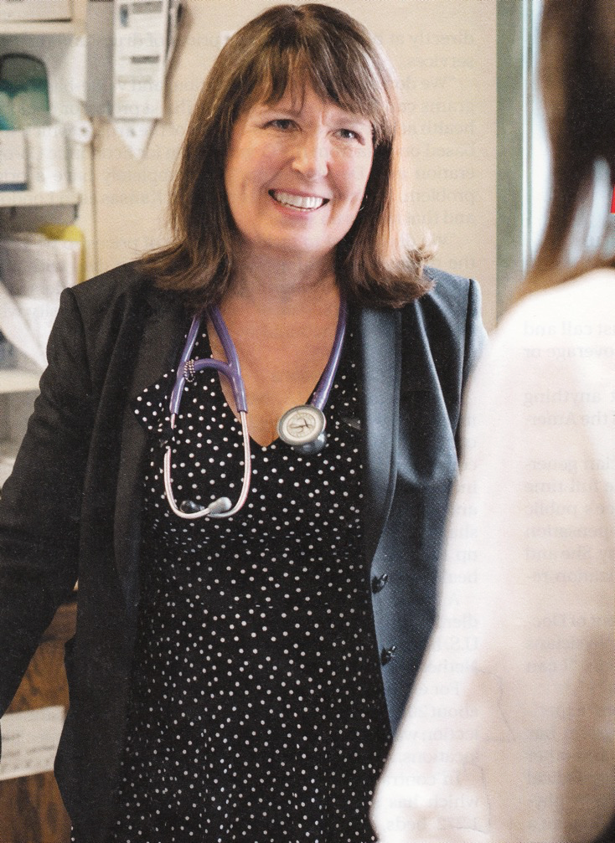
“It’s not a big hassle. I can focus on patient issues, not administrative issues.”
Dr. Trina Larsen Soles
President of Doctors of BC
Represents physicians in British Columbia
Source: Modern Healthcare 4/9/18

Slide 117
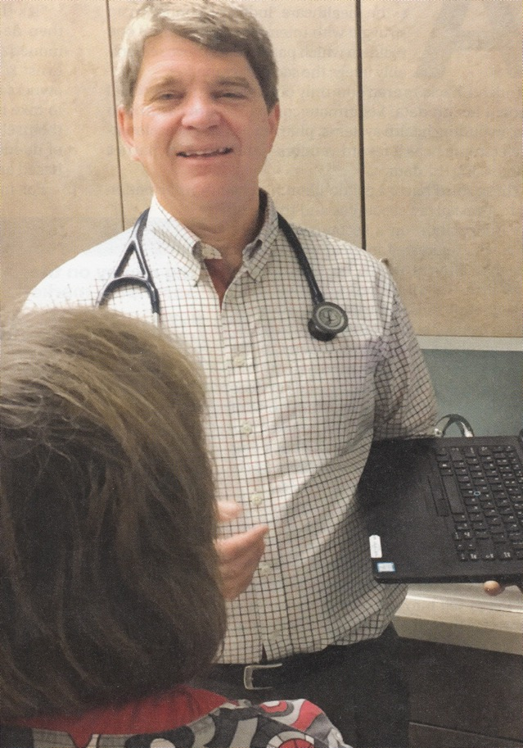
“It’s an incredible bureaucratic mess to get anything done for patients.”
Dr. John Cullen
President-Elect
American Academy of Family Physicians
Source: Modern Healthcare 4/9/18

Slide 118
Wide Support for Medicare-for-All
Democrats
“Do you support or oppose a policy of Medicare for All?”
Republicans
Source: Reuters/Ipsos 8/23/2018

Slide 119
Rising Support for Single Payer
Percent favoring “a national health plan in which all would get insurance from a single government plan”
Source: Kaiser Foundation, 2018

Slide 120
Most Doctors Now Favor Single Payer Support Has Sharply Increased
2008
2017
Source: Merritt Hawkins surveys of physicians

Slide 121
A National Health Program for the USA

Slide 122
National Health Insurance
Universal – covers everyone
Comprehensive – all needed care, no co-pays
Single, public payer – simplified reimbursement
No investor-owned HMOs, hospitals, etc.
Improved health planning
Public accountability for quality and cost, but minimal bureaucracy
Proposal of the Physicians Working Group for Single Payer NHI
Gaffney et al AJPH June 2016 106:6 + Suppl.
JAMA 2003;290:798

Slide 123
Funding for the NHP
Revenue Sources
Recipients of Money
NHP
Fund
Medicare and Medicaid
Hospital Operating Costs
Hospital Capital Costs
State / Local Governments
HMOs
Employers
Fee-for-Service Physicians
Private Insurance Revenues
Home Care Agencies
New Taxes
Long-Term Care
NEJM 1989;320:102

Slide 124
Hospital Payment Under an NHP
Hospitals remain privately owned.
Capital purchases/expansion budgeted separately based on health planning goals.
Negotiated global budget for operating costs. Operating funds cannot be diverted to capital.
NEJM 1989;320:102

Slide 125
Three Options for Physician and Ambulatory Care Payment Under the NHP
Fee for
Service
Capitation for Institutions
With Salaried Physicians
Globally Budgeted Institutions
Mandatory assignment
Simplified negotiated fee schedule
Free disenrollment
No selective enrollment period
Capitation for operating costs, not capital purchases, profits or physician incentives
Inpatient care under hospital’s global budgets
Institutions with salaried physicians
Hospitals
Clinics
Home care agencies
Himmelstein and Woolhandler. NEJM 1989;320:102

Slide 126
Single Payer Transition: For Displaced Clerical and Administrative Workers
All 400,000 health insurance workers and about ½ of the 2.6 million clerical/administrative employees in healthcare providers likely to be displaced – total 1.7 million.
Many likely to be redeployed in expanded clinical workforce.
Funding for income support and job retraining modeled on WWII GI Bill.
Job displacement is common in the US – 60 million/year, including 20 million who are fired: 1.7 million = number who are fired every 31 days. (source: People’s Policy Report)

Slide 127
Single Payer Transition: For Patients
Every U.S. resident receives an insurance card.
Full coverage for all medically necessary care, no copayments, deductibles or coinsurance.
Prescription drug formulary, with alternatives covered when medically indicated
Free choice of any participating provider or hospital.

Slide 128
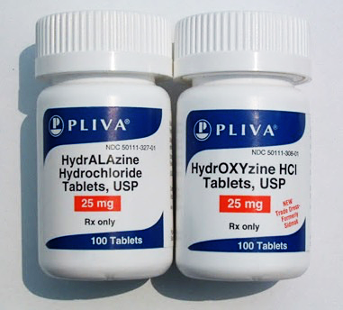
Sound-a-Likes Can Be Dangerous

Slide 129
Beware of Single-Payer “Sound-a-likes”
Single Payer Medicare for All
Medicare Extra for All
Medicare Advantage for All
Medicare Public Option

Slide 130
Public Option
Medicare competes with private insurance.
Many remain uninsured since buy-in optional + expensive.
Wouldn’t fix Medicare’s weaknesses
- Copays/deductibles
- Medicare Advantage rip-off
- Provider payment strategies drive gaming/abuses
Minimal administrative cost savings.
Medicare = de facto high risk pool, raising costs.

Slide 131
Medicare Extra for All
Like “Public Option” but buy-in mandatory for those without employer coverage.
Sliding scale premiums and copays.
Employers could offer private plans or contribute to employees’ Medicare buy-in.
Medicare Advantage option persists.
Traditional Medicare = de facto high risk pool
Sacrifices most administrative savings, hence unaffordable.

