Slide 1
Policy pitfalls: faux single-payer plans and legislative deficiencies
Himmelstein/Gaffney
PNHP Annual Conference 2018

Slide 2
Kaiser Family Foundation Healthcare Poll: M4A/SP Support Growing
Public Opinion on Single-Payer, National Health Plans, and Expanding Access to Medicare Coverage [Internet]. The Henry J. Kaiser Family Foundation. 2018 [cited 2018 Sep 13]. Available from: https://www.kff.org/slideshow/public-opinion-on-single-payer-national-health-plans-and-expanding-access-to-medicare-coverage/

Slide 3
2018 Reuters Poll: Support for "Medicare-for-All"
Progressive movement stirs Democrats [Internet]. Reuters. [cited 2018 Sep 13]. Available from: https://www.reuters.com/investigates/special-report/usa-election-progressives/

Slide 4
Lazarus D. With a single sentence, Obama moves Medicare for all into the political mainstream [Internet]. latimes.com. [cited 2018 Sep 13]. Available from: http://www.latimes.com/business/lazarus/la-fi-lazarus-obama-medicare-for-all-20180911-story.html

Slide 5
1. Faux Single-Payer Plans
Variants
Public option on some or all ACA marketplaces
Medicaid buy-in
Medicare buy-in
Medicare Extra-for-All

Slide 6
Public option on ACA marketplaces
Sold on marketplaces with few plans or all marketplaces.
Endorsed by Obama in 2016 in Journal of the American Medical Association for marketplace with few plans.
Competes with other private plans.
Congressional Budget Office:
“would have minimal effects . . . on the number of people who would be uninsured.”
Slightly lower premiums 2/2 Medicare rates.
https://www.jacobinmag.com/2017/07/trumpcare-obamacare-repeal-public-option-single-payer; https://www.cbo.gov/budget-options/2013/44890

Slide 7
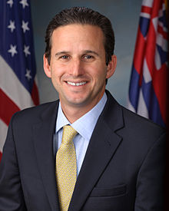
Medicaid Buy-In
Sen. Brian Schatz
States could choose make their Medicaid programs available to uninsured individuals.
People could use ACA subsidies to reduce the cost.
Essentially, creates a Medicaid public-option on the exchanges.
Would raise Medicaid rates to Medicare.
https://www.vox.com/policy-and-politics/2017/8/22/16171160/schatz-health-care-medicaid

Slide 8
Medicare Buy-In: 2 Bills
Kaine-Bennett (“Medicare X”):
Individual Medicare buy-in on exchanges (“X”)
Not funded through Medicare
Murphy-Merkley (”Choose Medicare Act”): Individual + Employer
Premiums actuarially-based
Could use ACA subsidies
ACA subsidies would be increased (up to 600%FPL)
https://www.vox.com/policy-and-politics/2018/4/18/17252714/democrats-medicare-buy-in-chris-murphy-jeff-Merkley; https://www.vox.com/health-care/2017/10/20/16504800/medicare-x-single-payer

Slide 9
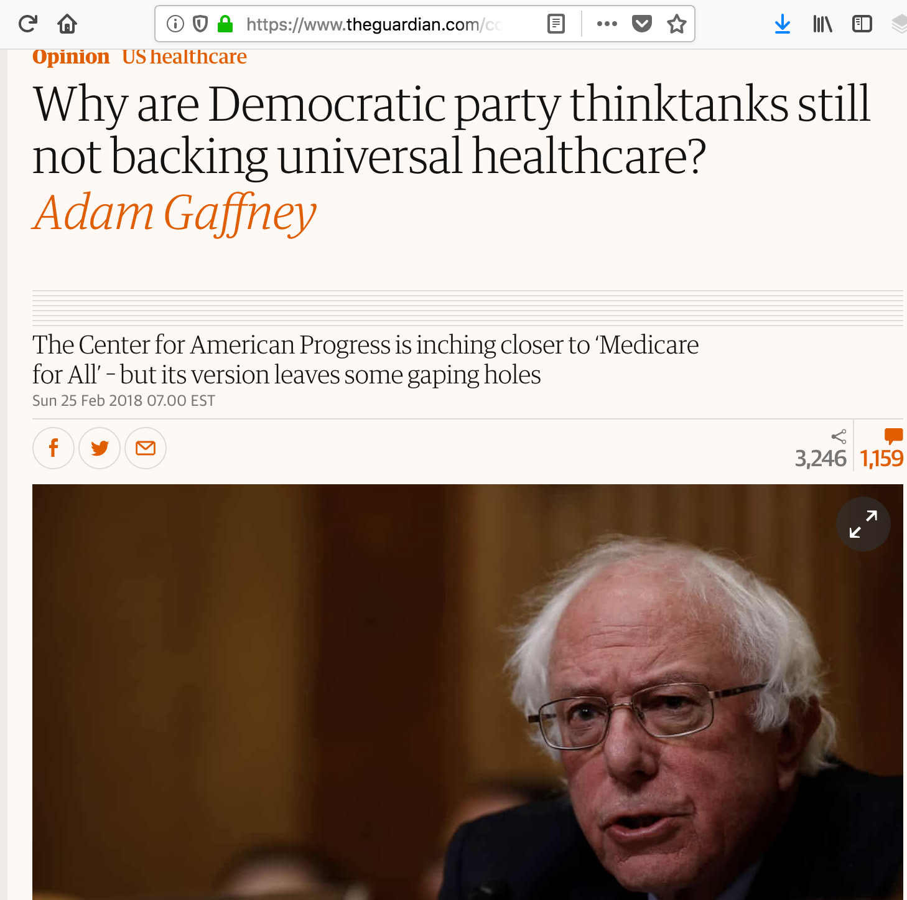
Medicare Extra-for-All
Center for American Progress in 2017
Cover all those not covered by other plans (automatic enrollment).
Employers could switch workers to Medicare Extra
Medicare-Extra could be sold by private insurers.
Lack of administrative savings.
Persistence of copays / deductibles (some workers could even see worse benefits).
https://www.theguardian.com/commentisfree/2018/feb/25/us-healthcare-reform-medicare-for-all

Slide 10
2. Legislative Shortfalls
 | HR 676 (HOUSE BILL) | S 1804 (SENATE BILL)
Copays | None | Small copays only for drugs
Abortion | Not covered | Covered
Long-term care (LTC) | Covered | Does not cover; leaves to state Medicaid programs, which have to maintain current LTC spending.
Payment methods | -Global budgets for institutional providers. -Separate operating/capital budgets | Retains current Medicare payment methods: -”Value-based” payments -No global budgets -Not separate operating/capital –Accountable Care Organizations (back door for insurers to participate)
Corporate healthcare providers | Cannot participate; converted to non-for-profit | Can participate

