Slide 1
Overcoming Health Disparity in Creative Communities: Enticement, Engagement, and Empowerment
Bethany Bultman
Co-founder and CEO
March 3rd, 2018
Notes:
https://vimeo.com/67806662 (10 seconds to 3 minutes)

Slide 2
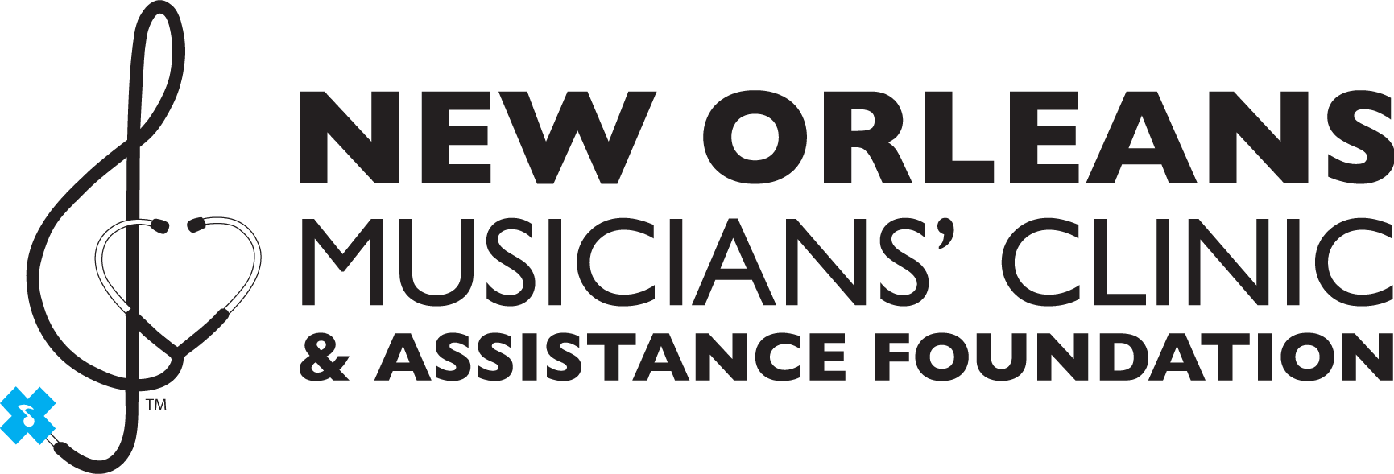
“Want to know a
dirty little secret?”

Slide 3
Performers and Healthcare Disparity:
Peek behind the curtain

Slide 4
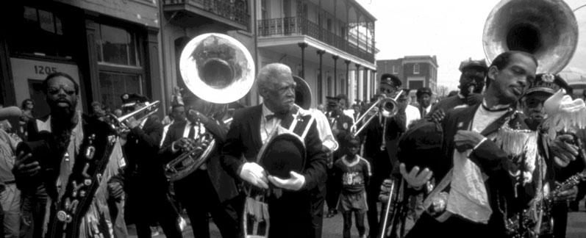
A performer’s “calling” can be a barrier to seeking preventive health and practicing self-care.
Performers often work in unhealthy environments with long and late night hours for low, often cash-based, pay. Occupational threats such as noisy rehearsal spaces, smoky clubs, disrupted sleep patterns, and emotional stress can result in physical disease, anxiety disorders, and/or self-medication, drug and alcohol dependence.

Slide 5
How do we change negative health outcomes for performers?
The lack of access to healthcare for the working poor in New Orleans has fostered a culture for centuries our performers do not seek preventive and primary health care services, but rather rely on “riding it out”, “muscling on” or self medicate, while waiting until the advanced stages of illness when they can no longer tolerate their symptoms.
Notes:
On top of the physical and psychological ailments. A historic lack of access to health insurance coverage and ability to navigate traditional health care services often leaves performers with no other ways to address chronic conditions than booze and the bible.

Slide 6
James Booker 1939-1983
Known to his fans as the Bayou Maharajah, he attracted audiences the world over with his unique virtuosic style combining classical, gospel, stride and jazz piano. In private, Booker self-medicated his mental illness with drugs and alcohol and routinely checked himself into Charity Hospital’s mental ward. In 1983 Booker was left unattended for hours in the Emergency Room. He died before receiving treatment at the age of 43.

Slide 8
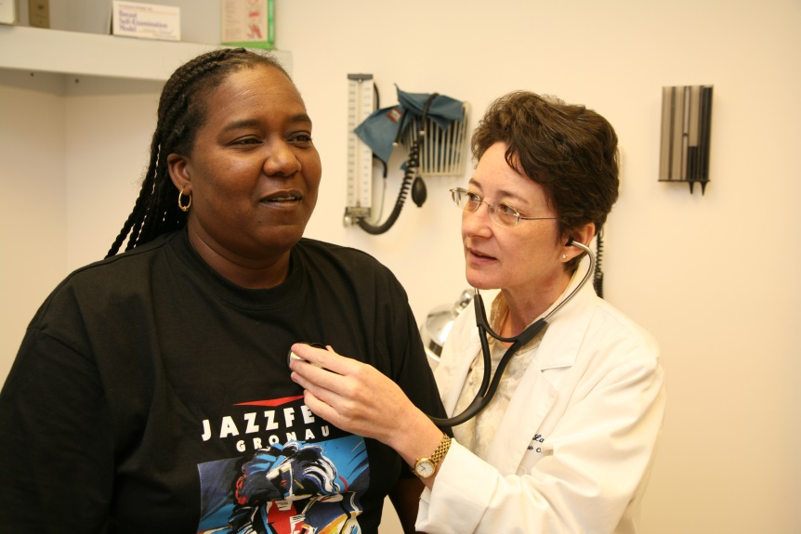
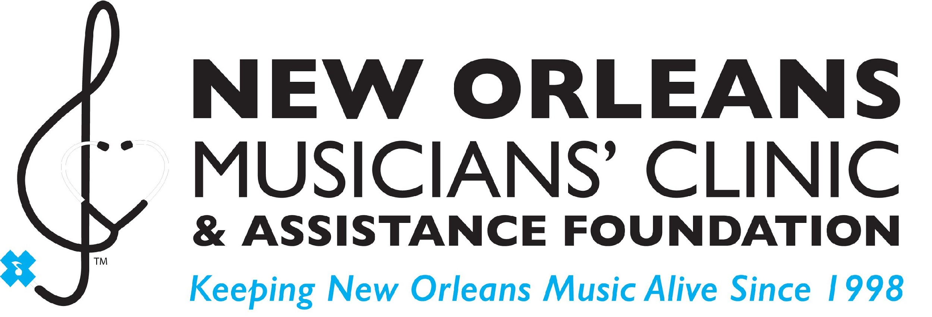
Since May 1998, the New Orleans Musicians’ Clinic, as a federally designated Patient Centered Medical Home, combats these health disparities by providing direct, comprehensive and specialty medical services to more than 2,500 performing artists and culture bearers.

Slide 9
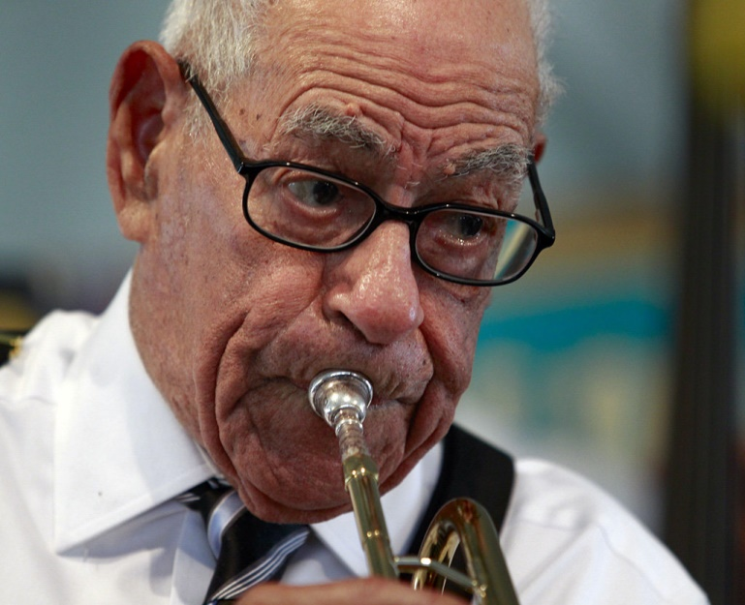
NOMC Gold Standard
Our oldest patient, Lionel Ferbos was performing a weekly gig as a jazz vocalist, a trumpet player and a band leader up until 3 months before he died at the age of 103. That is the gold standard of Performance Arts Medicine which we aspire to for all of our 2500+ patients. Engaging patients in their own well being is the only way our clinic can succeed in truly sustaining the long-term well-being of performers.

Slide 10
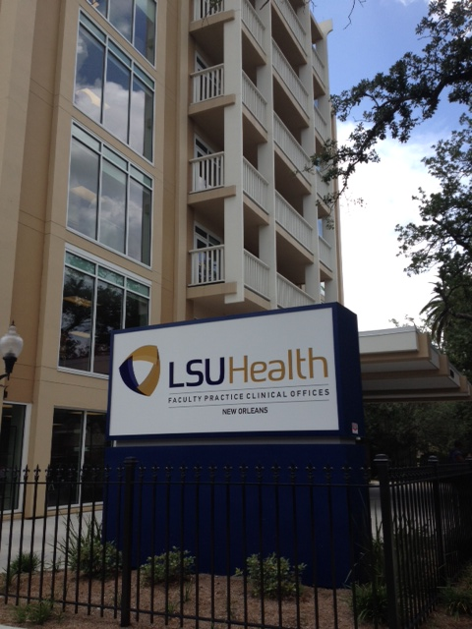
Our medical clinic is supported by the LSU Health Care Network (which donates the space for the NOMC), family foundations, and donors.

Slide 12
Notes:
The NOMC is dedicated to sustaining New Orleans' performers in body, mind and spirit by providing comprehensive primary and mental health care and social services. We serve musicians and tradition bearers, delivering an innovative, donor supported health care model, which provides cost-efficient access to high quality care and wellness programs to keep New Orleans' music ALIVE.

Slide 13
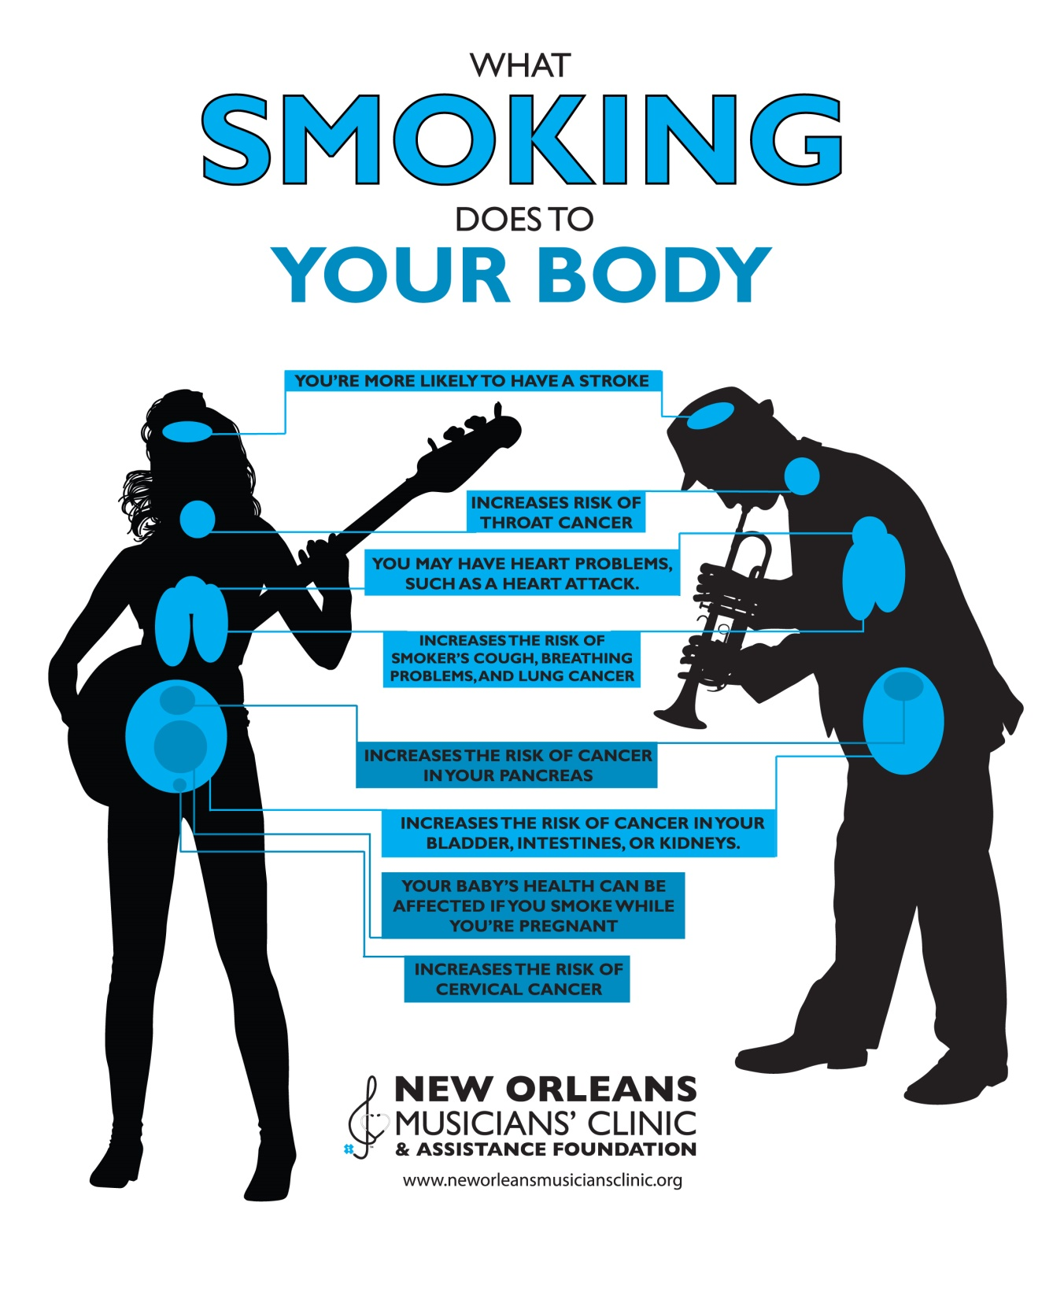
Notes:
Our primary clinic centers on a community health model which produces health outreach events to serve thousands of local community members each year - advocating for community wide wellness and relying on m

Slide 14
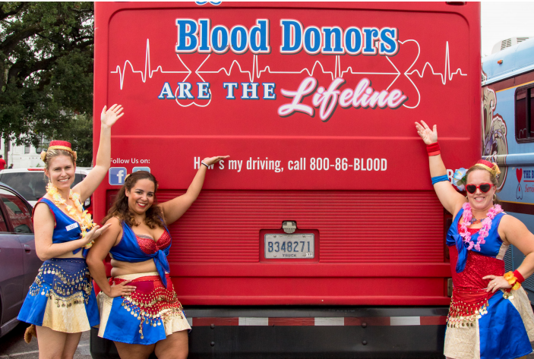
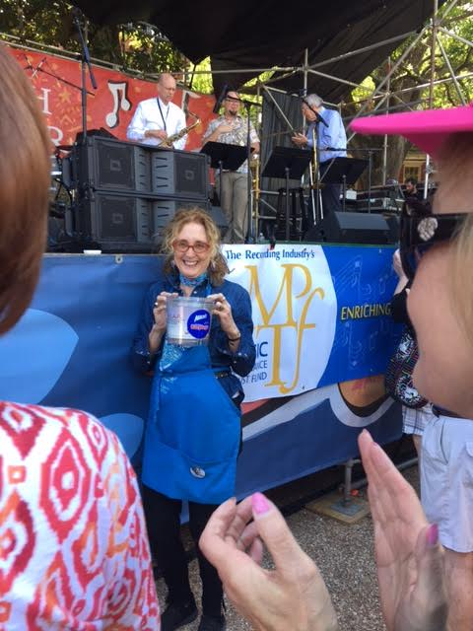
ANNUAL SUMMER BLOOD DRIVE
SAFE SOUNDS FREE EAR PLUGS AT FESTIVALS

Slide 15
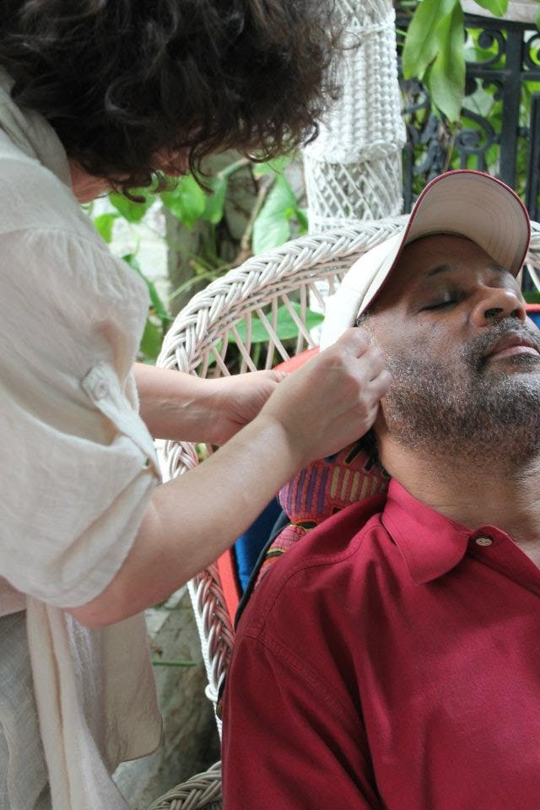
EAR ACUPUNCTURE WITH ACUDETOX.ORG
ANNUAL FLU SHOT DRIVE FOR CULTURAL WORKERS

Slide 16
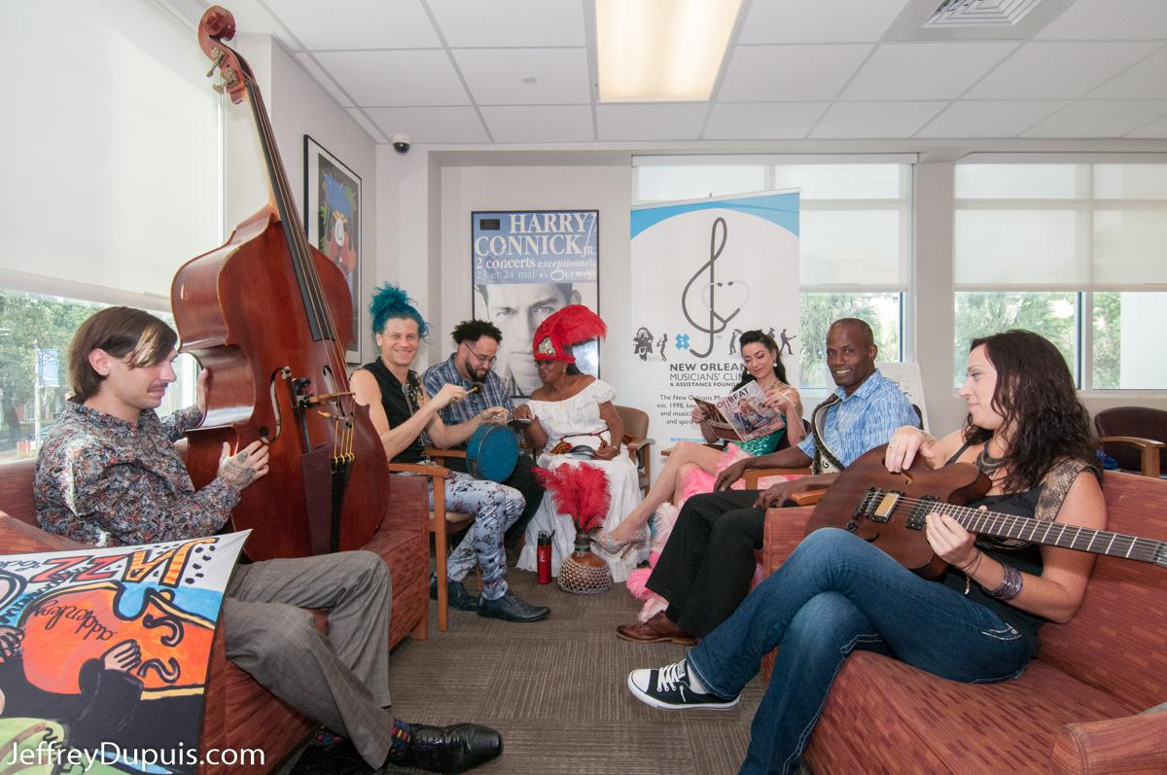
CHANGE begins with YOU
What you can do to sustain performers in mind, body and spirit:
SELF ADVOCATE FOR YOUR OWN MEDICAL SKILLS: Each of you has the ability and calling to sustain a performer’s wellbeing.
THINK OUTSIDE THE BOX: Establish partnerships with your colleagues in public health and social justice.
GET INVOLVED: Join Athletes and the Arts to improve health outcomes for all performers.

Slide 18
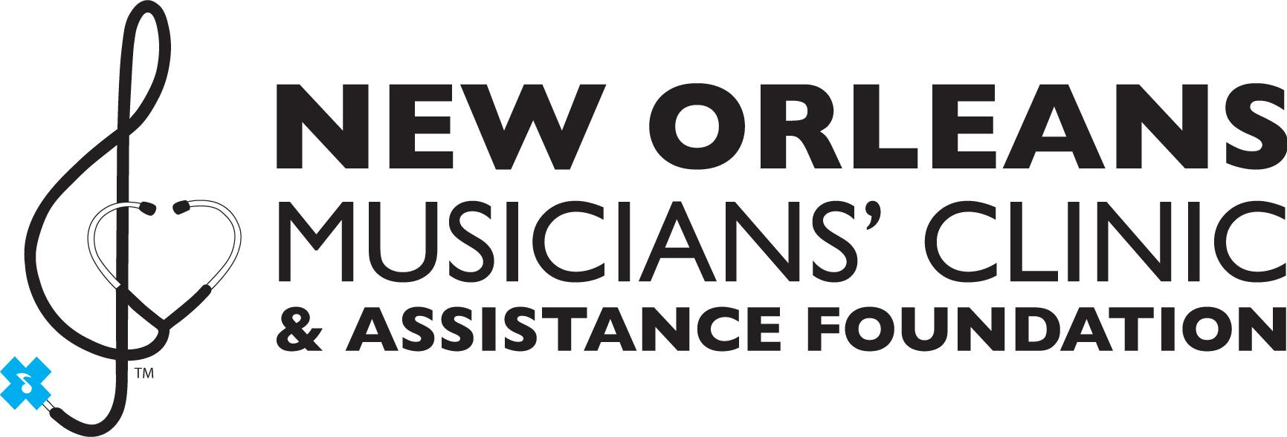
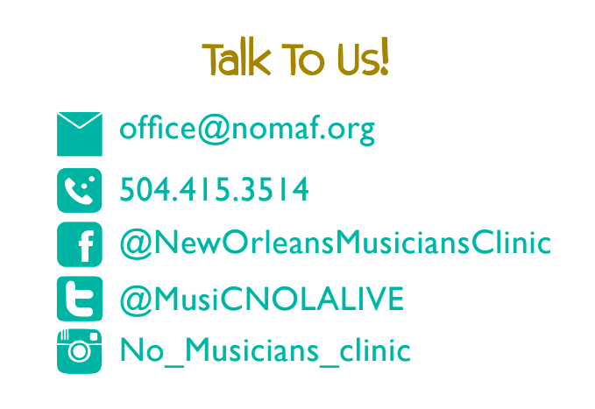
www.neworleansmusiciansclinic.org

