Slide 1

Single Payer 101
Tony Spadaro and Erin Hollander
Perelman School of Medicine at University of Pennsylvania
Anthony.Spadaro@uphs.upenn.edu
Erin.Hollander@uphs.upenn.edu

Slide 2
Premiums, deductibles, copays, reimbursement,
Premiums and taxes
Reimbursement
Risk Pool

Slide 3
Premiums, deductibles, copays, reimbursement,
Copays and deductibles
Premiums and taxes
Reimbursement
Risk Pool

Slide 4
Premiums, deductibles, copays, reimbursement,
Copays and deductibles
Premiums and taxes
Reimbursement
Profit

Slide 5
A Few Sick People
Account for Most Health Dollars
Percent of total health spending accounted for by decile
Top 2 deciles account for 81.5%
Decile of Privately Insured Americans
JAMA 2016;316:1348

Slide 6





Medicare for All? Single Payer? NHI?
What’s the difference?
Also known as
“National Health
Insurance”
also known as
“Medicare for All”
“Single Payer”
Notes:
Lots of different terms for this thing, all mean the same thing
What most people care about, healthcare, less so who does the paying

Slide 7
Differing Frameworks
Economic/Policy –
Human Rights Perspective-
Business Perspective -
Racial Justice Perspective –
Patient Perspective –

Slide 8
Differing Frameworks
Economic/Policy – We can cover everyone for cheaper! PNHP is really good at this!
Human Rights Perspective- Providing everyone healthcare is the moral thing to do
Business Perspective - companies would save money if they didn’t have to provide their employees insurance
Racial Justice Perspective – single payer can be a starting point to deal with some of the racial inequities in our healthcare system
Patient Perspective – Our patient’s Stories

Slide 9


Slide 10
Healthcare as a human right
EVERYONE gets health insurance from birth to death
All NECESSARY services paid for
Paid for by progressive taxation
  Instead of sick people paying more, rich people do
No co-payments, deductibles, cost sharing
Notes:
Medicare for all codifies health insurance as right,
This is the future single payer activists want, and arguably I think most want this, single payer activists go the step further and argue that this is actually economically cheaper than the current system we have and that it is also politically possible

Slide 11
Advantages of Medicare for All
EVERYONE is in the same boat; same risk pool
Healthcare no longer tied to workforce
All Providers will be in-network, FREEDOM of choice for patients
It will be in the interest of the government to promote health
Notes:
Achieving single payer will protect health care as a human right because it will put rich and poor alike in the same boat, more so than Social Security and Medicare as it exists now, a single payer system will be the third rail that politicians will be afraid to touch
Furthermore when the state is the payer, the state takes on all the risk, but since it can’t dump sick patients or only selectively enroll healthy people it is incentivized to take care of the health of everyone. Preventative medicine will be seen as healthcare, housing will be seen as healthcare, eliminating food desserts will be healthcare, stopping corporations will be healthcare.
Free up the workforce, make US labor market more competitive, GM spent more on employees health insurance than on cars in 2008,

Slide 12
No but seriously WTF is the ACA
Three main pillars
  Regulate
    Insurance companies, please be a little less evil!
  Mandate
    Everyone go buy insurance
  Subsidize
    Either through Medicaid or Subsidies
  Plus some other stuff
    ACOs, Electronic Medical Records, etc
Notes:
Regulate: tell insurance companies they have to provide essential health benefits, only a certain percentage of overhead, ‘must sell affordable plans for employee based plans
Mandate: everyone has got to buy it, not the same as covering everyone, allows people to fall through cracks,
Subsidizie medicaid expansion in state, subsidizes to insurers to incentivize them to cover low income individuals, some tax abatement.
4. Some other stuff that is supposed to help regulate cost: incentivize health care ‘innovation’, ban insurance companies from excluding people with pre existing conditions while allowing those under 26 to stay on parents, try to manage creating riskier insurance pools with bigger insurance pools

Slide 13
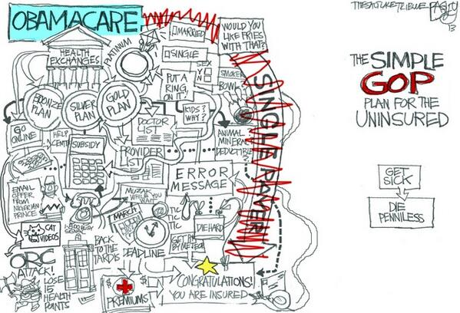

Slide 14
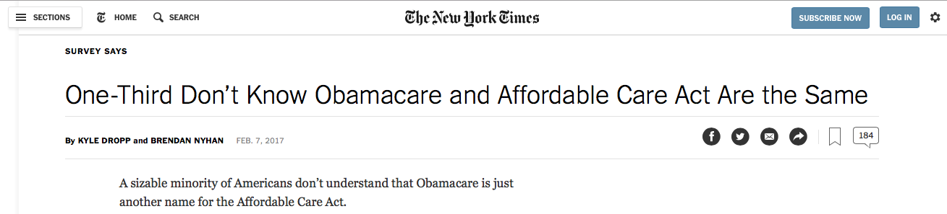
Notes:
The standard liberal response to this is derision
But this is a real downside to the ACA, and makes it politically vulnerable
Medicare, Medicaid, Social Security don’t have this problem

Slide 15
“Triple Aim” of
Good Healthcare Systems
QUALITY of patient care
Access to Care
Minimize COST
Notes:
This is what a good healthcare system seeks to do, although alternatively some people say that this is the “iron triangle” of healthcare reform and at best we can hope to accomplish two of these goals.

Slide 16
How is Medicare for All Going to Work?
Cost
  Reduce administrative overhead
  Negotiate better prices
Quality
  Get rid of junk plans
  End class based rationing
Access
  Everyone In, Nobody Out
Notes:
I want you to think about these three things, because I’m going to use this framework to explain why Medicare for All can work and why it is the best option we have

Slide 17
How is Medicare for All Going to Work?
Cost
  Reduce administrative overhead
  Negotiate better prices
Quality
  Get rid of junk plans
  End Class based rationing
Access
  Everyone In, Nobody Out

Slide 18
The Most Expensive
Health Care System In the World
Annual per capita dollars spent on health care
USA Total
$9,960
Note: Public includes benefit costs for govt. employees & tax subsidy for private insurers
Source: OECD 2016;106:449 – Data are for 2015 or most recent available
Notes:
The US government already spends more than most other countries to in total, and the combined public and private sector spend way more, yet we aren’t getting the same coverage and the same outcomes, where is all that money going

Slide 19
We’re Number 25 in Life Expectancy
Life Expectancy at birth
2013 data from OECD accessed Nov 19 2015
https://data.oecd.org/healthstat/life-expectancy-at-birth.htm
Notes:
We aren’t getting our bang for our buck

Slide 20
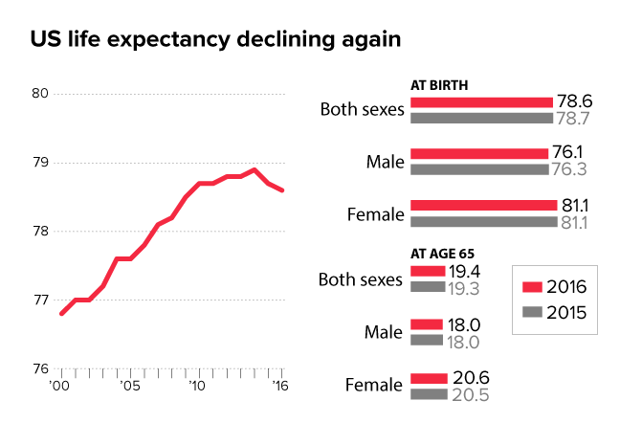
… And it’s still going down

Slide 21
Cost: 31% of Our Healthcare Dollars are not spent on healthcare
Medical care
69%
Canada
Medical overhead, administration, and insurance profits
31%
84%
16%
United States
$1,300 monthly premium → $400 monthly waste
Woolhandler, et al “Costs of Health Administration in the U.S. and Canada,” NEJM 349(8) Sept. 21, 2003
Notes:
This goes to overhead, administrators, profits
Healthcare dollar waste is on both sides of the table, insurers processing claims, and hospitals figuring out how to correctly bill all the different payers.
ACA tried to limit this by mandating that insurers must use 80 cents or so out of every dollar on health care, not actually happening though

Slide 22
Cost: HMO Overhead, 2017
Source: SEC filings to shareholders.
Calculated as (100 – Medical Loss Ratio)
Notes:
Private health insurance has much higher overhead than Medicare.

Slide 23
Cost: HMO Overhead, 2017
Source: SEC filings to shareholders.
Calculated as (100 – Medical Loss Ratio)
Notes:
Private health insurance has much higher overhead than Medicare .

Slide 24
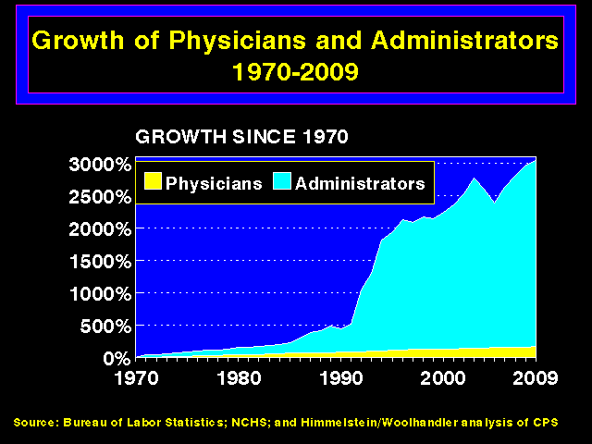
Cost: Too Many Hospital Administrators
3,000%
2,000%
1,000%
0
Administrators
Physicians
1970
1980
1990
2000
2009
Source: Bureau of Labor Statistics; NCHS; Himmelstein/Woolhandler analysis of CPS
Notes:
Figuring out how to maximize profit takes a lot of people
See how administrators have grown compared to rest of the health care sector

Slide 25
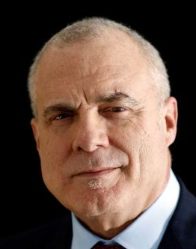
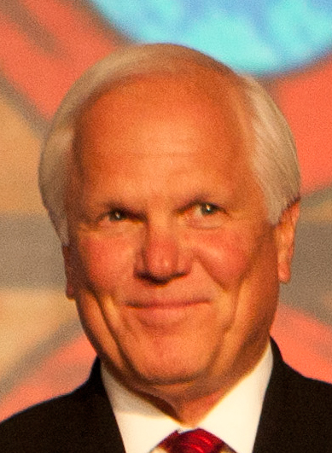
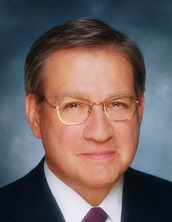

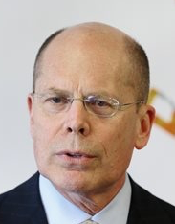
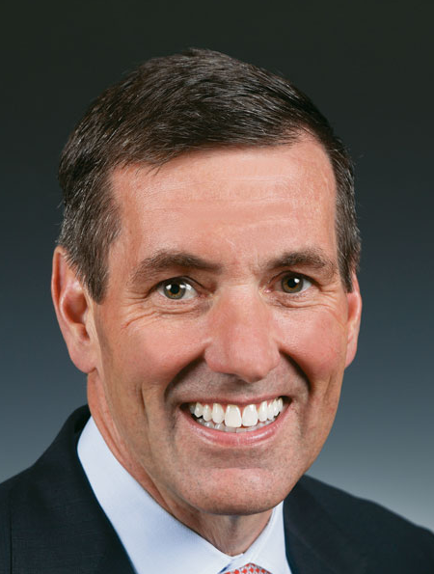
Cost: CEO salaries
Mark Bertolini | Joseph Swedish | Michael Neidorff
David Cordani | Steve Hemsley | Bruce Broussard
Aetna
Annual Comp:
$17.3 M
Pay/Weekday:
$66,538
Wellpoint
Annual Comp:
$13.6 M
Pay/Weekday:
$52,308
Centene
Annual Comp:
$ 20.8 M
Pay/Weekday:
$80,000
Cigna
Annual Comp:
$17.3 M
Pay/Weekday:
$66,538
United
Annual Comp:
$14.5 M
Pay/Weekday:
$55,769
Humana
Annual Comp:
$10.3 M
Pay/Weekday:
$39,615
Source: SEC filings
Notes:
Something to think about when your patient wont be able to make a follow up appointment because they cant afford a $20 co-pay, cause these people think they will abuse the system too much

Slide 26
Cost: Lower Drug Prices with More Public Coverage
Cabin, Siman, Himmelstein & Woolhandler.
Health Affairs 8/2014
Notes:
In addition to savings on administrative costs, having a single payer system would allow for Medicare to negotate with pharmaceutical companies to lower cost of prescription drugs

Slide 27
We Pay Too Much for Drugs
Aaron S. Kesselheim, Jerry Avorn, Ameet Sarpatwari. The High Cost of Prescription Drugs in the United StatesOrigins and Prospects for Reform. JAMA. 2016;316(8):858–871. doi:10.1001/jama.2016.11237

Slide 28
We Can’t Negotiate Drug costs
Aaron S. Kesselheim, Jerry Avorn, Ameet Sarpatwari. The High Cost of Prescription Drugs in the United StatesOrigins and Prospects for Reform. JAMA. 2016;316(8):858–871. doi:10.1001/jama.2016.11237

Slide 29
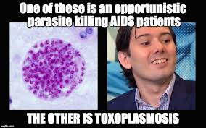
Pharma is profiting off of patients

Slide 30
Cost: A Fork in the Road
19%
17%
15%
13%
11%
9%
7%
5%
USA 1971:
HMO Act
USA
Health costs % of GDP
Canadian Single Payer Fully Implemented
Canada
1960 | 1970 | 1980 | 1990 | 2000
2014
Source: Statistics Canada, Canadian Institute for Health Info, and NCHS/Commerce Dept.
Notes:
Medicare for all in Canada has not only lowered administrative costs, in lowered total healthcare expenditure, bending the health care cost curb compared to the US

Slide 31
How is Medicare for All Going to Work?
Cost
  Reduce administrative overhead
  Negotiate better prices
Quality
  Get rid of junk plans
  End class based rationing
Access
  Everyone In, Nobody Out

Slide 32
Quality: Most of the Medically Bankrupt Had Insurance at the Onset of Their Illness
Source: Himmelstein et al. Am J Med: August, 2009

Slide 33
Quality: Deductibles Are Increasing Rapidly
Percent of Workers
With Deductibles >$999 (Single Coverage)
Source: Kaiser/HRET Survey of Employer-Sponsored Benefits, 2015
Notes:
The ACA didn’t cause this, but it didn’t help either
Recent KFF study found that among people making 150% of FPL 2/3 didn’t have enough liquids assets to pay a mid-range deductible
Even among those making more than 400% of FPL 10% didn’t have liquid assets for a mid range deductible and 20% couldn’t afford a high range deductible.

Slide 34
Uninsured and Under-Insured
Delay Seeking Care for Heart Attacks
Odds ratio for delayed care*
Source: JAMA April 15, 2010. 303:1392
*Adjusted for age, sex, race, clin. charact., hlth status, social/psych fx, urban/rural.
Under-insured=had coverage but patient concerned about cost
Notes:
This study showed that among those with out insurance or those with insurance with high co-pays more likely to avoid seeking care

Slide 35
Many Specialists Won’t See
Kids With Medicaid
% of Clinics Scheduling
Appointments for Children
Bisgaier J, Rhodes KV.
N Engl J Med 2011;364:2324-2333
Notes:
35
Figure 2 Clinics Scheduling Specialty Care Appointments for Children, According to Type of Insurance. Public insurance was reported by callers as the Illinois Medicaid–Children's Health Insurance Program (CHIP) umbrella program; private insurance was reported by callers as Blue Cross Blue Shield. Each of the 273 clinics was called twice (for a total of 546 calls) by the same caller, with only insurance coverage varying between the two calls: once reporting Medicaid–CHIP coverage and once reporting private coverage. Calls were made 1 month apart, and the order of the reported insurance status was randomly assigned. Asthma clinics included 38 allergy–immunology clinics and 6 pulmonary disease clinics.

Slide 36
No Socioeconomic Disparity In
Surgical Waits in Ontario
100%
75%
50%
25%
Percent With Longer Than Ideal Wait Time
CV | General | Ortho | ENT | Plastic
Type of Surgery
Poorest 20%
Wealthiest 20%
Pediatrics 2014;e504-511

Slide 37
Even Americans with Above-Average Incomes Have Worst Access to Care
Percent Reporting Access Problem
Source: NEJM 10/23/2014

Slide 38
How is Medicare for All Going to Work?
Cost
  Reduce administrative overhead
  Negotiate better prices
Quality
  Get rid of junk plans
  End class based rationing
Access
  Everyone In, Nobody Out

Slide 39
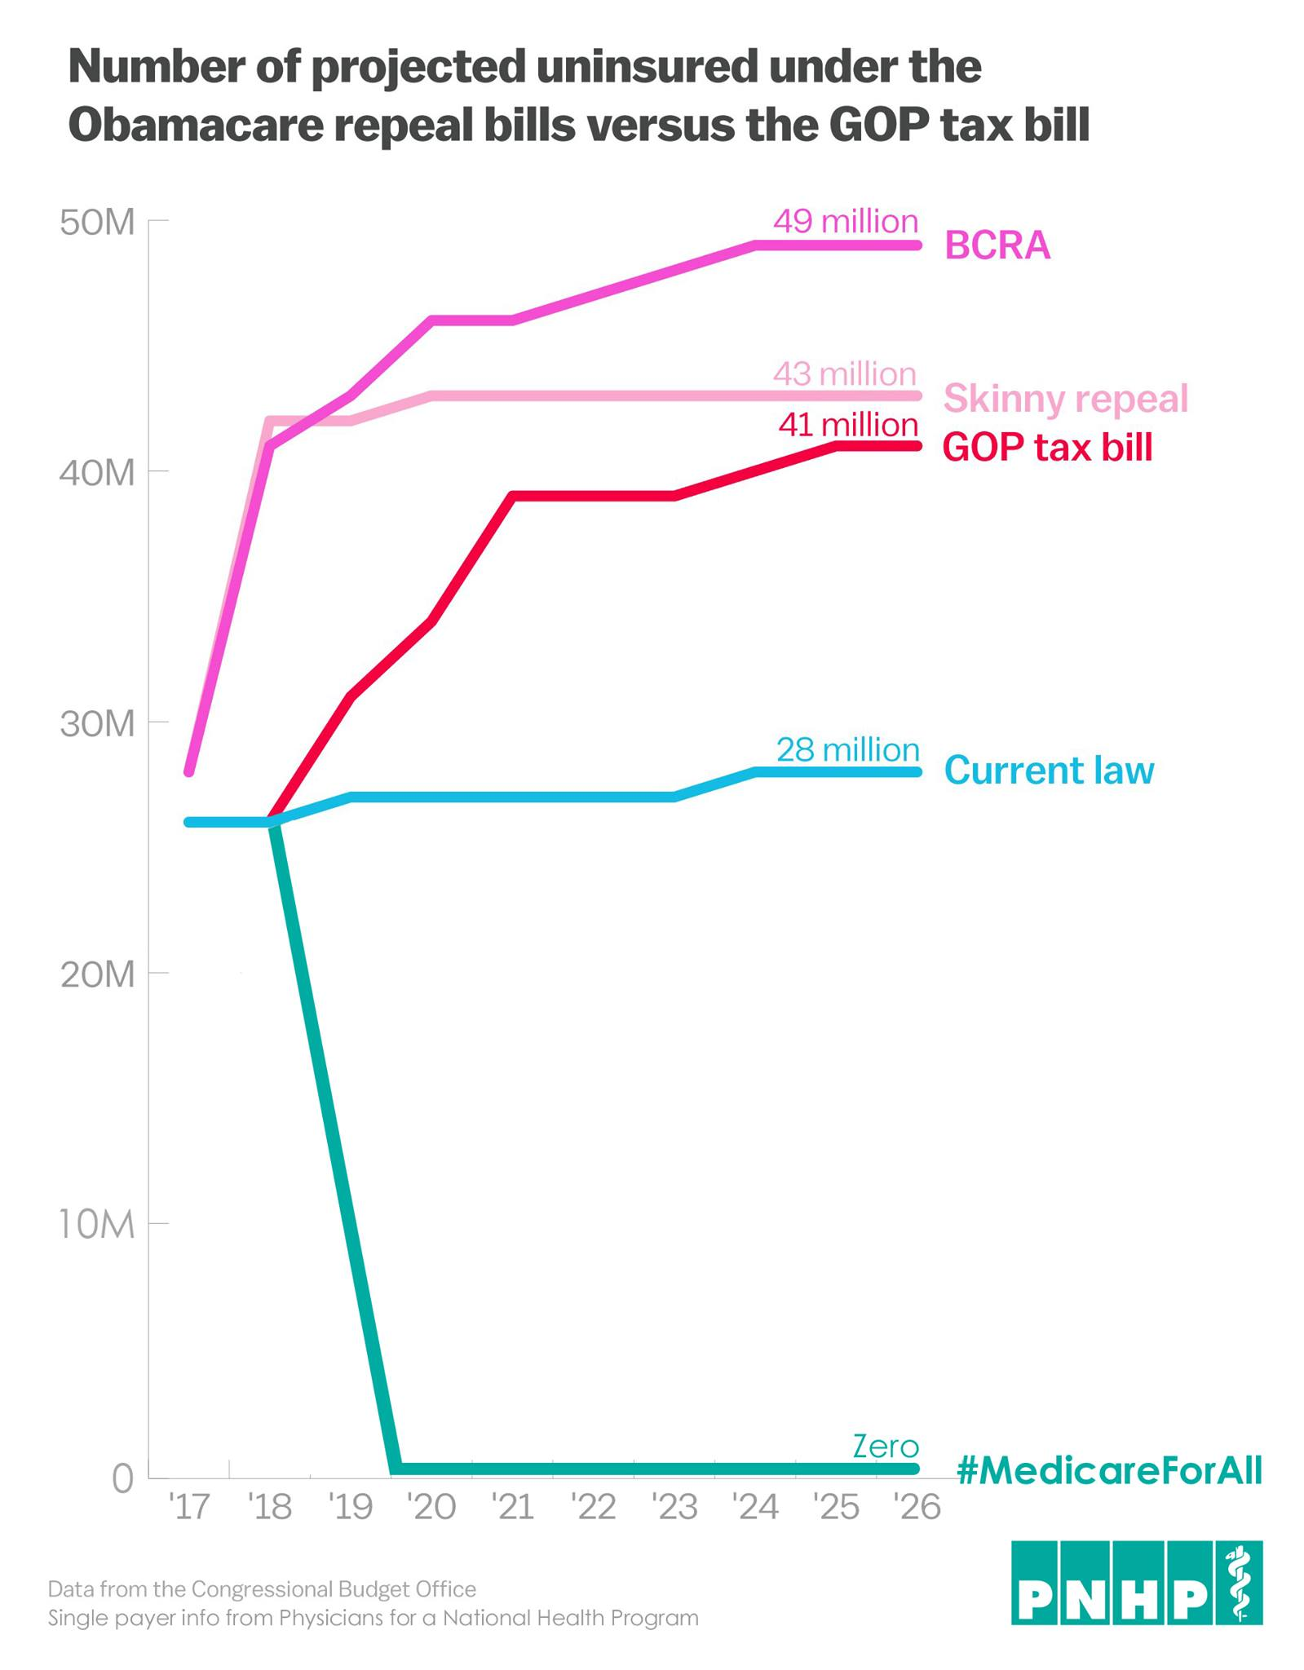
28 million Remain Uninsured

Slide 40
The Ultimate Cost
29,000 Annual Deaths
State | Percent Uninsured | Excess Deaths
California | 8.6% | 3,315
Texas | 17.1% | 4,612
Florida | 13.4% | 2,660
New York | 7.1% | 1,380
Georgia | 13.9% | 1,387
USA | 9.4% | 28,949
Source: Wilper et al. Am J Public Health 2009, update 2015
State tabulations by author
Notes:
This is Post ACA!
\
This is from a study that compared insured vs uninsured in our current health care system, which arguably has room for more improvement than just insuring everyone,

Slide 41
Access: Health Insurance Is
Increasingly Unaffordable
Average Family Premium as a Percentage of Median Family Income
http://www.commonwealthfund.org/interactives-and-data/chart-cart/presidents-column/costs-of-failure/average-family-premium-as-a-percentage-of-median-family-income
Accessed Feb. 25, 2016
Notes:
And our families spend a lot
This is just premiums, it doesn’t include out of pocket expenses like copays, article in forbes in 2016, 7 in 10 americans have less than $1000 in savings in bank
What does all this money go to

Slide 42
Access: Insurance Companies Use Formulary Design to exclude those with Pre-Existing Conditions
Drugs of Choice | Illness | Plan 1 | Plan 2 | Plan 3
Anti-Retrovirals | HIV | No | No | No
Triptans | Migraines | No | No | No
Anti-Psychotics | Schizophrenia | No | No | No
Macrolides | Pneumonia | Yes | No | No
L-Dopa | Parkinson’s | Yes | No | No
Anti-Convulsants | Seizures | Yes | No | No
ACE Inhibitors | Hypertension | Yes | Yes | No
Metformin | Diabetes | Yes | Yes | No
Oster & Fendrick, Am J Managed Care 2014;9:693-4
Plan 3 = Harvard Pilgrim
“No” = No drug of choice available on Tier 1 (lowest co-pay)
Notes:
This is a way around the ACA reg forbidding discrimination based on pre-existing conditions
Create formularies that wont cover your condition

Slide 43
Most Want Medicare-for-All
Do you favor “expanded, universal Medicare-for-All”?
All Adults
Democrats
Source: Kaiser Health Tracking Poll, 12/17/2015

Slide 44
“Expanded, Universal Medicare for All”
Favored by Most Independents and Even Many Republicans
Independents
Republicans
Source: Kaiser Health Tracking Poll, 12/17/2015

Slide 45
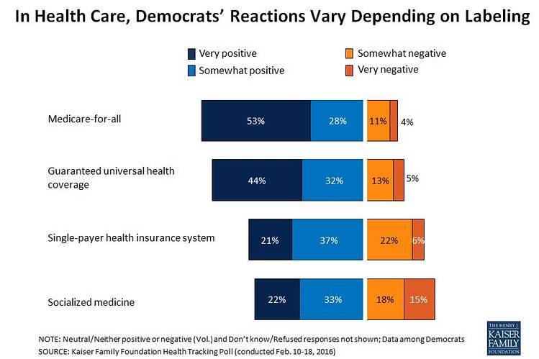
“Single—payer” is much less popular

Slide 46
Most Physicians Support a National Health Program.
Psychiatry
Peds Specialties
Emergency Med
General Peds
General Int. Med
Med Specialties
Family Med
OB-Gyn
General Surgery
Surg Specialties
Radiology
59%
of physicians support single payer
0 | 25% | 50% | 75% | 100%
Percent supporting National Health Insurance
2007 detail of surveys of random samples of US physicians.
Carroll and Ackerman. Ann Int Med 2008;148:566

Slide 47
Canadian Physicians’ Incomes
Average FFS billings per FTE physician, 2014-2015
Specialty | Income
Family Medicine | $271,417
Internal Med | $378,468
Pediatrics | $292,242
Psychiatry | $258,697
Dermatology | $368,003
Specialty | Income
OB-GYN | $405,504
General Surgery | $417,773
Thoracic Surgery | $529,829
Ophthalmology | $668,887
Avg All Canada | $337,767
Source: Canadian Institute for Health Information
Figures are in Canadian $

Slide 48
PNHP Proposal: HR 676
“Improved Medicare for All”
Who?
How?
Cuts administrative costs by $476B annually
Cuts pharmaceutical costs to ‘European levels’ by $116B annually
Total savings: $592B
What?
120 co-sponsors; majority of Democrats in the House
Saves $592B annually while covering all 30M+ uninsured Americans, and improving benefits.
Improves quality, reduces cost, expands access
Notes:
Record number of co-sponsors,

Slide 49
S.1804 – Medicare for All Act of 2017
Overall Design
Immediate Improvements
Four-year Implementation
  Inpt, outpt, ER, Rx,
  Drug price negotiations
  No copays or deductibles (except Rx)
  Prohibits sale of duplicative insurance
  Add dental, vision, and hearing
  Limit on out-of-pocket for A and B; no deductibles
  “Medicare Transition Plan” on exchanges (Public option)
  Office of Primary Care
  Medicare available at gradually reducing ages
  Parts C and D options remain until full implementation
Notes:
This is Bernie Sander’s Bill, currently has 17 co-sponsors many considered potential 2020 presidential candidates.
Going to cover mostly all care except long term care, eliminates cost sharing

Slide 50
Many Good Options for Funding S.1804
7.5% income-based premium by employers
4% income-based premium by households
Savings from Health Tax Expenditure
Many other options
Employee making $50,000 per year, family of four
  Employer paid $12,865 in premiums in 2016
  7.5% tax = $3,750
Employer saves $9,115 per employee
  Revenue raised: $3.9 trillion over ten years
  Businesses save $9,000 per employee
  Revenue raised: $3.5 trillion over ten years
  Typical middle class family saves $4,400
  Revenue raised: $4.2t over ten years
  Tax subsidies become obsolete
  Make personal income tax more progressive
  Wealth tax on top 0.1%

Slide 52
Take Home points
America is not #1 in health outcomes but we are #1 in healthcare expenditures, and it doesn't’t need to be this way.
Medicare has a much lower overhead than private health insurance, we could save a ton of money with Medicare for All, and use that to improve the healthcare system
Support has never been higher, this is not an impossible dream, but there is still a lot of work to be done
Notes:
Although people describe it as a giant tax increase, because of increased federal expenditure, most people spend on healthcare either in the form of premiums, Out of pocket expenses, tax subsidies, employer contribution, etc.
We are paying for single-payer without getting the benefits of it. A public program is only as good as the amount of money you put into it, and we are putting in more than anyone else in the world.

Slide 53
For more information…
Anthony.Spadaro@uphs.upenn.edu
Health policy websites:
  The Commonwealth Fund: www.commonwealthfund.org
  Kaiser Family Foundation: www.kff.org
  Health Affairs Blog: http://healthaffairs.org/blog/
  Physicians for a National Health Program: www.PNHP.org

Slide 54
Questions ??
How would physician compensation change in a single-payer system? How are the decisions on how to allocate every healthcare dollar made in a single-payer system? (as in, the decision of what gets covered and what doesn't)
How will we transition from a for-profit private insurance health care system to single payer? What will happen to all the people employed by insurance companies? How will provider reimbursement be affected (esp since in countries with single payer systems, their medical education is much less costly than here in the US and graduates here have a greater debt burden)?
How do large, private, for-profit hospital systems adjust to a single-payer system, or do they have to?

Slide 55
Upcoming Events
SNaHP summit in New Orleans on March 3rd
Upcoming Webinars
January 17th, 8pmEST/5pmPST - The Conservative Case for Single Payer - Presented by Dr. Ed Weisbart
Sunday, Jan 21st (Time TBD) - The Intersection of Racial Justice and Single-Payer - Presented by Dorothy Charles
Sun, Jan 28th (time TBD) - Effective Single Payer Advocacy - Anand Saha

Slide 56
Patient Stories
  A diabetic patient needed a second medication for better blood sugar control however couldn’t ACCESS medication because of cost
  Another patient, had sickle cell disease, multiple hospitalizations of greater than a week for pain, couldn’t get an appoint with a pain specialist to get QUALITY care
  Both patient’s poorly controlled medical conditions will COST the medical system a lot of money
Notes:
Tell the story of two patients

Slide 57
Quality: NY State Cheapest Bronze Plan (Family, 2017)
Premium: $12,563
Deductible: $8,000
Coinsurance: 50% after deductible for:
    Ambulance, ED, Urgent Care
    Imaging & diagnostic tests
    Outpatient visits
    Chemotherapy
    Inpatient
Out-of-pocket maximum:
  $14,300 for a family with income-based adjustments …
Notes:
Affordable plans don’t have to be affordable for families

Slide 58
Many Elective PCIs Are Inappropriate
Uncertain
41.3%
Appropriate
33.9%
Inappropriate
22.0%
JAMA IM 2014;174:1630
Based on 1,225,562 patients in PCI Cath Registry

Slide 59
Higher Medication Co-Pays =
Worse Pediatric Asthma Outcomes
Children age 5-18
Source: JAMA 2012;307:1284

Slide 60
The Medical Arms Race:
Which Hospitals Opened New
Invasive Cardiology Programs, 1996 – 2014?
Strong Predictors
Modest Predictor
Weak Predictor
  A competing hospital opening a program was a strong predictor of opening a new program.
  For-profit ownership was a strong predictor.
  Being a non-profit in a market dominated by for-profits was also a predictor.
  Lack of service availability in the community was a weak predictor of opening a new program.
Source: NBER Working Paper W23530 - June, 2017

Slide 61
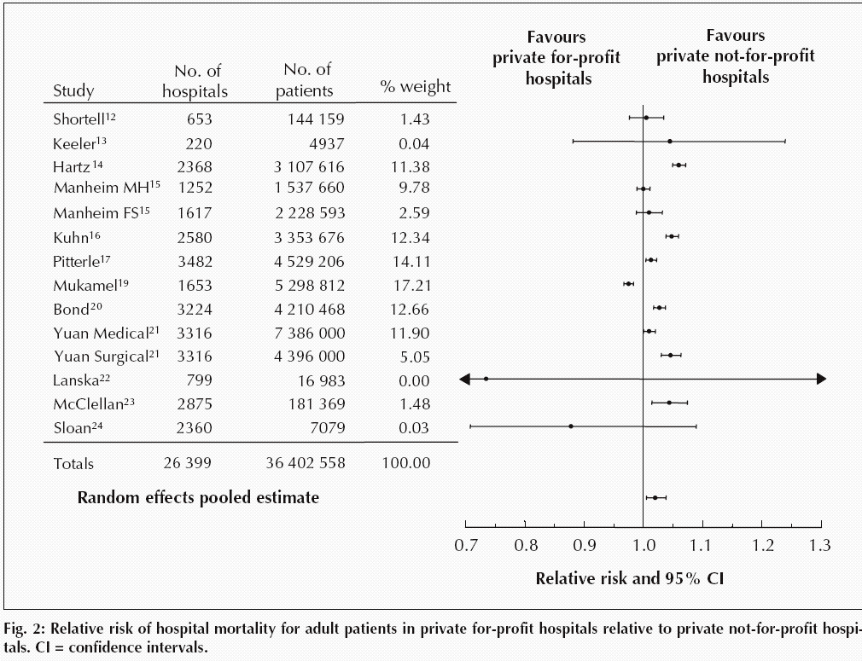
For-Profit Hospitals’ Death Rates
Are 2% Higher
Relative risk of hospital mortality for adult patients in private for-profit hospitals relative to private not-for-profit hospitals
Source: CMAJ Devereaux et al. 166 (11): 1399.

Slide 62
Mortality Gap by Income
Is Shrinking in Canada
Remaining Life Expectancy at Age 25
Source: Toronto Globe & Mail, 11/8/2013
“For the most part, the differences in health status between the highest and lowest income groups have been shrinking over time.” – Public Health Agency of Canada

Slide 63
Quality: High Deductibles Cut All Kinds of Care
150,000 Employees Lost “Cadillac” Coverage
No Evidence that Patients Shifted to “Higher Value” Care
Percent utilization reduction
Brot-Goldberg et al, 5/2015 – http://eml.berkeley.edu/~bhandel/wp/BCHK.pdf accessed Nov. 15, 2017
Note: Findings closely resemble those of Rand Health Insurance Experiment
Note: Study found no evidence that patients shopped for lower prices

Slide 64
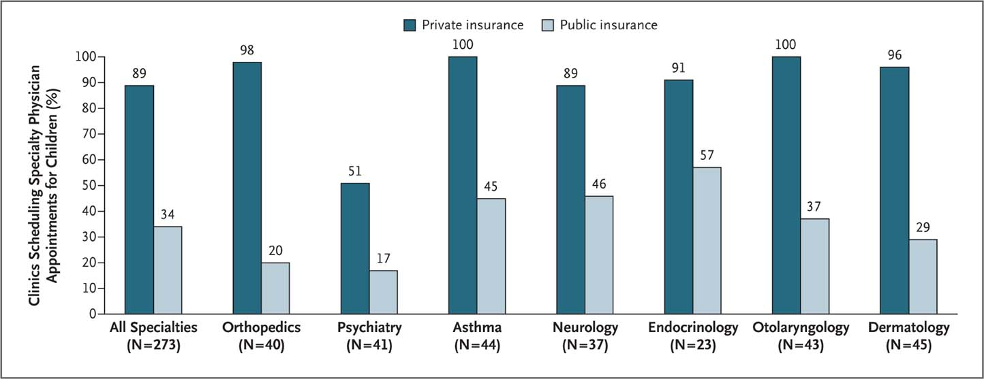
Many Specialists Won’t See Kids With Medicaid
Bisgaier J, Rhodes KV. N Engl J Med 2011;364:2324-2333
Notes:
Figure 2 Clinics Scheduling Specialty Care Appointments for Children, According to Type of Insurance. Public insurance was reported by callers as the Illinois Medicaid–Children's Health Insurance Program (CHIP) umbrella program; private insurance was reported by callers as Blue Cross Blue Shield. Each of the 273 clinics was called twice (for a total of 546 calls) by the same caller, with only insurance coverage varying between the two calls: once reporting Medicaid–CHIP coverage and once reporting private coverage. Calls were made 1 month apart, and the order of the reported insurance status was randomly assigned. Asthma clinics included 38 allergy–immunology clinics and 6 pulmonary disease clinics.

Slide 65
Low Birth Weight Increased in Iowa
After a Massive Immigration Raid
Relative Risk of Low Birth Weight
Int J Epidemiol 2017;839
Note: 2008 Postville, Iowa raid was the largest single-site immigration raid in history. 900 agents handcuffed and chained all Latinos at meatpacking plant.

Slide 66
22.5% of 111,707 Defibrillator Implants Were
Not Evidence-Based
Sometimes Lethal
  In hospital death rate for non-evidence based ICD implant 0.6%
  Cost of ICD implant ~$25,000
Note: In-hospital death rate for non-evidence-based ICD implantation was 0.6%.
Cost of ICD implant ~$25,000
Source: JAMA 2011;305:43

Slide 67
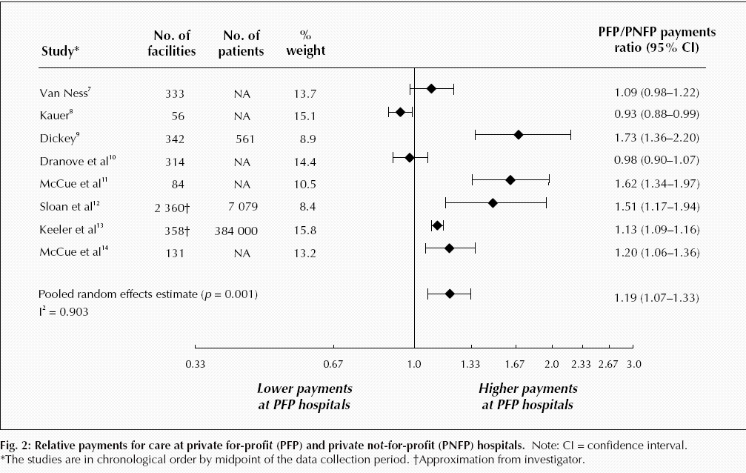
For-Profit Hospitals Cost
19% More
Relative payments for care at private for-profit (PFP) and private not-for-profit (PNFP) hospitals
Source: CMAJ Devereaux et al. 170 (12): 1817.

Slide 68
For Profit Home Care: Lower Quality
Source: Cabin, Siman, Himmelstein & Woolhandler.
Health Affairs 8/2014

Slide 69
High U.S. Costs Do Not Result From
Bad Health Habits
Aging
Overuse of Care

Slide 70
Smoking Prevalence
Percent of population >age 15 who smoke daily
Source: OECD, 2016
Note: Data are for 2015 or most recent year available

Slide 71
Percentage of Elderly
Percent of population >age 64
Source: OECD, 2016
Note: Data are for 2015 or most recent year available

Slide 72
Hospital Inpatient Days per Capita
Days/person/year
Source: OECD, 2015 & AHRQ
Note: Data are for 2014 or most recent year available

Slide 73
Physician Visits per Capita
Source: OECD, 2017
Note: Data are for 2016 or most recent year available

Slide 74
Overall Administrative Costs per Capita
United States and Canada, 2016
Source: Woolhandler et al. NEJM 2003;349:768 (updated); Himmelstein et al. Health Aff 9/2014

Slide 75
Ultimate Cost:
Personal Bankruptcy
62%
of all bankruptcies in 2007 were medical
92%
had medical debts over $5,000
or 10% of pretax family income
75%
had health insurance
Himmelstein, et.al. Am J Med, August, 2009
Notes:
Most of these people had insurance!

Slide 76
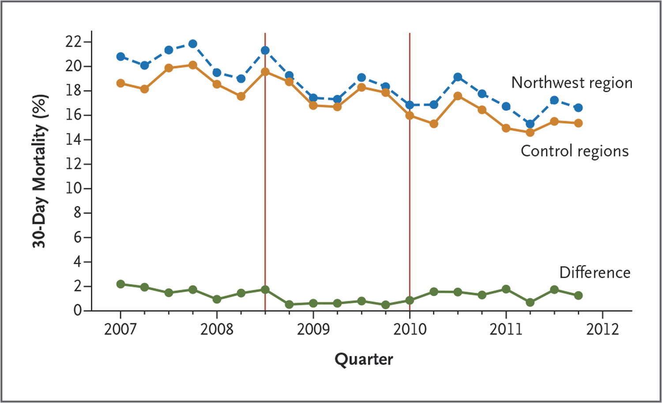
P4P Didn’t Lower Hospital Mortality in England
P4P Hospitals
P4P Hospitals
P4P Bonuses
Begun
Bonuses + Penalties Begun
N Engl J Med 2014;371:540-548.

Slide 77
Why Management Cares
So Much About Upcoding
Medicare Payment to Medicare Advantage Plan:
Same Patient, Different Coding
Base rate $3950
Uncompl. DM $1040
CKD $0
Obesity $0
Depression $0
Chronic CAD $0
Total $4990
Base rate $3950
DM II with diab. CKD $3180
CKD stage 4 $2370
Morbid Obesity $2730
Major depression $3950
CAD with angina $1400
Total $17580
Source: SGIM Forum, 2017

Slide 78
