Slide 1

The Impact of Health Reform
29 East Madison, Suite 602
Chicago, Il 60602
312-782-6006
www.pnhp.org

Slide 2
Health
Reform
The
Uninsured
The Underinsured
Medical Bankruptcy
Healthcare Costs
Administrative Costs

Slide 3
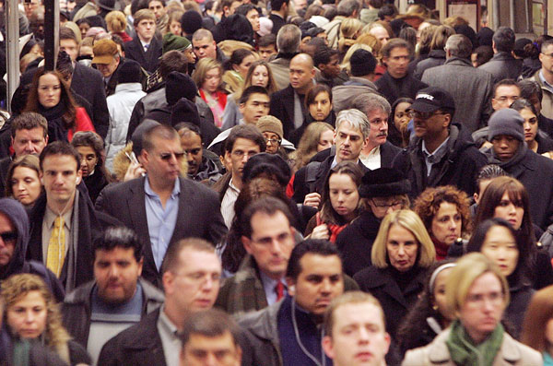
Impact of Health Reform on:
The Uninsured
Number of uninsured
Safety net hospitals
Community health centers
Reduced from 46 million today to ~23 million in 2019
Funding through Medicare cut by $36 billion through 2019
Receive extra $1 billion annually

Slide 4

Impact of Health Reform on:
The Underinsured
If you like your current coverage you can keep it.
If you don’t like your current job-based coverage, you have to keep it.
Policies required to cover at least 60% of expected health costs
Example: $2,000 deductible + 20% co-insurance for next $15,000 of care.

Slide 5

Impact of Health Reform on:
Medical Bankruptcy
No change in bankruptcy rates
Up to 50% reduction in bankruptcy rates
12.5%
overall
For the 75% of medical bankruptcy filers who have insurance
For the 25% of the medically bankrupt who were uninsured in 2007 but will gain coverage under reform
Maximum expected reduction in medical bankruptcies

Slide 6
Impact of Health Reform on:
Health Care Costs (Expansions)
Expanded Medicaid
Small employer tax credits
Temporary high risk pools, subsidy for retirees <65, etc
Subsidies for private coverage
$434 billion
$358 Billion
$37 Billion
~$10 Billion
All figures reflect spending through 2019

Slide 7
Impact of Health Reform on:
Health Care Costs (Savings)
$136 billion
Decreased Medicare Advantage/HMO overpayment
$36 billion
Decreased Medicare (DSH) payment to safety net hospitals
$196 billion
Decreased Medicare fee-for-service payments to doctors/hospitals
$87 billion
Other Medicare/Medicaid cuts
All figures reflect spending through 2019

Slide 8
Impact of Health Reform on:
Cost Control Provisions
Insurance Changes
Insurance Exchanges
Fraud and Abuse prosecution/recovery
Medicare Advisory Board
Benefit Changes
Tax on “Cadillac” coverage
Coverage of preventive services
System Changes
Health Information Technology
Comparative Effectiveness Research
Experiments in Change
Alternatives to Fee for Service
Malpractice reform

Slide 9

Health Reform Bill:
Proven Cost Control Provisions

Slide 10
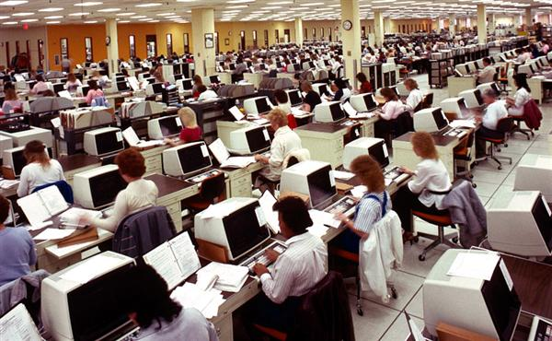
Impact of Health Reform on:
Administrative Costs
IRS cost to enforce mandate: $5 - 10 billion
Running insurance exchanges (based on MA):
~4% of premiums
Insurance overhead:
~13% of new premium revenues = $42 billion
Cap on insurance overhead: ????
Standardized claim forms: ????

Slide 11


Role Played by Health Industry
In Health Reform
Former VP of Public Policy for WellPoint/Anthem
Pharma spent
$100,000,000
supporting reform
Senate framework written by Liz Fowler
Favoring reform
Insurance company ads
Promoting reform
Democrats
Insurance company donations
Republicans

Slide 12
The Impact of Health Reform
29 East Madison, Suite 602
Chicago, Il 60602
312-782-6006
www.pnhp.org

