Slide 1

Divestment
A New Strategy for Single Payer
Rob Stone
Katie Robbins
Kay Tillow

Slide 4
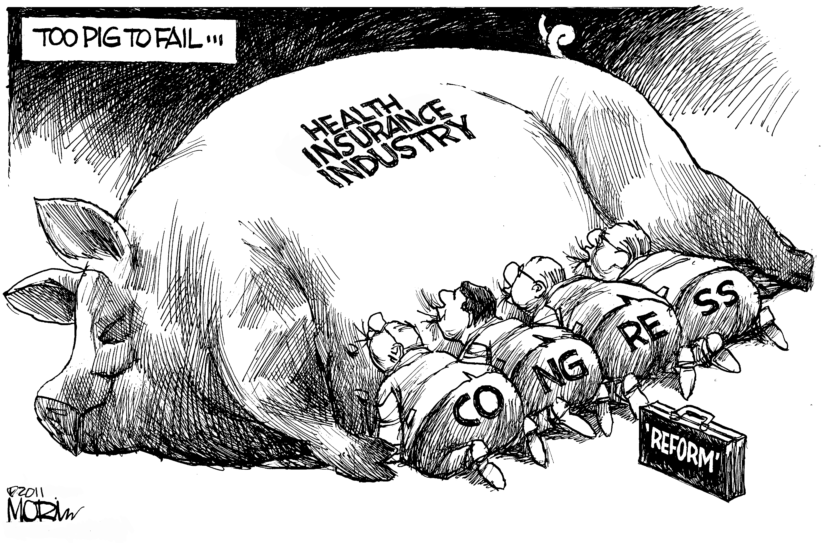

Slide 5

The Medical-Industrial Complex
“Remember that what the rest of us call health care costs, they call income.” - Paul Krugman, Nobel Laureate New York Times 5/10/09
Notes:
The strongest argument in favor of single payer is that of all the proposals being discussed, it is the one best able to control costs. The strongest argument against single payer is that it is the plan best able to control costs. Controling costs is a problem? As Nobel Prize-winning economist Paul Krugman put it, writing about what he calls The Medical-Industrial Complex: “Remember that what the rest of us call health care costs, they call income.”
Everyone says, “single payer isn’t feasible.” What they mean is that the forces profiting from our bloated system see Medicare for Everyone as their greatest threat. Therefore, it isn’t politically feasible

Slide 6
The Big 7 Health Insurers 2011
Company | Home Office | Market Cap [billions] | Employees | Lives Covered [millions]
United Health Care | Minnetonka, MN | $49 | 87,000 | 25
WellPoint/Anthem | Indianapolis, IN | $22 | 37,500 | 34
Aetna | Hartford, CN | $14 | 34,000 | 18
Cigna | Bloomfield, CN | $12 | 30,600 | 11.5
Humana | Louisville, KY | $12 | 35,200 | 11
Coventry | Bethesda, MD | $5 | 14,000 | 5
Health Net | Woodland Hills, CA | $2 | 8,000 | 6
“Our systems are perfectly designed to attain the results we are currently achieving.”
– W. Edwards Demming
Notes:
Accessed 8/27/11
Risk Metrics Governance Risk Indicator http://www.msci.com/
Board Audit Compensation Shareholder Rights
UNH low low low low
WLP low low medium medium
AET low low medium low
CI low low low medium
HUM low low medium low
CVH low low medium medium
HNT low low medium medium
SRI links
http://www.unitedhealthgroup.com/main/SocialResponsibility.aspx
WellPoint: http://www.wellpoint.com/CR/index.htm
http://www.cigna.com/about_us/social_responsibility/index.html
http://www.aetna.com/about-aetna-insurance/aetna-corporate-profile/corporate-responsibility.html
http://www.humana.com/resources/about/corporate/
110 million covered by these 7. 52 M uninsured. 58 M Medicaid. 163 M private insurance. 48 M Mcare (9 M dual eligible) Total pop 311 now, some of these #’s 2007
110/163= 67% of privately insured covered by these 7. ~50% Pvt Ins. ~17% uninsured. ~33% MC/MC

Slide 7
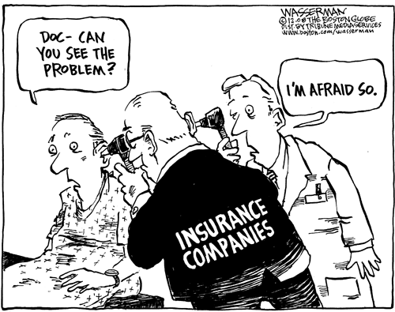
Notes:
Doctors don’t like it

Slide 8
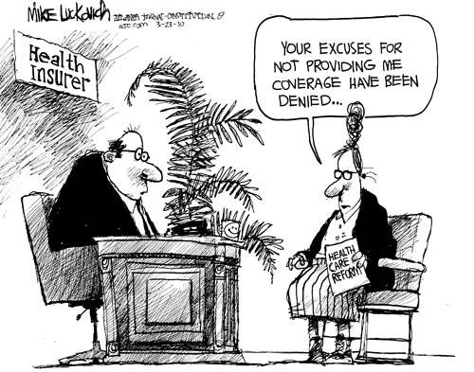
Notes:
Patients don’t like it

Slide 9
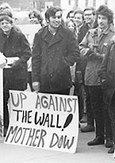

Slide 10
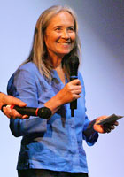
Karen Green Stone at Wellpoint Annual Shareholder’s Meeting
“Angela, it takes 285 public school teachers in Indiana who earn an average of $47,000 a year to equal your 2010 compensation package of $13.4 million.
Would you kindly tell us why you are entitled to so much more than them?”
Indianapolis, May 17, 2011 http://pnhp.org/blog/2011/05/19/

Slide 11
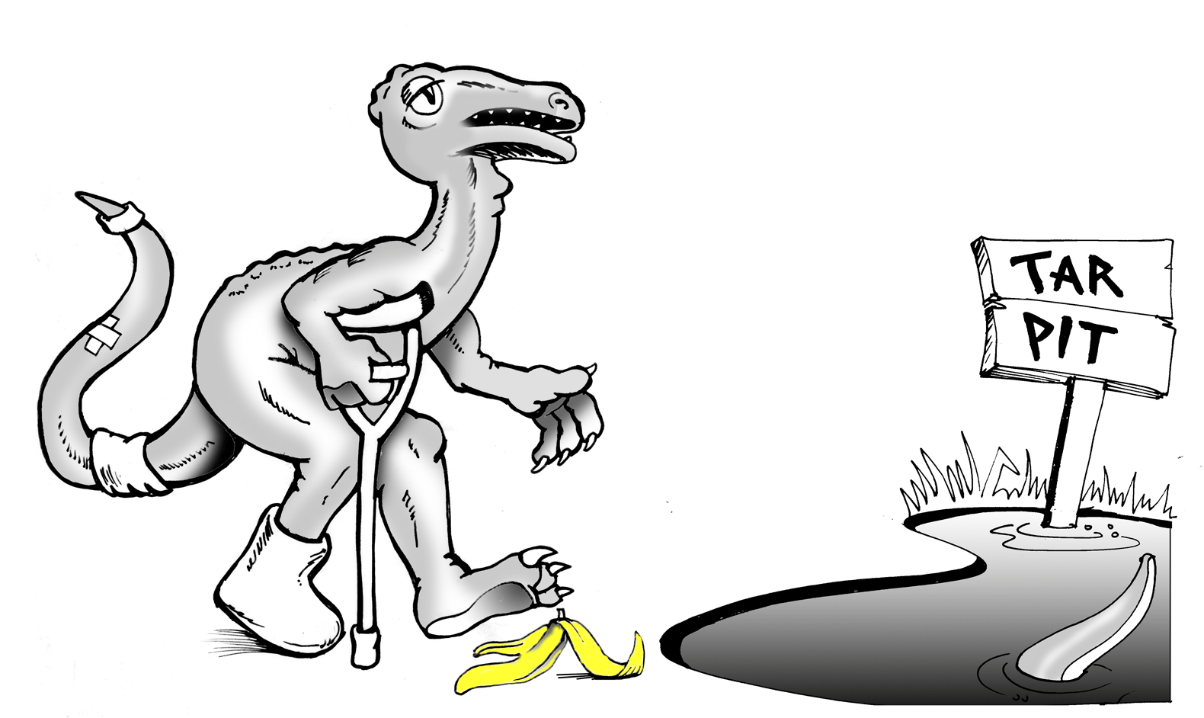
The Health Insurance Industry
A Dinosaur Stumbling Toward a Tar Pit
Notes:
Investors should get out while they can

Slide 12


