Slide 1

Hollis Rotary Club
Ken Dolkart MD FACP
June 13, 2018

Slide 2
“Millions of our citizens do not now have a full measure of opportunity to achieve and enjoy good health. Millions do not now have protection or security against the economic effects of sickness. The time has arrived for action to help them attain that opportunity and that protection”
“Of all the forms of inequality, injustice in healthcare is the most shocking and inhumane”
“Nobody dies because they don't have access to health care.”
Famous Healthcare Quotes:
Notes:
-Harry Truman, 1945, proposing a universal national health insurance 72 years ago – during the red scare, this was opposed by AMA as a socialist experiment, but the govt was never to own hospitals or practices. Wage controls were in place during the 40s to prevent the hyperinflation seen in europe after the war, so healthcare benefits were offered as a popular tax deductible competitive perk for employees and employers in lieu of salary increases. Health coverage has been linked w employers ever since
-Martin Luther King 1966, speaking on the moral imperative of assuring healthcare for all – many people who were the working-poor, disabled or unemployed did not have access to employee-sponsored health insurance
-Raul Labrador at a town hall meeting in Idaho after the passage of the AHCA and the CBO evaluation that 24 million Americans will lose their current health insurance. Estimated that 36,000 Americans died in 2016 due to lack of insurance

Slide 3
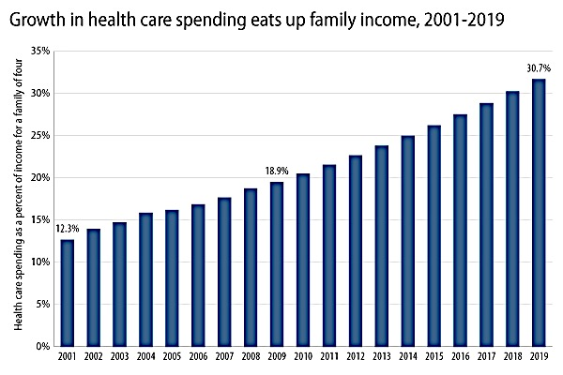
Notes:
Paying for healthcare and medication remains at the top of American’s financial worries, outweighing concerns about housing, food or retirement. It doesn’t have to be this way.
Health expenditures are triple that of inflation, at a time when middle class wages have been relatively flat

Slide 4
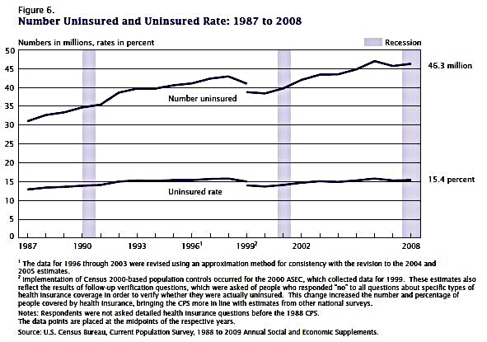
Recent History of Uninsured/Underinsured Pre 2008 Recession
Notes:
In the 1980s, health insurers were deregulated to “unleash the power of the free market” and the previously non-for-profit, regional Blue Cross Blue Shield also was allowed to reincorporate as for profit . During the subsequent 20 years - prior to the ACA (Obamacare) - a rising number of Americans became uninsured, in part due to fewer employees receiving benefits from a lifelong employer, combined with the progressive unaffordability of health premiums for the self-insured. In addition, many more people were underinsured, paying what they could afford for inadequate policies with limited preventive care and few essential benefits.

Slide 5
Bankruptcies Due to Uninsurance or Underinsurance in NH
NH Bankruptcy by County – 2013
Notes:
-Personal bankruptcy increased dramatically between 1980 and 2004, in part due to increased consumer debt related to credit cards and decreased savings and lack of consumer protection, but in 2/3rds the immediate cause of bankruptcy was uncovered medical illness.
-Bankruptcy rates in 2004 were 80x that in 1980.
-Unexpected uncovered medical expenses accounted for 2/3rds of Bankruptcy in NH and the US as a whole,
-The majority of people who became medically bankrupt HAD flimsy underinsurances.

Slide 6
Numerous Federal Health Ins. Systems
1965:Medicare – for >age 65 and dialysis pts - Funded via US revenue, mandatory Fed. payroll taxes and beneficiary premiums
1965:Medicaid for those <poverty level- funded jointly w Federal-State taxes but administered at state level
2003:Medicare Part D – supplement to Medicare, administered by for profit pharmacy benefit managers, Medicare cannot negotiate prices
Programs w Special Relations w Federal Govt:
1946 - Veterans Health Administration; 1955 - Indian Health Services; 1956-66 - Dept of Defense Tricare;1959 - Federal Employees Health Benefit Program (FEHBP)
Various State Programs:
1902-49 – Statewide Workers Compensation
Notes:
US Heath system has numerous, duplicated care programs. A convoluted, contorted collection of just tax supported programs costs 2 trillion dollars annually. These include multiple tax-funded employee coverage schemes, tax credits, Veterans care, Tricare, CHIP, Medicaid, Medicare, Obamacare (ACA), Workmans’ comp. Indian Health Services, and multiple other redundant systems. The ACA, as designed by insurance company and pharmaceutical lobbies, was a lifesaving dinghy attached to a leaking, rusted, unbalanced ship of healthcare funding.

Slide 7
Newer Responses to Rising Uninsured
1997 SCHIP - poorer families with children > poverty levels & ineligible for Medicaid –funds provided 7.6 million kids
1976-2014: State High Risk Pools - catastrophic coverage for pts denied insurance for “preexisting conditions.” Expensive, 1/25 “uninsurables” covered, 200,000 people covered by 34 states
ACA (Obamacare) – Must give 10 Essential Benefits, NoDenial for Preexisting conditions,No Limits on Yrly/Max Cov. Cov for kids < 26, Expded Medicaid to138% FPL, Limits on Profits by Insurers, Insr Companies in State Exchanges, Incentives for imprvd hospital safety coordination of care and avoidable hospital readmissions
Notes:
During this period, states experimented with High Risk Pools - Hi Risk Pools Covered only 200,000 people in 34 states in 2008 at height of availability – expensive
The ACA was a response to the tragedy of harm and bankruptcy of lack of coverage for the rising uninsured
Our perpetual anxiety over Healthcare Security will only worsen as premiums climb for the ACA (Obamacare) since young, healthy individuals no longer need contribute with the elimination of the “mandate.” An increasingly ill (and costly) pool of remaining participants will strain what’s left of the ACA, effectively “repealing” the current, incomplete availability of this coverage. This, in turn, will evoke calls from Insurance Industry-financed politicos for “the good old days” of exclusions of preexisting conditions and the re-issuance of worthless insurance “product.”

Slide 8
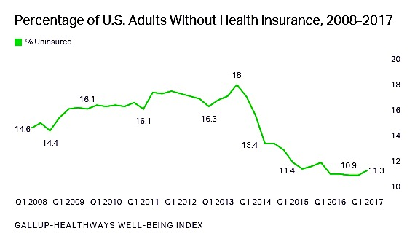
Americans without Health Insurance
Notes:
-The number of Americans w/o health insurance dropped from 44 million in 2013 to 28 million in 2016 and remained steady through 2017
-Of interest, there is wide discrepancies in bankrutpcy rates between states, with Tennessee and the South, where medicaid expansion has not been offered, continuing to have having the highest rate of bankruptcies in 2004, and Massachusetts the lowest.
-Overall Personal bankruptcy filings dropped 50% between 2010 and 2016

Slide 9
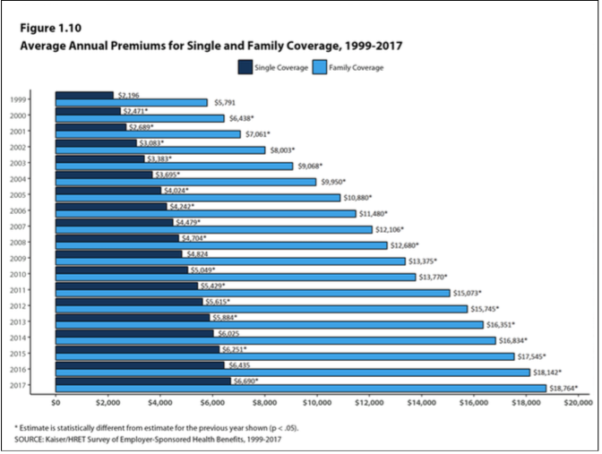
Notes:
Still, premiums continue to explode after the ACA, having typically tripled since 1999, and the out-of-pocket expenses for those with employer-sponsored health benefits have more than doubled between 2005 and 2017.
From Kaiser Foundation which has excellent information for business and country as a whole on health costs

Slide 10
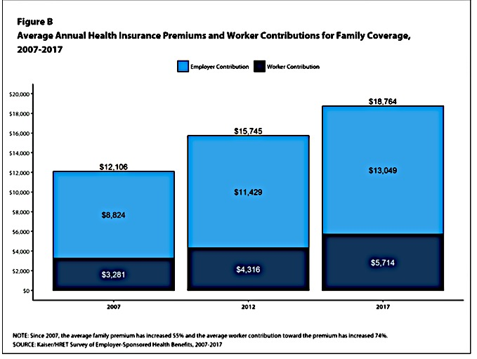
Notes:
Kaiser Family Foundation- Breakdown by worker vs employer contribution

Slide 11
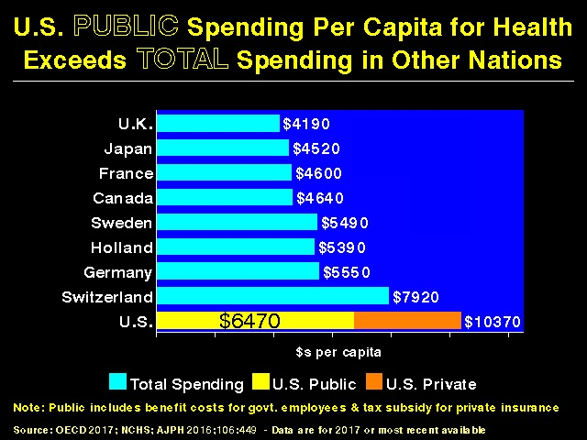
Vital Signs of US Health Care: Higher Tax and Private Spending
Notes:
We annually pay 10,000$ per capita for our healthcare, twice that of most other nations. Our expenditure of 18% of GDP, or 3.2 trillion dollars yearly, towers over other developed nations. Not only do we pay vastly more in out of pocket expenses per capita, but, ironically, our Publically Tax Funded costs exceeds the total per capita expenditures for healthcare in most other countries. And despite all of this, we leave 28 million Americans totally uninsured!
Largely due to waste and pricing failures, the U.S has the most inefficient and expensive health care system in the world. We spend more money per capita than any other developed country, but rank dead last in “efficiency, equity and outcomes,”. In the ideological effort to avoid single-payer national health care, we spend, overall, almost 50% more of our GDP on healthcare than the next most expensive national program (France, at 11% of GDP.)

Slide 12
Value in healthcare = health outcomes achieved
dollars spent
Notes:
SO what do we get for this additional expense?
Some have said that US healthcare is often unnecessarily complex, fragmented and inefficient. The Institute of Medicine provides some analogies:
-If home building were like healthcare, carpenters, electricians and plumbers would each work with different blueprints, work would be duplicated or redone, and blueprints would be faxed back and forth with little coordination or any shared conception of what the house should look like.
- If banking were like US healthcare, taking money out of an ATM would take days or weeks, rather than seconds, since banks would fax pages back and forth, rather than share computer systems
- If shopping was like healthcare, product prices would never be posted, the price to a consumer could vary widely within the same store, depending on the source of payment, and costs would vary by a factor of 10 across the town, state or country.

Slide 13
Vital Signs of US Health System: Outcomes - Poor Performance
Notes:
Americans trail other developed nations in most parameters of health. The US ranks last in mortality amenable to medical care, infant mortality, and healthy life expectancy at age 60. Mortality amenable to medical care means keeping people healthy and preventing death by appropriate interventions, preventing stroke by treating HTN or amputations by treating diabetes.

Slide 14
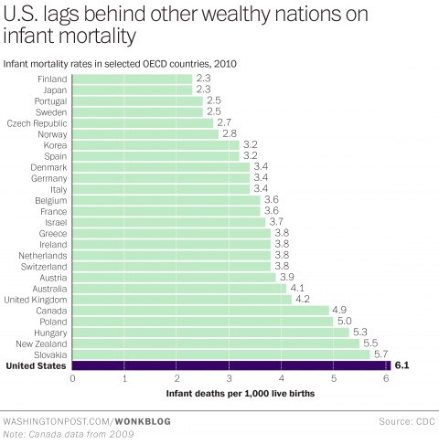
Vital Signs Outcomes: Infant Mortality
Notes:
Infant mortality reflects a for-profit-driven medical industry that incents procedures and medicalization rather than a comprehensive, integrated, family-directed, person-centered health system that links physician practices with social services. The most notable way the U.S. differs from other industrialized countries is the absence of universal health insurance coverage. Other nations ensure the accessibility of care through mandatory, universal health systems.

Slide 15
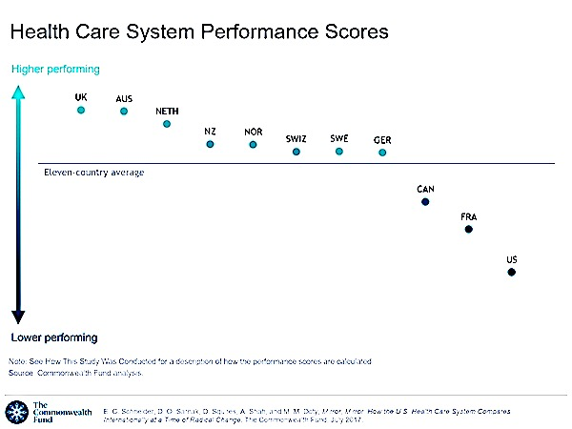
Notes:
The US is lowest among the 11 highest income industrialized democracies in terms of access to care, efficiency and equity of care, and poorly in timeliness of care, coordination of care and patient health and satisfaction, according to the Commonwealth Fund report, CDC, OECD and WHO. (OECD = organization for Economic Cooperation & Development) Ranked dead last in industrialized nations and 37th overall
The Commonwealth Fund

Slide 16
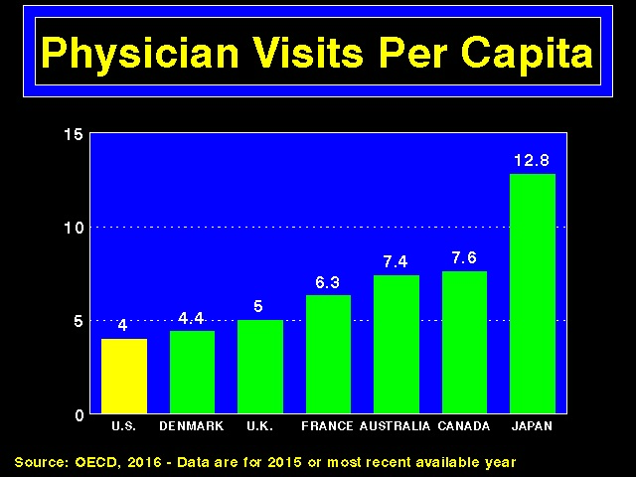
Notes:
There are many determinants of our overall deficient healthcare financing and quality. However, It must be stated that outcome differences are NOT due to a sicker or older population in the US. Americans are younger, not older, and smoke less than in many European nations. And citizens in other countries visit their doctor more often, have similar if not more hip replacements, have a much higher rate of kidney transplants, and have increased support for long term care via these systems than in the US.

Slide 17
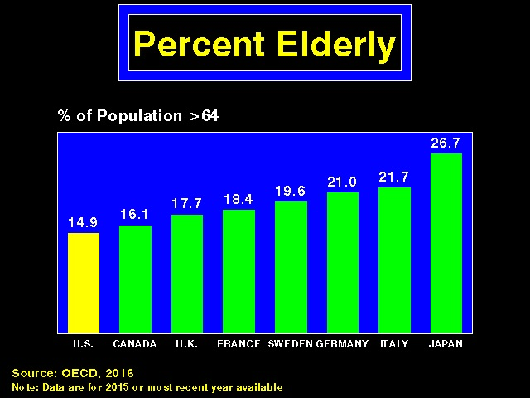

Slide 18
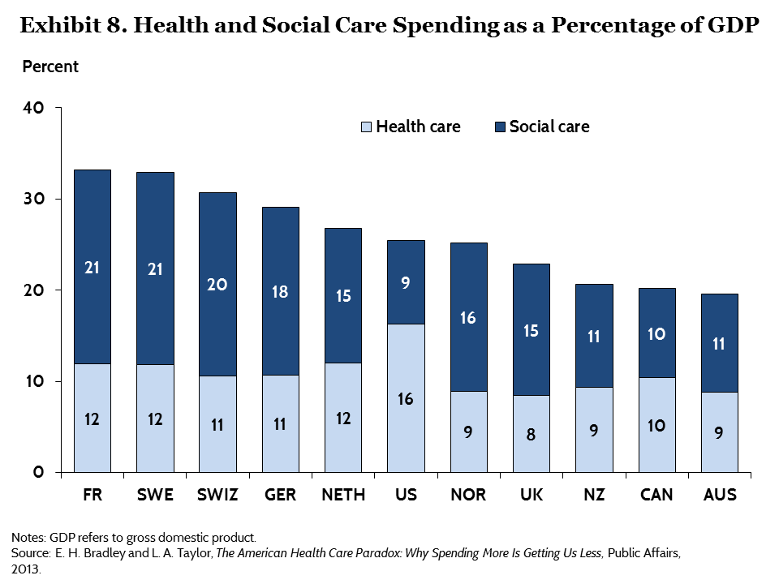
Notes:
The reduced funding of social services and the coordination of such services with health services to support children and struggling families, has resulted in poor outcomes that extend from infant mortality to perhaps the opioid epidemic that is afflicting this nation. One can argue that the devaluing of the importance of health insurance for economically struggling people has come home to roost. Those states that denied the expansion of the ACA to 137% of federal poverty levels are, not surprisingly, the states with the highest infant and maternal mortalities and poorest outcomes in healthcare.

Slide 19
Unnecessary Waste in the American Healthcare System:
Waste:$ on healthcare that provide no benefit to pts (1/3rd of all US Healthcare Costs are considered waste)
Notes:
So, given he relatively poor outcomes, why is health care so expensive in the US? Is it like that elsewhere? Does it have to be so?

Slide 20
Waste in the American Healthcare System:
1.Unnecessary Profit, w adm. geared to Profit, not improved care. (e.g. parallel teams of reviewers to limit “medical loss”) 220 b$/yr
2.Hospital Adm.multiple, non-uniform ins.forms/policies, 150b$/yr
3.Practice Adm.multiple, non-uniform interactions, 75b$ /yr
4.Misuse /overuse of care for unnecessary, ineffective, duplicated tests, or tests that add expense w/o improving health 200b$/yr
5.Inefficiently delivered services, missed prevention opportunities – care fragmentation, operational inefficiencies 130b$/yr
6.Pricing Failures – Uncontrolled Cost of Medications, Diagnostics, Procedures w inflated prices - >>200b$/yr
7.Fraud 68b$/yr
Notes:
3.We still us outdated “usual and customary” fee schedules for doctors to produce widgets rather than coordinated care:
Although this is changing, due to reforms via Centers for Medicare & Medicaid Services created under the ACA, there remains a residual widget program of rewards for procedures, rather than reimbursement for time spent in care of chronic conditions
Medical malpractice does drive some unnecessary testing, but is likely a tiny fraction

Slide 21
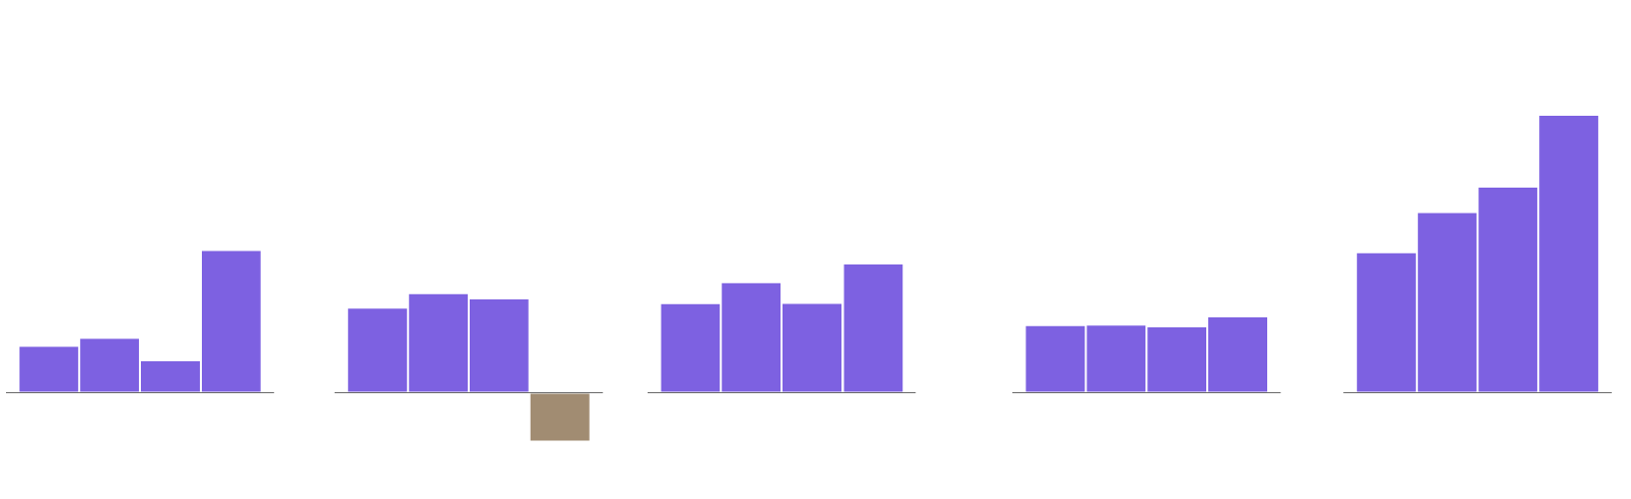
The “Free Market” Experience of Obamacare has been Great for the Insurance Industry, continuing on an “Upward Profit Spiral”
Q1 Profits at health insurance companies 2014-2017
In millions of dollars
2,172
1,115 million $
1,010
-381
598
14’ 15’ 16’ 17’
14’ 15’ 16’ 17’
14’ 15’ 16’ 17’
14’ 15’ 16’ 17’
14’ 15’ 16’ 17’
Humana Aetna Anthem Cigna United Health
4.5 billion $ in one quarter for 5 top insurers
Notes:
Profits in health insurance exist by minimizing payouts to enrollees, “cherry-picking” the market of enrollees with the lest anticipated “medical loss” so to maximize payout to CEOs and stockholders. For profit health insurers have incentive to exclude people with preexisting conditions, or make such premiums exhorbitant, and insurers can increase profits by selling “underinsurance” with huge deductibles before payouts are given. Enrollee’s cumulative annual dollars accrue to profit, but not to yearly improvements in care.

Slide 22
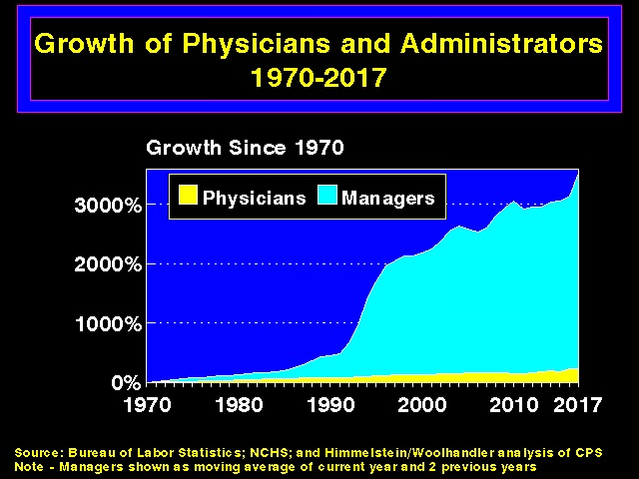
Notes:
Administrative Costs in US Astronomical:Uncoordinated Public programs with multiple administrations run parallel to that of the The proliferation of Numerous For-Profit Health Insurers, each with their own banks of utilizations review nurses and a in multitude of different claim forms w different codes, drug formularies and regulations, has exploded administrative costs for hospitals and practices. Back in the 1960s, BC-BS was the major non-profit insurer, which had one uniform billing practices.

Slide 23
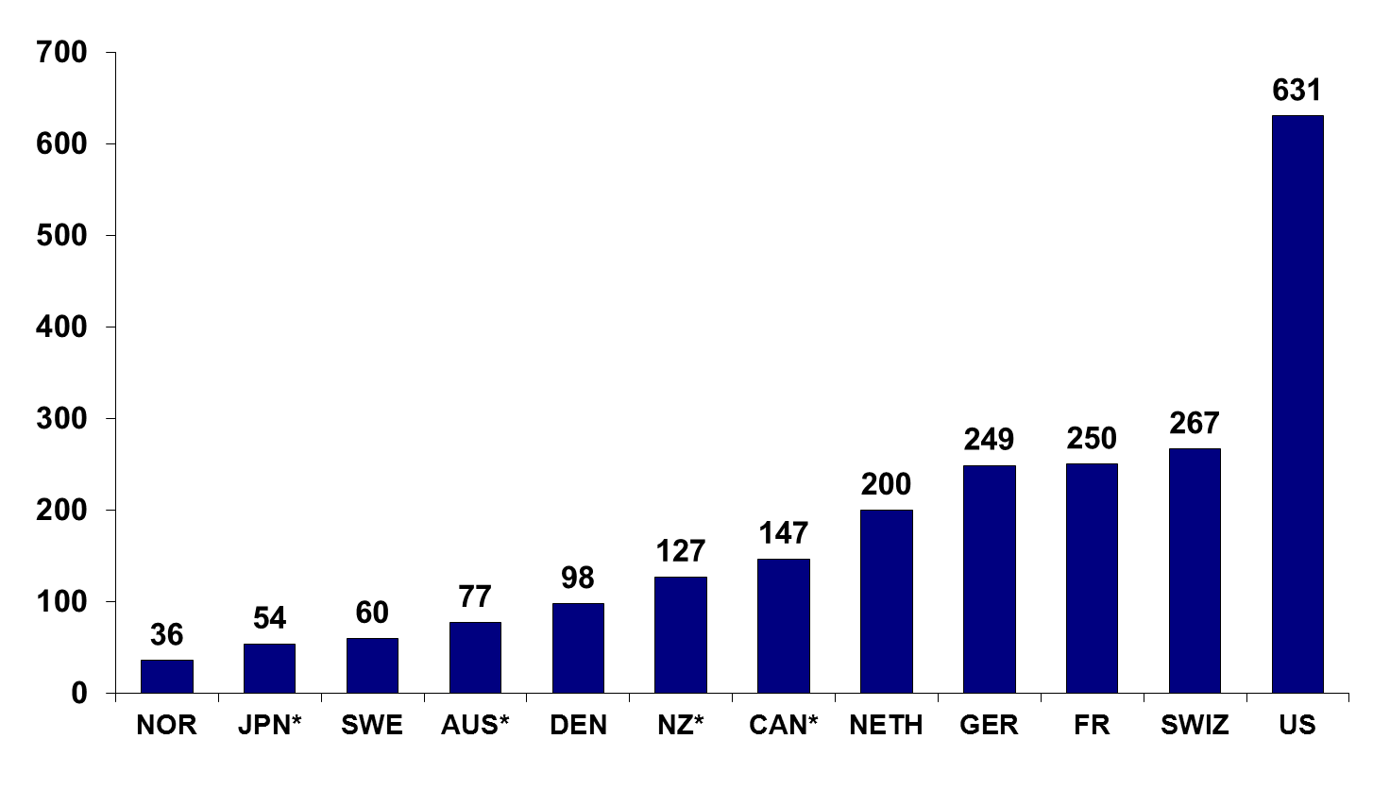
Health Insurance Administration $ per Capita, 2012
($US)
* 2011.
Source: OECD Health Data 2014.
Notes:
The processing time and costs for submitting billing, drug formulary and insurance related activities is estimated to be 90,000$ per physician in the US. Although that is an extraordiary number, it has been confirmed in a number of studies and is mine amd my colleagues personal experience as well
Simply by implementing the efficient model that medicare uses tor uniformity in administration and billing, he US would save 225 billion annually in
administrative costs,

Slide 24
Administrative Cost Comparison
Notes:
Here’s a comparative illustration of Private insurers' overheadvs Medicare.. Single-payer reforms could also sharply reduce billing and paperwork costs for physicians, hospitals, and other providers.

Slide 25
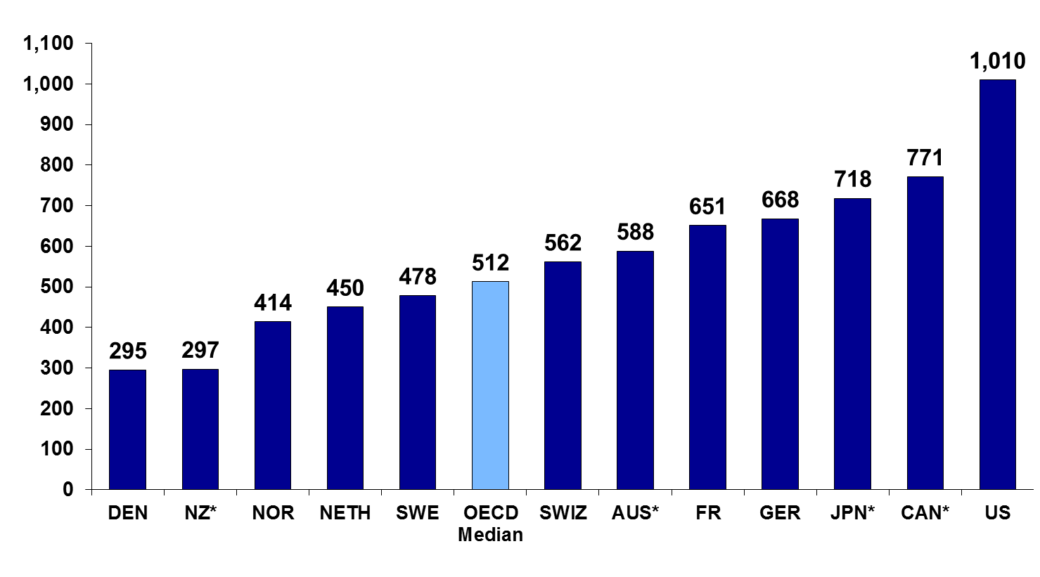
Pharmaceutical $ Per Capita – Pricing Failure
Notes:
A key cause of waste is the non-negotiated, unbridled costs of medications and procedural costs, known as Pricing Failure.
Above #s are Adjusted for Differences in Cost of Living
This is due to an absence of nationally supervised price controls, the absence of negotiation for costs between Medicare, Medicaid and drug and equipment manufacturers, and huge variability and lack of transparency in charges. There needs to be a proper balance imposed on the incentives for reasonable profit for main-lining and marketing life-improving, novel medications, and the interests of those for whom the drug is developed. The best drug in the world is worthless if unaffordable.
(We can think of the bad boy of the pharma industry, MartainScrelli, but the bigger players are not in the news)
US does pretty well at limiting unnecessary brand name drugs instead of generics

Slide 26
Cause of Pricing Failure;Medical-industry prices are typically immune to normal market forces.
The well-functioning market:price = cost of production of the product +a reasonable profit.
BUT:Costs of medical services NOT transparent, often negotiated behind closed doors of increasingly monopolized provider organizations and insurance co. Opaque prices w huge variability intra & interstate
AND Consumers can’t make technical decisions about elements of medically nuanced complex procedures or medications
New Hampshire has attempted to be more transparent, and estimate costs via the NH Healthcost Website (https://nhhealthcost.nh.gov. )
Notes:
A person might know what they want in a car, do comparison shopping for the commodity, but the need for intravenous contrast dye during a CAT scan is another thing. And the need for medical care often arises as an urgency in a person not prepared to balance a comparison of hospitals and costs against their health. (Consumers often cannot find out what is specifically covered by their insurance!, and many costs arise which exceed even the largest deductible. ) Lastly, recommendations arising in a trusted long term relationship of patient and clinician often determines where a procedure or surgery is performed, rather than comparison shopping, cost or knowledge of value.

Slide 27
Insurance Deductibles – Do They Work?
“Theory”:in a competitive free market high deductibles and copays lead patients to seek services at highest quality and lowest cost
But:prices are not transparent nor “competitive”
Folks covered by high deductibles DO decrease expenditures by 10-15% BUT only because people forgo or delay care, rather than because they choose less expensive care.
High deductibles DO work to lower health insurer’s “medical loss”, but do little to ultimately lower costs and do nothing to improve care.
Notes:
See recent NY Times article (https://www.nytimes.com/2018/05/04/health/breast-cancer-insurance-deductibles.html

Slide 28
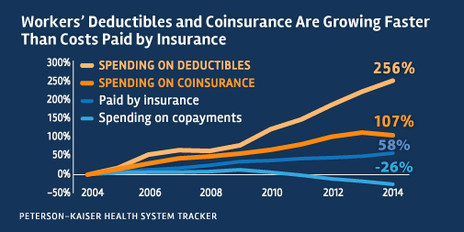
Notes:
Coinsurance is a scheme in which enrollee pays % of health care costs, such as 89% paid by insurance, 20% paid by enrollee, up to a maximum

Slide 29
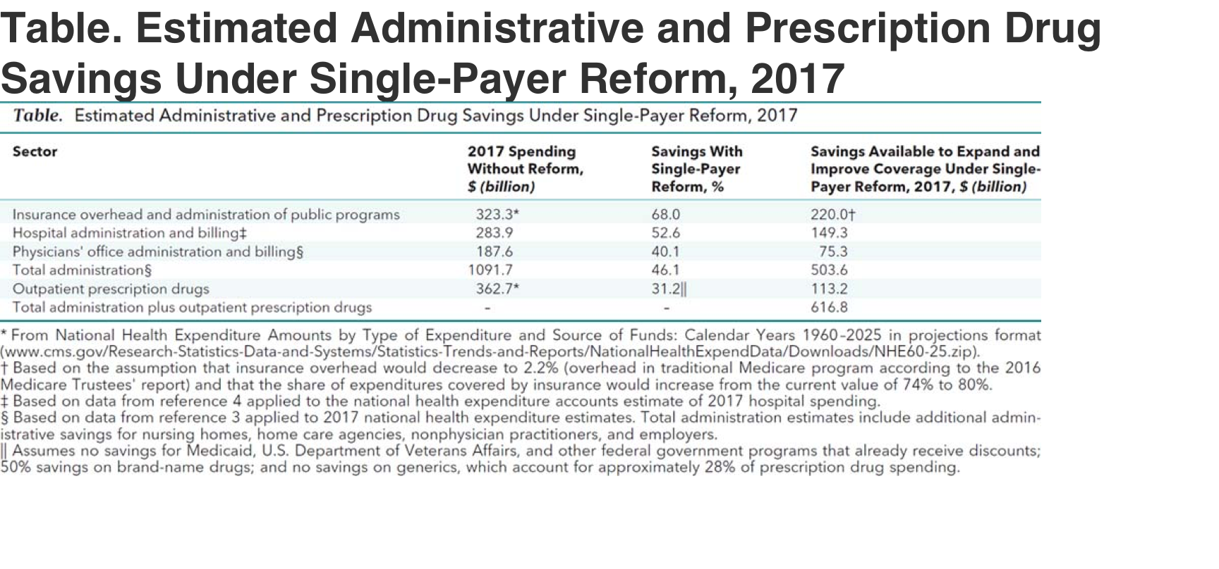
Notes:
estimates are a savings of 600 billion dollars annually for single payer reform and negotiated pharmaceutical costs.
The common objection for single-payer proposals is it might be so expensive that it will require unbearable tax increases. However, no increase in total health care spending is required, as analyses indicate the savings w single payer twould offset costs, with better quality and outcomes if we allocate the resources more efficiently. The current tax rate for Medicare is 1.45% for the employer and 1.45% for the employee, or 2.9% total. Together with current levels of taxation via payroll taxes and ACA level taxes on the very wealthy, would be more than ample to save 350$ per person per year for healthcare, and provide for expanded medicare for all.

Slide 30
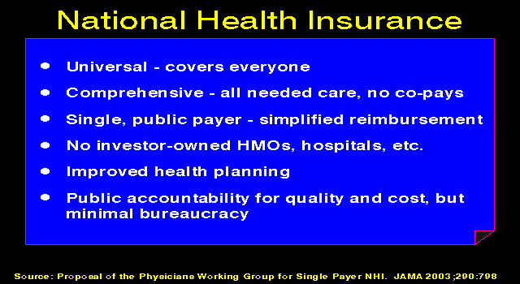
Notes:
Improved Medicare for All would entail long range planning based on medical need rather than stock yields. Our perpetual anxiety over Healthcare Security will only worsen as premiums climb for the ACA (Obamacare) since young, healthy individuals no longer need contribute with the elimination of the “mandate.” An increasingly ill (and costly) pool of remaining participants will strain what’s left of the ACA, effectively “repealing” the current, incomplete availability of this coverage. This, in turn, will evoke calls from Insurance Industry-financed politicos for “the good old days” of exclusions of preexisting conditions and the re-issuance of worthless insurance “product.”

Slide 31
Advantages to Business with Single Payer:
1. All employees (full, part time, seasonal; one, 100 or 1000) are completely covered, care is comprehensive, without gaps
2. Does not require Employers comparing insurance co.
3. All competitors pay the same % of payroll to cover emply. 4. Workmans Comp, Auto & Liability costs will decrease -medical component is covered
5. Retiree health costs decrease - Rx fully covered
6. Future health costs are predictable - based on payroll, not on what the premiums might be.
7. Customers, with fixed health care costs, have more money to spend on products and services
Notes:
Health care financing in the U.S. is regressive, weighing heaviest on the poor, the working class, and the sick. With the progressive financing plan outlined for HR 676 (below), 95% of all U.S. households would save money.
HR 676 (Section 211, Appendix 2) specifies a financing plan for single-payer that includes
Maintaining current federal financing for health care
Increasing personal income taxes on the top 5% of income earners
Instituting a modest tax on unearned income
Instituting a modest and progressive tax on payroll, self-employment
Instituting a small tax on stock and bond transactions
The following progressive financing plan would meet the specifications of HR 676:
Existing sources of federal revenues for health care
Tax of 0.5% on stock trades and 0.01% tax per year to maturity on transactions in bonds, swaps, and trades
6% high-income surtax (applies to households with incomes > $225,000)
6% tax on unearned income from capital gains, dividends, interest, profits, and rents
6% payroll tax on top 60% of income earners (applies to incomes over $53,000, tax paid by employers)
3% payroll tax on the bottom 40% of income earners (applies to incomes under $53,000, tax paid by employers)
HR 676 would also establish a system for future cost control using proven-effective methods such as negotiated fees, global budgets, and capital planning. Over time, reduced health cost inflation over the next decade (“bending the cost curve”) would save $1.8 trillion, making comprehensive health benefits sustainable for future generations.

Slide 32
Financing of Medicare for All
HR 676 -95% of all U.S. households will save money.
Maintains current federal financing for health care
Continues the ACA’s increase in personal income taxes on the top 5%
Maintains a modest tax on unearned income, as in the current ACA
Maintains a modest but progressive tax on payroll taxes
HR 676 Institutes a small tax (0.5%) on stock trades and 0.01% tax per year to maturity on transactions in bonds, swaps, and trades
HR 676 would also maintain the incentives of the ACA for improved hospital safety, maintain incentives for coordination of care and reforms to provide reimbursement for overall quality rather than quantity in Medicare. This has resulted in 150,000 fewer avoidable hospital readmissions per year!
HR 676 establishes a system for future cost control using proven-effective methods such as negotiated fees, global budgets, and capital planning. Over time, reduced health cost inflation over the next decade (“bending the cost curve”) would save $1.8 trillion, making comprehensive health benefits sustainable for future generations.
Notes:
Health care financing in the U.S. is regressive, weighing heaviest on the poor, the working class, and the sick. With the progressive financing plan outlined for

Slide 33
--
There are now 113 Co-sponsors of HR 676

Slide 34
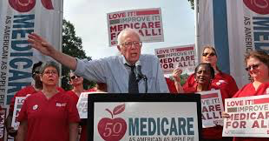
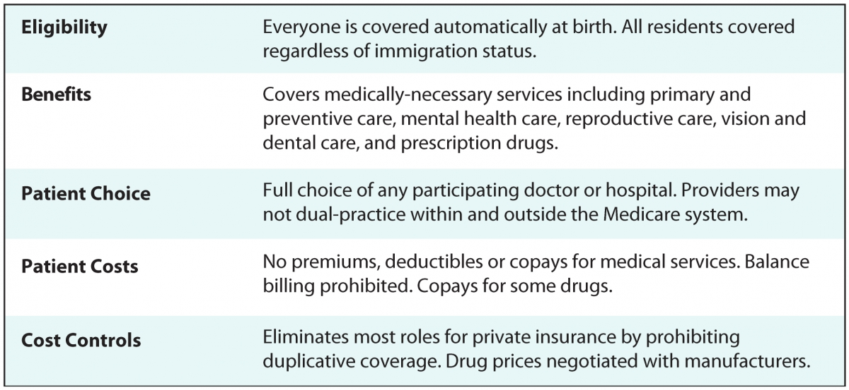
Medicare for All Act of 2017
S-1804 – Bernie Sanders
UK
^{UK}
^{UK}
Notes:
Implemented over 4 year period:1st year eligibility all children <18 and Medicare expanded to age 55
Medicare Transition Plan has expansion to age 45 2nd yr, and 35 3rd year, all citizens 4th year

Slide 35
Financing of Medicare for All under M4All S-1804
7.5% Income-Based Employer Payroll tax - 2016:employers paid av. $12,865 on premiums for worker. Employer paying 7.5% via payroll tax saves 3,750$ To protect small business, 1st $2 million payroll are exempt, or other adjustments
4% Income-based Households Tax – typical family of 4 earning $50K now pays $5300 in premiums to private insurer. 4% tax is $844, or, in lieu of premiums, savings of $4,400
Elimination of Tax exclusion for Health Coverage >250 $Bil/yr
Progressive Income Tax Increase on Wealthy
Tax Capital Gains/Dividends
Eliminate Tax Deductions for Wealthy
Drug Prices are Negotiated

Slide 36
Medicare for All Act of 2017 S-1804 – Bernie Sanders
Implemented over 4 year period:1st year eligibility all children <18 & Medicare expanded to age 55, then yearly expansion to age until all citizens covered in 4th year
Replaces Medicare/Medicaid/SCHIP/FEHBP/Tricare &ACA
Proposed Covered Services:
10 current categories of care in ACA – HHS determines new benefits based on National practice guidelines/stakeholders/public
New:Dental care/hearing-aides/medical equip/abortions
Copays if equally effective generic drugs exist (annual cap 200$)
Office of Primary Care:coordinates Medical Education goals and policies to meet “Triple Aim” and service underserved areas
Regional Ombudsmen
Long-term care for seniors and people with disabilities will continue as currently covered under Medicaid.
Mechanisms for transitions for displaced workers in Health Industry
Notes:
Triple Aim is better health, better care at lower costs

Slide 37
AmeriCare
a graduated single payer concept introduced by Rep Stark of California in 2009
The “public option” – people can opt put and keep their current insurance
Financed through employee contributions as well as premiums
Financed thru State contributions equal to Medicaid and CHIP, which are rolled into AmeriCare
Unlike HR676, maintains role for private insurers and providers also may remain for-profit
Ctr for American Progress:”Medicare Extra for All” Single Payer Lite
-funded by America’s Health Insurance Plans/Eli Lilly, donors -newborns, non-covered, all >65 “automatically enrolled” at medical point of care
Premiums not covered by other insurance “automatically collected thru tax withholdng and on tax returns. Individuals who are not required to file taxes would not pay any premiums.

