Slide 1
VA Privatization and the Fight for Medicare for All
Suzanne Gordon
11/9/2018

Slide 2
Summary
VHA is a unique model for health care delivery
A universal health care system for a small but vulnerable segment of American population
Its incentives are entirely different than US insurance system driven by profit
Those advocating for national health care and Medicare for All have a huge stake in the outcome of the fight against VA privatization

Slide 3
Value of VHA
  Improvements in healthcare for veterans and all other Americans (think the Shingles Vaccine, Nicotine Patch)
  Coordinated care
  Does well what much of the rest of the American healthcare system does poorly
    Primary care
    Geriatric care
    Mental health care
    Homelessness
    Palliative and hospice care
  Delivers high quality care and lower cost

Slide 4
Why?
Work on Salary No Incentive to Overtreat
Lifetime responsibility for patients, thus more incentive to do preventive care, and health maintenance of all sorts
Huge patient population consistent over time
Community of Care – for providers and patients

Slide 5
Fully Integrated Care
Not Just National System
Integration of Services
Mental Health and Primary Care
Home Based Care
Pharmacy/Nutrition/Social Work Employment/Housing/Veterans’Courts etc.

Slide 6
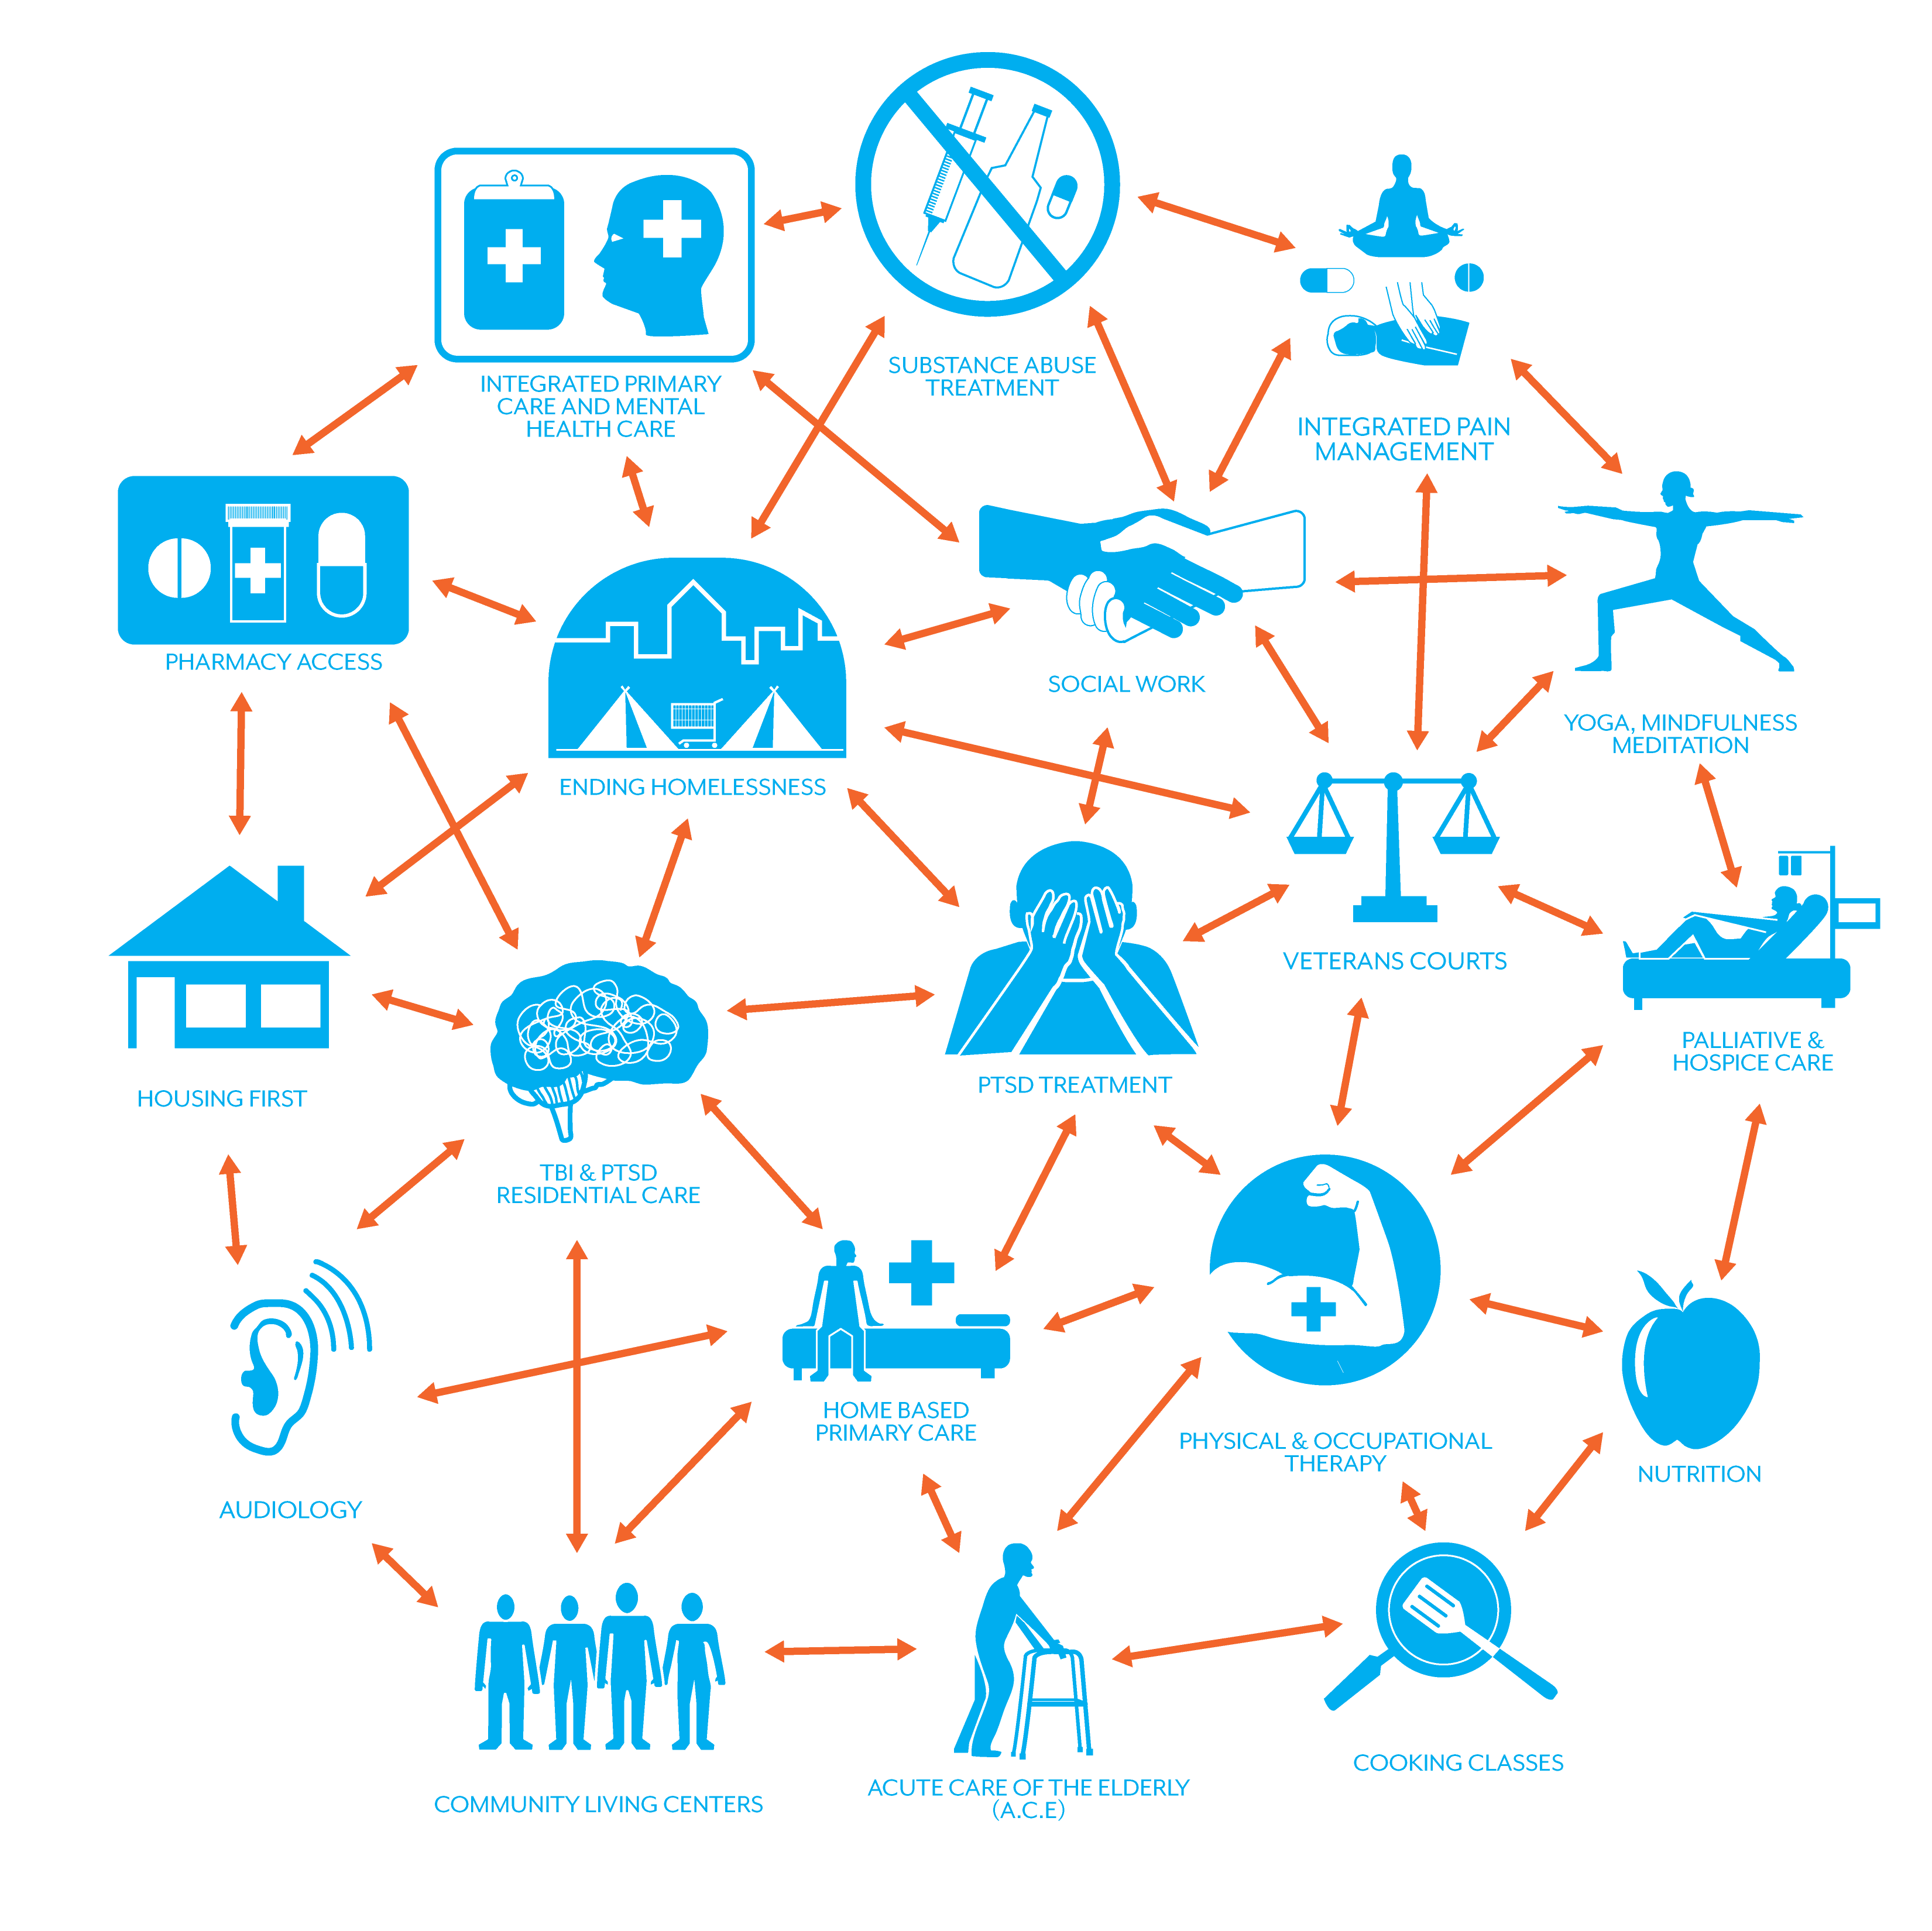
Comprehensive Veteran Healthcare

Slide 7
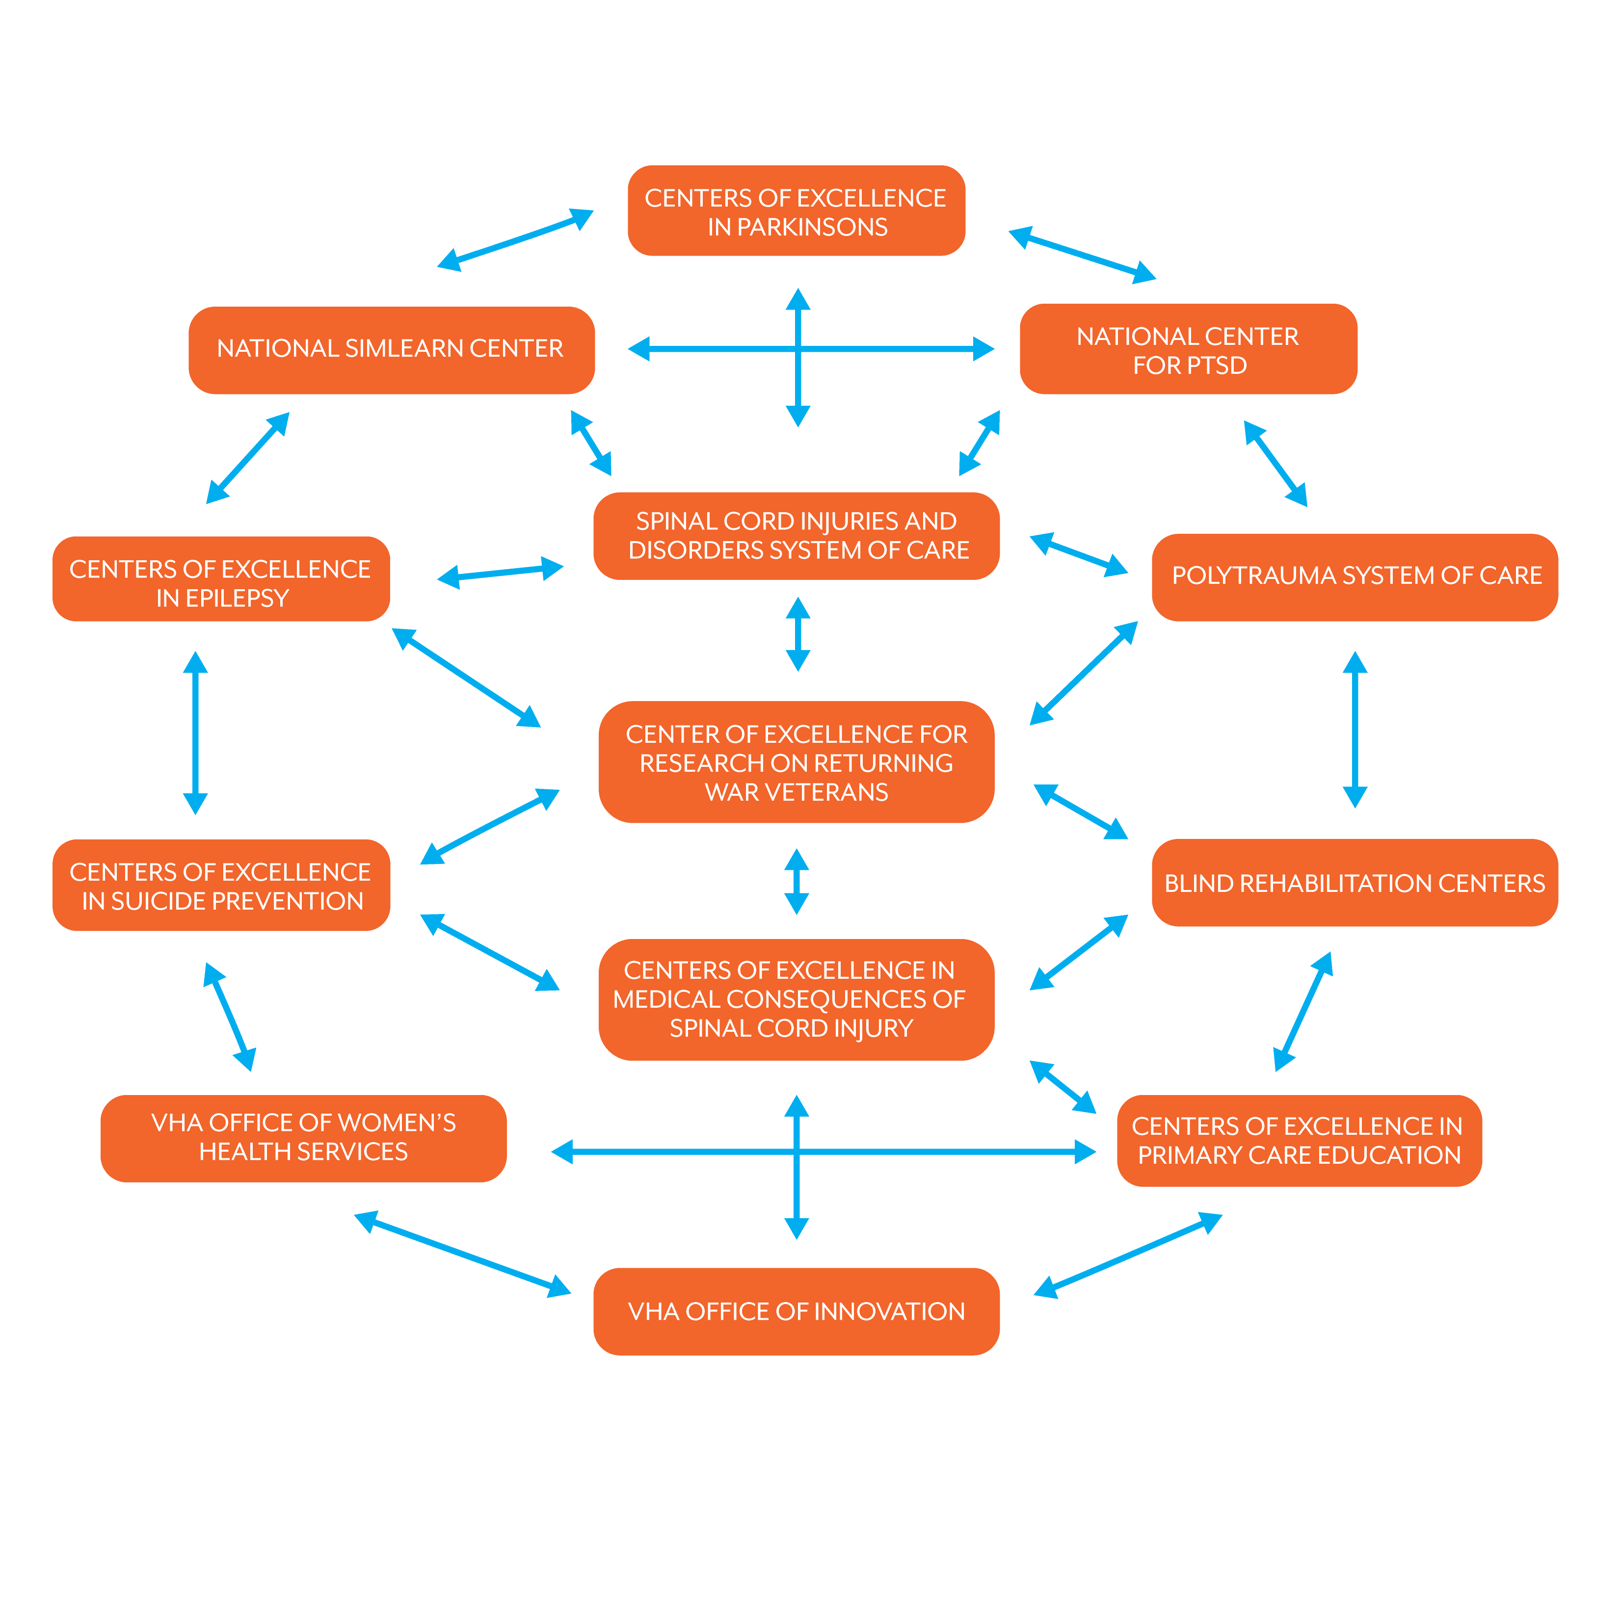
Connected VA Organizations

Slide 8
Expertise in Veterans’ Needs
Increased mental illness
PTSD
Obesity
Substance Abuse
Traumatic brain injury
Homelessness
Toxic Exposures
Notes:
26% of returning Iraqi War veterans have early evidence of PTSD

Slide 9
Notes:
Patient continues to have right to tort action

Slide 10
Notes:
Patient continues to have right to tort action

Slide 11
Studies Document
NEMJ men with heart failure, heart attacks, pneumonia less likely to die when treated at VA hospital
JAMA VA is a “bright star in the constellation of safety practice.”
VA Commission on Care “Behavioral health programs …largely unrivaled.”

Slide 12
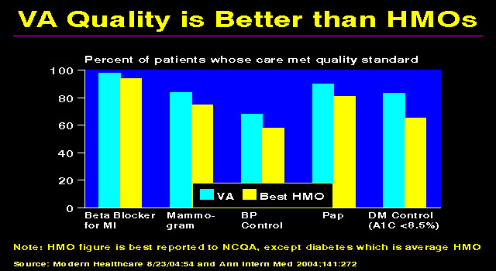

Slide 13
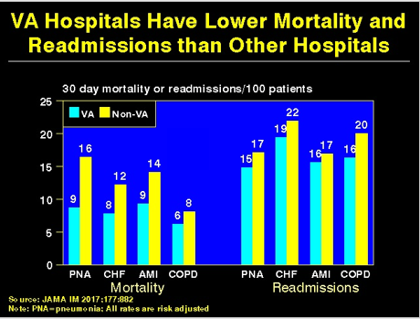

Slide 14
Readiness to Serve: When Criticizing VHA No One Asks Compared to What?

Slide 15
Compared to What?
Preventable patient deaths and injuries in PS
Wait times in PS
Mental health in PS
Cultural understanding in PS
Integration of Care in PS
Notes:
A 2014 study of wait times in American hospitals by health-care consulting firm Merritt Hawkins found long wait times and large disparities depending on location. In their just released 2017 study of wait times, the firm found that wait times in 15 metropolitan areas had increased by 30% since 2014. The average wait time for a new physician appointment was 24 days. In Boston, the average wait time to see a family physician was 109 days while in Albany patients had to wait 122 days. Some practices were entirely closed to new patients.. In Boston patients who had to wait to see a cardiologist for 133 days in 2014 were now waiting as much as 365. In Houston the longest wait for a heart doctor jumped from 26 to 43 days. In Denver the longest wait to see a dermatologist went from 180 to 365 days while the shortest delays increased from one to seven.

Slide 16
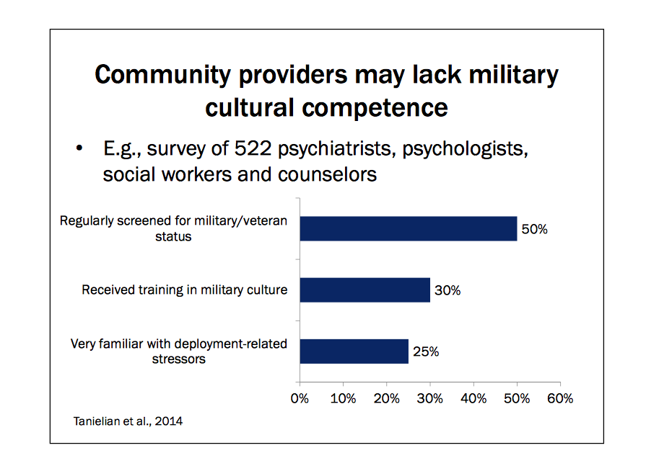
Compared to What?

Slide 17
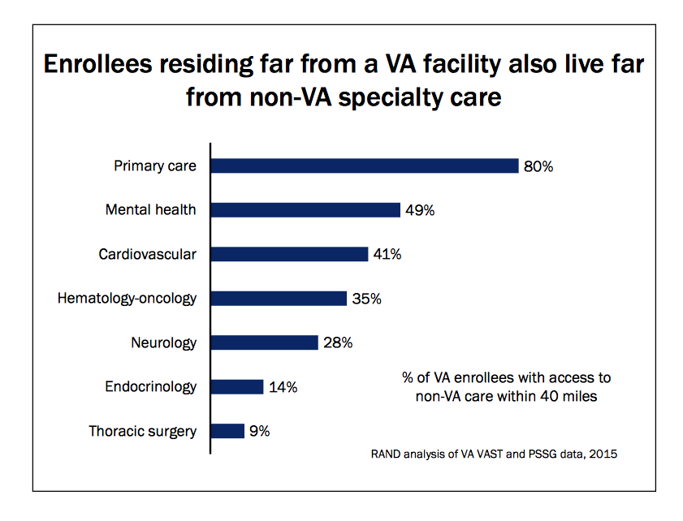
Compared to What?

Slide 18
Patient Deaths and Injuries in Private System
Between 250,000 and 440,000 people die every year in our private healthcare system
Preventable patient deaths is the third leading cause of death in the US today

Slide 19
Mental Health
Thomas Insell, MD: “The mental health system is badly broken… the equivalent of a civil rights issue.”
Jails and prisons house majority of mentally ill
HRSA: 55% of American counties (all rural) have no psychiatrist, psychologist or social worker
Only 55% of psychiatrists accept insurance

Slide 20
Mental Health
RAND: 70% of mental health professionals do not provide evidence based therapies to their patients
RAND: Almost 90% of mental health professionals have no understanding of military culture or military related mental health issues
Between 2000 and 2010, rates of suicide increased by 40 percent among veterans who didn’t use the VA, but declined by 20 percent among those who did. (Hoffmire, Pys Online)
RAND Ready or Not: Only 2% of private sector providers able to competently care for veterans

Slide 21
Wait Times
RAND: “wait times at the VA for new patient primary and specialty care are shorter than wait times reported in focused studies of the private sector.”
Merritt Hawkins: Between 2014 wait times in private sector increased by 30%
Average wait time for new appointment 24.5 days

Slide 22
Wait Times
Boston 109 days to see family physician
Boston 365 days to see a cardiologist
Commonwealth Fund: One in four Americans four to six days to see a PCP even when sick

Slide 23
Dangers Ahead
Plans to outsource care to private doctors, hospitals health systems will drain money from the VA
Facilities will close, staff will be laid off, services curtailed
Care will be uncoordinated

Slide 24
The VA System: Threats from Congress
MISSION Act
COVER Commission
Executive Orders

Slide 25
Dangers Ahead
Cost for potentially inferior care will soar
Eligiblity will be further restricted
Veterans will pay more in out of pocket payments
Services will be curtailed
VA will crumble

Slide 26
VA role in Medicare for All
Critical to consider what role VA would play under a Medicare for All plan
Critical to consider what role veterans would play in lobbying for such a plan

Slide 27
Talk to Ten
Tell Your Stories

Slide 28
Thank You
Suzanne Gordon
sg@suzannegordon.com
www.suzannegordon.com

