Slide 1
Building a feminist, anti-racist, pro-immigrant SP movement: Why and how?
Roona Ray, MD MPH
Physicians for a National Health Plan
Annual Conference
San Diego, 10 November 2018

Slide 2
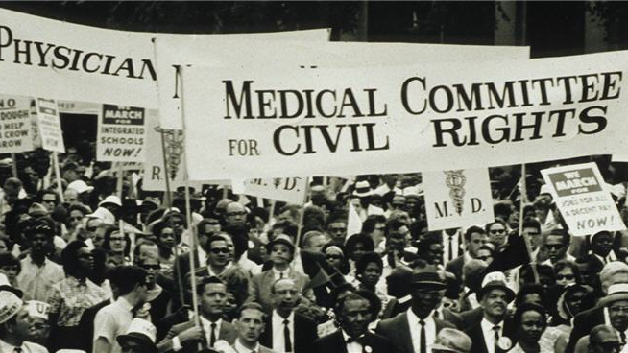
Outline & objectives//
Who are we?
Why is single payer a feminist, anti-racist, & pro-immigrant issue?
How do we organize with this perspective in our communities?
Approaches in New York
Explore potential allies
Some readings

Slide 3
Who? //

Slide 4
Why are you here?
Notes:
I think that engaging people around single payer as a feminist, anti-racist, and pro-immigrant issue will grow the powerful movement we need to build power and win single payer, health justice, and civil rights.

Slide 5
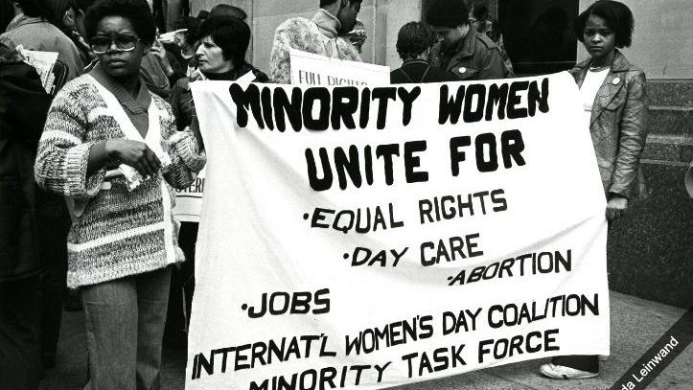
Why? //

Slide 6
Why is single payer a feminist issue?

Slide 7
Why is single payer an anti-racist & civil rights issue?

Slide 8
Why is single payer pro-immigrant issue?

Slide 9
Single payer is one part of a larger landscape of health justice & civil rights demands that we must engage with.

Slide 10
We build power by involving people who are most affected by the healthcare crisis & working in solidarity with them.

Slide 11
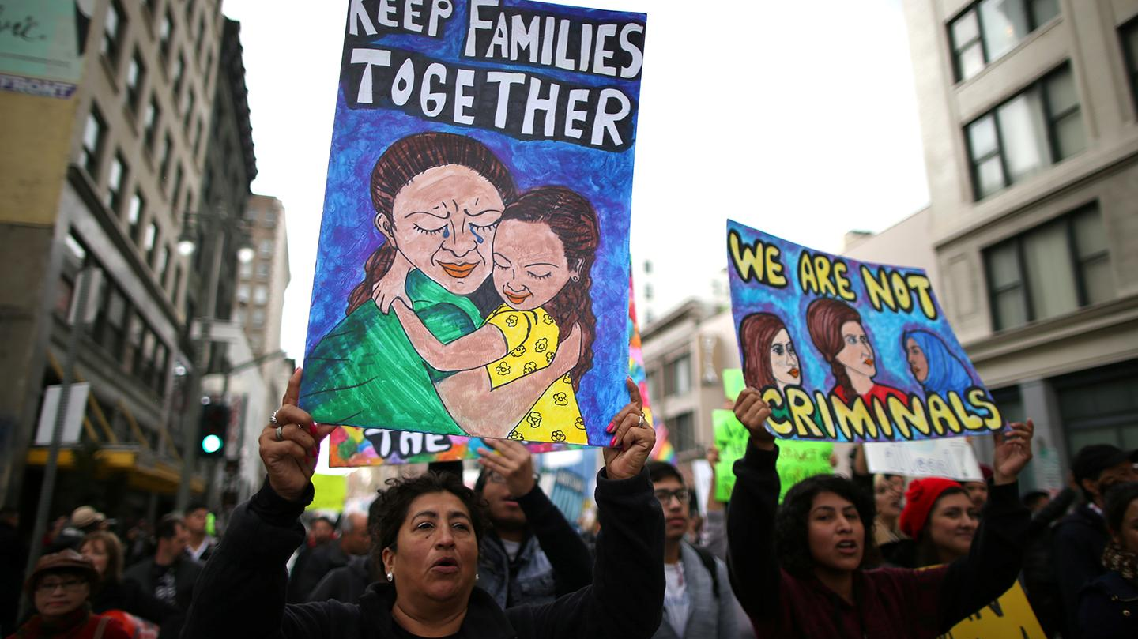
How? //

Slide 12
How do we unlearn sexism, racism, & xenophobia?

Slide 13
Who in your community cares about feminism, racial justice, & immigrants?

Slide 14
How have/would you approach/ed them as a single payer activist?

Slide 15
How would your life & your community’s life change if you had guaranteed healthcare?

Slide 16
Approaches in New York
Anti-racism training
Online and in collaboration with
Healthcare Rights and Access Survey
Focused outreach to communities of color & immigrant communities, including translation on-demand
Jointly organized events
Power to Heal, a film about how Medicare desegregated US hospitals
People of color & immigrants caucus
New flyer on racial & immigrant justice & SP

Slide 17
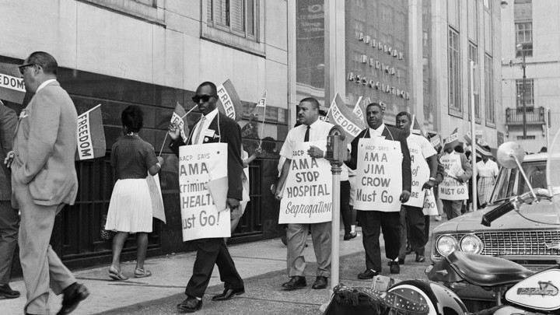
Demands for healthcare for all and single payer in current movements for women, people of color, & immigrants: //
Black Mamas Matter Alliance
Poor People’s Campaign
NY Immigration Coalition
Democratic Socialists of America NYC Socialist Feminist Working Group
The Movement for Black Lives
National Women’s Liberation
National Domestic Workers’ Alliance

Slide 18
Some reads: //
“The Fight for Healthcare Has Always Been About Civil Rights”
“Undocumented, Uninsured, Unafraid”
”The Feminist Case for Single Payer”

Slide 19
Thanks! //

