Slide 1
Building a Successful Chapter—and having Fun along the Way
Denise Finck-Rothman, MD
Jessica Schorr Saxe, MD
Health Care Justice—NC
PNHP Leadership Training
November 9, 2018

Slide 2
History—very brief
Charlotte Health Professionals for Health Care Reform—2009
Adoption of single-payer support: Health Care for All NC, Charlotte chapter
Health Care Justice—NC 2013
Notes:
You can tell that we didn’t mean to be a permanent organization by our original title.
Not only is there no acronym, but it’s so long and cumbersome that no one can remember it.

Slide 3
Decisions, Decisions, Decisions

Slide 4
Structure—Formal vs. Informal
Guidelines/By-laws?
Board? Officers? Terms?
Committees?

Slide 5
Financial
Dues? If so, different levels? How will you track?
No dues If not, how will you fundraise
Notes:
Discuss how a couple of Board members pointed out that fundraising can be disconnected from dues.

Slide 6
Determining Membership
Dues? If so, does membership expire for nonpayment of dues? When?
Resolution?
Notes:
We have found it useful to have members join by signing resolution. This helps increase our ranks—which is useful when telling others how many members we have—e.g., in talking to editorial board of newspaper.

Slide 7
Committees—some possibilities
Membership
Legislative
Education
Communications
Financial/Fundraising
Notes:
Sometimes our committees are aspirational. E.g., we have not had a functioning Communications Committee for about a year, though we have plans to do so in March when some new people will be active and we can move our legislative chair, who has professional communications skills, to that position.
Sometimes reality of a volunteer organization depends on who is available. It is still worthwhile to know what committees you would like to have so that you can look out for the right people to recruit.
And sometimes the right person emerges with interests and skills for something you hadn’t planned—e.g., George with Education committee
Your committees can have some flexibility about what they cover

Slide 8
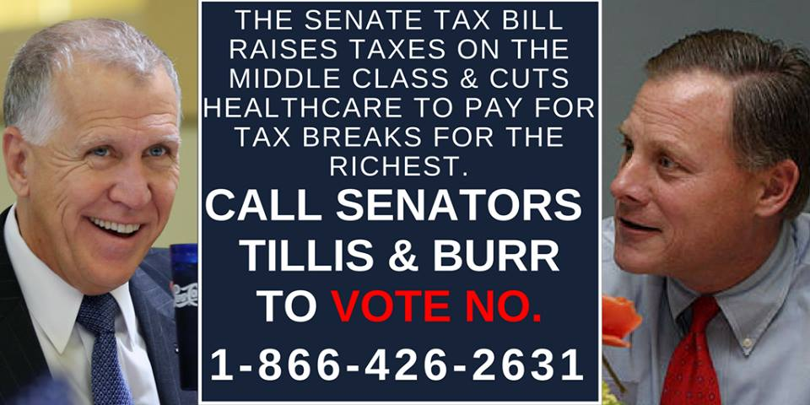
Notes:
This was a campaign of our legislative committee. And this is probably in keeping with what you think a legislative committee should do—encourage contacting legislators to vote in favor of health care issues—and against bills like the tax bill that would cut health care.
Our committee does that--but that’s not all that it does.

Slide 9
Notes:
We have a very creative chair and she had the idea that we should participate in some fairs and festivals. So here are some of our members at the Pride Festival—where we have recruited lots of members.

Slide 10
Notes:
And here’s another activity organized by the legislative committee in partnership with Action NC.

Slide 11
Our Structure: This is us
The Board:
Chair
Chair-Elect
Treasurer
Secretary
Committee chairs

Slide 12
Our Committees
Communications
Education
Legislative
Membership
Cornwell satellite

Slide 13
Tips
PNHP is great resource
Members most likely to work on areas they are enthusiastic about
There may be more support in community than you think
Recruit everywhere—including medical visits
Be open—to creativity, to serendipity, to fun
Notes:
PNHP helps with website; has resources on their website, sends speakers, sent staff for organizing workshop
Enthusiasm: George—education, talking to conservatives; Zach—faith community
Jacki –Cornwell
The more you ask, the more members and volunteers you’re likely to come across

Slide 14
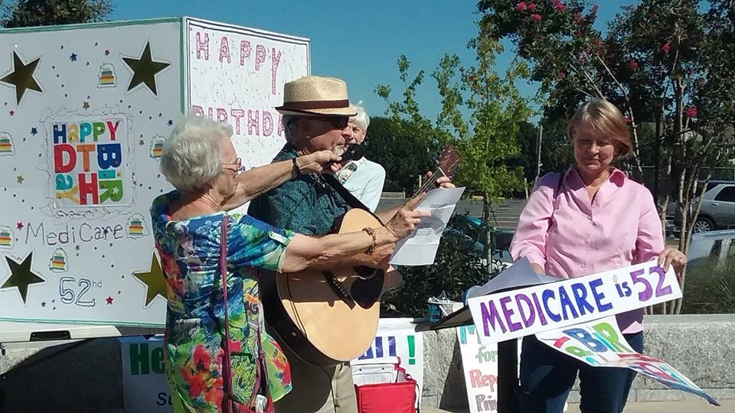

Slide 15
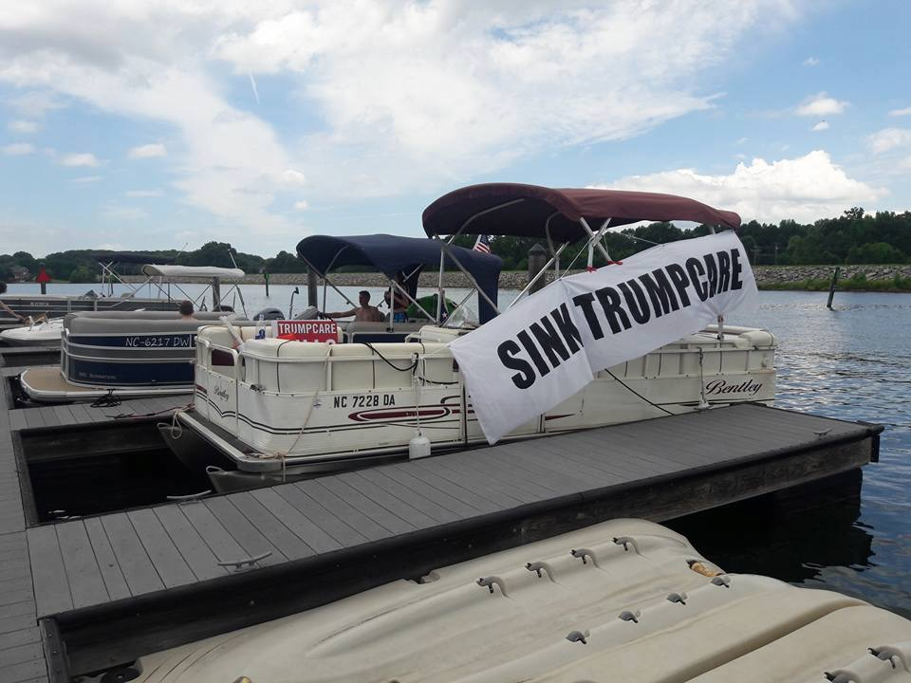
Notes:
And here’s on of our more creative events. One of our senators has a lake house.
So another group had the idea of sending a flotilla out to the lake house with our message.

Slide 16
Notes:
Here we are with some of our signs. Note that we’re on a boat.
This got us on Rachel Maddow.

Slide 17
Our Successes
Increased profile of Medicare for All in the community
Relationship with Charlotte Observer
Increasing membership
Many active volunteers
Congresswoman Alma Adams 1st in NC to sign on as co-sponsor HR 676

Slide 18
Our Opportunity Areas
Younger members/Board members and volunteers
Other forms of diversity
Communications committee to improve outreach, social media, website
Notes:
Open to suggestions about all of these
Barriers to recruiting younger. They are busy, and retired people have more time.
We don’t have a 4-year med school

Slide 19
Conclusion
YOU CAN DO IT
Email for help:
Denise Finck-Rothman: DeniseFinck@hotmail.com
Jessica Schorr Saxe: jessica.schorr.saxe@gmail.com
Healthcarejusticenc.org
Facebook: Health Care Justice – North Carolina

