Slide 1
Chapter Building
Kentuckians for Single Payer Health Care
www.kyhealthcare.org

Slide 2

KSPH was founded in 2004 following a showing of the movie “Damaged Care” “When big business threatens innocent lives for profit, she risked everything to bring the system to its knees.”

Slide 3
Key lessons from the KSPH experience:
1. Keep focus: Educate & organize for single payer
2. Stay positive: Single Payer works; most people can be won to it.
3. Energize: Activities keep people motivated. People like to do things. Actions are important, not only for the results, but also for the benefit of the activists.
4. Plan: Grand Rounds, Events, Actions, Fun Things

Slide 4
Key points continued:
5. KSPH is a membership organization with modest annual dues.
A. Provides funds for the events we choose to do.
B. Gives supporters a concrete way to demonstrate support,
C. Helps us to clearly identify our supporter base.
6. Twice a month email newsletter and building of contact database.
7. Regular meetings at the same day, same time, and same place has helped us build a cohesive organization.

Slide 5
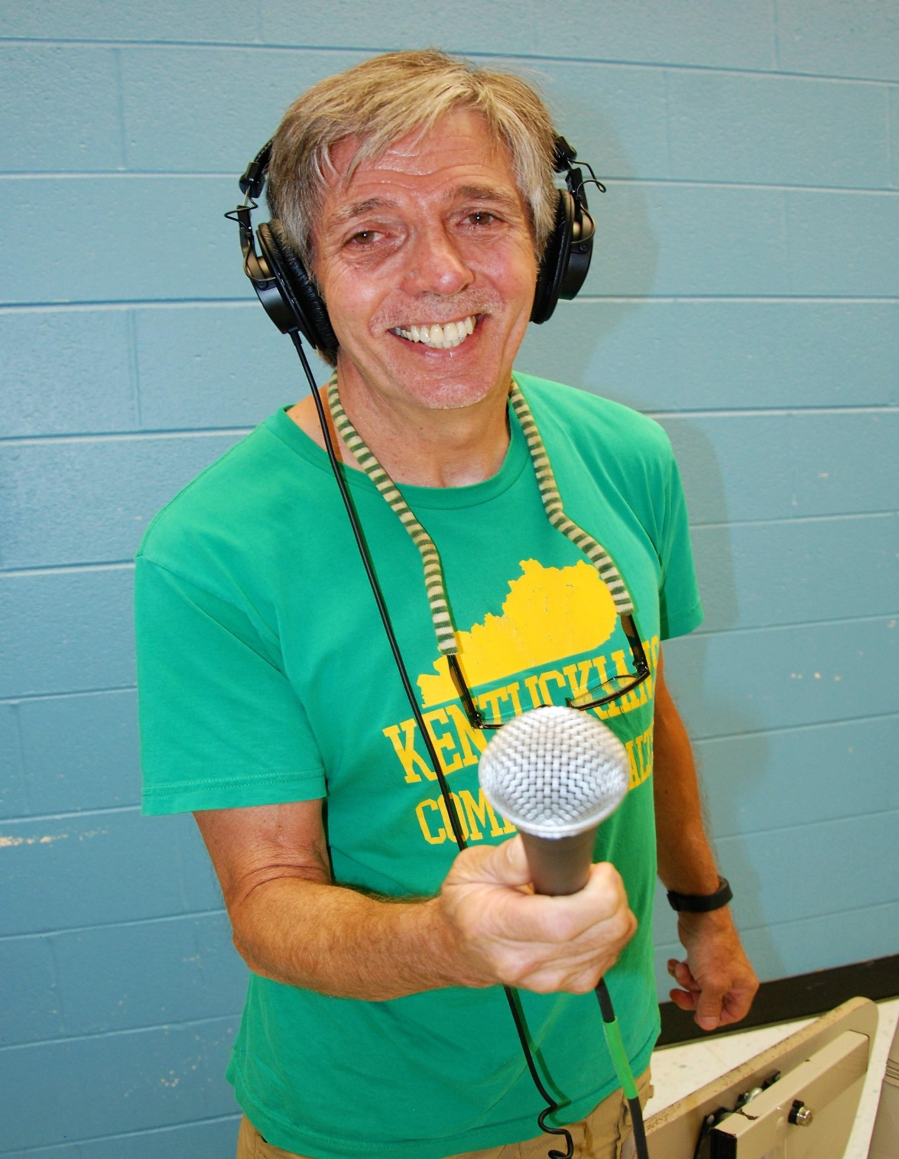
Weekly Radio Show on Single Payer

Slide 6
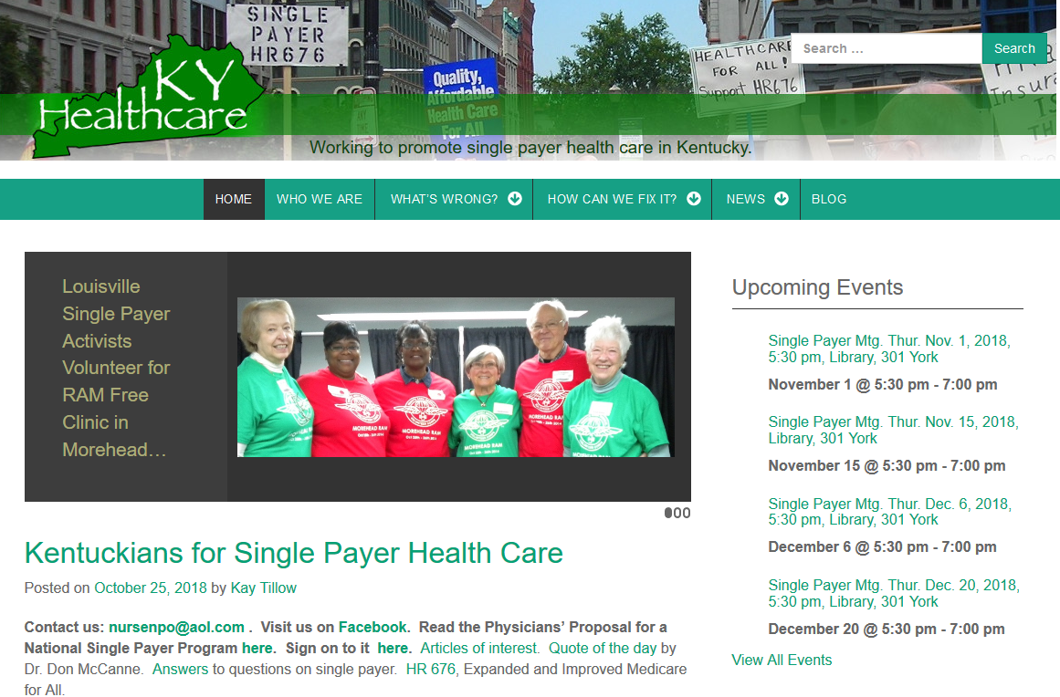
Keep up-to-date website

Slide 7
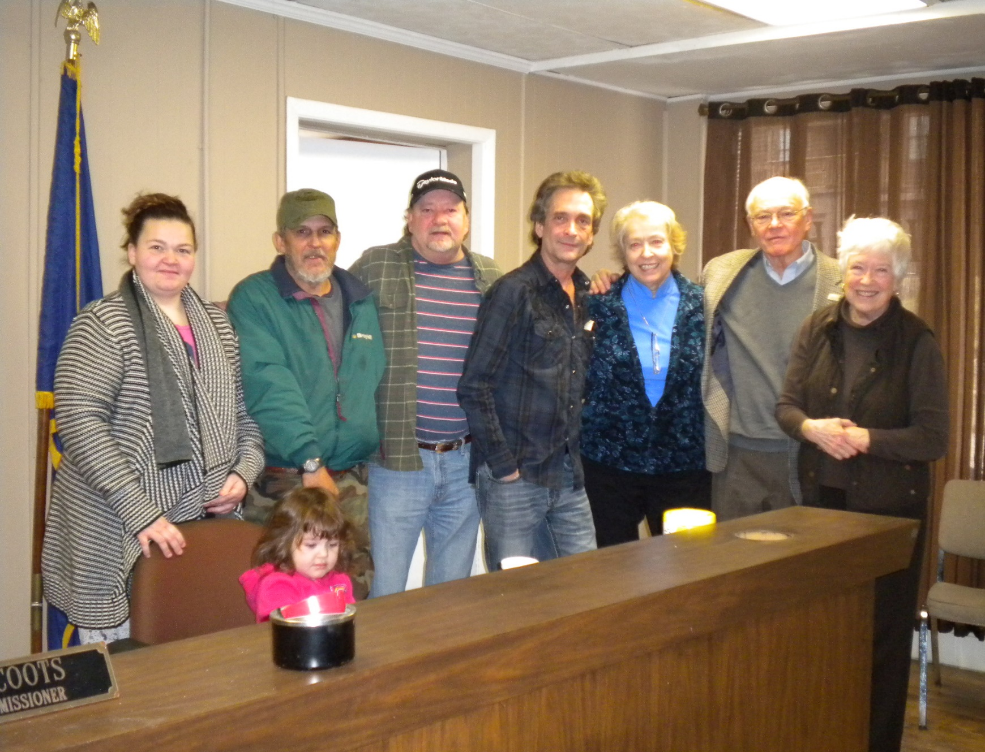
Resolutions for HR 676--Vicco

Slide 8
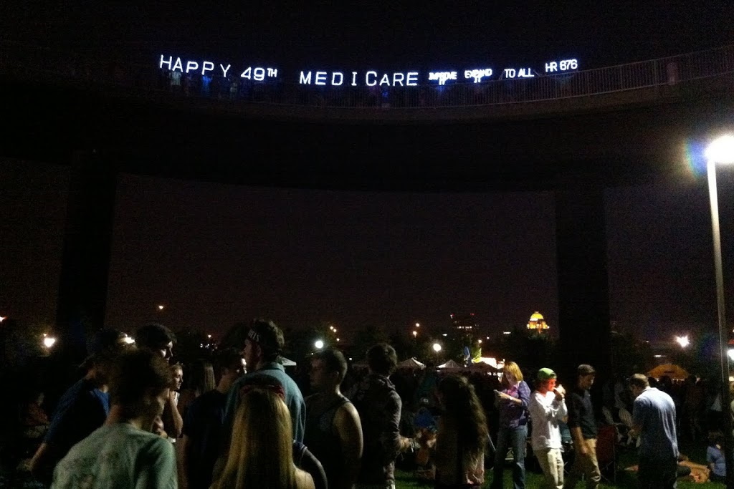
Have some fun—Light up the night

Slide 9
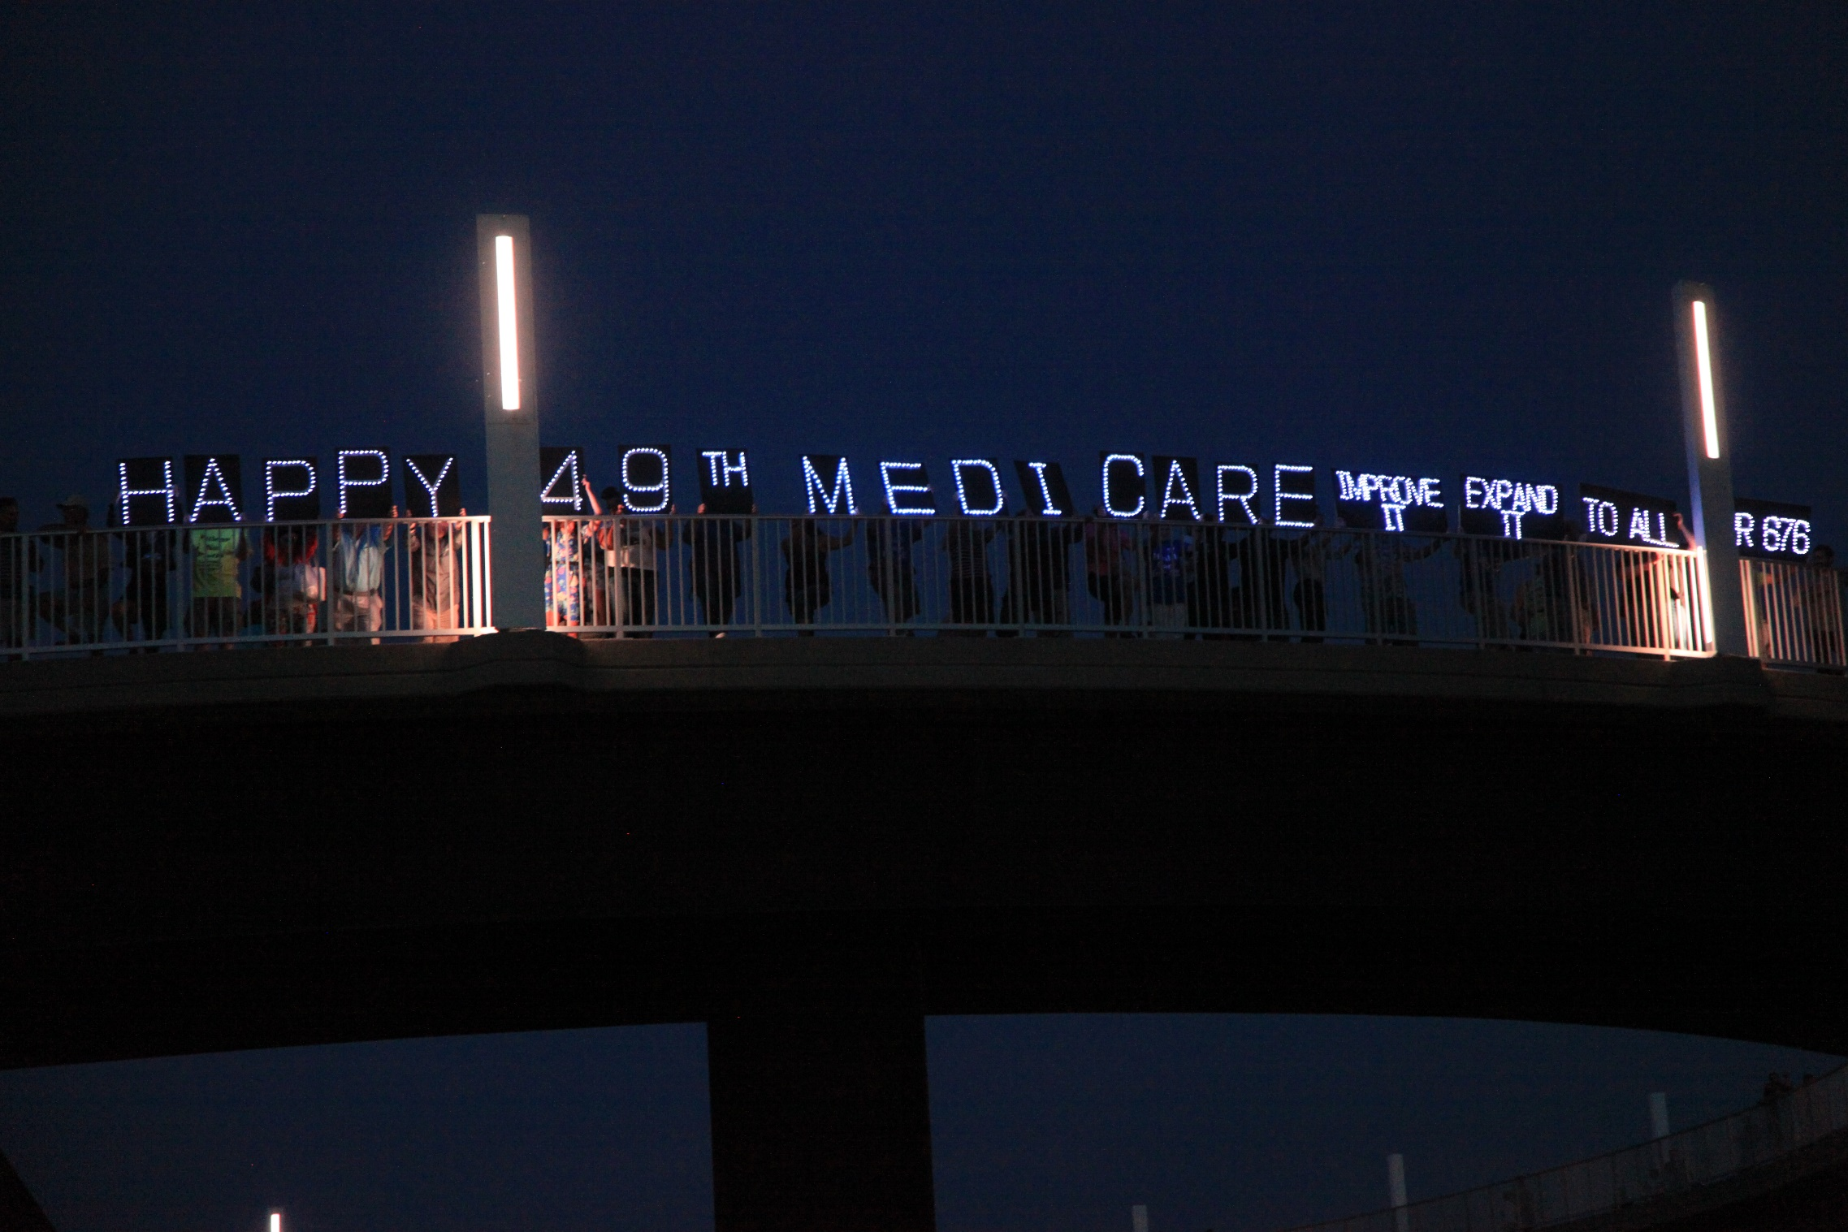

Slide 10
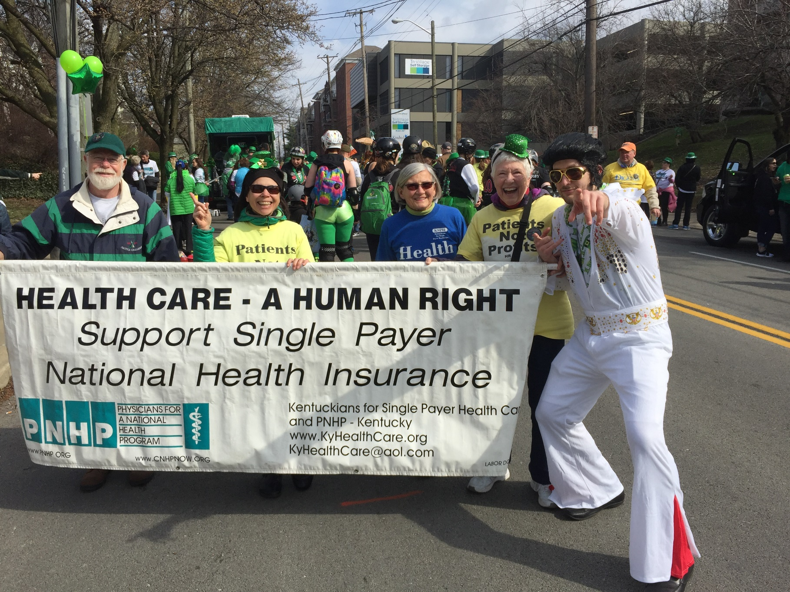

St. Patrick’s Day Parade

Slide 11
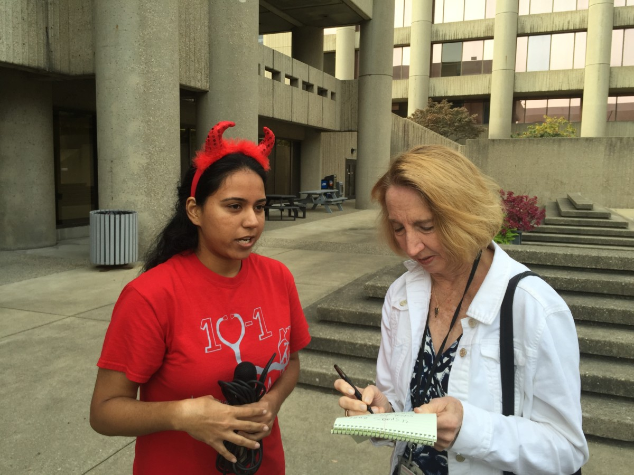
Support Medical Students
Notes:
Develop allies in the media. Here a medical student is speaking with the health reporter for the Louisville Courier-Journal

Slide 12
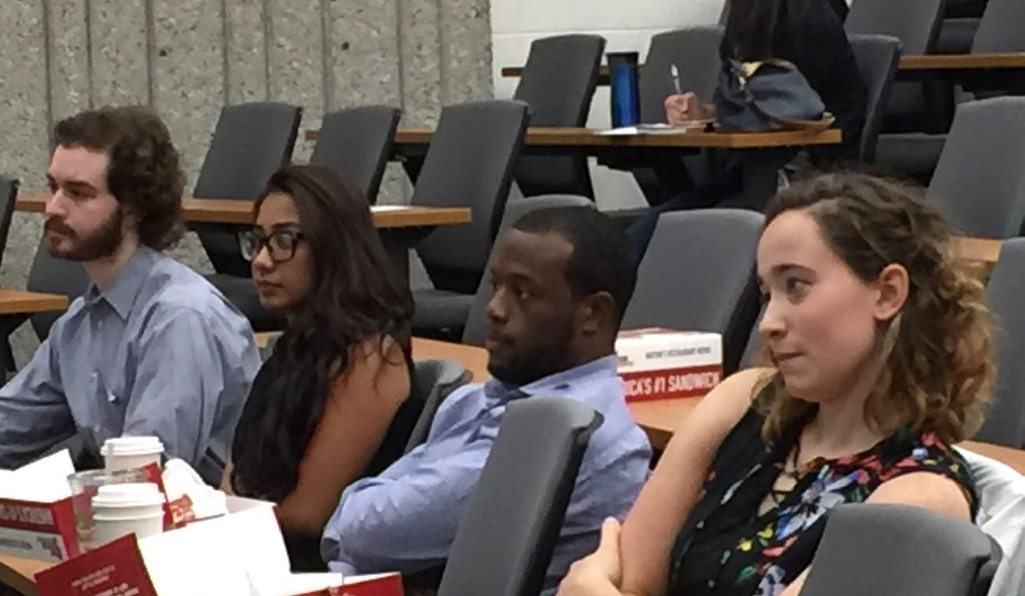
Med Students at a discussion with Dr. Margaret Flowers

Slide 13
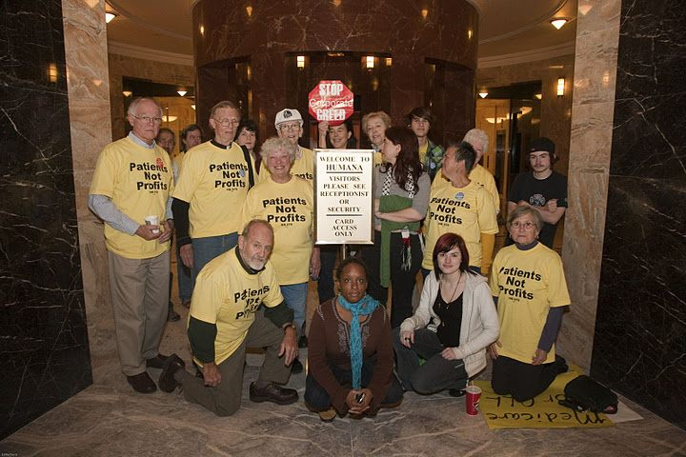
Sit In at Humana to End Denial of Care

Slide 14
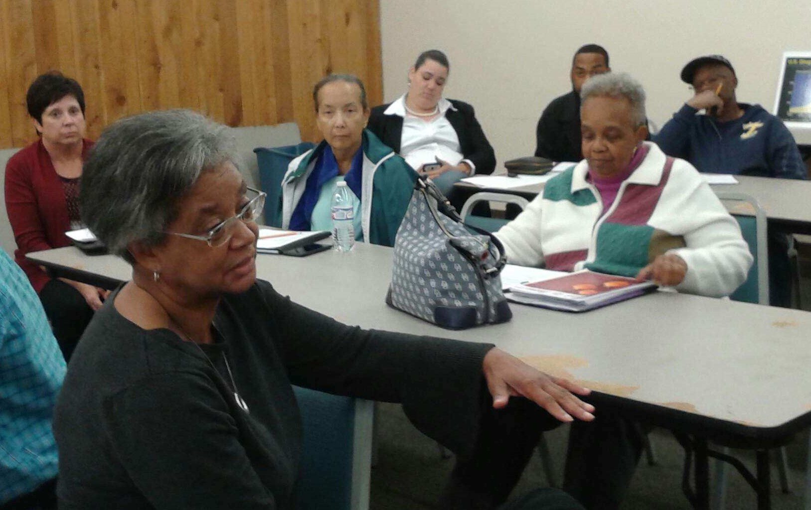
Show “Fix It” everywhere

Slide 15
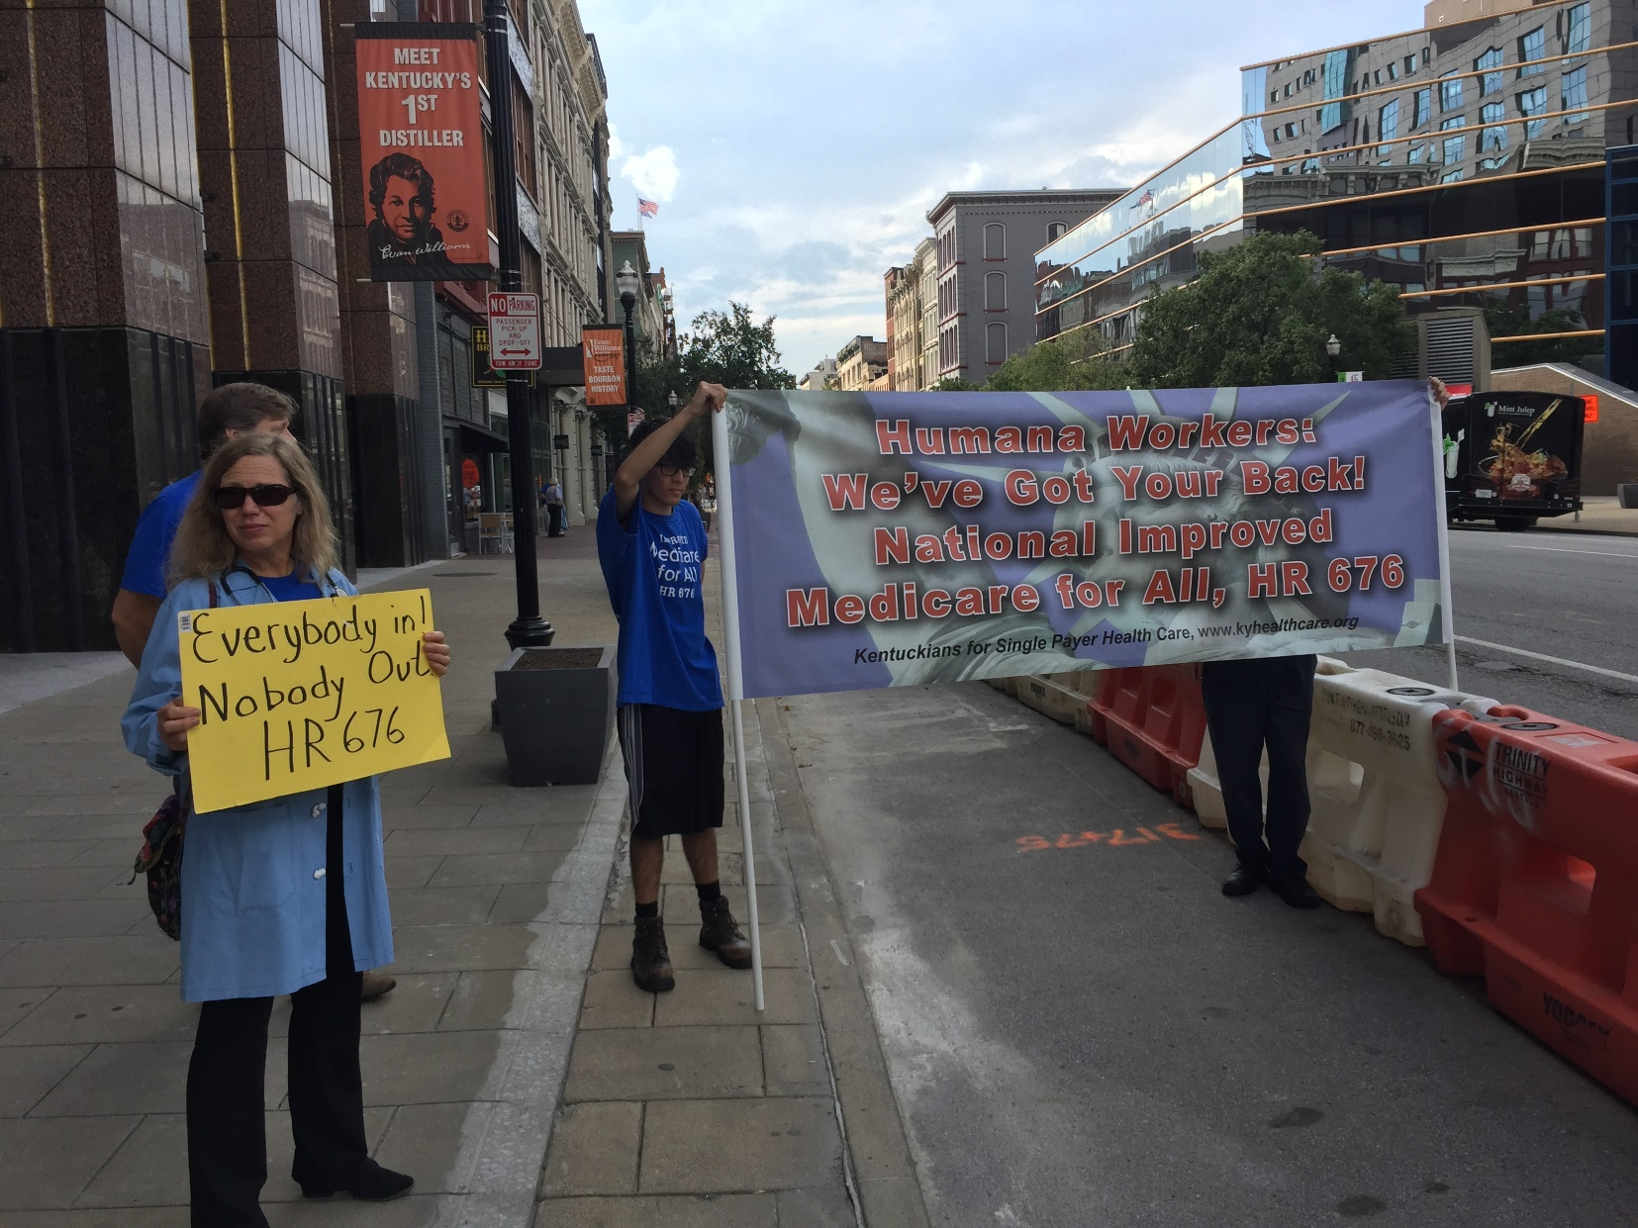
Let insurance workers know they have a future with HR 676

Slide 16
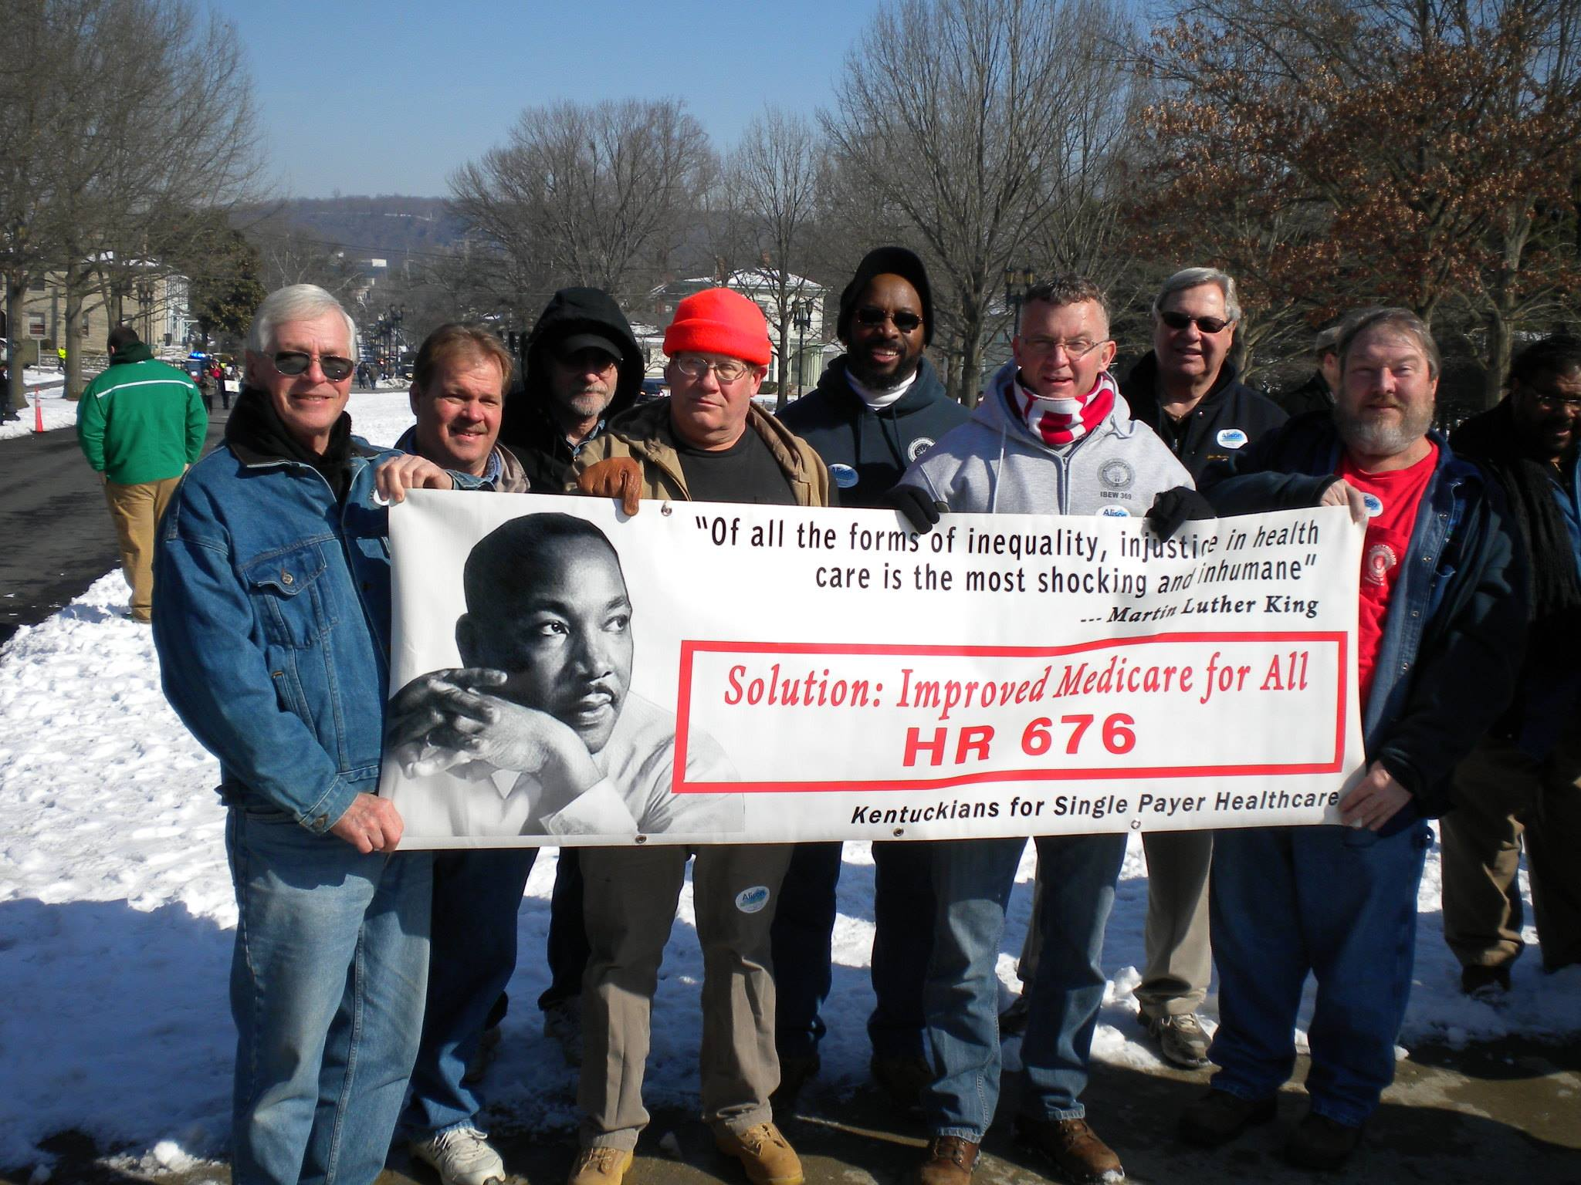
Marching with labor unions

Slide 17
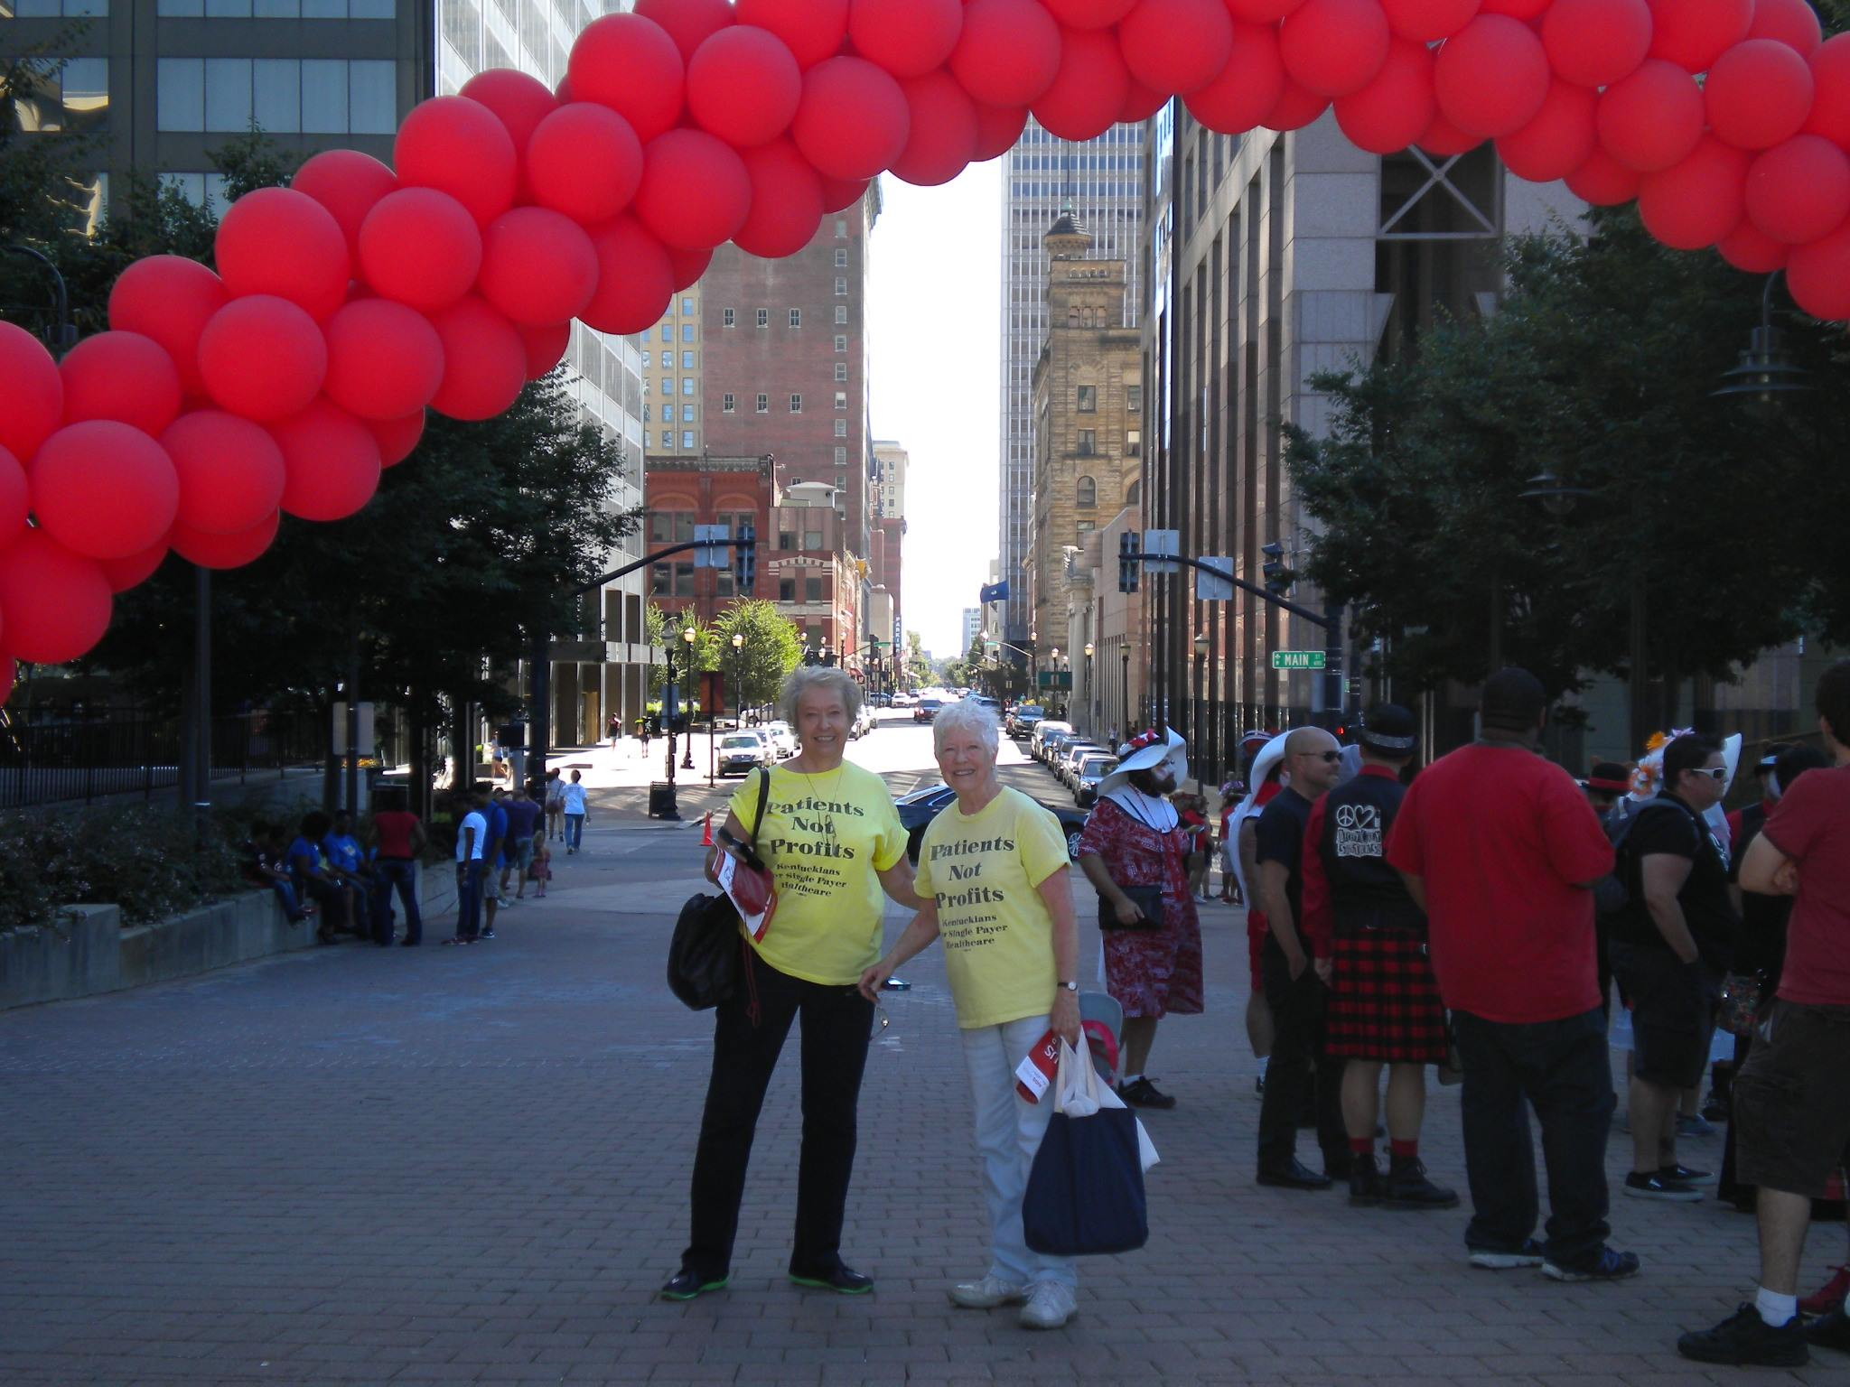
Walk the Walks- with tiny flyers

Slide 18
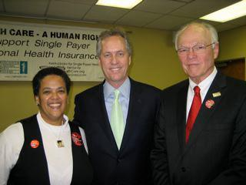
Plan Events

Slide 19
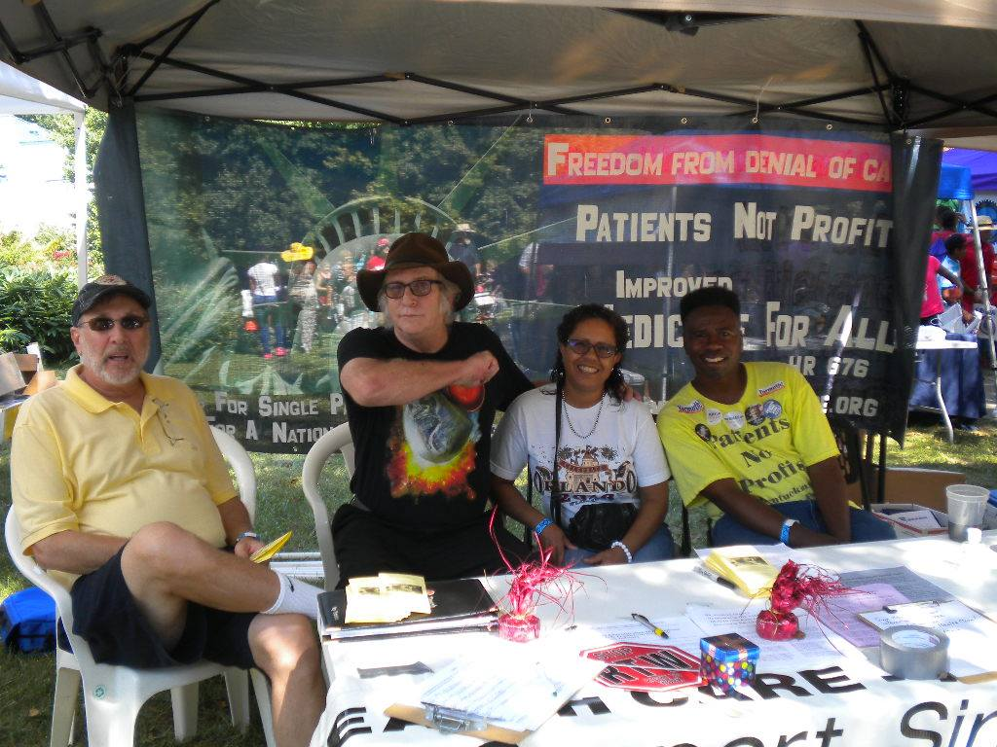
Set up Booths fairs, Labor Day, markets

Slide 20
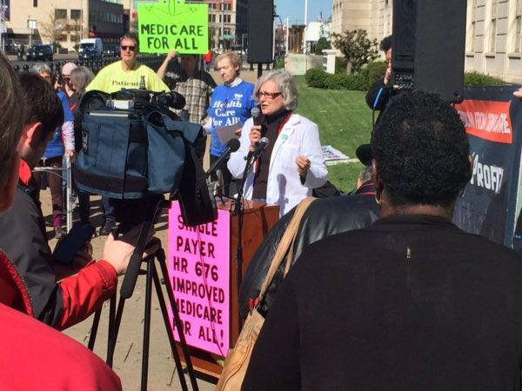
Sidewalk Town Hall

Slide 21
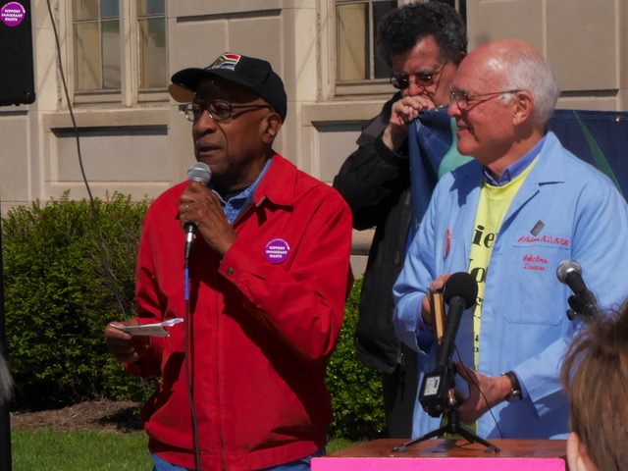
“Of all the forms of inequality, injustice in health care is the most shocking and inhumane.” Dr. Martin Luther King, Jr.
Read by Bob Cunningham, National Day of Action for Single Payer, April 8, 2017

Slide 22
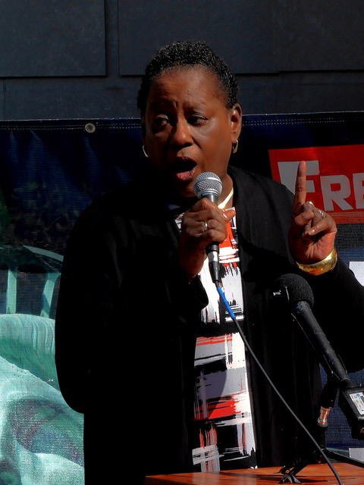
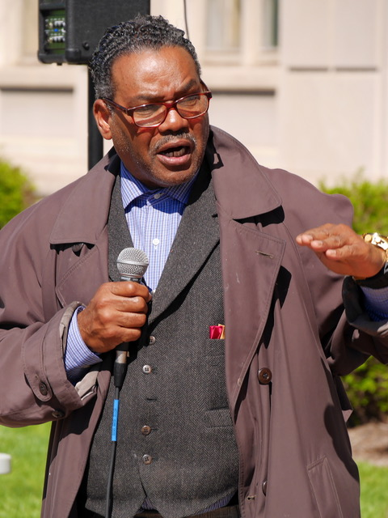
Everybody In, Nobody Out
National Day of Action, April 8, 2017

Slide 23
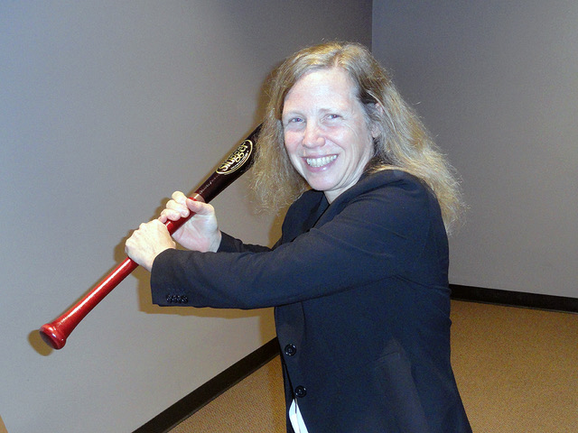
Kentuckians for Single Payer Healthcare event Grand Rounds: Health Care: A Business or a Public Good? Thur., Oct. 4 & Fri., Oct. 5, 2018 Margaret Flowers, MD

Slide 24
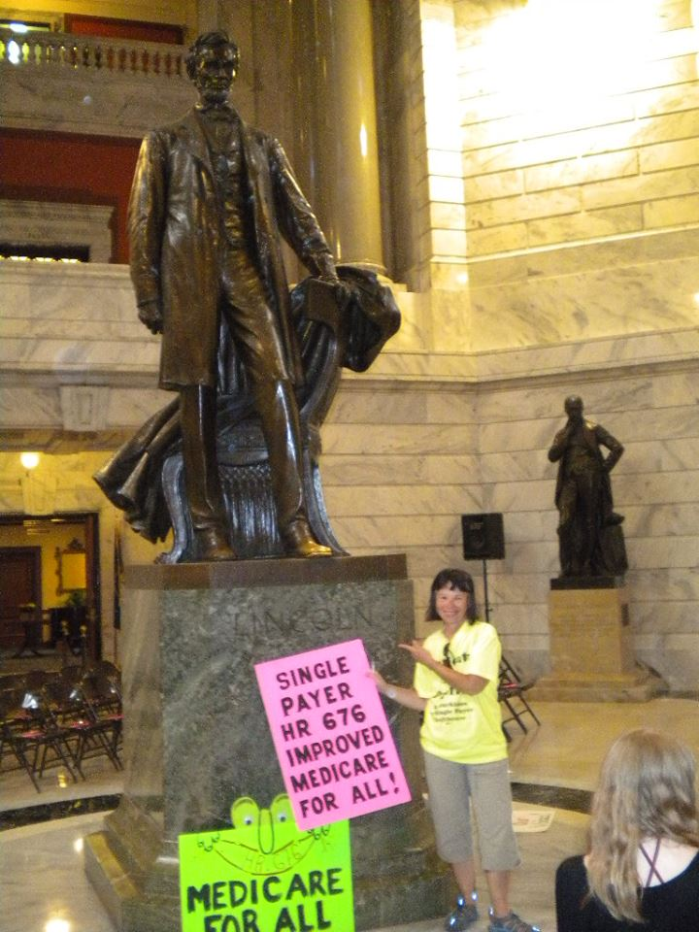
With women’s groups in the state Capitol in Frankfort

Slide 25
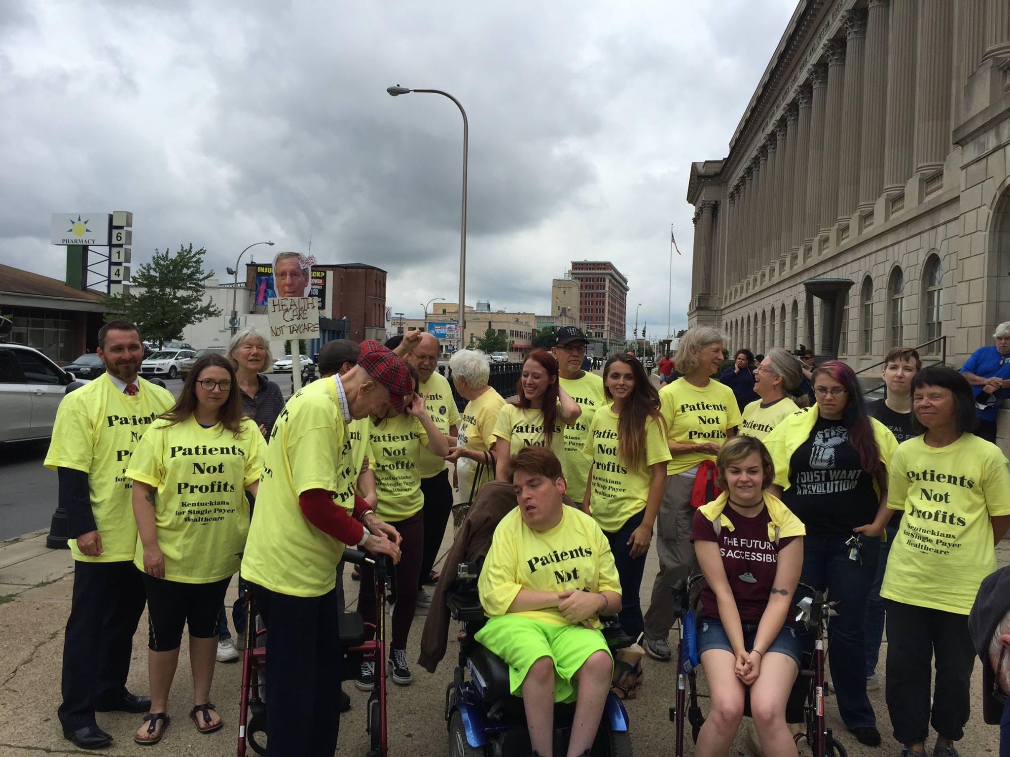
Sit In at Sen. Mitch McConnell’s office

Slide 26
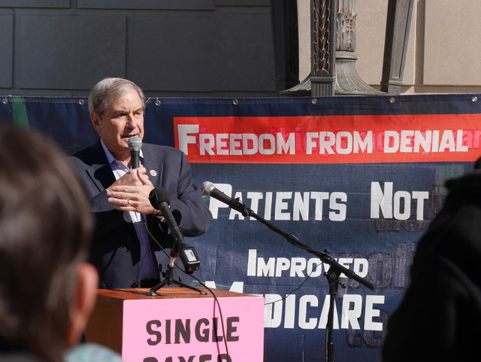
Work to win elected officials to support Single Payer
Congressman John Yarmuth, (KY, D -3)

Slide 27
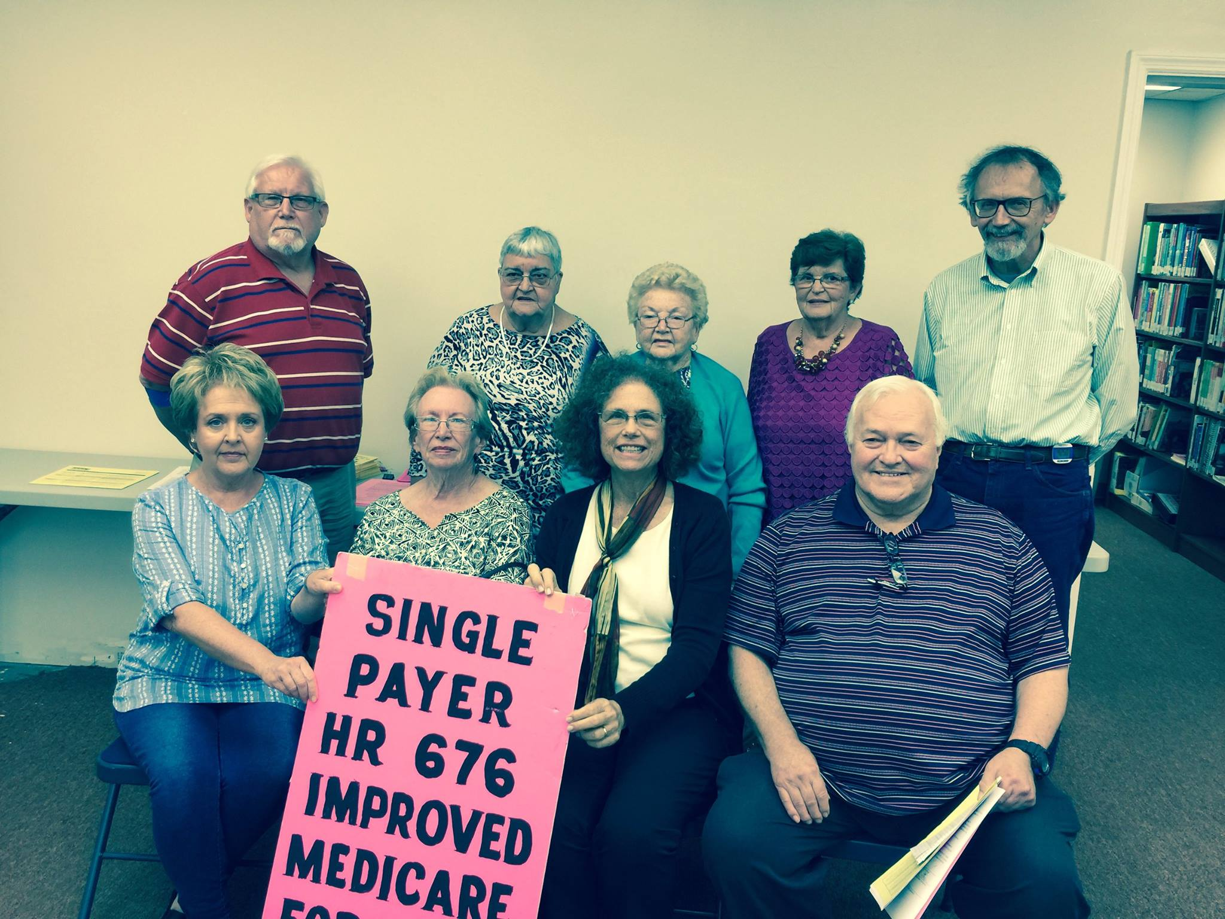
Take the show on the road— Films & Single Payer programs across the state.

Slide 28
Act boldly! The data & the people are with us! Educate. Organize. Speak with confidence. Make HR 676 happen.

