Slide 1

Civic Power Through Engagement
A guide by the PNHP Organizing Team

Slide 2
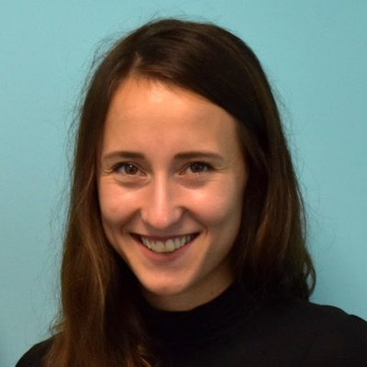
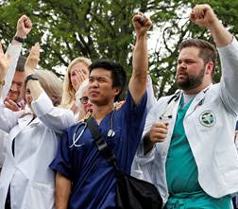
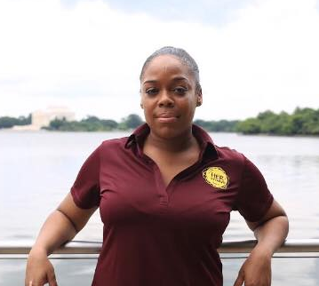
Who are we?

Slide 3
Overview
How do we stay focused?
SMART Goals
Coalition Building

Slide 4
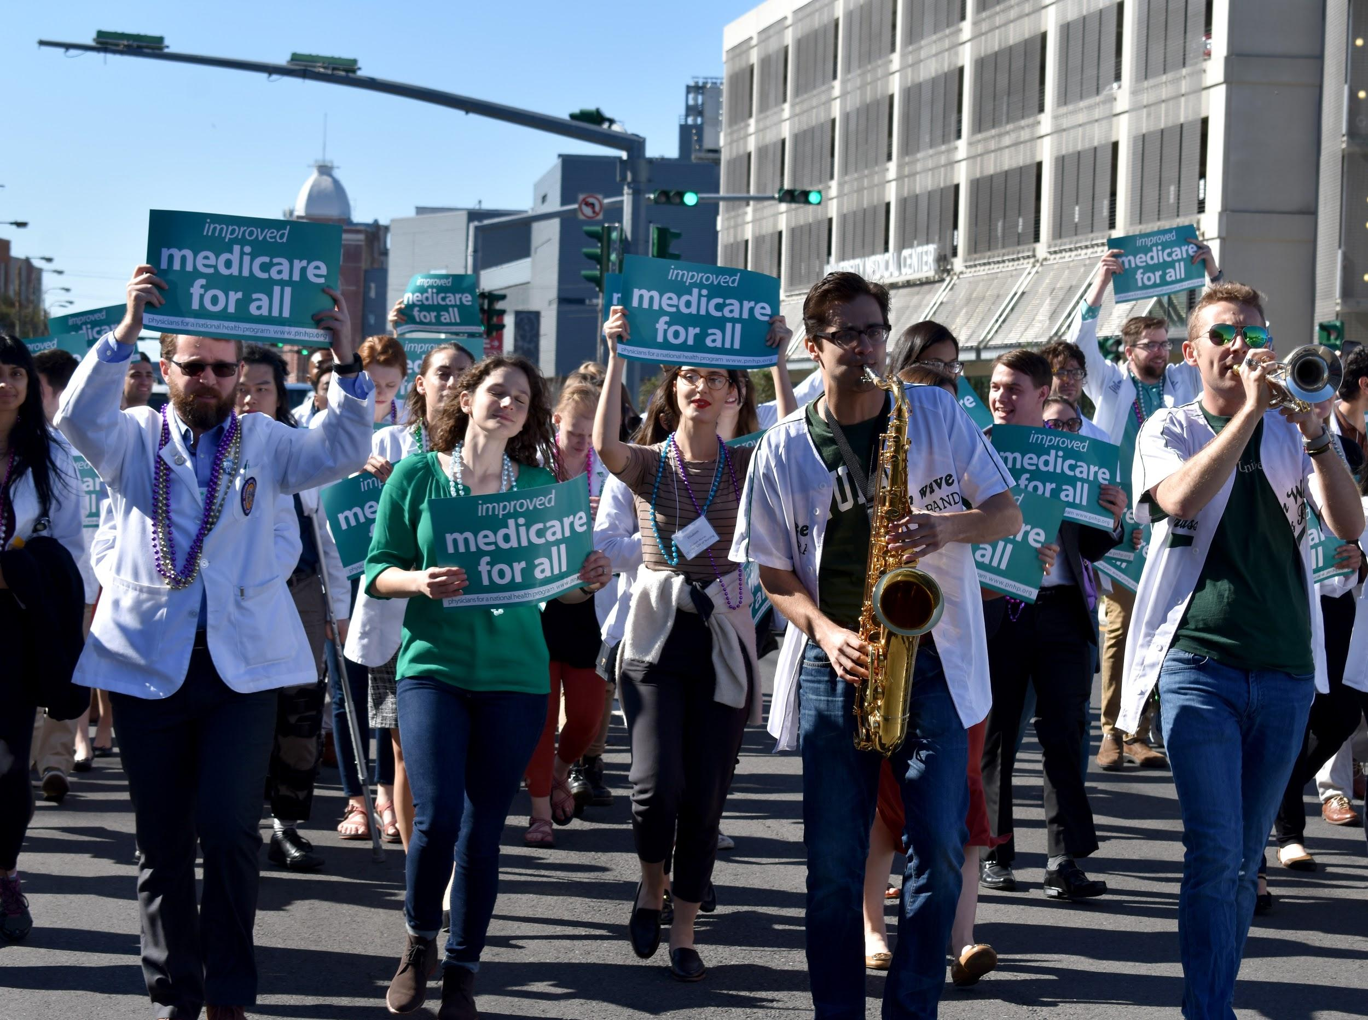
How do we stay focused?
In the world today, it seems like we are constantly bombarded by the news. How do we stay focused on single-payer, when it feels like there are so many other things to talk about? In order to make meaningful change, PNHP members must stay engaged, focused, and organized.
Since single payer can feel like such a long term goal, how do we make change and not get distracted or discouraged?

Slide 5
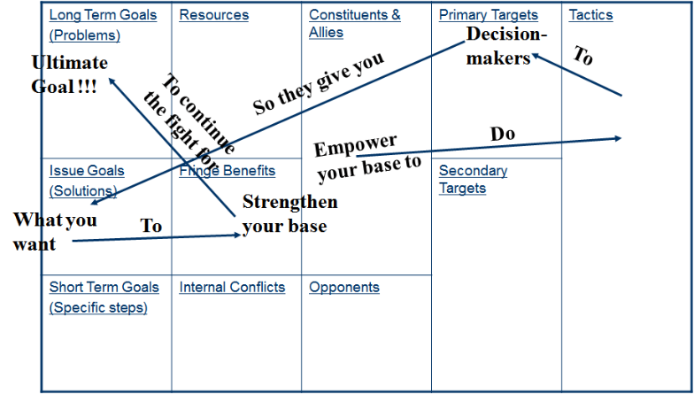

Slide 6


The long-term goal is to achieve Single-payer.
What are examples of
short term goals?
Tip
When thinking of your goals, it is important to stop and question “how will this help me achieve our long-term, organizational goal?”
Write that down.

Slide 7
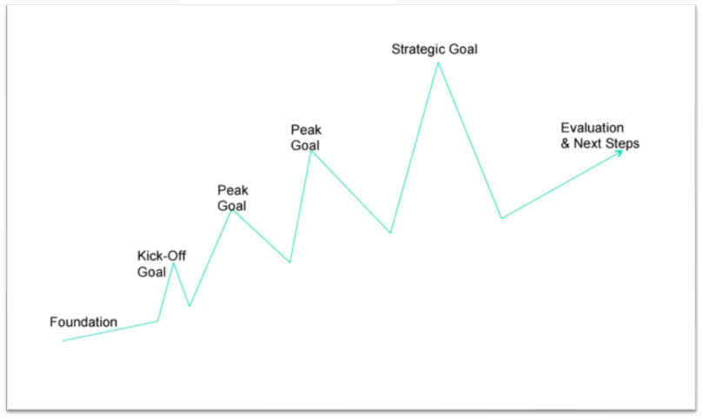

Slide 8
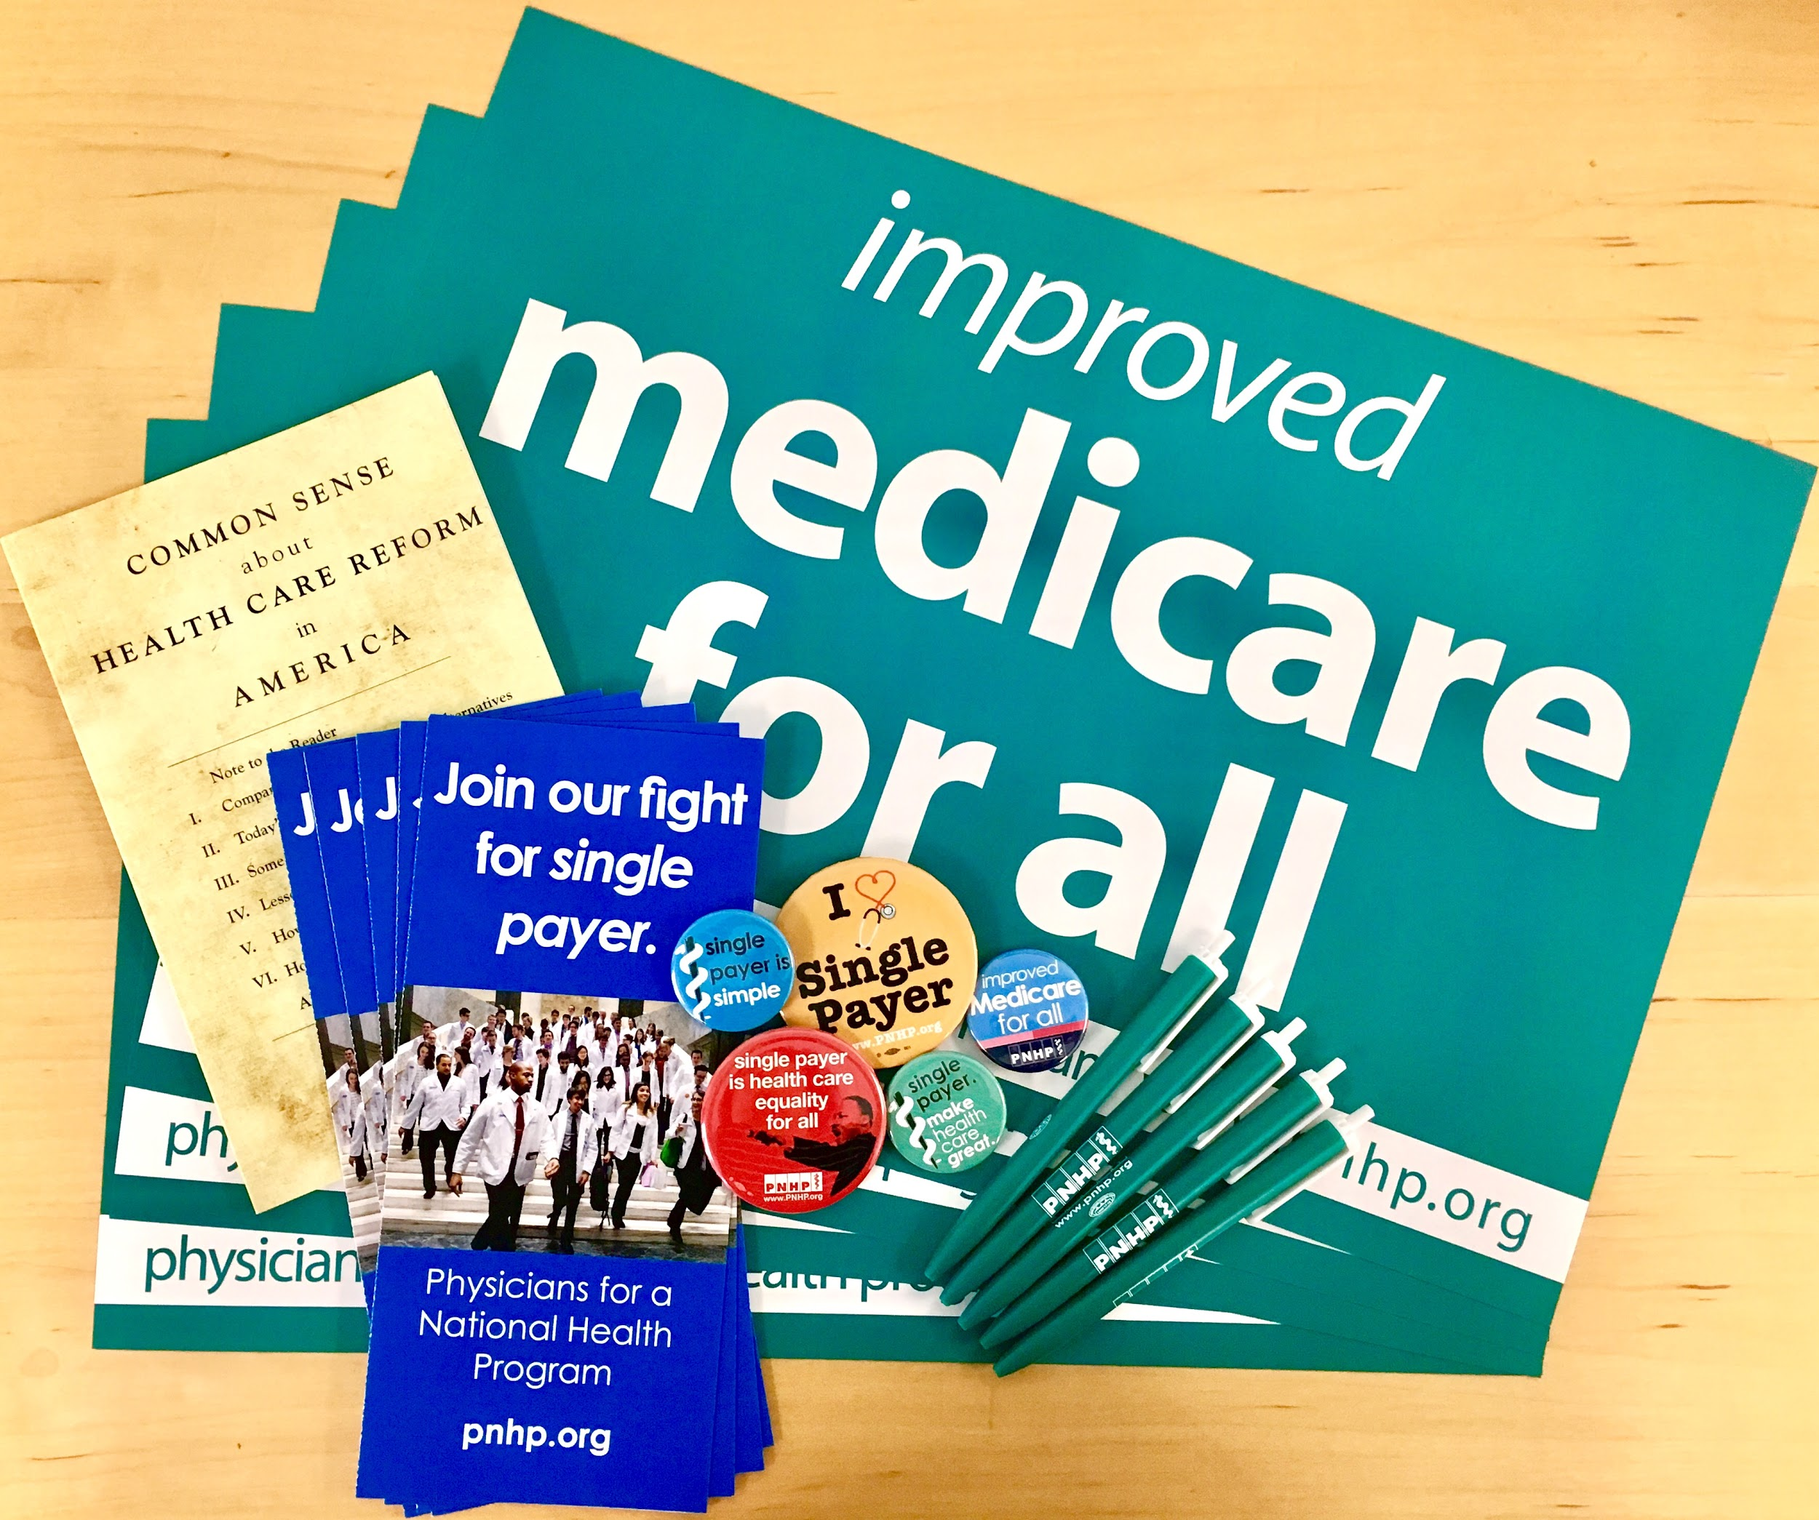
Make SMART Goals
An action without a goal is a fool’s pursuit and a goal without an action is a dream.
Specific
Measurable
Attainable
Relevant
Time-Bound
What do you hope to achieve? “Single payer” is our long term goal, but what about shorter term checkpoints along the way? A great example of a goal is “Have 5 of my colleagues join our chapter by the end of the year”.

Slide 9
Build a coalition
Goal: Add 5 colleagues to your chapter by the end of the year.
How do you get your friends and colleagues to join your chapter? Learn more HERE.
Tip
Make sure your goal is realistic: if you want to add 20 physicians to your network by the end of the year, but you know 3 people, the goal becomes a fantasy.

Slide 10
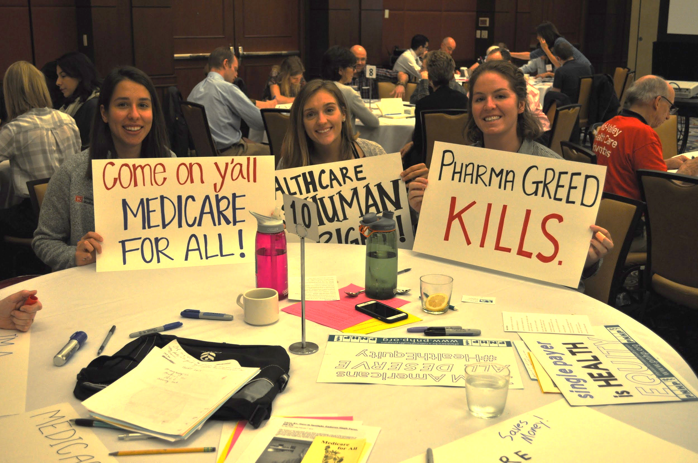
Inform the public through tabling events
Goal: Perform 2 tabling events every 6 months.

Slide 11
Call-a-thon
Goal: Perform a call-a-thon every November 1st, calling at least 100 people and asking them to contact their congressperson to support HR 676.
What’s great about this goal, is it is an event you can split up. Can you imagine what would happen if you and 4 other colleagues got together for 30 minutes and called in for support?
We know: change would happen.
Learn more HERE.

Slide 12
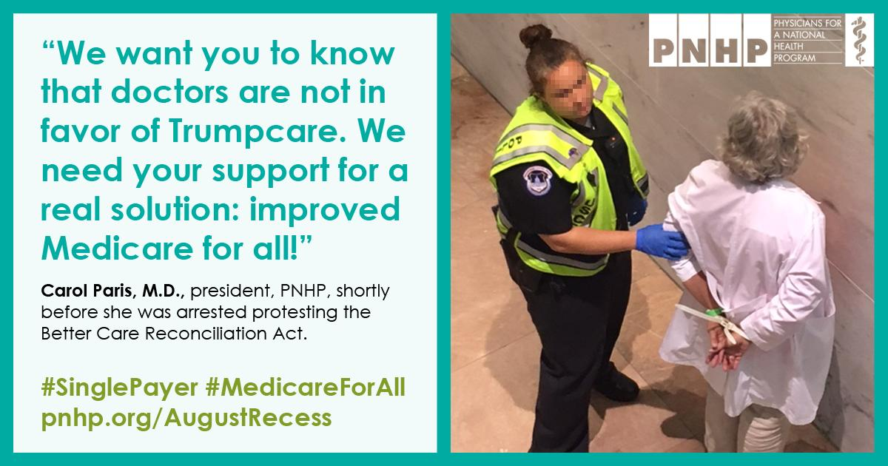
Social Media Presence
Tip
Staying up to date with health policy and staying actively engaged are two key components to being a modern-day organizer.
It’s difficult to make change when no one can hear you.
Goal: Tweet at least once a month about single-payer; at least once a week, read one article about single payer OR healthcare news.Learn more HERE.

Slide 13
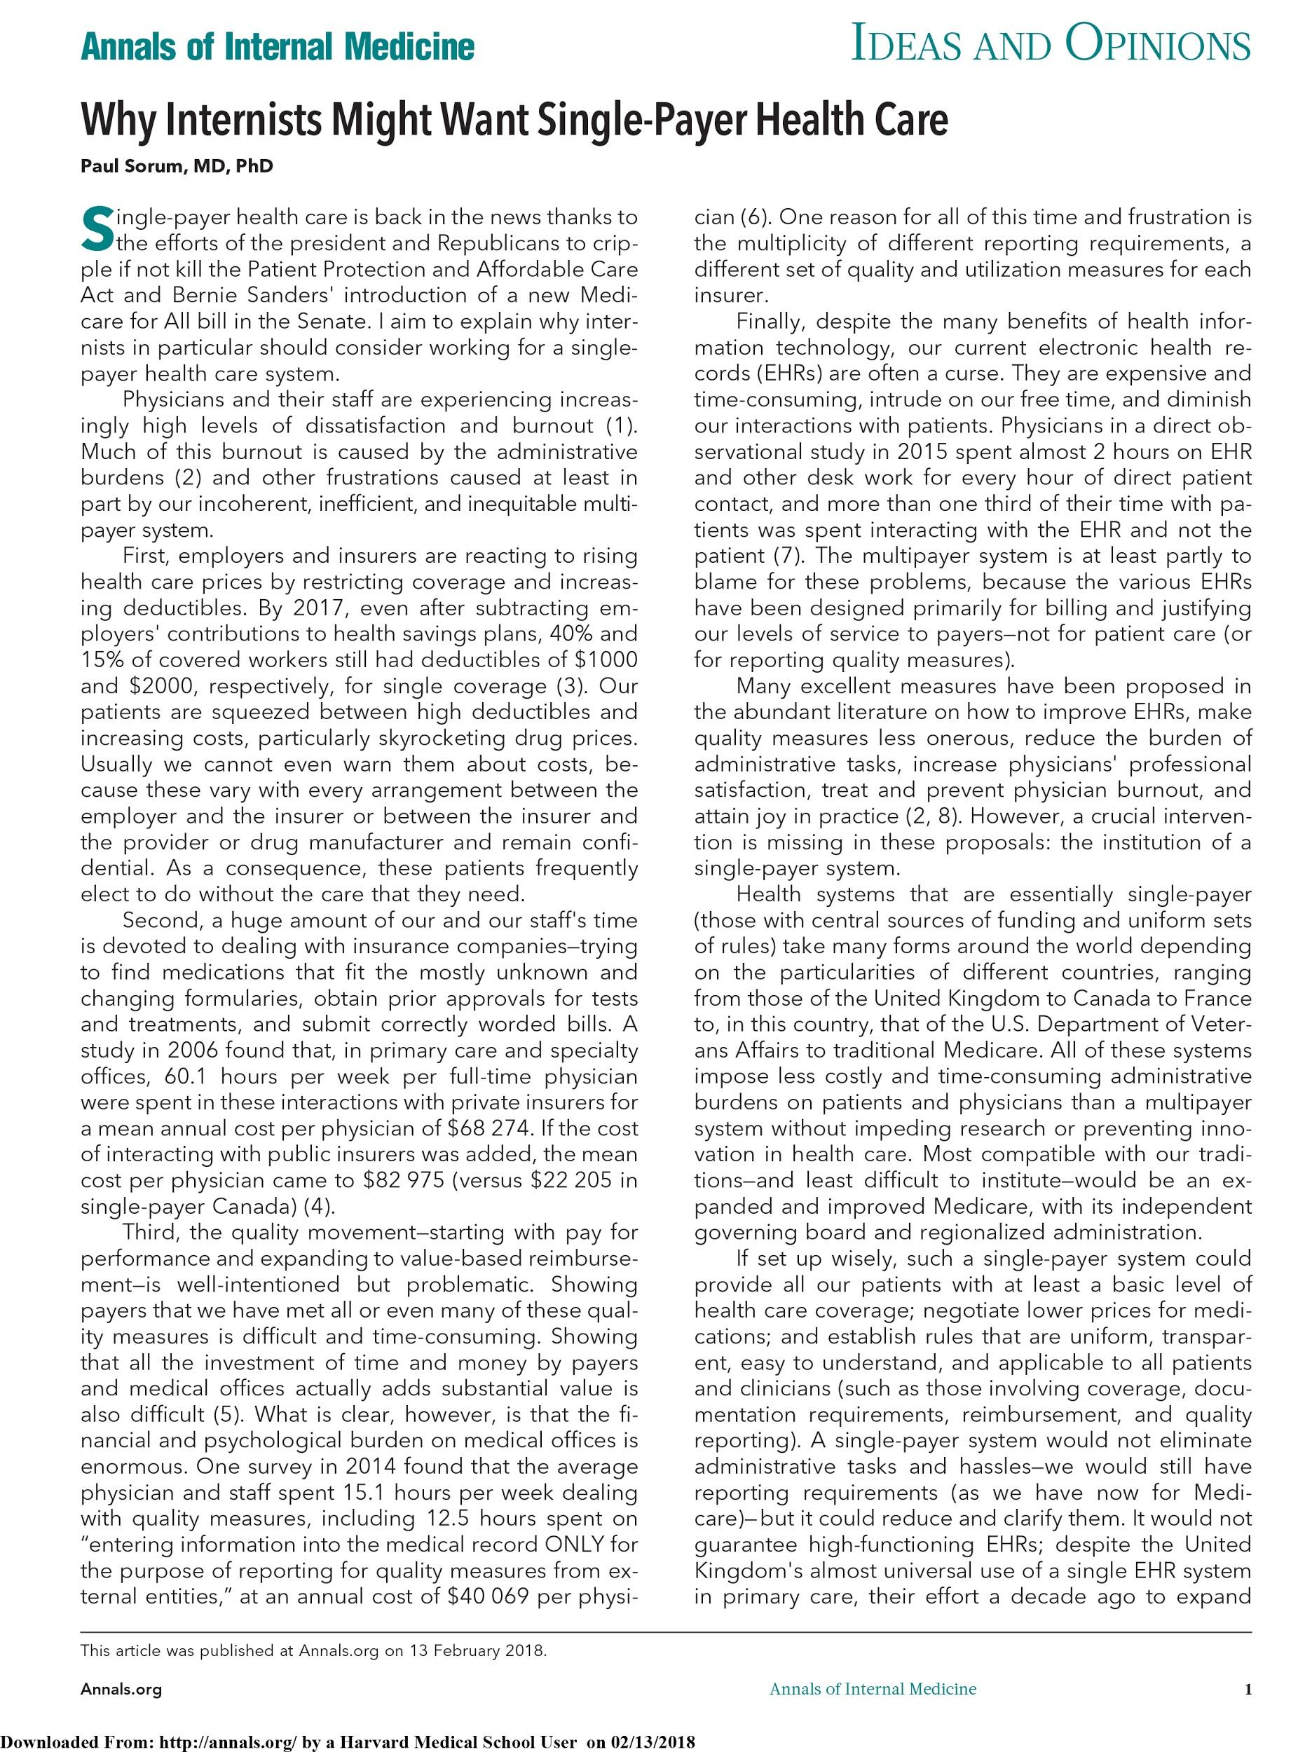
Write an Op-Ed or A Letter to the Editor
Goal: Write & Submit an Op-ed every 3 months.
Tip
Your words matter.
Writing for a publication, one that is read by “the common person”, means your message can reach far and beyond.
Learn more HERE.

Slide 14
How to Track your Goals
Goal | Specifics | Measurement Metric | Attainability | Relevance | Timeliness
Improve social media presence by tweeting at least once a week | Make a Twitter; Tweet once a week on Fridays | Weekly measurement; I can go back on my timeline and check my progress | Once I make a Twitter, this should work because I have a 2 hour gap on Fridays | All of the other chapter members are tweeting; twitter is popular | Twitter is popular and becoming a tool for spreading the single payer message

Slide 15
Be SMART & Engage

