Slide 1
Communicating with Conservatives
George Bohmfalk, MD

Slide 2
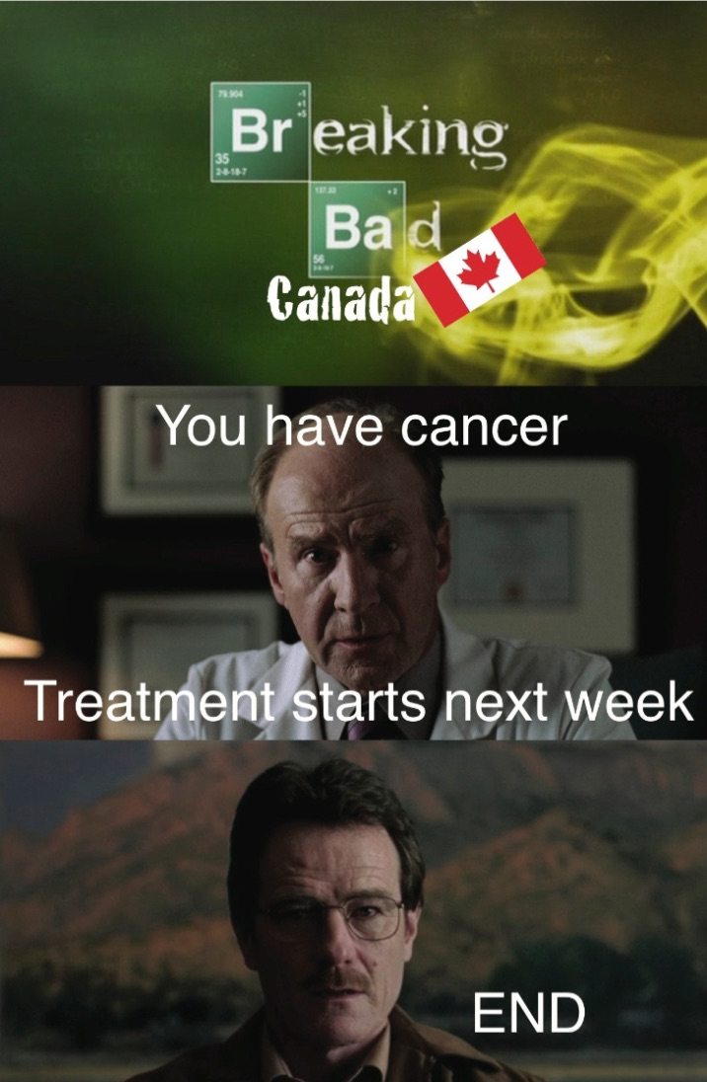

Slide 4
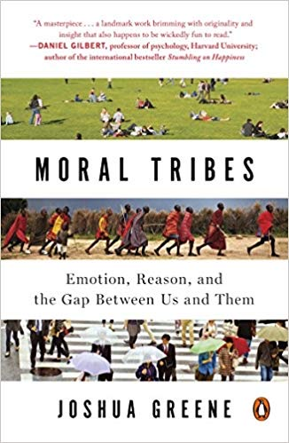
Moral Tribes
Joshua Greene

Slide 5
Tragedy of the Commons
One tribe, common pasture:
You work it out
Joshua Greene. Moral Tribes 2012

Slide 6
Tragedy of Commonsense Morality
Northerners
Each family has its own fenced
pasture
Each family has same number
of sheep
Family size
equals
flock size
Westerners
Easterners
Common
ownership of pastures and flocks
Southerners
Joshua Greene. Moral Tribes 2012

Slide 7
Tragedy of Commonsense Morality
Incompatible moral visions:
“Us vs Them”
Joshua Greene. Moral Tribes 2012

Slide 8
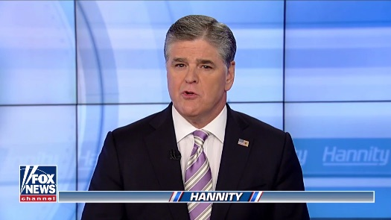

Tribe Becomes Stronger than Policy
People are forced to choose between believing
experts or their tribal members

Slide 9
Metamorality
Deep pragmatism
Beyond compromise
Form of utilitarianism
Best solution for the most people

Slide 10
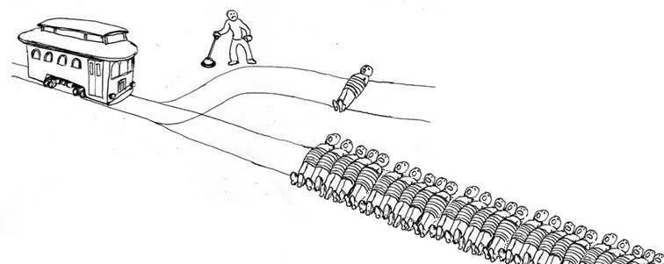

Trolleyology
Sacrificing insurance and pharmaceutical companies
to benefit the larger population

Slide 11
George Lakoff

Slide 12
“Nurturant Parent” Model
Love, empathy, nurturance >> authority
Support, protect, & nurture kids >> discipline
Obedience follows love & respect for parents, not fear of
Kids can question parents to understand decisions
Cooperation >> aggressive competition
Empathy for others
Kids choose their own paths
Goal: happy & fulfilled kids who respect all, not just authority

Slide 13
“Strict Father” Model
#1 responsibility: protect & support family
Parental authority & rules unchallenged
Breaking rules  punishment, retribution
Goal: self-disciplined, self-reliant children
Who respect & don’t challenge authority
No meddling by parent in child’s life
Competition important  meritocracy
Moral order follows Natural order

Slide 14
Moral Order Follows Natural Order
God over all
Man over woman
Man over environment
Rich over poor
USA over other countries – America First!
Whites over people of color – any color!
Straights over gays
Winning over losing

Slide 15
“Strict Father” Model
#1 responsibility: protect & support family
Conservative policies:
Resist any gun control
Control = meddling by parent
Shrink government but expand military

Slide 16
“Strict Father” Model
Parental authority & rules unchallenged
Breaking rules  punishment, retribution
Conservative policies:
Death penalty – innocence a secondary concern
Pro-life – women broke rules, no choice allowed
Illegal immigrants deported, families separated

Slide 17
“Strict Father” Model
Goal: self-disciplined, self-reliant children
Conservative policies
Medicaid work requirements
Get more off welfare
Don’t pay for someone else’s stuff

Slide 18
“Strict Father” Model
Competition important; meritocracy
Conservative policies:
Merit-based immigration
Means testing welfare
Two-tiered health insurance, boutiques

Slide 19
Moral Order Follows Natural Order
God over all
Man over woman
Man over environment
Rich over poor
USA over other countries – America First!
Whites over people of color – any color!
Straights over gays
Winning over losing

Slide 20
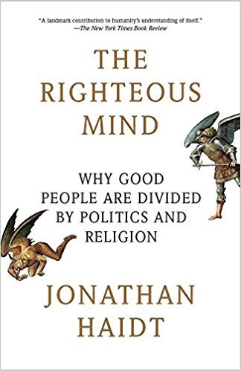
Jonathan Haidt: The Righteous Mind

Slide 21
Liberals: 2 Channels Conservatives: 5 Channels
5
4
3
2
1
0
Harm
Fairness
Endorsement
Authority
Ingroup
Purity
Very Liberal | Slightly Liberal
Moderate
Slightly Conservative | Very Conservative
Chart from Haidt, Jonathan. The Righteous Mind. 2013.

Slide 22
Jonathan Haidt: The Righteous Mind
Morality
binds and blinds

Slide 24
George Lakoff:
Morality is
too important
to be left to churches.
It’s not about
the money –
it’s all about
the morals.

Slide 25

He who
frames the issue,
wins the argument.
- George Lakoff

Slide 26
Conservative Framing Terms
Obamacare = him, minority, ? foreigner
ACA = low quality affordable
Taxes = affliction, burden, need relief, death tax
Death panels (Palin)
Regulations = burdens
Entitlements – recipients not self-reliant
Safety net - implies failure, hammocks for lazy
Mandate – government forced upon us
Wealth redistribution
Socialized medicine

Slide 27
Framing Words
Progressive
Conservative
Revenues – Business term
Investments for growth
Protections that help
End-of-life planning
Estate planning
Family reunification
Empowerment
Burdensome taxes that need reform
Spending on commodities
Onerous regulations against a few
Death panels
Death tax
Chain migration
Support of weak (welfare, entitlements)

Slide 28
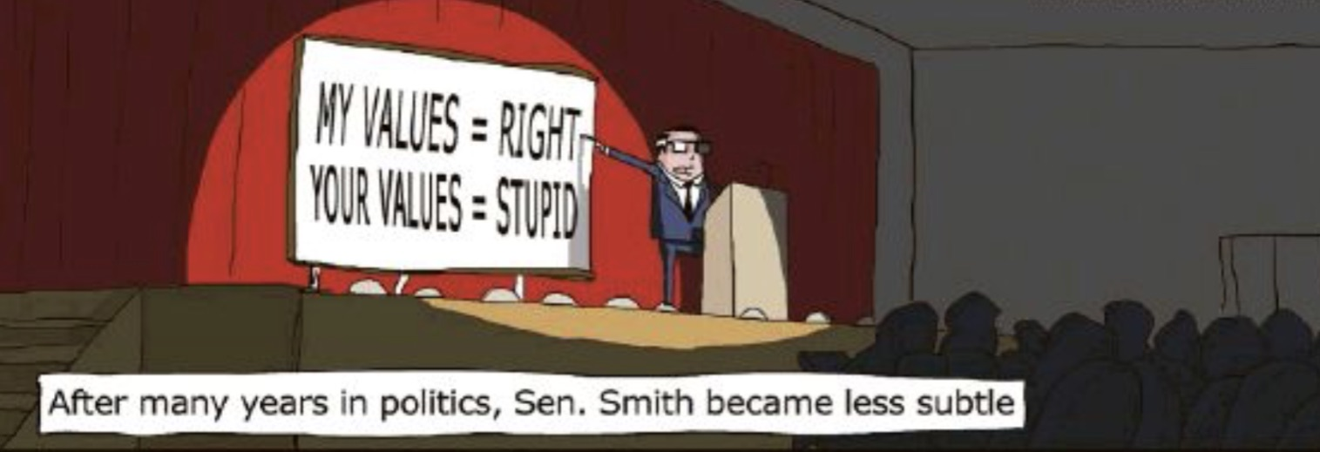
What Not To Do
Don’t slam profits and CEO salaries
Don’t talk down to conservatives
Don’t overwhelm with factoids
Don’t do most of the talking

Slide 29
How to Talk with a Conservative
Talk to the elephant, not the rider
Look for the metamorality
Make them explain their ideas
Accentuate the positive
Emphasize conservative values
Eliminates waste
Brings system efficiencies
May reduce size of government

Slide 30
Effective Conservative Words
Authority
Peace of mind
Investing
Liberty
Rise to top
Freedom
Protections
Competition
Natural order
Loyalty
Security
Patriotism
United States

Slide 31
Key is empathy
Make them feel someone’s pain
Tell stories

Slide 32
“MAMAGA”
Medicare for All
really can
Make America Great Again

