Slide 1

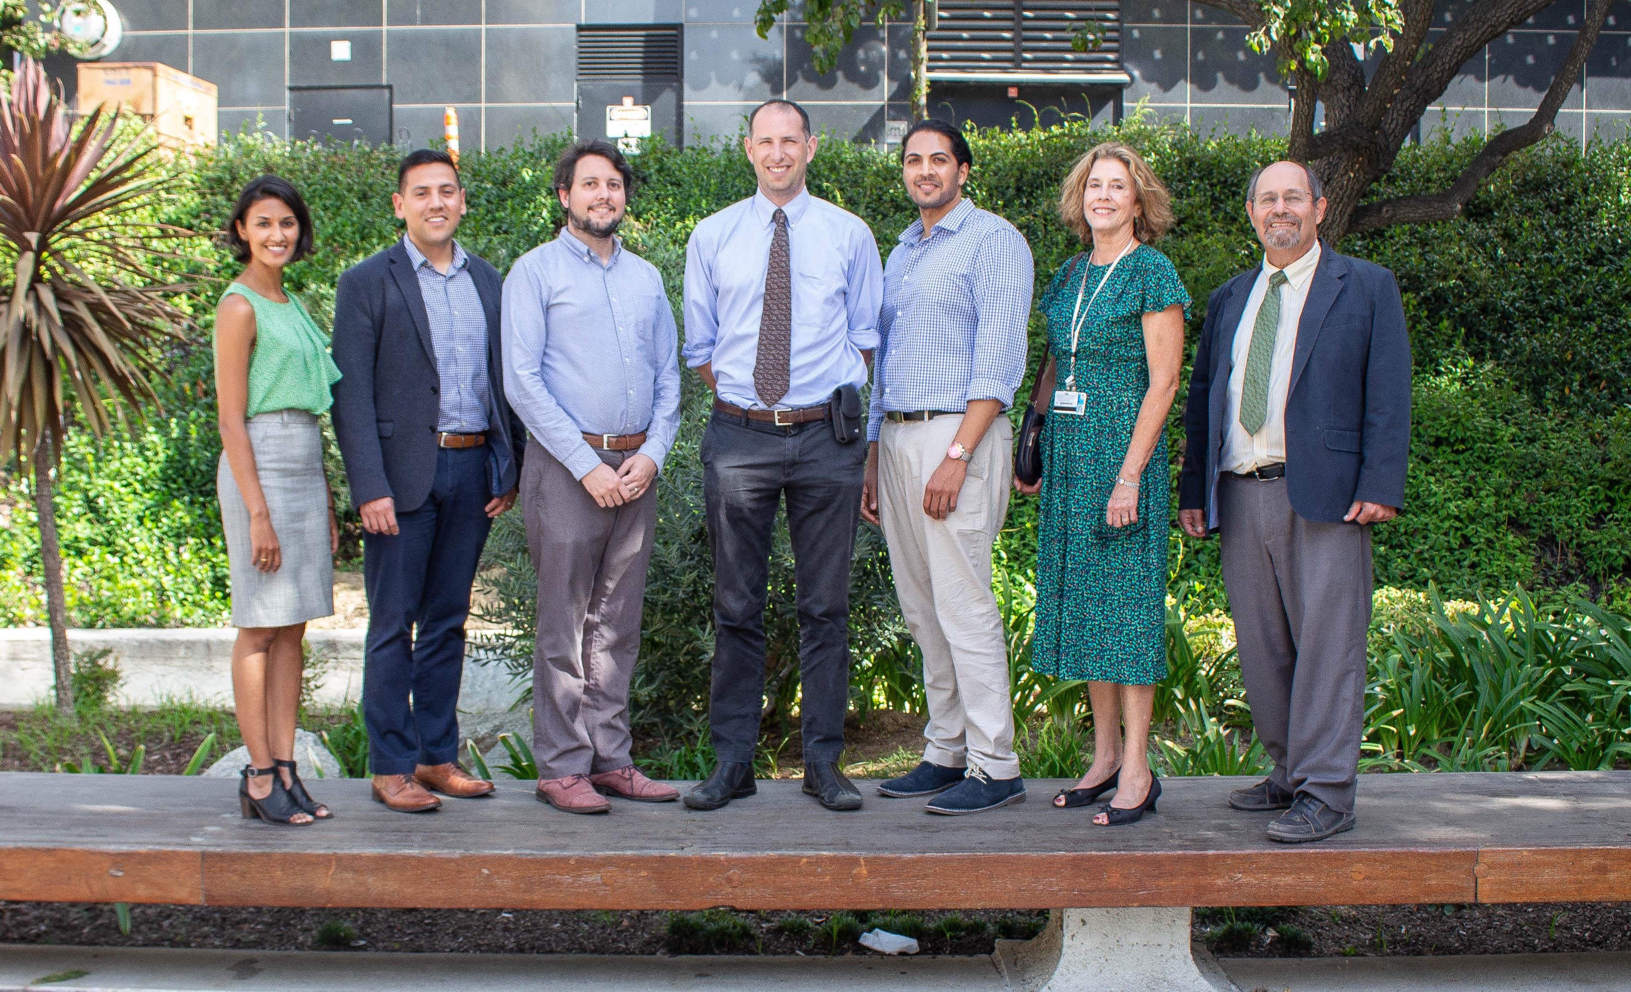
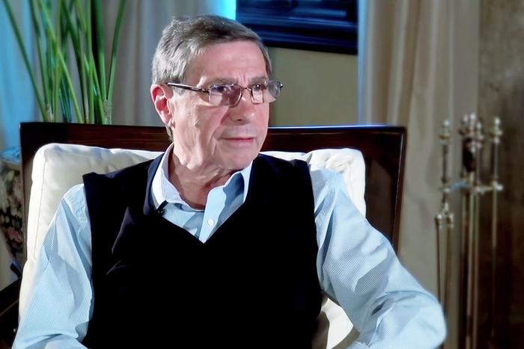
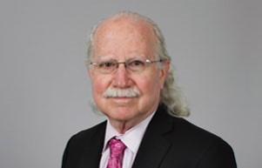
Treating Overtreatment Michael Hochman, MD, MPH Gehr Family Center for Health Systems Science Saturday November 10, 2018

Slide 2
Agenda
Cases
Group Discussions About Drivers of Overuse
Group Discussions About Policy Fixes

Slide 3
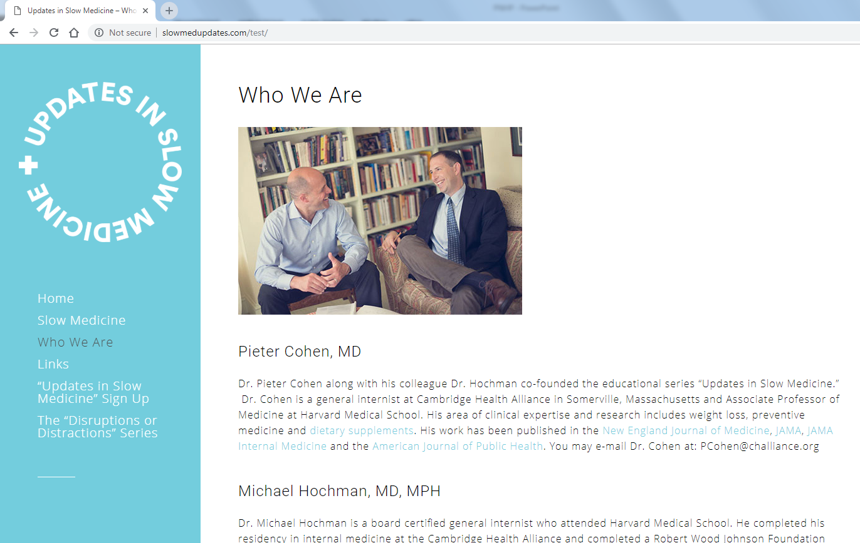
Updates in Slow Medicine
http://slowmedupdates.com/

Slide 4
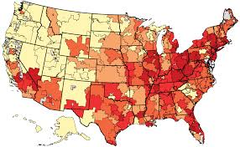
Dartmouth Health Atlas

Slide 5
Case 1
40 year old healthy woman presents for a Wellness Visit.
She requests a “full panel of labs” as part of your exam.
How do you respond?
What if she is persistent?

Slide 6
Case 2
You are evaluating a patient for an incidental adrenal mass.
The patient had a CT scan done at an outside hospital that identified the mass.
Do you try to obtain the CT scan images from the outside provider or do you simply repeat the study?

Slide 7
Case 3
A 55 year old woman presents for a wellness check.
She had a normal mammogram at age 50, but has not been to the doctor since.
The mammogram 5 years ago and was very uncomfortable and she does not want to repeat it.
How hard do you push?

Slide 8
Case 4
You find out that an ENT specialist is recommending ear tubes for your 3 year old patient.
You don’t think ear tubes are indicated because he has only had 1 ear infection and has no hearing deficits.
How do you respond?

Slide 9
Case 5
An elderly woman with advanced cirrhosis shows up to your busy clinic.
She has had 6 hospital admissions over the past three months.
You have 3 patients in the waiting room, and are running 20 minutes behind.
Do you engage in a conversation about palliative care?

