Slide 1
Communicating effectively about Single Payer Medicare for All
Ed Weisbart, MD
Claudia Fegan, MD

Slide 2
Strangers in Their Own Land:
A Journey to the Heart of Our Political Divide
Russell Hochschild, Arlie. Strangers in Their Own Land. 2018. pg 228

Slide 3
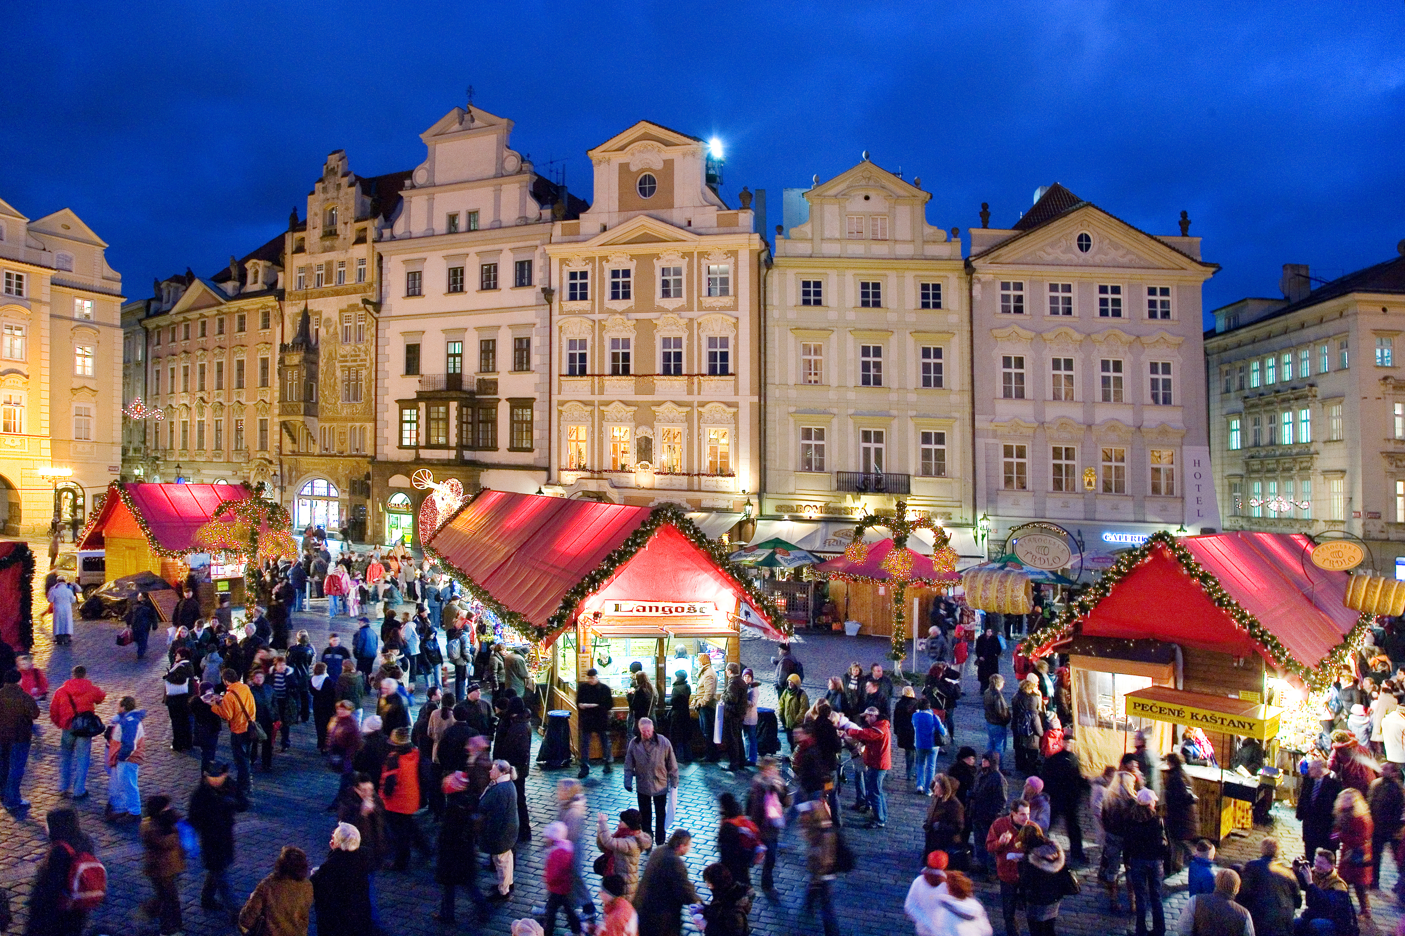
Liberals Have a Deep Narrative: “Creatively designed, hard-won public sphere as a powerful integrative force in American life”
“We’re proud of this public square – we built it!”
“Marauders are invading it and dismantling it.”
“Their McMansions; our public bricks!”
Russell Hochschild, Arlie. Strangers in Their Own Land. 2018.

Slide 4
Conservatives Have a Deep Narrative
Waiting in line for the American Dream
Pride at waiting patiently
Line-cutters slow the line down
Government is escorting line-cutters to the head of the line.
Russell Hochschild, Arlie. Strangers in Their Own Land. 2018.

Slide 5
“While economic self-interest is never entirely absent,
what I discovered was the profound importance of
emotional self-interest –
a giddy release from the feeling of being a
stranger in one’s own land.”
Russell Hochschild, Arlie. Strangers in Their Own Land. 2018. pg 228

Slide 6
Got $10 to Risk?
Heads: You lose $10.
How much should tails be worth?
Losses generally count
double of gains.

Slide 7
Medicare for All Focused on Loss Aversion
Gain Centric Messages
Loss Centric Messages
Save money for the other things you want.
See any doctor you want.
Live longer and healthier.
Stop wasting your money.
Don’t let anyone take away your choice of doctor.
Don’t die younger than you need to.

Slide 8
We Each Have Different Comfort Zones
Efficiency, financials, performance, measurements
Methods, regulation, quality, control, timing, policies
Facts
Forms
Manny Elkind
“Whole Brain Model”
Futures
Feelings
Concepts, vision, purpose, strategy, global
Relationships, communication, culture, values
Manny Elkind, Mindtech Inc.

Slide 9
Medicare for All from the Four Quadrants
Life expectancy data
Cost trend charts
Bills pending in Congress
Implement through a link to Social Security
Facts
Forms
Futures
Feelings
Businesses unfettered by the cost of American healthcare
Personal stories
Connect to the issues
Manny Elkind, Mindtech Inc.

Slide 10
Liberals and Conservatives Often Think Differently
George Lakoff
“Moral Politics”

Slide 11
Lakoff Identified Two Cognitive Models
Nurturant
Mother
Two-Framed
Strict
Father
Equality
Diversity
Helping hand
Both frames are active
Looks undecided
Hierarchical
Social Darwinism
Consequences
20% of Americans
60% of Americans
20% of Americans
Liberals
Independents
Conservatives

Slide 12
Lakoff Identified Two Cognitive Models
Personal freedom, consequences of your actual choices, and prudence
Nobody should take away your choice of doctor
Less wasteful to buy insulin than dialysis
They tend to agree but have questions.
Use stories to activate nurturing frame.
Address gaps and misinformation.
Ask for commitment and action.
Liberals
Independents
Conservatives

Slide 13
Moral Foundations Questionnaire
Jonathan Haidt
“The Righteous Mind”
Online survey of 132,000 Americans
Identified five moral pillars
Compared individual scores with where people stood on the political spectrum
Haidt, Jonathan. The Righteous Mind. 2013.

Slide 14
Five Moral Pillars
Fairness
Reciprocal altruism, justice, rights, autonomy
Caring
Cherish, nurture, and protect others
Loyalty
Patriotism, self-sacrifice, “one for all, all for one”
Authority
Deference to leadership, respect for traditions
Sanctity
Bodies are temples desecrated by immorality
Haidt, Jonathan. The Righteous Mind. 2013.

Slide 15
Our Personal Moral Pillars Vary With Our Politics
Strongly
Endorse
Fairness
Caring
Both sides believe
they hold the
moral high ground.
“You heartless
bastards don’t care.”
“Your lack of morals will destroy our society.”
Loyalty
Authority
Sanctity
Strongly
Reject
Very Liberal | Slightly Liberal
Moderate
Slightly Conservative | Very Conservative
Chart from Haidt, Jonathan. The Righteous Mind. 2013.
(Commentary by Ed Weisbart)

Slide 16
Five Moral Pillars of “Cover Everybody”
Do not expect
these two arguments
to persuade conservatives.
Fairness
Healthcare is a human right
Caring
Protect the vulnerable
Loyalty
Poor outcomes but plenty of reasons for national pride
Authority
Sanctity

Slide 17
Medicare Means
Healthier Americans
1
3
5
7
9
11
13
15
17
USA
Rank
Age 65
Women
Men
0-1 | 1-4 | 5-9 | 10-14 | 15-19 | 20-24 | 25-29 | 30-34 | 35-39 | 40-44 | 45-49 | 50-54 | 55-59 | 60-64 | 65-69 | 70-74 | 75-79 | 80-84 | 85-89 | 90-94 | 95-99
Institute of Medicine. Shorter Lives, Poorer Health.
Fig 1-9: Ranking of US mortality rates by age group among 17 peer countries, 2006-2008. 2013
Peer nations are Australia, Austria, Canada, Denmark, Finland, France, Germany, Italy, Japan, Norway, Portugal, Spain, Sweden, Switzerland, Netherlands, United Kingdom
Age

Slide 18
Five Moral Pillars of “Cover Everybody”
Fairness
Healthcare is a human right
Caring
Protect the vulnerable
Loyalty
Poor outcomes but plenty of reasons for national pride
Authority
Mention, but don’t over-emphasize, your sources.
Sanctity
Medicare keeps us from poverty and extends our lives

Slide 19
Tribalism Trumps Moral Pillars
“Our brains were
designed for tribal life,
for getting along with
a select group of others (Us) and for
fighting off everyone else (Them).”

Slide 20
Tribalism Trumps Moral Pillars
One good example
Translation:
“I’m in your tribe”
Lakoff frames:
Nurturing + hierarchy
Moral Pillars:
Loyalty and Authority
“Most of you know me as the neighborhood pediatrician
but you may not realize
I also run a
small business.”
PNHP Workshop participant, Nov. 3, 2017

Slide 21
Like It or Not, You’re In a Tribe
8 minute free quiz
HiddenTribes.us
Recognize yourself as tribal
Recognize others’ tribes
Avoid inter-tribal barriers
HiddenTribes.us
https://static1.squarespace.com/static/5a70a7c3010027736a22740f/t/5bbcea6b7817f7bf7342b718/1539107467397/hidden_tribes_report-2.pdf
Accessed Oct 30, 2018

Slide 22
None of This Helps If You Can’t Speak

Slide 23
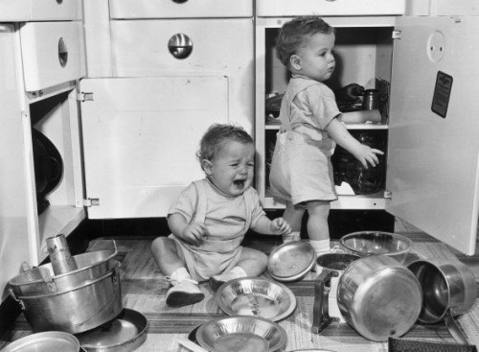
We’ve All Heard These Things
“I’m sorry, but…”
“Too much material, so…”
“I know this doesn’t show up on my slide...”
“I’d rather be talking to you about…”
“This is really Dr. X’s presentation, but…”
“Somebody please watch the clock for me…”

Slide 24
Be Yourself, Sort Of
Be Yourself
Sort Of
Say what you believe
Stand or walk where you want
Dress for comfort
1st person singular pronouns are powerful
2nd person engage
3rd person distance
Stay on message
No rocking or swaying
Avoid mannerisms (“like”) and pause fillers (“um”, “er”, “look”...)
Use your outdoor voice
Be remembered for your content, not your clothing choices

Slide 25
Look Relaxed, But You Are On a Stage
It’s your job to
manage their expectations
You’re giving a performance
An agenda is not a workplan.
Get permission: “Here’s where we’ll be in 20 minutes; is that what you were expecting?”
Your audience should always track where you are in the talk
Surprise! Audiences can read!
Know your opening line
Don’t tune the piano on stage. Play the music.
Your audience is full of musicians; let them play too.

Slide 26
Track Your Own APMs
“Actually, I actually find that
this is actually an
important point, actually.”
-Actual speaker’s name protected
If anyone
points this out
to you,
thank them.
APM = “Actuallys” per Minute

Slide 27
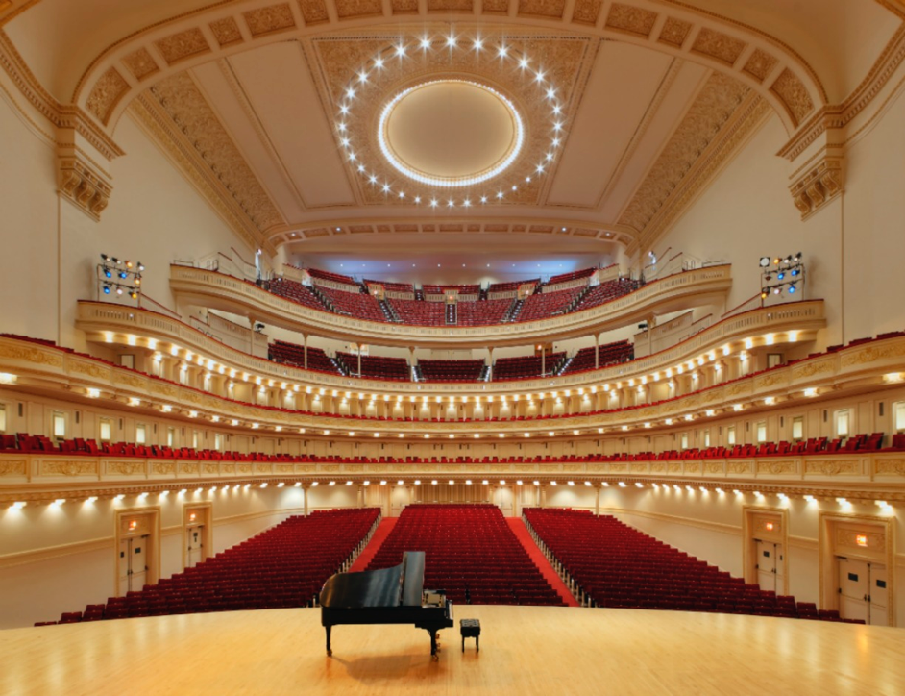
How Do You Get to Carnegie Hall?

Slide 28
“PowerPoint” Is Not “Word”
Three exceptions…
Legal
Legislative
Webinars
6 line maximum
20 point font minimum
28 point much better
Paragraphs
Books

Slide 29
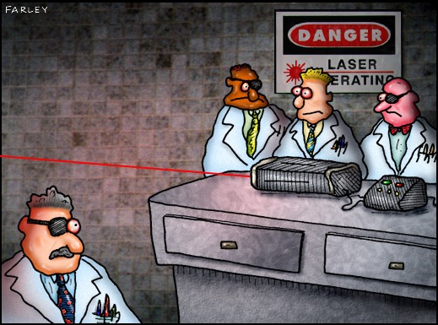
Lasers are for
amusing cats.

Slide 30
Our Words Matter.
"Simplify, simplify, simplify"
said Emerson.
"One simplify would do, Ralph”
replied Thoreau.

Slide 31
Simple, Prudent, and Proudly American
Non-partisan messages about Medicare for All:
Simple. Not complicated.
Stop wasting our money.
Nobody should take away your choice of doctor.
Businesses should focus on their businesses.
Medicare is proudly American.

