Slide 1
Working with Media
A guide for PNHP activists
2018 Leadership Training
Clare Fauke is a communications specialist at PNHP
Natalie Shure is a journalist and head of research for “Adam Ruins Everything.” Her writing has appeared in The Nation, Jacobin, Pacific Standard.

Slide 2
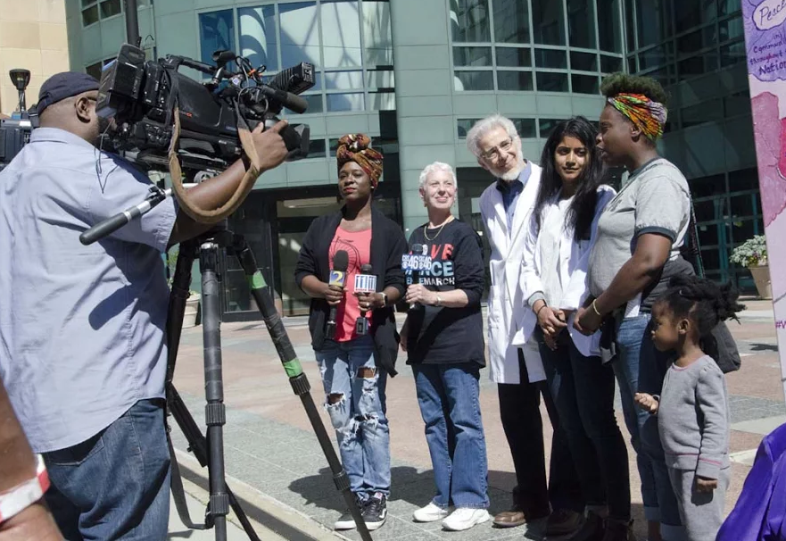
Why bother with media?

Slide 3
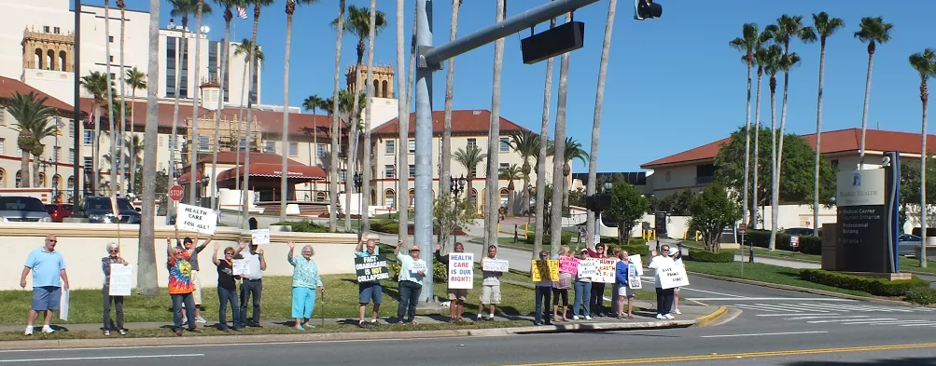
How do we get
our message out?

Slide 4
Media tactics:
Ranked in order of easiest to hardest.
HINT: Like most things in life, the most difficult is also the most effective.
Letters to the Editor
Op-eds
Editorial Board meetings
Public Events

Slide 5
Letters to the Editor
Two types of letters:
Response to a published article or editorial;
Response to current events or news of the day.
TIP: Nobody will publish a letter about
something that happened a year ago.

Slide 6
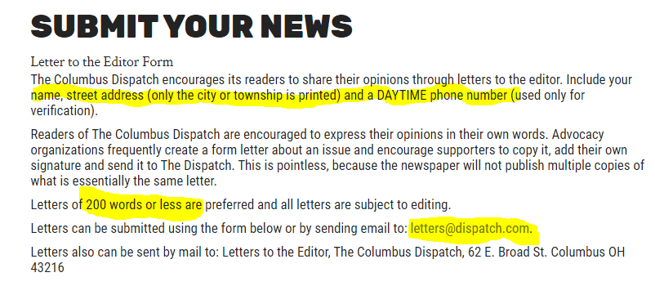
Letters to the Editor
Review your paper’s submission guidelines!

Slide 7
Letters to the Editor
Keep it short! Fewer than 200 words.
Use your voice as a doctor, patient, parent, etc. Lead with a personal experience.
Tie it to a news story or local official.
Use statistics, but provide links to current, credible sources.
Submit in body of email (no attachments!). Include contact info and brief bio.

Slide 8
Op-Eds
Same content guidelines as Letters.
Length = about 600 words.
Submit in body of email with contact & short bio.
If accepted, you may be asked to edit down
& provide a photo.
Consult publication guidelines for length & submission. Only submit to 1 paper at a time!

Slide 9
Editorial Board Meetings
What is an editorial board?
Includes editorial page editor, editorial writers, & reporters from various beats. Determines topics and positions for editorials.
Why meet with the editorial board?
Educate editors and reporters
Establish relationship with staff
Request endorsement of single payer

Slide 10
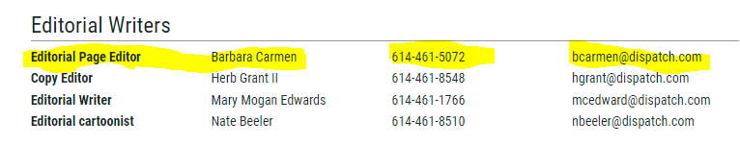
Editorial Board Meetings
How to set up a meeting:
Send an email to the opinion or editorial page editor to request a meeting: Briefly describe the issue, why it’s important, & your point of view. Follow up with phone call.

Slide 11
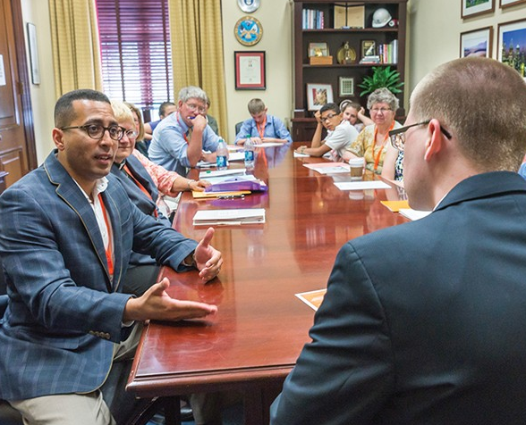
Editorial Board Meetings
Prepare for the meeting:
Invite 1-2 colleagues
Prepare 5-minute presentation making the case for single payer
(no power points!).
One-page handouts for all participants.

Slide 12
Editorial Board Meetings
At the meeting:
Just like a lobby visit:
  Introductions
  Your presentation
  Answer questions
  Plan for follow up
After the meeting:
Thank you note
Follow up answers + new information

Slide 13

Public Events
Movie screenings (Fix It, Big Pharma)
Educational panels
Rallies & Marches
“Die-ins”
Crash town hall meetings
NO PRESS CONFERENCES!

Slide 14
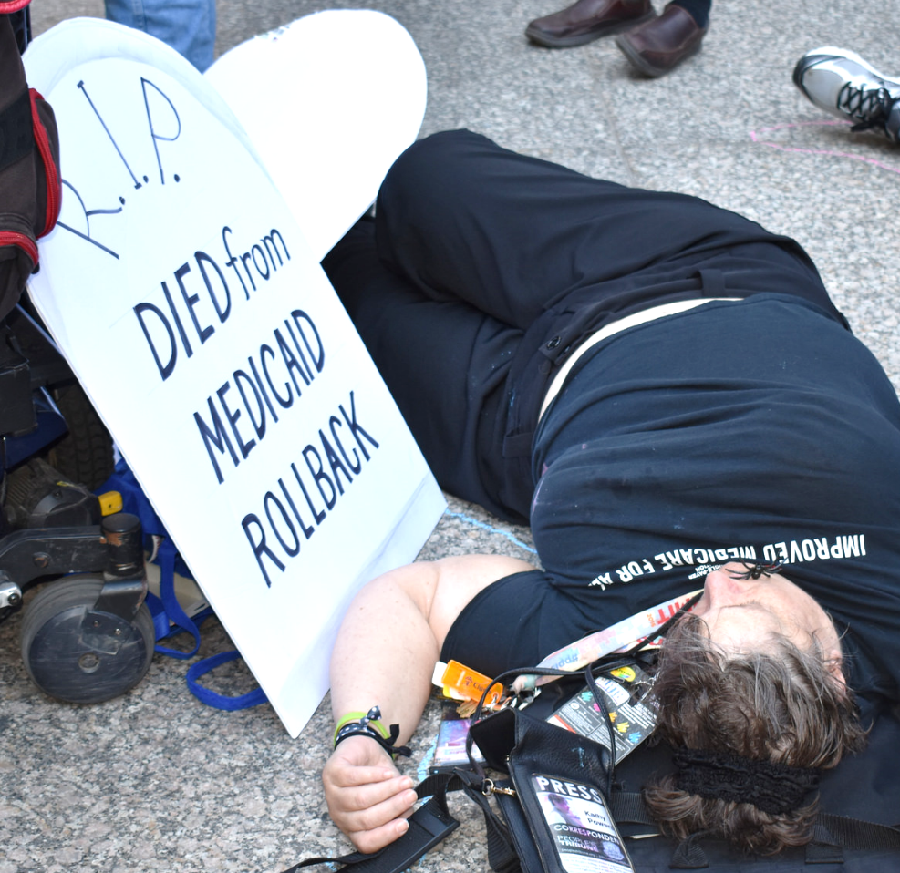
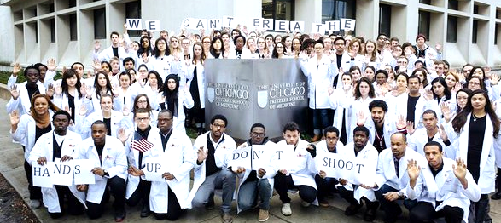
Public Events: Media strategy
Imagine the headline or photo
you want to see published!

Slide 15
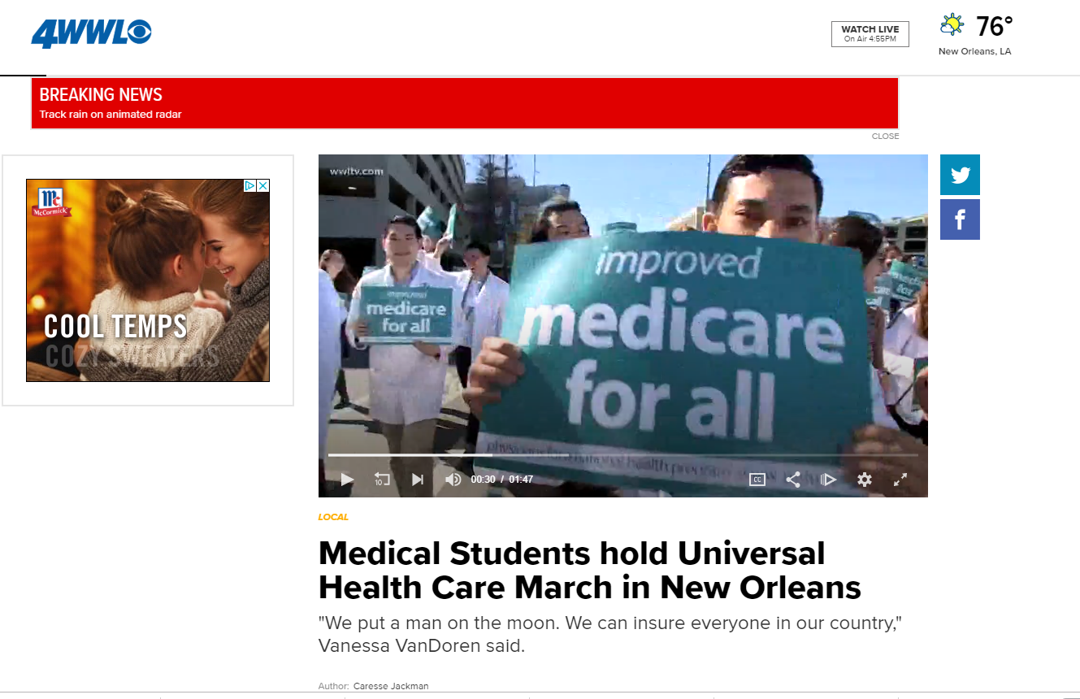
Public Events: Media strategy
https://www.wwltv.com/article/news/local/medical-students-hold-universal-health-care-march-in-new-orleans/289-525211554

Slide 16
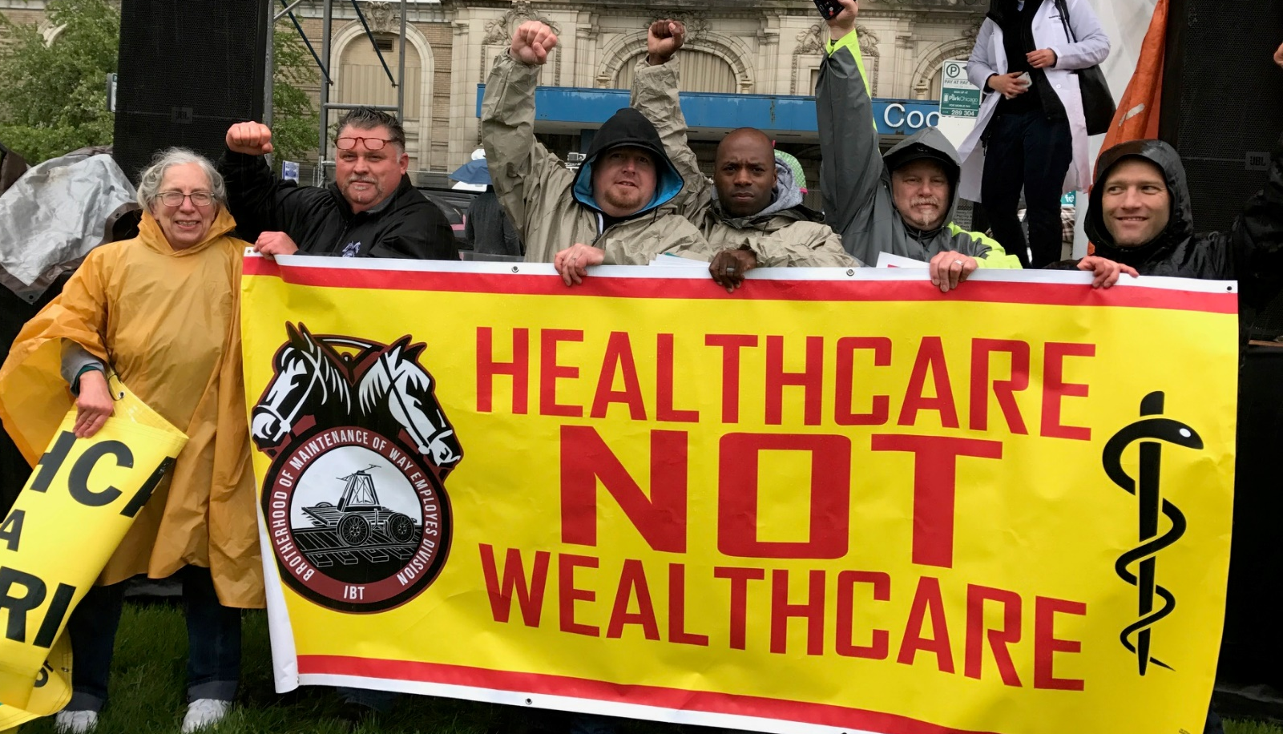
Public Events: Media strategy
Plan the event:
Early in the day
(before noon)
Accessible location
Diverse & dynamic
speakers
Visuals: White coats,
signs, banners, props

Slide 17
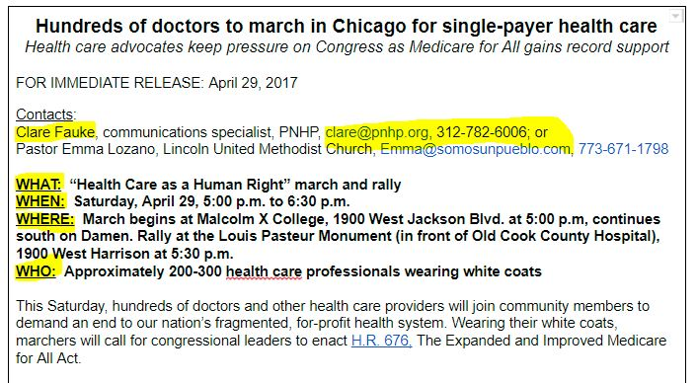
Public Events: Media strategy
Press advisory: WHO, WHAT, WHEN, WHERE, WHY

Slide 18
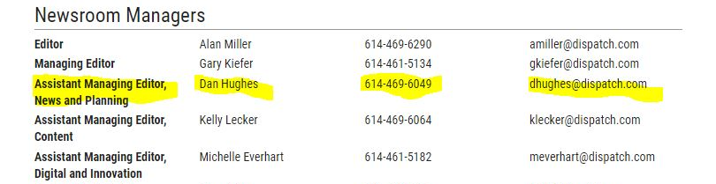
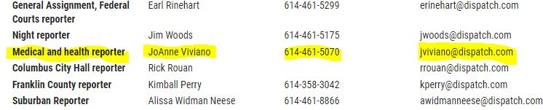
Public Events: Media strategy
Email advisory to health reporters & assignment editors 4-5 days ahead; follow up with call.

Slide 19
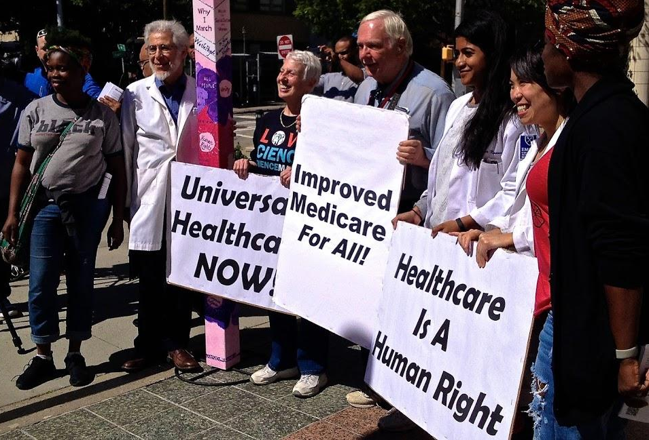
Public Events: Media strategy
Day of Event:
Press packets for dedicated liaison
Assign dedicated photographer
2-3 prepared spokespeople

Slide 20
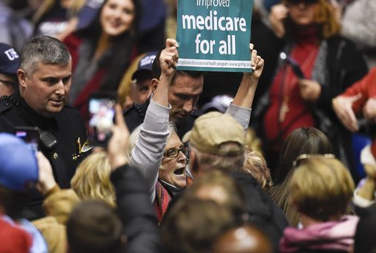
Media strategy for “crashing” events
Visibility: White coats, stethoscopes, signs, buttons, matching t-shirts
Introduce yourself to anyone who even looks like a reporter.
Bring a press release (and business cards) to hand to reporters.
PNHP Pres. Carol Paris crashing a Trump rally in March

Slide 21
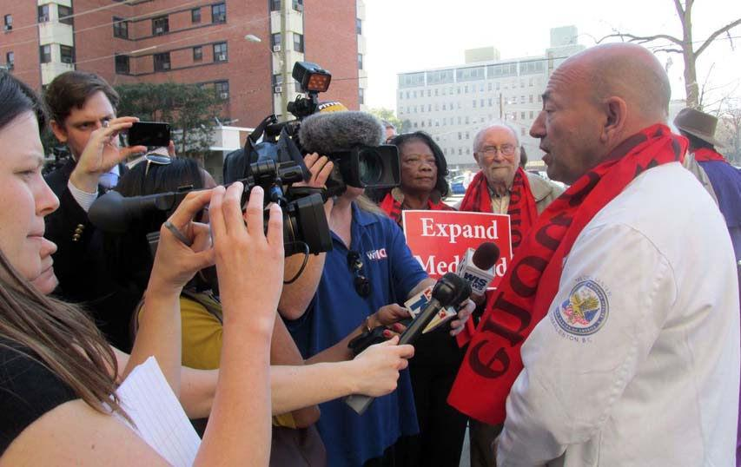
Talking with Reporters
Do your homework:
PNHP.org “FAQ” page
PNHP Data Update;
PNHP news
Read health care news every day.
Make a list of tough questions and practice your answer!

Slide 22
Talking with Reporters
Stay on message: Address the question, then bring it back to single payer.
Don McCanne Rule: Conclude every statement with, “Under a well-designed single payer system…”
OK not to know: “I’m not sure but I’ll get back to you with the answer.” “I don’t know about that but I do know that with Medicare for all…” Bring it back to what you DO KNOW.
Doctor’s perspective: Use personal examples: patients not getting treatment, time wasted on billing

Slide 23
Talking with Reporters
  Q: Won’t Medicare for all result in health care rationing?
  A: No, and in fact, the U.S. already rations care based on income. As a doctor, I see patients every day who skip medications or delay treatments because insurance refuses to cover it. More than 20,000 Americans die every year because they don’t have health insurance. That’s rationing! Under a well-designed single-payer system, everyone in the U.S. can see the doctor of their choice when they need to, not just when they happen to have coverage."

Slide 24
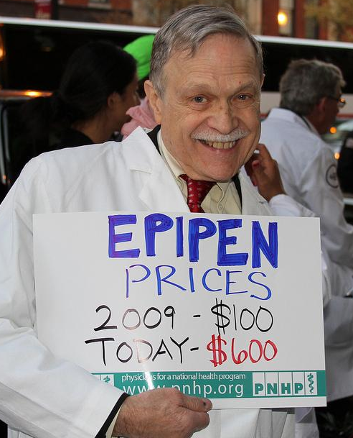
Talking with Reporters
Make bold, colorful statements & speak from a doctor’s perspective:
Use concrete examples from your own practice:
Patients waiting until it’s too late to seek care
Time wasted on billing
Insurance companies denying payment
Skyrocketing drug prices
Instead of, "Drug prices are a major concern for patients,” say, “One of my patient’s insulin costs went from $100 per month to $500 per month, and now she’s skipping doses in order to pay the rent!”

Slide 25
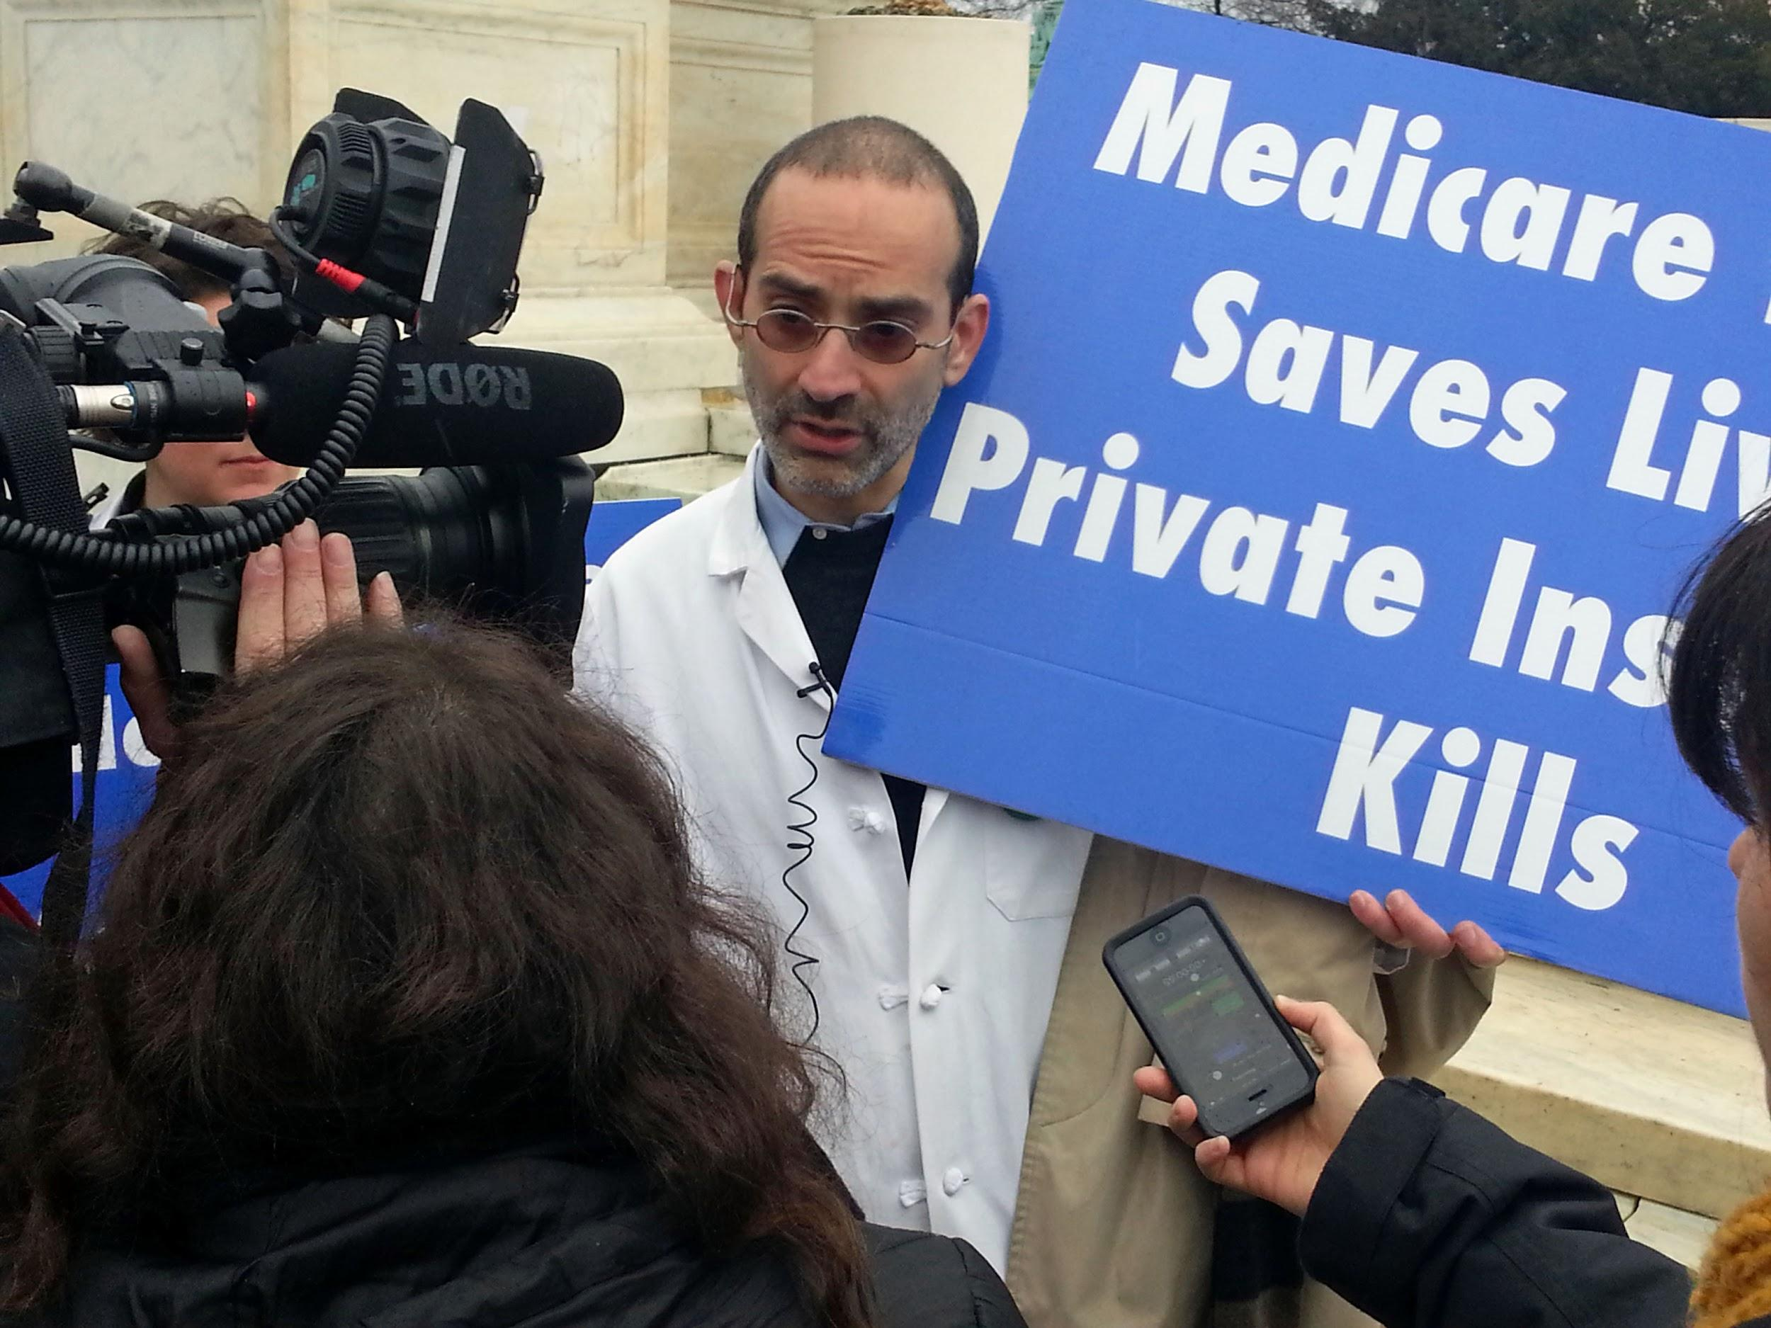
Talking with Reporters
Building long-term relationships:
Be a source: Journalists are always looking for new sources. Email an introduction, comment, offer expertise, or to let them know about an event or new study. Follow them on Twitter and respond to their posts.
Push back when a reporter gets it wrong:
Contact the reporter directly with a corrective. Stick to the facts and maintain a helpful tone. Offer new information or a different perspective.

Slide 26
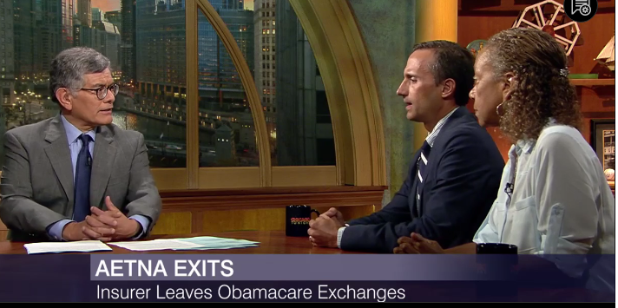
Talking with Reporters
  Exercise: Media Appearance Case Studies
  What went right and wrong?
  Body language
  Facial expression
  Volume & tone of voice
  Single payer message
  Pivoting from negativity
  Don McCanne rule
  Susan Rogers on “Chicago Tonight”:
  http://chicagotonight.wttw.com/2016/08/18/making-sense-illinois-changing-health-care-landscape
  Adam Gaffney on “The Take”:
  http://www.pnhp.org/news/2017/august/dr-adam-gaffney-on-the-take

