Slide 1
Health Has Stopped Improving in the USA

Slide 2
Progress on Mortality Halted
Age adjusted mortality per 100,000
Source: NCHS
Note: Data for 2017 is preliminary

Slide 3
American Exceptionalism
Australia
France
Canada
Finland
UK
Life expectancy at birth (years)
USA 2017
78.6
1960 | 1970 | 1980 | 1990 | 2000 | 2010
Selected OECD Countries, data of most recent years as available
https://stats.oecd.org/Index.aspx?QueryId=51879#
Accessed Nov 19 2019

Slide 4
The Uninsured

Slide 5
Uninsured All Year, 1940-2018
Medicare / Medicaid
Millions
Source: Social Security Bul, HIAA, CPS, and CBO estimate

Slide 6
Uninsured by Race/Ethnicity, 2018
US Census Bureau

Slide 7
38,882 Deaths During 2019
Due to Uninsurance
State | % Uninsured | Excess Deaths
Texas | 18.1 | 6,731
California | 8.1 | 4,143
Florida | 14.5 | 3,999
Georgia | 14.6 | 1,989
North Carolina | 10.7 | 1,447
New York | 5.5 | 1,397
USA | 9.1% | 38,882
Woolhandler & Himmelsetin. Ann Int Med 2017;167:424
Based on best estimate from multiple studies of 1 death per 769 uninsured/year and number of uninsured at the time of the survey

Slide 8
Medicare Coverage Improves
Cancer Detection and Outcomes
Rate per 100,000 women/year
Cancer diagnoses rise
and deaths fall at age 65
NBER Working Paper 26292, Sept 2019
*Breast, colorectal, or lung cancer

Slide 9
Medicaid:
Poor Access, But Better Than Nothing

Slide 10
Medicaid Enrollment, 1987-2019
Millions of Americans
Bureau of the Census and Kaiser Foundation

Slide 11
Kids in Working Families Are Being
Shifted to Medicaid/SCHIP
Small Employers
Large Employers
Percent of children in working families with Medicaid / SCHIP
Health Affairs 2019;38:1132

Slide 12
Medicaid Improved Access and Hypertension Control for the Poor
Odds ratio for Medicaid vs Uninsured
Christopher, Wilper, Himmelstein, Woolhandler, McCormick – AJPH 2015
Odds ratios are adjusted for sex, age, race/ethnicity, presence of chronic conditions, disability

Slide 13
Many Specialists Won’t See
Kids With Medicaid
% of Clinics Scheduling
Appointments for Children
Bisgaier J, Rhodes KV.
N Engl J Med 2011;364:2324-2333
Notes:
13
Figure 2 Clinics Scheduling Specialty Care Appointments for Children, According to Type of Insurance. Public insurance was reported by callers as the Illinois Medicaid–Children's Health Insurance Program (CHIP) umbrella program; private insurance was reported by callers as Blue Cross Blue Shield. Each of the 273 clinics was called twice (for a total of 546 calls) by the same caller, with only insurance coverage varying between the two calls: once reporting Medicaid–CHIP coverage and once reporting private coverage. Calls were made 1 month apart, and the order of the reported insurance status was randomly assigned. Asthma clinics included 38 allergy–immunology clinics and 6 pulmonary disease clinics.

Slide 14
Managed Care Firms
Have Taken Over Medicaid
Medicaid managed care enrollment (millions)
In 2017, 88.2% of all Medicaid enrollees
were in managed care plans
Sanofi Managed Care Digest, 2019

Slide 15
Medicaid Managed Care Patients
Can’t Get Appointments
Won’t take new plan patient
8%
Offered appt >2 wks
24%
HHS OIG survey of
1800 physicians listed on managed care rosters finds
majority are unavailable
Offered appt <2 wks
25%
Not participating
43%
Source: HHS Inspector General’s Report. 12/2014. OEI-02-00670

Slide 16
Underinsurance
Impedes Access, Worsens Health, and
Bankrupts Families

Slide 17
Under-Insurance Growing
Percent of Adults 19-64 under-insured*
Commonwealth Fund Health insurance Surveys 2003-2018
*Under-insurance is defined here as being insured all year, but out-of-pocket expenses were >10% of income (>5% of income if low income) or deductible was >5% of income

Slide 18
Average Deductible Rising
Average Deductible for Covered Workers, Single Coverage
Kaiser/HRET Survey of Employer-Sponsored Benefits

Slide 19
Many Plans Now Pay Nothing for
Out-of-Network Care
Percent with any out-of-network benefit
RWJF 10/4/2018

Slide 20
High Deductible Coverage (HDHP) Compromises Finances and Access
Percent of Adults 18-64
Cohen & Zammitti, NCHS, June, 2017 – Based on 2016 NHIS data
Note: Of people with job-based coverage, 26.9% had HDHP in 2011, rising to 39.6% in 2016
Note: HDHP = >$1200/$2400 single/family deductible in 2011. $1300/$2600 in 2016

Slide 21
Many Families Lack Assets
To Pay High Deductibles
Median Financial Assets
Income Quintile or Decile
Federal Reserve Survey of Consumer Finance, 2016

Slide 22
Financial Toxicity of
Cardiovascular Disease Care
Couldn’t Pay
Couldn’t Pay
Hardship
but Paid
Hardship
but Paid
No Hardship
No Hardship
Source: J Am Coll Cardiol 2019;75:727
Hardship = Borrowed money or other problem (e.g., food insecure or med non-adherence) due to med bill

Slide 23
Insured Cancer Survivors’
High Out-of-Pocket Costs
Mean annual out-of-pocket medical costs
1,409 cancer survivors above age 50; Median household income was $51,371
Source: JAMA Oncology 2017;3:753. Based on analysis of data from Health and Retirement Study

Slide 24
High Deductibles Cut All Kinds of Care
150,000 employees lost “Cadillac” coverage
No evidence that patients shifted to “Higher Value” care
Utilization Reduction
Source: Brot-Goldberg et al, 6/2015 – http://eml.berkeley.edu/~bhandel/wp/BCHK.pdf
Note: Findings closely resemble those of Rand Health Insurance Experiment
Note: Study found no evidence that patients shopped for lower prices

Slide 25
High Deductible Plans
Delayed Breast Cancer Care
Extra delay (months) for high vs. low deductible
Health Affairs 2019;38:408

Slide 26
High Deductible Plan Delayed Care for
Macro-Vascular Complications of Diabetes
Extra delay (months), diabetics with high deductible vs low deductible plan
Source: Ann Int Med 2018;169:845 – Patients whose employers switched to high deductible vs. no switch
Note: Complications = cardiac, cerebrovascular, and peripheral vascular disease

Slide 27
Uninsured and Under-Insured
Delay Seeking Care for Heart Attacks
Odds ratio for delayed care*
Source: JAMA April 15, 2010. 303:1392
*Adjusted for age, sex, race, clin. charact., hlth status, social/psych fx, urban/rural.
Under-insured=had coverage but patient concerned about cost

Slide 28
Drug Deductible Reduced Needed Medication Use
Comparison at Firms That Added vs Didn’t Add Drug Deductible
Percent change in days of medication use after drug deductible implemented
Source: Huckfeldt et al. NBER W20927 – 2/2015

Slide 29
Higher Medication Co-Pays =
Worse Pediatric Asthma Outcomes
Children age 5-18
Source: JAMA 2012;307:1284

Slide 30
Who Pays for Long Term Care?
Woolhandler/Himmelstein analysis of NCHS data

Slide 31
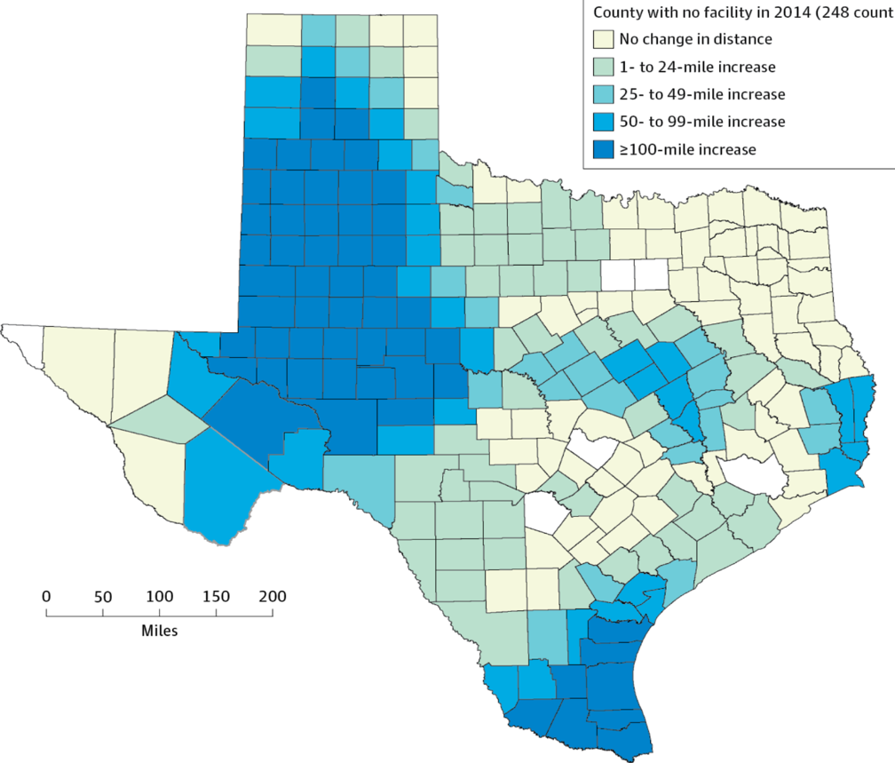
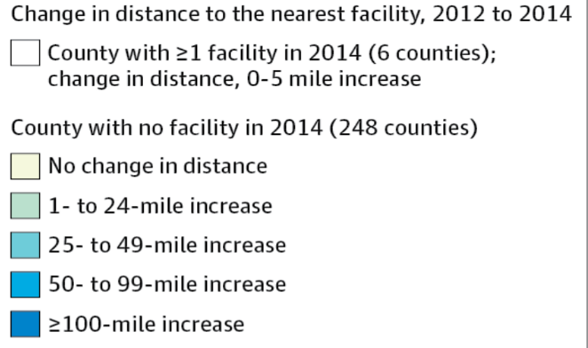
Texas Is Putting Abortion Facilities Out of Reach: Forcing Women to Travel 100 Miles Further
Copyright © 2012 American Medical Association.
All rights reserved

Slide 32
²/₃ of Bankruptcy Filers Cite Medical Bills or Illness-Related Work Loss as a Cause
“Work Loss” defined here as “Work loss due to illness”
National Survey of Debtors, 2013-2016
Source: Himmelstein, Thorne, Lawless, Foohey, Woolhandler. AJPH 2019;109:431

Slide 33
Most of the Medically Bankrupt Had Insurance at the Onset of Their Illness
Source: Himmelstein et al. Am J Med: August, 2009

Slide 34
Medical Bills Are Most Common Reason for Collection Calls
Percent of Consumers Receiving Collection Calls with Specific Type of Debt
Medical collection calls were the only category which did not differ by income
Consumer Financial Protection Bureau, January 2017

Slide 35
Health Costs Force Millions into Debt
And to Forego Other Essentials
Total borrowing to pay health costs: $88 billion
Percent of adults who borrowed money or reduced spending due to health care costs
Westhealth/Gallup. Public Perceptions of the US Healthcare System - 2019

Slide 36
Despite Medicare, U.S. Seniors Have More Cost-Related Access Problems
Percent of persons >65 reporting cost-related access problems in past year
Source: Health Affairs 2017;36:2123

Slide 37
Medicare Needs Improvement
Percent of seniors spending at least 20% of income on premiums and out-of-pocket costs
For many seniors,
medical costs consume
more than 1/5th of income
Income Group (% of Federal Poverty Level)
Commonwealth Fund, May 12, 2017

Slide 38
Rising Economic and Health Inequality

Slide 39
Mean Family Income for Each Fifth:
1966 – 2018 (Inflation Adjusted)
Income
Source: Bureau of the Census
Constant USD, 2018

Slide 40
Women Health Workers’ Low Pay
1.7 million of them – and their children – live in poverty
Source: Himmelstein K, Am J Public Health 2019;109:198
Note: 34.9% of the 14.1 million women health care workers earn < $15/hour

Slide 41
Lower Income, Shorter Lives
Percent of persons age 51-61 in 1992 still alive in 2014
Income (Mid Career)
GAO – Income and Wealth Disparities Continue Through Old Age. Aug 2019 (data from HRS)

Slide 42
Widening Gap in Life Expectancy Between High and Low Earners
Remaining Life Expectancy for Men Turning 60
Source: Waldron. ORES, Social Security Admin, #108, 2007

Slide 43
Income Inequality Worst in USA
Top 1% income share
Source: World Top Incomes database – data are for 2017 or most recent available

Slide 44
Other Nations Ameliorate Poverty
Through Taxes and Social Spending
Percent with incomes <50% of median
OECD Poverty Statistics, 2019

Slide 45
Incarceration Rates
Prisoners per 100,000 population
Walmsley – World Prison Population List, 11th Ed.

Slide 46
US Prison and Jail Population
Note: 13% of Black men cannot vote because of criminal records: >1 of 4 in AL, FL, MS, IA, NM, WA, WY
Note: BJS changed prison census method in 2005 causing data discontinuity
Source: Historical Statistics and Stat. Abstract of the US ., Bur. of Justice Stats., NYT 10/23/98

Slide 47
Persistent Racial Inequalities

Slide 48
Black and Native Americans
Die Younger
Life Expectancy at birth (years)
Source: CDC and HIS
Note: Hispanics can be of any race

Slide 49
Indian Health Service:
Grossly Underfunded
Medical spending 2017 per user
Source: National Tribal Budget Formulation Workgroup, April 2018
Note: Estimated spending shortfall, including facility upgrades = $36.83 billion

Slide 50
Race/Ethnicity and Maternal Mortality
Every group in the US does worse than Canadians
Maternal
deaths / 100,000 live births, 2016
MMWR September 2019 and OECD

Slide 51
Median Family Income
Median income
(Inflation-adjusted 2015 $s)
Whites
Blacks
Bureau of the Census

Slide 52
Growing Wealth Gap for Minorities
Median household net worth (2013 $s)
Kochhar-Pew Research Center, 12/12/14 – Based on Federal Reserve Data

Slide 53
School Segregation
Increased 1988-2016
Share of Black students in schools with <10% White students
1988
2016
Harming Our Common Future. Civil Rights Project. May 10, 2019

Slide 54
Job Discrimination Persists
Experimental Study of the Impact of “Whitening” Resumes
Callback rate after resume submitted
Black Applicant
Asian Applicant
Source: Kang SK, et al. Admin SciQ, 2016 – Job ads with pro-diversity language yielded same result
*e.g., change “Lamar J. Smith” to “L. James Smith” or “Lei Zhange” to “Luke Zhang”
** e.g., change “Aspiring Asian Business Leaders” to “Aspiring Business Leaders”

Slide 55
Driving While Black
More Likely to Be Searched, Less Likely to Be Found with Contraband
Black Rate / White Rate
(1.0 = Equally Likely)
Car Searched
Contraband Found Among Those Searched
NY Times 10/25/15

Slide 56
Police More Likely to Kill Minority Men
Police killings per day in USA: 2.8
Police killings account for
8% of all USA homicides
Police killings per 100,000 men
Source: AJPH 2018;108:1241

Slide 57
Causes of Black/White Disparity
In Adult Mortality
MMWR May 2, 2017
Note: “Other” includes conditions (e.g., diabetes) for which Black death rates are higher and some (e.g., COPD, cirrhosis) for which Black death rates are lower.

Slide 58
Black Enrollment in
U.S. Medical Schools, 1976-2018
AAMC Goal:
11.7%
Percent Blacks in 1st Year Medical School Class
RWJ Fdn. 1987; AAMC;
JAMA Annual Medical Education Special Issue

Slide 59
Physicians/Population by Race/Ethnicity
Physicians per 1000 population
Data are for 2008
Source: AMA and Census Bureau

Slide 60
Black and Female Physicians Earn Less
Annual Income
Source: Ly et al. BMJ 2016;353:2923
Note: Figures are adjusted for hours worked, specialty, age, years in practice, practice type, percent of revenue from Medicare/Medicaid

Slide 61
Minority Children and Youth
Get Few Psychiatrist Visits
Psychiatrist visits per year per 1,000 population
Source: Marrast, Himmelstein, Woolhandler. Int J Hlth Serv 2016

Slide 62
Blacks in VA: No Health Disadvantage
Odds ratio for Black vs White Vets
(<1 indicates lower rate for Blacks)
Kovesdy et al. Circulation 9/18/2015
Longitudinal study of 3,072,966 Vets cared for at VAs

Slide 63
Immigrant Health

Slide 64
Immigrants Get Little Care
Total Health Care
ED Care
Children
Health Care
$ per capita
*Adjusted for ethnicity, poverty, age, insurance status, patient/parent-reported health status
Source: Mohanty et al. Am J Public Health 2005;95:1431

Slide 65
Low Birth Weight Increased in Iowa
After a Massive Immigration Raid
Relative Risk of Low Birth Weight
Int J Epidemiol 2017;839
Note: 2008 Postville, Iowa raid was the largest single-site immigration raid in history. 900 agents handcuffed and chained all Latinos at meatpacking plant.

Slide 66
Preterm Latinx Births Increased
After President Trump’s Election
Number of preterm births to Latina women
11/2016 – 7/2017
2,337 excess preterm births during 9 months post-election
Source: Gemmill et al, JAMA Network Open July 19 2019
Note: Expected number calculated based on trends, 2009 – Oct 2016

Slide 67
Immigrants Keep Medicare Afloat
$3.7 Billion
$10.1 Billion
Net contribution to Medicare Trust Fund, 2009
-$30.9 Billion
Source: Zallman et al, Health Affairs 2013;32:1153

Slide 68
Immigrants Subsidize Native-Born in Private Insurance
$17.0 Billion
Net contribution to private insurance, 2014 (premiums minus benefits)
$7.7 Billion
US Born
-$24.7 Billion
Documented Immigrants
Undocumented Persons
Source: Zallman et al. Health Affairs October, 2018

Slide 69
Rationing Amidst a Surplus of Care

Slide 70
22.5% of 111,707 Defibrillator Implants Were
Not Evidence-Based
Note: In-hospital death rate for non-evidence-based ICD implantation was 0.6%.
Cost of ICD implant ~$25,000
Source: JAMA 2011;305:43

Slide 71
Many Elective PCIs Are Inappropriate
Uncertain
41.3%
Appropriate
33.9%
Inappropriate
22.0%
JAMA IM 2014;174:1630
Based on 1,225,562 patients in PCI Cath Registry

Slide 72
Urgent Care Centers and Retail Clinics
Increase Use and Costs for
Low Acuity Conditions
Visits per 1000 or $s per member for low acuity conditions
Source: JAMA IM 2018;178:1342

Slide 73
The Medical Arms Race:
Which Hospitals Opened New Invasive
Cardiology Programs, 1996-2014?
Strong predictors
A competing hospital opening a program
For-profit ownership
Also
predictive
Being a non-profit in a market dominated by for-profits
Weakly
predictive
Lack of service availability in the community
Source: NBER Working Paper W23530 - June, 2017

Slide 74
Administrative Overhead Rising

Slide 75
Growth of Physicians and Administrators
Growth since 1970
Bureau of Labor Statistics; NCHS; Himmelstein/Woolhandler analysis of CPS
Managers shown as moving average of current year and two previous years

Slide 76
Doctors Spend Twice as Much Time on
EHR/Desk Work as With Patients
Source: Sinsky et al. Ann Int Med 9/6/2016 – based on time/motion observation + home diary
Note: Figures are percent of office hours – exclude the 1-2 hrs/night of home EHR/desk work

Slide 77
EPIC EHR Notes Longer in US
Documentation Driven by Payment Complexity
Number of Institutions Using Epic
Non-USA
USA
Average Number of Characters per Ambulatory Note
Source: Ann Intern Med 2018; 169:51
13 international organizations represent 140,000 notes from Canada, the UK, Australia, the Netherlands, Denmark, the United Arab Emirates, and Singapore.
254 organizations within the United States represent 10 million notes.

Slide 78
Investor-Owned Care:
Inflated Costs, Inferior Quality

Slide 79
Extent of For-Profit Ownership
Commerce Dept. Service Annual Surveys & MedPac. Data are Q1, 2018 or most recent available.
* Data are for non-government-owned hospitals
** Data are for share of establishments

Slide 80
Health Industry Profits, 2018
Pharmaceuticals | $72.7 B
Insurers | $22.1 B
Equipment/Supplies | $11.8 B
Providers | $4.0 B
Distributors / Wholesalers | $2.2 B
Pharmacy / Lab / Benefit Managers | $1.3 B
Fortune 500, 2019
Note: Excludes firms not in Fortune 500 which account for substantial pharma profits

Slide 81
“Non-Profit” Health Systems Becoming Venture Capitalists
Organization | Priv. Equity Investments | Total Investments
Kaiser | $5.825 B | $40.835 B
Mayo | $2.565 B | $9.384 B
Ascension | $2.335 B | $20.339 B
Clev. Clinic | $1.008 B | $8.934 B
UPMC | $.962 B | $6.856 B
Indiana U Health | $.595 B | $4.801 B
Organization | Priv. Equity Investments | Total Investments
Dignity | $.525 B | $6.837 B
Providence St. Joseph | $.372 B | $9.646 B
Cath Health Init | $.334 B | $6.472 B
Sutter | $.217 B | $5.983 B
Baylor/Scott & White | $.214 B | $5.667 B
Modern Healthcare May 13, 2019:42

Slide 82
Non-Profit Leaders Collecting Big Paydays from Pharma
Name | Position | Company | Board Pay 2017 | Share Value
Robert Alpern | Dean, Yale | AbbVie | $335,929 | $4.3 M
Peter McDonnell | Dir, Hopkins/Wilmer Eye | Allergan | $449,941 | $0.7 M
Tyler Jacks | Dir, MIT Koch Inst | Amgen | $343,998 | $1.1 M
Julia Haller | Chief Wills Eye Hosp | Celgene | $525,470 | $86.5 M
Marschall Rung | Dean, U Mich | Lilly | $279,000 | $1.1 M
Kevin Lofton | CEO, Cath Hlth Init | Gilead | $415,803 | $1.8 M
Laura Glimcher | CEO, Dana Farber | Glaxo | $101,000 | $0.1 M
Mary Beckerle | CEO, Hunstman Cancer | J&J | $324,893 | $0.7 M
Mark McClellan | DIR, Duke Hlth Pol | J&J | $284,893 | $1.2 M
A E Washington | CEO, Duke | J&J | $284,893 | $2.3 M
John Noseworthy | CEO, Mayo | Merck | $234,167 | $0.3 M
Chares Sawyers | Chair, MSKCC | Novartis | $367,000 | $0.7 M
Dennis Ausiello | Dir, MGH Ctr | Pfizer | $375,000 | $1.9 M
Joseph Goldstein | Chair, U Tx Southwest | Regeneron | $1,307,211 | $4.2 M
BioPharma Dive. “Directors who hold board seats and lead non-profits”

Slide 83
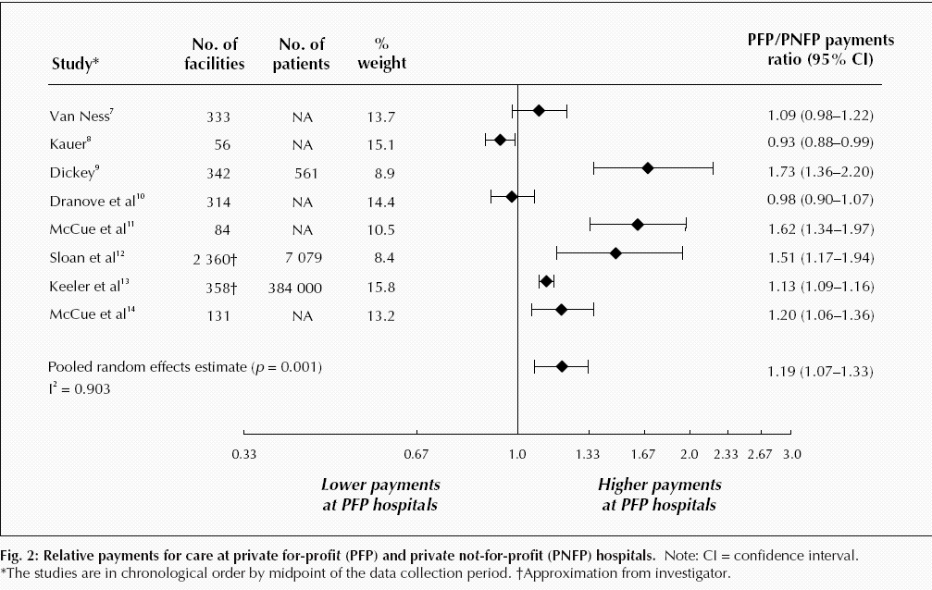
For-Profit Hospitals Cost
19% More
Relative payments for care at private for-profit (PFP) and private not-for-profit (PNFP) hospitals
Source: CMAJ Devereaux et al. 170 (12): 1817.

Slide 84
For Profit Hospitals Have Highest Readmission Rates for Every Condition
Readmission
rate adjusted
for severity
(Expected
rate = 1.0)
Source: PLOS One 9/18/2018 – based on Medicare data 2012-2015

Slide 85
For-Profit Hospitals’
Administrative Costs Are Higher
Percentage spent on administration
Himmelstein and Woolhandler
Analysis of 2011 Medicare hospital cost reports

Slide 86
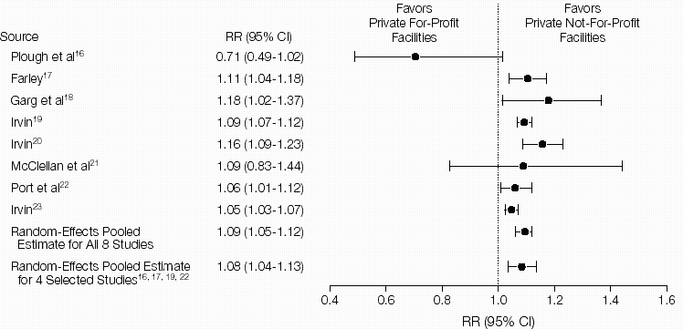
For-Profit Dialysis Clinics’ Death Rates
Are 9% Higher
Relative Risk (RR) of Morality in Hemodialysis Patients
Source: JAMA 2002;288:2449
Notes:
86

Slide 87
Investor-Owned Dialysis Clinics Discourage Transplants
Percent of dialysis patients placed on transplant list
Investor-Owned
Non-Profit
Source: JAMA 2019;322:957

Slide 88
VA Kidney Care:
Less Dialysis, Better Survival
Percent of patients with new kidney failure
Source: JAMA IM 2018; 178:657
Kidney failure defined as eGFR<15
Non-VA defined as Medicare-paid, mostly delivered by investor-owned facilities

Slide 89
For Profit Home Care: Lower Quality
Source: Cabin, Siman, Himmelstein & Woolhandler.
Health Affairs 8/2014

Slide 90
For Profit Home Care: Higher Cost
Annual Cost per Patient
Source: Cabin, Siman, Himmelstein & Woolhandler.
Health Affairs 8/2014

Slide 91
For-Profit Nursing Homes:
Less Nursing Care
A National Study
Nursing staff hours per patient day
Health Affairs 2019;38:1095

Slide 92
Hospice Goes For-Profit
Percent of hospices under for-profit ownership
Source: MEDPAC annual report, 2018 and previous reports
Profit rate: for-profits = 16.4%; non-profits = .1%.
Mean LOS: for-profits = 106 days; non-profits = 66 days

Slide 93
For-Profit Hospices Avoid
Unprofitable Patients
Likelihood of accepting all patients, regardless of care needs
(and profitability)
Source: Health Affairs 2012;31:2690
Note: Based upon accepting patients on chemo, TPN, transfusions, tube feeds, intrathecal cath, palliative radiation, or living alone

Slide 94
US Prescription Drug Spending
Prescription drug spending,
Billions of dollars
Estimated
Source: CMS, Office of the Actuary
Note: 2017-2019 estimated

Slide 95
Medicare Would Have Saved $71 Billion Over 6 Years if it Paid VA Prices
Spending for top 50 drugs ($s Billions)
Medicare Spending
Cost at VA Prices
JAMA IM 2019;179:431

Slide 96
Medicare Part D Drug Prices Are
Several-Fold Higher than in Other Nations
Average price of 79 single-source drugs
Purchasing these 79 drugs at the UK price
would have saved Medicare $41 billion in 2018
Health Affairs 2019;38:804

Slide 97
As With Drugs,
Device Prices Are Highest in the USA
Mean cost per device, 2014
(exchange rate adjusted $s)
Source: Health Affairs 2018;37:1570
Note: Devices account for 6% of U.S. health expenditures

Slide 98
What Goes Into a $6,000 Orthopedic Implant
Source: Modern Healthcare 2/5/2018

Slide 99
Insulin Cost Tripled 2006-2013
Average cost per patient in 2013:
$736
Mean expenditure per patient for insulin
Source: JAMA 2016;315:1400

Slide 100
Drug Company Profits
Return on Revenue (%)
Fortune 500 rankings for 1995-2017
Total drug company profits, 2017= $44.4 billion. Depressed by one-time charges for repatriated profits

Slide 101
Health Industry Profit Rates
Profits as percent of revenues
Source: Modern Healthcare August 5 2019:14
Note: Figures are for 5 largest firms in each sector

Slide 102
“Is Curing Patients a
Sustainable Business Model?”
“The success of its [Gilead’s] hepatitis C franchise has gradually exhausted the available pool of treatable patients…
“In the case of infectious diseases such as hepatitis C, curing existing patients also decreases the number of carriers able to transmit the virus to new patients.”
– Goldman Sachs asks
in biotech research report
CNBC Investing
Tae Kim @firstadopter. Published 3:15 PM ET Wed, 11 April 2018. Updated 7:20 PM ET Wed, 11 April 2018

Slide 103
Profits Dwarf Cancer Drug R&D Costs
Analysis of All Drugs Approved 2006 – 2015
From Firms With Only One Approved Drug
Mean Cost or Revenue per Drug
(Millions)
Prasad et al. JAMA IM, online 9/11/2017
* Costs of all company R&D, including their non-approved agents
** Total revenue from sales since approve – mean of 3.8 years

Slide 104
Drug Companies’ Cost Structure
Marketing
and Admin
35%
Manufacturing
27%
Profits
(After Taxes)
18%
R&D
13%
Taxes
7%
Source: Health Affairs 2001;20(5):136

Slide 105
Investor-Owned Medicaid HMOs:
Higher Administrative Costs, Lower Quality
Note: Publicly Traded = Publicly traded Medicaid-only plans
Source: McCue. Commonwealth Fund, June, 2011

Slide 106
Insurers Risk Select Via Formulary Design
Put generics needed by sicker patients into high co-pay tier
Drugs of Choice | Illness | Plan 1 | Plan 2 | Plan 3
Anti-Retrovirals | HIV | No | No | No
Triptans | Migraines | No | No | No
Anti-Psychotics | Schizophrenia | No | No | No
Macrolides | Pneumonia | Yes | No | No
L-Dopa | Parkinson’s | Yes | No | No
Anti-Convulsants | Seizures | Yes | No | No
ACE Inhibitors | Hypertension | Yes | Yes | No
Metformin | Diabetes | Yes | Yes | No
Oster & Fendrick, Am J Managed Care 2014;9:693-4
Plan 3 = Harvard Pilgrim
“No” = No drug of choice available on Tier 1 (lowest co-pay)

Slide 107
Private Insurers More Frequently
Deny Hepatitis C Drugs
Denial rate for prescriptions for Hep C DAA* agents
Source: Gawda et al., Open Forum Infectious Disease. 2018
*DAA = direct-acting antivirals, such as sofosbuvir (Harvoni)

Slide 108
Insurance Overhead, 2019
Overhead
SEC filings for first or second quarters, 2019
Note: Overhead = 1 – (medical benefits/premiums)

Slide 109
Health Care CEO’s Pay, 2018
CEO | Firm | Total Pay
Leonard Schleifer | Regeron | $117.8 M
Milt Johnson | HCA | $109.1 M
Gary Guthart | Intuitive | $99.2 M
John Hammergren | McKesson | $63.2 M
Ken Frazier | Merck | $48.4 M
Ian Read | Pfizer | $47.0 M
Jeff Leiden | Vertex | $32.6 M
CEO | Firm | Total Pay
Miles White | Abbott Labs | $31.6 M
David King | LabCorp | $30.5 M
Richard Gonzalez | AbbVie | $28.5 M
Bruce Broussard | Humana | $27.2 M
David Wichmann | United Health | $21.5 M
Michael Neidorff | Centene | $21.1 M
Source: Axios
Note: Figures are for compensation, including actual realized stock gains

Slide 110
Medicare Advantage:
The Only Working Model of Competing Private Plans and a Public Option (Traditional, FFS Medicare)

Slide 111
ACA Non-Profit Insurance Co-Ops:
A Failed Public Option
24 co-ops got federal start-up loans from ACA
4 remain, covering ~150,000 lives
Attracted costliest enrollees, e.g.:
  98 percent of all HIV patients (on Iowa exchange) chose the co-op because it offered low HIV drug copays
  A flood of cancer patients enrolled in the NY co-op - the only exchange plan covering care at Memorial Sloan Kettering Cancer Center

Slide 112
Traditional Medicare:
More Efficient than Private Insurers or Medicare Advantage

Slide 113
Medicare Advantage Plans’
High Overhead
Medical Services
97.8%
Medical Services
86.3%
Overhead
2.2%
Profit
4.5%
Overhead
9.1%
Sources: GAO 12/2013 and Medicare Trustees Report 2012 – Figures are for 2011
Note: MA overhead = $905/enrollee; profit = $447/enrollee
Total MA profit = $3.3 Billion

Slide 114
Medicare Advantage Plans’ Narrow Networks
Traditional Medicare
Broad
100%
More than a third of all Medicare Advantage plans lack an NCI cancer center.
49% of narrow networks exclude academic med centers.
Medium
Small
31%
Medium
30%
Narrow
16%
Broad
23%
Sources: Kaiser Family Foundation June, 2016
Note: “Narrow” = <30% of hospitals; “Medium Small” = 20-49%; “Medium” = 50-69%; “Broad” = >69%

Slide 115
Despite Medicare’s lower overhead, Medicare Advantage plans outcompete Traditional Medicare by cherry picking, upcoding and lobbying for overpayment.

Slide 116
Medicare HMO Enrollment
Medicare HMO Enrollees (millions)
2019
Source: CMS and Kaiser Foundation

Slide 117
Medicare and Medicaid
Keep Private Insurers Afloat
Revenues of five largest private insurers,
$ Billions
Private
Medicare and Medicaid
Source: Health Affairs 2017;36:2185
Notes:
Aetna, Anthem, CIGNA, Humana, and United Healthcare
Figures exclude government payments for public workers’ coverage

Slide 118
A Few Sick People
Account for Most Health Spending
Percent of total spending accounted for by each decile among non-institutionalized Americans
81.5%
Decile of Health Spending
Source: JAMA 2016;316:1348

Slide 119
Medicare Advantage Plans’
Strategy #1: Cherry Picking
Marketing
Network manipulation
Benefit design

Slide 120
“When Apps Get Your Medical Data, Your Privacy May Go With It”
Ban on Cherry Picking
Now Unenforceable
Worse Lies Ahead
  Proposed federal rules require doctors and hospitals to let patients download their medical records to any App
  Apps are exempt from HIPAA so data can be used, shared or sold
  Google has purchased 21% of “Oscar”, a health insurer founded by Josh Kushner
  Insurers can use info on web searches, purchases etc. to medically profile potential enrollees and target marketing
NY Times. Sept 3, 2019

Slide 121
Medicare Advantage Enrollees
Cost $1,253/year Less Before Enrolling
Medicare expenditures in prior year
(Risk-score adjusted)
Source: Kaiser Foundation. May 2019
Note: For example, difference for patients with asthma = $1,410; depression = $1,198; arthritis = $1,371

Slide 122
Medicare Advantage Plans’
Strategy #2: Lemon Dropping
Network manipulation
Benefit design
Hassle factor

Slide 123
High Needs Patients Frequently Disenroll From Medicare Advantage Plans
Another example of “lemon dropping”
Percent switching from Medicare Advantage to FFS Medicare Annually
Source: JAMA IM 2019;179:524
Note: High need = 2 or more chronic conditions; Medicaid = Medicare + Medicaid “Dual Eligibile”

Slide 124
Sickest Patients
Switch Out of Medicare Advantage
Percent switching out during 2011
Plan switched out of:
  Traditional Medicare
  Medicare Advantage
Health Affairs 2015;34:1675
Similar results for patients with hospital or home care use, more marked among dual eligibles

Slide 125
Most MA Plans Now Require
20% Co-Insurance for Chemotherapy
% of MA enrollees with various cost sharing requirements
Coinsurance 20%
Coinsurance >20% or Copay >$75
Source J Gen Intern Med 2019;34:1119

Slide 126
Medicare plans put generics into higher “tiers”, Boosting Copays by $6.2 Billion
Percent of generic drugs in each tier, Private Medicare Part D plans
Source: Avalere 5/22/2018

Slide 127
Medicare Advantage Plans’
Strategy #3: Cheating
Risk scores
Upcoding
Lying

Slide 128
Medicare Advantage Plans “Upcode”
Risk Scores spike immediately after patients enroll;
Biggest jump in HMOs that employ doctors
% increase in risk score vs. patients staying in FFS Medicare
Source: NBER Working Paper #21222
The 6.4% coding increases ups MA plans’ payments from Medicare by $10 billion per year; ~$650 per enrollee. It is equivalent to 6% of all enrollees become paraplegic or 39% becoming diabetic.

Slide 129
Medicare Advantage Plans’
Claims for Unsupported Diagnoses
$11.484
Billion
CMS estimate of overcharges to Medicare for diagnoses not supported in chart
$9.311
Billion
$9.095
Billion
CMS chart audit (but CMS only pursued recovery for 0.2% of projected overcharges)
Source: Kaiser Health News 7/16/2019

Slide 130
Advantage Plans Lie About Quality
M.A. Plans report few readmits
But audit shows rates higher than FFS Medicare
30-day readmission rate relative to Traditional Medicare
Annals of Internal Medicine 2019;171:99

Slide 131
95% of Plans Cheat on HEDIS Quality Measures
Medicare Advantage plans failing to cheat fall in rankings
Percent of elderly patients prescribed drugs that should be avoided
Annals of Internal Medicine 2013;159:456
Researchers compared reported HEDIS scores for high risk prescribing to actual Medicare Part D payment records for all enrollees and for enrollees sampled for HEDIS scoring

Slide 132
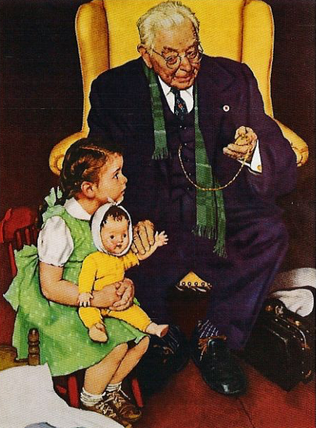
HMO “House Calls”:
A New Upcoding Scam
HMOs send their “house call doctor” – or one from Mobile Medical Examination Services Inc.
Doctor seeks out unimportant diagnoses, e.g. mild arthritis
No treatment offered
Extra diagnoses allow HMOs to upcode, adding >$3 billion/year to Medicare Advantage payments
Efforts to outlaw upcoding “house calls” were scrapped after industry lobbying blitz
Schulte, Center for Public Integrity, 2014

Slide 133
Profit-Driven Upcoding Makes
Accurate Risk Adjustment Impossible:
High cost providers inflate both reimbursement and quality scores
by making patients look sicker on paper.

Slide 134
Medicare Payment to Advantage Plans:
Same Patient, Different Coding
Original Coding
Base rate | $3,950
DM 2, uncomplicated | $1,040
Chronic Kidney Disease | $0
Obesity | $0
Depression | $0
Coronary Art. Dis., Chronic | $0
Total | $4,990
Enhanced Coding
Base rate | $3,950
DM 2 with Diabetic CKD | $3,180
CKD Stage 4 | $2,370
Morbid Obesity | $2,730
Major Depression | $3,950
CAD with Angina | $1,400
Total | $17,580
Enhanced Coding
Base rate | $3,950
DM 2 with Diabetic CKD | $3,180
CKD Stage 4 | $2,370
Morbid Obesity | $2,730
Major Depression | $3,950
CAD with Angina | $1,400
Enhanced Coding
Base rate | $3,950
DM 2 with Diabetic CKD | $3,180
CKD Stage 4 | $2,370
Morbid Obesity | $2,730
Major Depression | $3,950
Enhanced Coding
Base rate | $3,950
DM 2 with Diabetic CKD | $3,180
CKD Stage 4 | $2,370
Morbid Obesity | $2,730
Enhanced Coding
Base rate | $3,950
DM 2 with Diabetic CKD | $3,180
CKD Stage 4 | $2,370
Enhanced Coding
Base rate | $3,950
DM 2 with Diabetic CKD | $3,180
Enhanced Coding
Base rate | $3,950
SGIM Forum, 2017

Slide 135
Medicare Advantage Plans Raise Costs
Less spending on care, more on overhead
Total: $767
Total: $720
Monthly cost per beneficiary*
Source: Am. Econ. J. Applied Econ 2019;11:302 – Data are for 2010
* Adjusted based on diagnoses and mortality risk

Slide 136
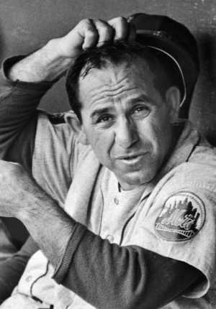

ACOs: Warmed Over Managed Care

Slide 137
HMO and ACO Similarities
Diagnosis:
FFS and “Fragmentation”
Rx:
Invert FFS incentives
  Shift insurance risk to providers
  “Protect” patients with P4P
  Consolidate providers into entities large enough to be “held accountable” for cost (via capitation)

Slide 138
HMO and ACO Differences
More ACOs are provider-based (so far)
Patients not restricted to ACO (so far)
Patients are mostly unaware they’re in an ACO

Slide 139
ACOs’ Explosive Growth Since 2010
Number of ACOs
Sources: Health Affairs Blog 10/31/13 and 3/31/15. Leavitt Partners 6/28/17

Slide 140
Physician-Leadership of ACOs Waning
Share of ACOs led by physicians
Source: Modern Healthcare 2/5/18:18
Physician-led = no formal affiliation with a hospital

Slide 141
Poll: Patients Reject ACOs
“Here are two different ways Medicare could pay doctors.
Which of these do you think
would be better for you?”
NEJM 2013;369:1066 – Kaiser/RWJ/Harvard Survey, 201

Slide 142
High Risk HMO Patients
Fared Poorly in the RAND Experiment
Relative Risk of Dying
Diastolic Blood Pressure
Source: RAND Health Insurance Experiment, Lancet 1988;1:1017
Note: High Risk = 20% of population with lowest income + highest medical risk

Slide 143
Depressed Patients:
Fee-For-Service vs. Managed Care
Primary Care Patients
Patients Seeing a Psychiatrist
Fee-For-Service
Number of Functional Limitations
Managed Care
Source: Medical Outcomes Study. JAMA 1989; 262:3298
Arch Gen Psych 1993; 50:517

Slide 144
Failure of Medicare HMO Risk Adjustment
Despite decades-long effort, CMS has failed to stop cherry-picking
Implications
  No net savings, probable increased costs
  Resources transferred from sick to healthy
  Biggest cheaters are biggest winners
  ACOs that embrace problem patients driven from the market
Intensive coding makes patients appear sicker on paper, ups risk-adjusted capitation fee and factitiously raises quality scores
ACOs that fail to cherry pick/upcode get low payments, and factitiously poor quality scores

Slide 145
ACOs Strategies Resemble
Those of MA Plans:
Cherry-picking
Lemon-dropping
Cheating

Slide 146
ACOS Got Rid of Patients
In Deteriorating Health
For patients already enrolled in an ACO, upcoding doesn’t boost risk-adjusted payments, so ACOs “Lemon Drop” with increasing care needs.
Change, 2012-2013 in risk score (“Hierarchical Condition Code”)
Health Affairs 2019;38:253

Slide 147
ACOS Got Rid of High Cost Patients
For patients already enrolled in an ACO, upcoding doesn’t boost risk-adjusted payments, so ACOs “Lemon Drop” high cost patients to generate bonuses from fake savings.
Total annual spending per patient
Health Affairs 2019;38:253

Slide 148
ACOS Got Rid of High Cost Patients
By Ejecting Their Doctors
Percent of doctors leaving ACO
Doctors Rank According to cost of Their Patients
Ann Intern Med 2019;171:27

Slide 149
ACOs: No Savings, No Quality Improvement After Control for Selective Enrollment
Cost Savings
Diabetes Quality Score
Estimated difference, ACO vs non-ACO
(Per quarter)
$118 Apparent Savings
+2.2 Apparent
- $6 Corrected
-1.9 Corrected
Ann Intern Med 2019;171:27

Slide 150
“Bundled Payment” for Medical Conditions*:
No Savings, No Quality Improvement
Medicare payments per case, bundled vs:
No differences in mortality, readmissions,
or use of the emergency department.
Baseline
Bundled Payment Period
Source: NEJM 2018;379:260
*Conditions = AMI, COPD, CHF, Sepsis, Pneumonia

Slide 151
The Toxicity of
Pay for Performance (P4P)

Slide 152
Assumptions Implicit in P4P
Performance can be accurately ascertained
Individual variation is caused by variation in motivation
Financial incentives will add to intrinsic motivation
Current payment system is too simple
Hospitals and physicians delivering poor quality care should get fewer resources

Slide 153
Medicare Value-Based Payment Program Penalizes Doctors Caring for High-Needs Patients
Percent of practices penalized*
Characteristics of Practices’ Patients
Source: JAMA 2017;318:453
* Note: Estimate based on simulation of penalties under mandatory Physicians Value-Based Payment Modifier Program

Slide 154
Quality Scores Tell More About Patients than Physicians
Harvard physicians with poorer/minority patients score low
Patient characteristics in panels of high-
and low-scoring physicians
Source: Hong C et al. JAMA 9/8/2010. 304:10;1107.

Slide 155
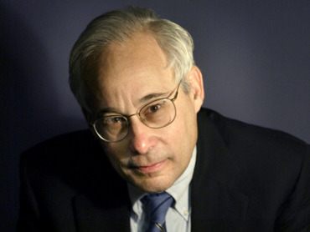
Pay for Performance?
“I do not think it’s true that the way to get better doctoring and better nursing is to put money on the table in front of doctors and nurses. I think that's a fundamental misunderstanding of human motivation.
“I think people respond to joy and work and love and achievement and learning and appreciation and gratitude – and a sense of a job well done. I think that it feels good to be a doctor, and better to be a better doctor.
“When we begin to attach dollar amounts to throughputs and to individual pay, we are playing with fire. The first and most important effect of that may be to begin to dissociate people from their work.”
– Don Berwick M.D.
Health Affairs. 1/12/2005

Slide 156
Performance Monitoring Increased Documentation of Alcohol Counseling, But Not Real Counseling Rate
Alcohol counseling rate among patients screening positive for unhealthy use
Source: JGIM 2017;33:268

Slide 157
CHF and Pneumonia Death Rates Rose with Readmission Penalties
Big penalties for readmission; small penalties for mortality
Time trend in 30-day post-discharge mortality rate
JAMA 2018;320:2542

Slide 158
P4P Did Not Lower
Hospital Mortality in England
P4P Hospitals
20%
15%
10%
5%
P4P Hospitals
30-Day Mortality
Control Regions
No
P4P
Bonuses Only
Bonuses plus Incentives
Difference
2007 | 2008 | 2009 | 2010 | 2011 | 2012
Source: N Engl J Med 2014;371:540-548

Slide 159
P4P Did Not Improve Mortality in England
World’s largest P4P program tied 25% of GP income to quality targets
Change in Deaths/100,000 From Pre to Post P4P Implementation
Source: Lancet 2016;388:268
Note: Data shows trends compared to developed nations without P4P

Slide 160
VA Hospitals Have Lower Mortality and Readmissions than Other Hospitals
Mortality
Readmissions
30 Day Mortality or readmissions per 100 patients
JAMA IM 2017;177:882
PNA = Pneumonia; All rates are risk-adjusted

Slide 161
VA Hospitals Have Lower Mortality Than Nearby Hospitals
A comparison of VA and non-VA hospitals in 121 hospital market areas
30-day mortality rate
Ann Intern Med 2019;170:426

Slide 162
ACOs and P4P:
Implementation Without Evidence
P4P – Official Medicare policy, widely adopted by private payers
Implementing everywhere interventions which
have been proven nowhere
risks failure on a colossal scale
  No RCTs showing improved outcomes.
  No improvement in 3 largest programs.
  Negative side effects likely, e.g. increased CHF deaths.
  VA (no P4P) has better quality than hospitals paid P4P
ACOs – Newest health policy panacea
  No RCTs.
  No savings once bonuses factored in.
  Disturbing HMO experience.

Slide 163
Mandate Model Reform:
Keeping Private Insurers In Charge

Slide 164

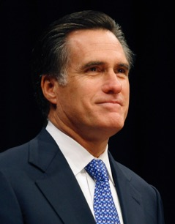

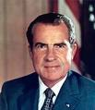
“Mandate Model” of Reform
Expanded Medicaid-like program
  Free for the poor
  Subsidies for low income
  Buy-in without subsidies for others
Employer Mandate +/- Individual
Insurance Exchanges
Notes:
164

Slide 165
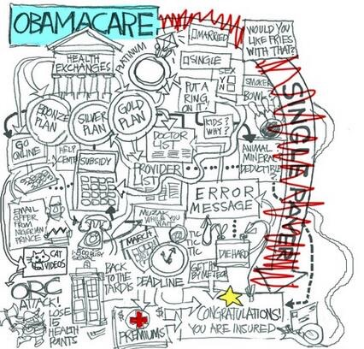
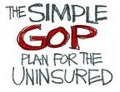



Slide 166
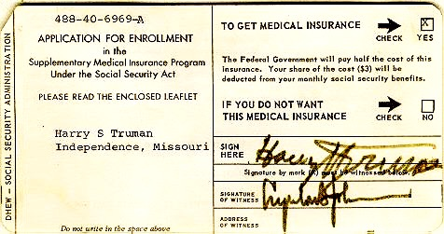


Medicare’s “Software”
18.9 million seniors enrolled within 11 months

Slide 167
ACA Decreased Incidence of Unmet Medical Needs Due to Cost
Better, but still not good.
Percent of Adults
Ages 18-64
Reporting an Unmet Health Need (Past 12 Months)
Income as Percent of Federal Poverty Level
Health Affairs 2017;36:1656

Slide 168
Trump’s Health Financing Actions
Expand “association” and “short term” junk insurance – Increase under-insurance, undermine ACA risk pool raising cost for sicker people.
Let employers deny coverage for birth control
Obstruct ACA enrollment
Allow states to implement punitive Medicaid changes
“Public charge” rule threatens documented immigrants if anyone in family uses Medicaid or nutrition services
Promote Medicare Advantage

Slide 169
Trump’s Short-Term Health Plans’ Outrageously High Overhead
Overhead as percent of premiums
Modern Healthcare August 12, 2019:10
https://www.modernhealthcare.‹com/insurance/short-term-health-plans-spend-little-medical-care

Slide 170

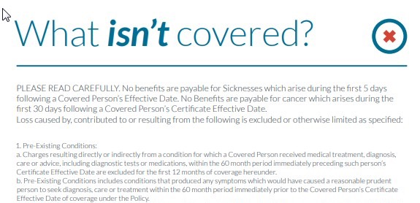
“53…mountain climbing, bungee jumping, scuba diving....”
https://www.modernhealthcare.com/article/20180505/NEWS/180509954/insurer-sends-some-mixed-messages-on-mountain-climbing
Notes:
53. Participating in hazardous occupations or other activity including participating, instructing, demonstrating, guiding or accompanying others in the following: operation of a flight in an aircraft other than a regularly scheduled flight by a commercial airline, professional or semi-professional sports, extreme sports, parachute jumping, hot-air ballooning, hang-gliding, base jumping, mountain climbing, bungee jumping, scuba diving, sail gliding, parasailing, parakiting, rock or mountain climbing, cave exploration, parkour, racing including stunt show or speed test of any motorized or non-motorized vehicle, rodeo activities, or similar hazardous activities. Also excluded is injury received while practicing, exercising, undergoing conditional or physical preparation for such activity.

Slide 171
Medicaid Work Requirement: Trivial Savings Unless Exempt Groups Are Also Disenrolled
Percent of Medicaid spending
Source: Goldman, Woolhandler, Himmelstein et al. Forthcoming, JAMA IM & CBPP, May 23, 2018
Note: Spending on enrollees with multiple exemptions appear in only one category
Note: Estimated bureaucratic costs of administering requirement: $185 million per year in KY, $600 mil in PA

Slide 172
American Taxpayers
Already Pay More Than
People in Nations With
National Health Insurance

Slide 173
²/₃ of Our Healthcare Spending
Comes From Our Taxes
Tax Funded
65%
Source: Himmelstein & Woolhandler – Analysis of NCHS data

Slide 174
US Public Spending per Capita for Health Exceeds Total Spending in Other Nations
USA Total:
$11,120
Total Spending
USA Public
USA Private
Note: “Public” includes benefit costs for gvt employees and tax subsidies for private insurance
OECD 2019; NCHS; AJPH 2016;106:449 (updated) – Data are for 2018

Slide 175
The USA
Trails Other Nations

Slide 176
USA Patients Skip Care More Often
Patients skipping a consultation, test, treatment, Rx, or follow-up due to cost in the past 12 months
Commonwealth Fund Survey, 2016

Slide 177
Life Expectancy
Years
OECD, 2019
Note: Data are for 2017 or most recent year available

Slide 178
Infant Mortality
Deaths in First Year of Life / 1000 Live Births
OECD, 2019
Note: Data are for 2017 or most recent year available

Slide 179
Maternal Mortality
Deaths per 100,000 Live Births
OECD, 2019 and Global Burden of Disease, 2015
Note: Data are for 2017 or most recent year available

Slide 180
High USA Costs Do Not Result From
Bad Health Habits
Aging
Overuse of Care

Slide 181
Smoking Prevalence
Percent of population >age 15 who smoke daily
Source: OECD, 2019
Note: Data are for 2018 or most recent year available

Slide 182
Percentage of Elderly
Percent of population >age 64
Source: OECD, 2019
Note: Data are for 2018 or most recent year available

Slide 183
Hospital Inpatient Days per Capita
Hospital days
per person
per year
Source: OECD, 2019 & Kaiser Fdn
Note: Figures are for 2018 or most recent available

Slide 184
Physician Visits per Capita
Source: OECD, 2019
Note: Data are for 2018or most recent year available

Slide 185
Number of Nurses per 1,000 Population
Source: OECD, 2019
Note: Data are for “professionally active nurses” for 2018 or most recent year available

Slide 186
PET Scan Units / Million Population
PET Scanners per Million Population
Source: OECD, 2019
Note: Data are for 2018 or most recent year available

Slide 187
USA Renal Failure Patients
Are Less Likely to Get Transplants
Percent of ESRD Patients with Functioning Transplants
Source: OECD 2015
Note: Data are for 2013 or most recent year available

Slide 188
Other Countries Provide
More Long Term Care
Percent of total population receiving LTC
OECD, 2019
Note: Data are for 2017 or most recent year available

Slide 189
Medical Journal Articles per Capita
Number of clinical medicine articles 1992-2002 per thousand population
Source: Lancet 2004;363:250

Slide 190
Out-of-Pocket Payments
$ per Capita
Source: OECD 2018, NCHS
Notes: Data are for 2016 or most recent year available. Figures adjusted for Purchasing Power Parity

Slide 191
Insurance Overhead
$ per Capita
Source: OECD 2019; NCHS; CIHI
Notes: Data are for 2018 or most recent year available. Figures adjusted for Purchasing Power Parity

Slide 192
Private Insurance:
High Overhead Everywhere
Percent overhead
Int. J Health Planning and Management 2018;e:263 and NCHS

Slide 193
USA Doctors Face Biggest Rx Hassles
Percent of Primary Care Doctors Saying MD or Staff Time
Getting Needed Rx Approvals Is a Major Problem
Source: Commonwealth Fund Survey of Primary Care Physicians, November, 2012
Note: Rx indicates prescribed drug or treatment

Slide 194
USA Doctors’ Satisfaction Is Low
Percent of primary care doctors saying they are satisfied or very satisfied
Source: Commonwealth Fund Survey of Primary Care Physicians, November 2012

Slide 195

Canada’s
National Health Insurance Program

Slide 196
Minimum Standards for
Canada’s Provincial Programs
Universal
  Universal coverage that is not impeded, either directly or indirectly, whether by charges or otherwise, reasonable access.
Portable
  Portability of benefits from province to province
Comprehensive
  Coverage for all medically necessary services
Public
  Publicly administered, non-profit program

Slide 197
Hospital Financing:
Medicare vs. Medicare
American Medicare
Canadian Medicare
  Per-patient payments
  Capital and operating payments intermixed
  New investments funded from surplus/profit
  For-profits thrive
  Global budgets
  Separate payment for capital and operations
  New investments funded by government grants
  Eliminates opportunity for profitmaking

Slide 198
Medicare vs Medicare:
Costs in a Parallel Universe
What if Medicare’s costs in the USA
had grown at Canada’s rate?
Medicare spending for aged (Billions)
Medicare, actual
Medicare at Canada’s growth rate
Source: Woolhandler & Himmelstein analysis based on CMS, CIHI, and Health Canada data
Note: Canada projections based on provincial spending for aged, adjusted for PPP

Slide 199
Free Care in Quebec Increased Physician Care for Serious Symptoms
Biggest impact on poor and middle class
Percent of serious symptoms for which physician was seen
Source: NEJM 1973;289:1174

Slide 200
Quality of Care Slightly Better in Canada than in the USA
A meta-analysis of patients treated for same illnesses
 | High-Quality Studies | Low-Quality Studies
Results favored USA | 2 | 3
Results favored Canada | 5 | 9
Mixed or equivocal results | 3 | 16
Source: Guyatt et al, Open Medicine, April 19, 2007. Table 1.

Slide 201
Cystic Fibrosis Patients
Live Longer in Canada
Uninsured in USA die youngest
Hazard Ratio
for death.
USA vs Canadian
CF patients
(Canada = 1.0)
Ann Int Med 2017;166:537
Note: Hazard Ratios are adjusted for multiple genetic and clinical characteristics

Slide 202
Infant Mortality, USA and Canada
Deaths per 1,000 Live Births
First province implements NHP
USA
Canada
Statistics Canada, Canadian Institute for Healtb Information, Natl Ctr for Health Statistics

Slide 203
Infant Deaths by Income, Canada 2011
Even poor Canadians do as well as average Americans
Infant mortality per 1,000
Income quintiles, Canada
Source: CDC and StatCan

Slide 204
Life Expectancy Falling for Lower-Income Americans, Rising for All Canadians
Change in life expectancy at age 50 over past 3 decades
Source: Growing Gap in Life Expectancy by Income. NAS; Rich man Poor Man, CD Howe Institute
Data is non-weighted average of male and female figures
Data are for Canadians turning 50 in 2000 vs 1970, and for Americans turning 50 in 2010 vs 1980

Slide 205
Healthcare Costs as a % of GDP
Canada’s NHP Enacted
USA
Health costs
% of GDP
NHP Fully Implemented
Canada
Sources: Statistics Canada, Canadian Inst. for Health Inf., and NCHS/Commerce Dept.
Note: USA data beyond 2017 is projected

Slide 206
US Medicare Coverage
Much Worse than Canada’s
Percent of Seniors’ Total Medical Expenses Covered
Note: Not comparable to figures for employer coverage because of high LTC needs in elderly
Source: EBRI and Himmelstein/Woolhandler analysis of Health Canada data

Slide 207
How Canada Controls Costs
Low administrative costs (16.7% of health spending vs. 31.0% in USA)
Lump-sum, global budgets for hospitals
Stringent controls on capital spending for new buildings and equipment
Single buyer purchasing reins in drug/device prices
Low litigation and malpractice costs
Emphasis on primary care
Exclusion of private insurers (private plans overcharge U.S. Medicare by tens of billions annually)
Source: Himmelstein & Woolhandler, Arch Intern Med, December, 2012

Slide 208
Insurance Overhead
United States and Canada, 2019
$ per Capita
NCHS and CIHI (projected)

Slide 209
Hospital Billing and Administration
United States and Canada, 2019
$ per Capita
(PPP adjusted)
Woolhandler et al. NEJM 2003;349:768 (updated); Himmelstein et al, Health Aff 9/2014

Slide 210
Cleveland Clinic: 210 Million Prices
“Compounding the complexity, we have many different payers and multiple different products within each payer.
“Specifically we estimate that we have 3,000 contracted rate schedules across the Cleveland Clinic… system.
“Further, our chargemaster reflects over 70,000 lines….
“Thus, the number of data points needed to be posted would exceed 210 million….”
Cleveland Clinic comment to CMS quoted in Modern Healthcare 9/30/2019

Slide 211
Duke Medical Center:
957 beds
1,600 billing clerks
Source: JAMA 2018;319:691
Notes:
Duke: 957 beds, 1,600 billing clerks

Slide 212
Physicians’ Billing-Related Expenses
United States and Canada, 2019
$ per Capita
(PPP Adjusted)
Source: Woolhandler/Campbell/Himmelstein NEJM 2003;349:768 (updated)
Note: Excludes dentists and other non-physician office-based practitioners
Excludes non-billing-related costs for documentation compliance, etc.

Slide 213
Duke Medical Center
costs to send bills for
one primary care physician:
$99,000 annually
Source: JAMA 2018;319:691
Notes:
Duke: 957 beds, 1,600 billing clerks

Slide 214
Overall Administrative Costs per Capita
United States and Canada, 2019
Source: Woolhandler et al. NEJM 2003;349:768 (updated); Himmelstein et al. Health Aff 9/2014

Slide 215
Few Canadian Physicians Emigrate Today
Net loss
(number moving abroad –
number returning)
A negative number indicates that more physicians returned from abroad then moved abroad
Source: Canadian Institute for Health Information

Slide 216
Canadian Physicians’ Incomes
Average Clinical Payments per Physician, 2017-2018
Specialty | Income
Family Medicine | $280,763
Internal Med | $403,942
Pediatrics | $298,814
Psychiatry | $278,069
Dermatology | $384,786
Specialty | Income
OB-GYN | $391,743
General Surgery | $452,283
Thoracic Surgery | $599,910
Ophthalmology | $768,958
Avg All Canada | $344,978
Source: Canadian Institute for Health Information
Figures are in Canadian $

Slide 217
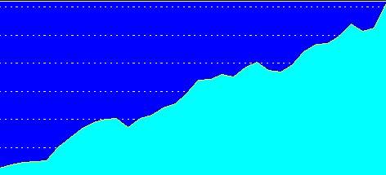
Trends in Canadian Physician Incomes
Mean physician income as multiple of all Canadian
full time employees
Source: Grant and Hurley, U Calgary School of Public Pol. Research Papers. July 2013, Vol 6, Iss 22.

Slide 218
Canadian Malpractice Insurance Costs, 2019
Specialty | Ontario* | Quebec | BC & Alberta
Family Med | $4,908 | $1,583 | $3,420
Psychiatry | $4,908 | $1,583 | $3,420
Cardiology | $8,448 | $2,248 | $5,028
Anaesthesia | $12,948 | $3,139 | $8,472
Neurosurgery | $38,980 | $7,312 | $26,424
Obstetrics | $73,924 | $18,050 | $48,588
*Government reimburses physicians for premiums above 1986 level. All figures in Canadian $s.
Source: Canadian Medical Protective Association www.cmpa-acpm.ca

Slide 219

“It’s not a big hassle. I can focus on patient issues, not administrative issues.”
Dr. Trina Larsen Soles
President of Doctors of BC
Represents physicians in British Columbia
Source: Modern Healthcare 4/9/18

Slide 220

“It’s an incredible bureaucratic mess to get anything done for patients.”
Dr. John Cullen
President-Elect
American Academy of Family Physicians
Source: Modern Healthcare 4/9/18

Slide 221
What’s OK in Canada?
Compared to the USA…
Life expectancy 2 years longer
Infant deaths 25% lower
Universal comprehensive coverage
More physician visits, hospital care; less bureaucracy
Quality of care equivalent to insured Americans’
Free choice of doctor and hospital
Health spending half of USA level

Slide 222
What’s the Matter in Canada?
The wealthy lobby for private funding and tax cuts; they resent subsidizing care for others.
Result: government funding cuts (e.g., 30% of hospital beds closed during the 1990s) causing dissatisfaction and waits for care.
USA and Canadian firms seek profit opportunities in health care privatization
Conservative foes of public services own many Canadian newspapers
Misleading waiting list surveys by right wing Fraser Institute

Slide 223
Most Favor Phasing Out Private Plans if They Can Keep Their Doctor/Hospital
Percent supporting Medicare for All with…
Source: Morning Consult July, 2019
Note: Question asked about choice of doctor and hospital

Slide 224
Wide Support for Medicare-for-All
Democrats
“Do you support or oppose a policy of Medicare for All?”
Republicans
Source: Reuters/Ipsos 8/23/2018

Slide 225
Wide Support for Medicare-for-All
Would you support or oppose providing Medicare to every American?”
Support
52%
Oppose
48%
Support
86%
Oppose
14%
Support
68%
Oppose
32%
Source: Harrisx/Hill.tv Poll, 10/22/2018

Slide 226
Most Doctors Now Favor Single Payer
Support Has Sharply Increased
2008
2017
Source: Merritt Hawkins surveys of physicians

Slide 227
A National Health Program for the USA

Slide 228
National Health Insurance
Universal – covers everyone
Comprehensive – all needed care, no co-pays
Single, public payer – simplified reimbursement
No investor-owned HMOs, hospitals, etc.
Improved health planning
Public accountability for quality and cost, but minimal bureaucracy
Proposal of the Physicians Working Group for Single Payer NHI
Gaffney et al AJPH June 2016 106:6 + Suppl.
JAMA 2003;290:798

Slide 229
Funding for the NHP
Revenue Sources
Recipients of Money
NHP
Fund
Medicare and Medicaid
Hospital Operating Costs
Hospital Capital Costs
State / Local Governments
HMOs
Employers
Fee-for-Service Physicians
Private Insurance Revenues
Home Care Agencies
New Taxes
Long-Term Care
NEJM 1989;320:102

Slide 230
Hospital Payment Under an NHP
Hospitals remain privately owned
Capital purchases/expansion budgeted separately based on health planning goals
Negotiated global budget for operating costs. Operating funds cannot be diverted to capital
NEJM 1989;320:102

Slide 231
Global Operating Budgets:
Key to Single Payer Savings
Cuts hospital administrative costs
Eliminates disparities in profitability of patients
Banning hospitals from keeping surplus minimizes entrepreneurial incentives
Funding capital through explicit grants minimizes unneeded duplication of expensive services

Slide 232
Three Options for Physician and Ambulatory Care Payment Under the NHP
Fee for
Service
Capitation for Institutions
With Salaried Physicians
Globally Budgeted Institutions
  Mandatory assignment
  Simplified negotiated fee schedule
  Free disenrollment
  No selective enrollment period
  Capitation for operating costs, not capital purchases, profits or physician incentives
  Inpatient care under hospital’s global budgets
  Institutions with salaried physicians
    Hospitals
    Clinics
    Home care agencies
Himmelstein and Woolhandler. NEJM 1989;320:102

Slide 233
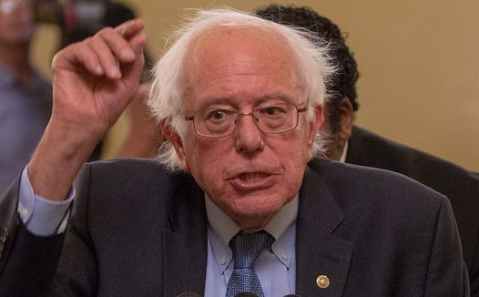
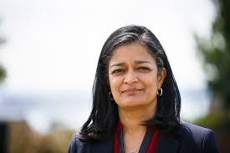
Current House and Senate Bills
Strengths
Universal coverage, single public plan
Comprehensive acute care benefits
No copays for covered services
Bans duplicative private coverage
Exemption from Hyde Amendment
Drug formulary and price negotiations

Slide 234
Current House and Senate Bills
Concerns
Both allow for-profit providers, with constraints
Senate bill: Adopts Medicare’s needlessly complex payment strategies, raising administrative burdens/costs and perpetuating incentives for upcoding etc., focusing on profitable services, etc.

Slide 235
Single Payer Transition:
For Displaced Clerical and Administrative Workers
All 400,000 health insurance workers and about ½ of the 2.6 million clerical/administrative employees in healthcare providers likely to be displaced – total 1.7 million.
Many likely to be redeployed in expanded clinical workforce.
Funding for income support and job retraining modeled on WWII GI Bill.
Job displacement is common in the US – 60 million/year, including 20 million who are fired: 1.7 million = number who are fired every 31 days. (source: People’s Policy Report)

Slide 236
66.1 Million US Workers
Separated from Jobs in 2018
Laid off
or fired
21.9 million
Job displacement
due to Single Payer
put into perspective
Quit
41 million
Other*
4.1 million
Source: Bureau of Labor Statistics – Job Opening and Labor Turnover Survey. January 2019
* ”Other” includes deaths, retirements, transfers, disability

Slide 237
Single Payer Transition:
For Patients
Every U.S. resident receives an insurance card.
Full coverage for all medically necessary care, no copayments, deductibles or coinsurance.
Prescription drug formulary, with alternatives covered when medically indicated
Free choice of any participating provider or hospital.

Slide 238
Medicare for All or
Medicare for More?

Slide 239
Single Payer and Private Coverage
Allowed
Banned
  Supplemental non-competing insurance
  Can only cover benefits not covered by the public plan
  Private insurance (including Medicare Advantage) duplicating public plan benefits
  Key to administrative savings

Slide 240
Public Option Rhetoric
“Don’t strip 150 million Americans of their private insurance; let them choose”
“M4A means a giant tax increase”
“If public is better, it will outcompete private insurance”
“There’s lots of ways to get to universal care”

Slide 241
Millions Lose Private Insurance Every Year
One in seven firms switch coverage every year;
Unknown millions affected
Millions affected
Source: Bruenig – Jacobin Blog Post. July 2019
Other reasons for involuntary switch: Employer stopped offering coverage; coverage too expensive; policy holder died; hours dropped

Slide 242
Transitioning to Germany
All funds are non-profit
One national fee schedule
Capital planning
Long term care
  Non-profit sickness fund boards:
  ½ unions and ½ employers
  All insurers pay same rates and include every doctor, every hospital
  States fund most hospital capital investment
  Single payer for long term care

Slide 243
Transitioning to Switzerland
All funds are non-profit
One national fee schedule
Capital planning
Expensive model
Mandatory coverage sold ONLY by non-profit insurers
  All insurers pay same rates and include every doctor, every hospital
  Cantons fund most hospital capital investment
Only the USA has higher health costs

Slide 244
Transitioning to Netherlands
Mixed
model
Unhappy physicians
Expensive model
Long term care
  Developed as German-style universal coverage
  Private insurers introduced 2006
  Doctors now complain of unbearable administrative burdens and rupture of cooperation
  Hospital administrative costs 2nd only to the USA
  Single payer for long term care

Slide 245
“Insurers in the Netherlands and Switzerland are not as a matter of public policy conceived of as private businesses and in important respects they are not allowed to function as private businesses. The Dutch and Swiss models--built on a uniform mandated benefit package, a limited menu of cost sharing, and provider rate regulation-- are not the models that private insurers in the United States are in fact advocating, but rather represent a quite different tradition based on social solidarity and not on market competition.”
“They have not, moreover, been successful in holding down costs or expanding access to insurance. Finally, their experience demonstrates again the tendency of insurers – even nonprofit insurers – to compete based on risk selection rather than cost, and the difficulty posed by trying to control this tendency through legal regulation.”
The Experience of Switzerland and the Netherlands with Individual Health Insurance Mandates: A Model for the United States? Timothy Stoltzfus Jost

Slide 246
Three Varieties of the
Public Option
Simple buy-in
Universal coverage with a public option
Medicare Advantage for All

Slide 247
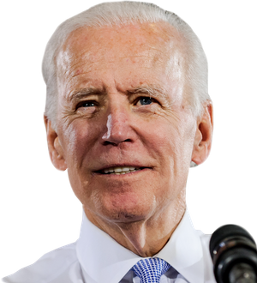
Public Option: Simple “buy-in”
Allow individuals to buy coverage from Medicare
Millions remain uninsured because buy-in expensive
High premiums, copays, deductibles persist
Minimal administrative cost savings
Medicare becomes de facto high-risk pool

Slide 248
Universal Coverage with a Public Option
Examples:
  Medicare Part E
  Medicare Extra for All
  Medicare for America

Slide 249
Medicare Extra for All
Employers “play or pay” - offer coverage or pay payroll tax (e.g. 8%)
Those lacking employer coverage required to purchase a Medicare-like public option
Financial hardship persists – Premiums + deductibles
Medicare Advantage option likely to expand

Slide 250
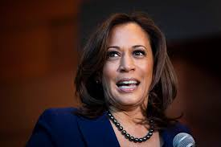
Medicare Advantage for All
Private managed care plans
Premiums paid by taxpayers

Slide 251
Public Option = High Costs
Less savings than single payer on insurers’ overhead
Multiple payers = no savings on billing and administration
Private insurers will tilt the playing field (as under Medicare Advantage) raising system-wide costs and perpetuating network restrictions, cherry-picking, lemon dropping etc.
Higher system-wide costs (compared to single payer) assure political pressure for benefit cuts

Slide 252
Estimating Single Payer Costs
Start from current costs
Subtract savings on insurers’ overhead
Subtract savings on providers’ administrative costs
Subtract savings on drug prices
Add costs of new utilization (doctor visits, hospitalizations, etc.)

Slide 253
Total Payments to ~1 Million Physicians
With and Without Medicare for All
$ Billion
Sources: Rand Corporation (2019), Urban Institute (2016), Mercatus Center (2018)
Note: Percentage estimates from original studies, applied to 2019 total physician expenditures
Note: Urban argued that “physician incomes would be squeezed” even as payments rose by >$100 billion

Slide 254
Physician Visits: No Surge After Medicare/Medicaid
Increased use by seniors and poor offset by small decrease for others
Doctor visits / 100 persons / year
Note: Medicare/Medicaid start-up in 1966
Gaffney et al. AJPH online 10/17/2019

Slide 255
Physician Visits: No Surge After ACA
Increased use by poor offset by small decrease for others
Doctor visits / 100 persons / year
Gaffney et al. AJPH online 10/17/2019
* Excludes seniors

Slide 256
ACA Coverage Expansion:
Non-target groups* did not perceive change in access
Percent reporting access problems
Gaffney et al. AJPH online 10/17/2019
* Non-target groups = >400% of FPL or Medicare

Slide 257
Free Care Did Not Increase
Total Physician Visits in Quebec
Care shifted slightly from healthy and wealthy to sick and poor
Physician visits per person per year
Income Group
NEJM 1973;289:1174

Slide 258
Total Payments to America’s ~5,500 Hospitals
With and Without Medicare for All
$ Billion
Sources: Rand Corporation (2019), Urban Institute (2016), Mercatus Center (2018)
Note: Percentage estimates from original studies, applied to 2017 total hospital payments
Note: Urban’s 2019 estimate is similar to 2016 estimate overall, but lacks detail

Slide 259
Hospital Use Did Not Surge After Medicare/Medicaid
Increased use by seniors was offset by small decrease among others
Hospitalizations / 100 persons / year
Gaffney et al. Ann Intern Med 2019;171:172

Slide 260
Hospital Use Did Not Surge After ACA
Increased use by poor was offset by decrease among others
Hospital days / 100 persons / year
Gaffney et al. Ann Intern Med 2019;171:172

Slide 261
Hospital Utilization in Canada Didn’t Surge after Single Payer Hospital Coverage
20
15
10
5
0
Hospital Days
Hospitalizations/100 or Days/10
Canadian single payer hospital coverage
Hospital Discharges
1952 | 1954 | 1956 | 1958 | 1959 | 1960 | 1961
Gaffney, Woolhandler, Himmelstein. The effect of large-scale health coverage expansions in wealthy nations on society-wide healthcare utilization. J Gen Int Med 2019. DOI: 10.1007/s11606-019-05529-y

Slide 262
Why Did the Urban Institute Predict
Huge Cost Increases from Single Payer?
Overhead
Admin. costs
Utilization
  Assumed minimal savings on insurance overhead
  Estimated M4A overhead at 6%
  Both Canadian and USA Medicare prove 2% feasible
  Assumed $0 savings on doctors’ and hospitals’ administrative costs
  Predicted a 20.9% utilization surge (doctor visits, hospitalizations, etc.)
  Extensive global experience belie this assumption

